Slide 1
DSD Final Checkpoint Presentation
Speaker: B12901140
Advisor: Prof. An-Yeu (Andy) Wu
Date: 2025/05/29

Slide 2
Table of Contents
Pipeline Structure
Hazard Handling
Future Work
Work assignment

Slide 3
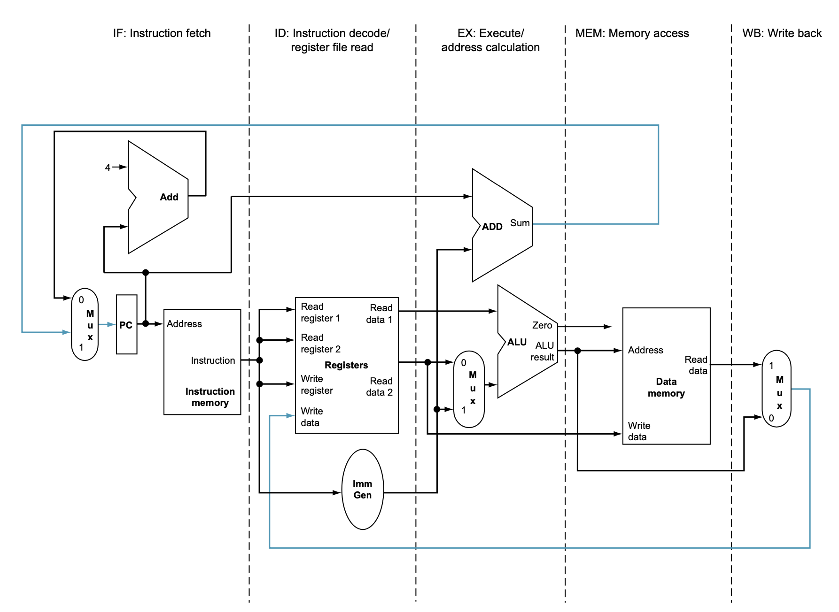
I. Pipeline Structure
5 stage RISC-V pipeline CPU → IF/ID/EX/MEM/WB with simplified RV32I Base Instruction

Slide 4
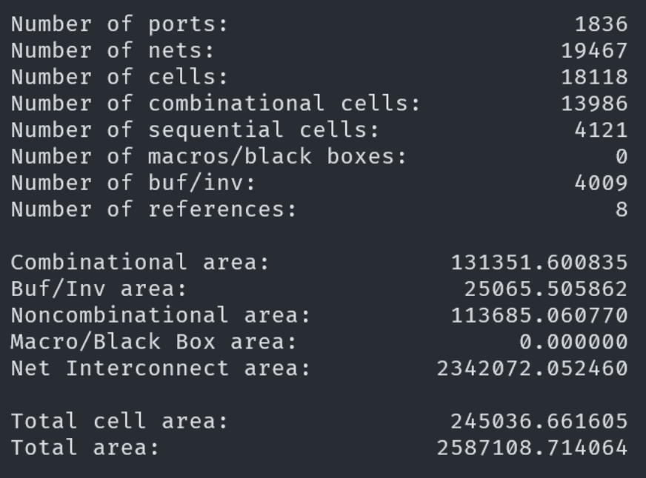
I. Pipeline Structure
Area = 245036.6 um^2, Clock cycle = 3.49 ns (because of only check clk < 3.5 ns ☺)

Slide 5
Table of Contents
Pipeline Structure
Hazard Handling
Future Work
Work assignment

Slide 6
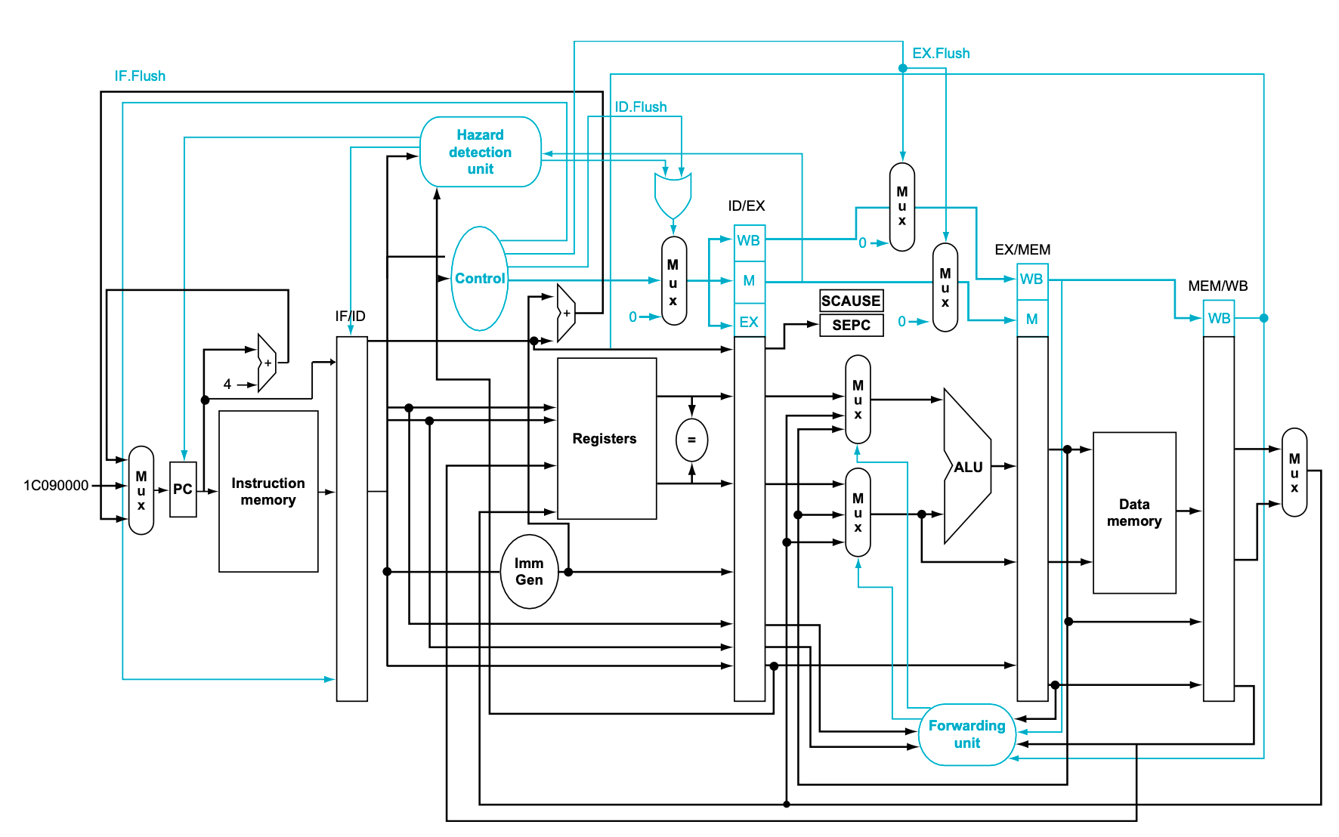
II. Hazard Handling
Load-use Hazard → Hazard detection unit
Data Hazard, Unconditional/Conditional Jump → Forwarding unit or pipeline flush

Slide 7
Table of Contents
Pipeline Structure
Hazard Handling
Future Work
Work assignment

Slide 8
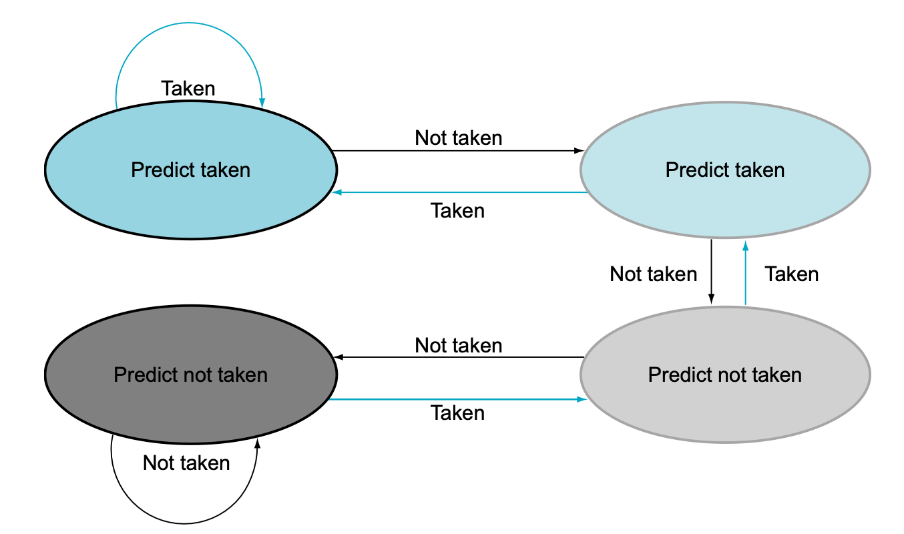
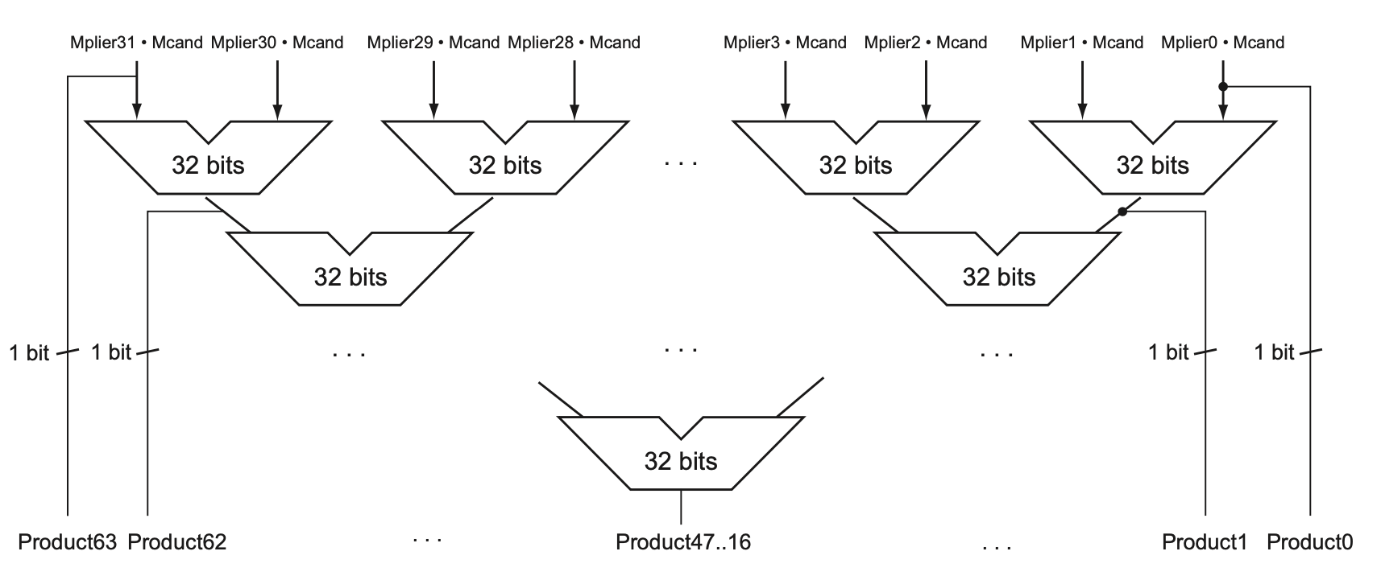
III. Future Work
Branch Prediction, Compressed Instruction, M-Extension (survey some papers/methods …)
Quick sort & Convolution
We still need to perform some retiming on the checkpoint architecture … ☺

Slide 9
Table of Contents
Pipeline Structure
Hazard Handling
Future Work
Work assignment

Slide 10
IV. Work assignment
B12901024: slide / debug
B12901035: overall structure of pipeline cpu / mainly debug / synthesis
B12901140: overall structure of pipeline cpu / mainly debug / slide

Slide 11
Reference
[1] Patterson, D. A., & Hennessy, J. L. (2017, April 27). Computer Organization and Design RISC-V Edition: The Hardware Software Interface (1st ed., The Morgan Kaufmann Series in Computer Architecture and Design). Morgan Kaufmann.

