Slide 1
FINAL YEAR PROJECT · PROJECT REVIEW
Watermark-Guided
Tamper Localization
and Recovery
45.49 dB
WATERMARKED PSNR
1.0000
BLOCK PRECISION & RECALL
A self-embedding fragile watermark that proves an image is untouched, localizes exactly where it was altered — and rebuilds the altered content from data hidden in the image itself.
0 / 1,802,240
FALSE POSITIVES, NULL TEST
PRESENTED BY
[Student Name 1] · [Student Name 2] · [Student Name 3] · [Student Name 4]
Guide: [Guide Name, Designation]
measured over 3,232 runs on a
32-image public corpus
Department of Computer Science & Engineering / Information Technology
Ajeenkya D Y Patil School of Engineering, Charholi Bk., Pune · Savitribai Phule Pune University · Academic Year 2026–27

Slide 2
CONTENTS
What this presentation covers
01
Introduction
02
Literature Review
03
Research Gap
04
Motivation
05
Problem Statement
06
Objectives
07
Methodology
08
System Architecture
09
Mathematical Model
10
Results & Validation
11
Conclusion
References and a live demonstration close the session.
Watermark-Guided Tamper Localization and Recovery
01

Slide 3
01
SECTION 01
Introduction
What the project is, and the one thing it does that detectors do not.

Slide 4
01 · INTRODUCTION
Editing an image is easy. Proving one was not edited is not.
The situation
What tools do today
What this project adds
A phone app or a one-click AI inpainter alters a photograph in seconds, leaving no visible trace. Evidence, records and reporting all rest on images.
Passive forensics and deep-learning detectors return a verdict — “likely fake, 0.87”. That is a score, not an account of what changed.
The image carries its own compressed backup. Verification names the altered blocks exactly, then repaints them from surviving data.
IN ONE SENTENCE
Before an image is released it is watermarked so that every 8×8 block carries a keyed fingerprint of itself and a compact description of a distant partner block — so the image can later prove which parts are untouched, and restore the parts that are not.
Detection answers “is this fake?”. This answers “which pixels, and what was there before?”
Watermark-Guided Tamper Localization and Recovery
02

Slide 5
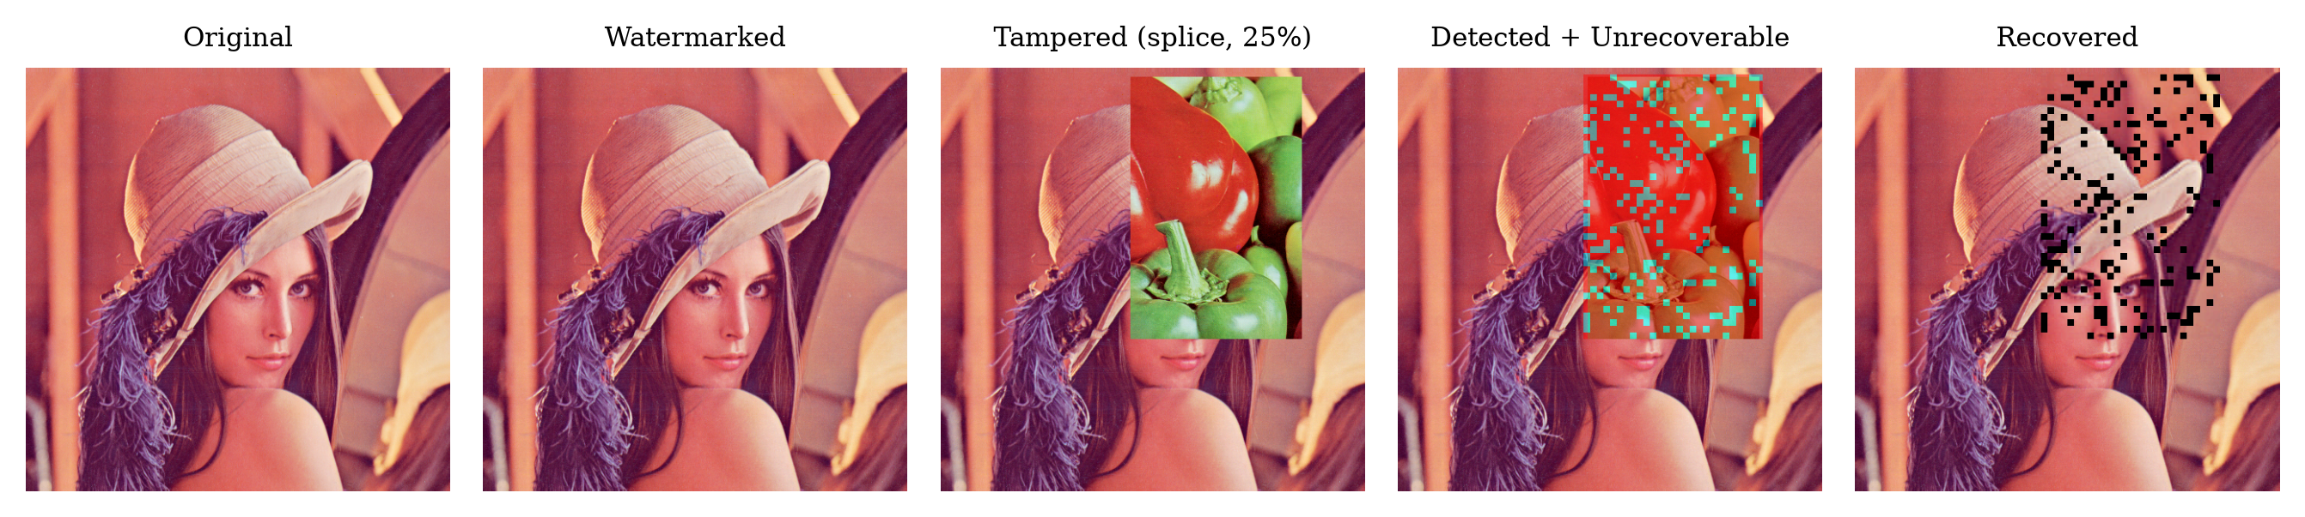
01 · INTRODUCTION
The pipeline, on one image
PROTECT → TAMPER → DETECT → RECOVER, ON A SINGLE IMAGE
▪ The mask panel shows flagged blocks in red and blocks whose partner was also destroyed — the unrecoverable ones — in a second colour. ▪ The recovered panel leaves those declared, not invented.
The mask is not a heat map. Every flagged block traces to exactly one keyed-hash mismatch that anyone holding the key can recompute.
Watermark-Guided Tamper Localization and Recovery
03

Slide 6
02
SECTION 02
Literature Review
Five families of prior work, and what each one settles.

Slide 7
02 · LITERATURE REVIEW
Five families, and what each one settles
Family
Representative work
Detects
Localizes
Recovers
Needs training
Passive forensics
Rey & Dugelay 2002; copy-move / ELA
partial
coarse
no
no
Learned detectors
Zhou 2018 (CVPR); ManTra-Net 2019
yes
yes
no
yes, large
Robust watermarking
Cox 1997 spread-spectrum
no (by design)
no
no
no
Fragile, detect-only
Wong & Memon 2001; Fridrich 2002
yes
yes
no
no
Self-embedding
Fridrich 1999; Zhang 2011; Korus 2013; AuSR 2022–23
yes
yes
yes
no
Learned proactive
EditGuard CVPR 2024; DeepMark / RecoverMark 2026
yes
yes
yes
yes, large
▪ Self-embedding (highlighted) is the family this project belongs to: the recovery data travels inside the image, so authentication and restoration need no external database.
Recent learned proactive watermarks also localize and recover — recovery is not claimed here as a novel capability. The distinction drawn later is auditability, not ability.
Watermark-Guided Tamper Localization and Recovery
04

Slide 8
02 · LITERATURE REVIEW
How the self-embedding line developed
Fridrich & Goljan: hide a
compressed copy of the
image inside itself.
2005
Reference sharing — one
backup serves several
blocks at once.
2013
Aminuddin & Ernawan:
AuSR1–3, LSB shifting,
TCBR/TCBD metrics.
2024–26
Lin et al.
Korus
EditGuard
Hierarchical verification
decouples localization
from payload size.
Korus & Dziech: fountain
codes, graceful decay,
37 dB at 50% damage.
EditGuard, Wu et al.:
learned proactive marks,
multi-feature fragile.
1999
2011
2022–24
Fridrich
Zhang et al.
Aminuddin
Two decades of work on capacity and mapping; comparatively little on reproducible, end-to-end measurement of the whole pipeline on a public corpus.
Watermark-Guided Tamper Localization and Recovery
05

Slide 9
03
SECTION 03
Research Gap
Where the published record stops, and what is left unmeasured.

Slide 10
03 · RESEARCH GAP
Where the published record stops
Verdicts without accounts
Capability without a protocol
Detectors return a confidence score. A score cannot be audited, contested, or reproduced by a second party.
Self-recovery schemes report favourable operating points; few publish a full grid over tamper class × ratio × image with an exact ground truth.
The null condition is rarely tested
Coverage limits stated, not mapped
False-accept behaviour under a wrong key is quoted from theory far more often than it is measured.
The tamper-coincidence limit of one-to-one mapping is well known; its actual shape across tamper ratio is seldom plotted.
THE GAP ADDRESSED
Not a new capability — a deterministic, fully auditable implementation of an existing one, measured end to end over 3,232 runs with exact, self-generated ground truth.
Every limit found in this work is reported, including the one where a published fountain-code scheme beats it by roughly 20 dB at 50% tampering.
Watermark-Guided Tamper Localization and Recovery
06

Slide 11
04
SECTION 04
Motivation
Why a deterministic, auditable answer is worth building.

Slide 12
04 · MOTIVATION
Why an auditable answer is worth building
Forensic and legal evidence
No training data
CCTV frames, accident photographs, contract and ID scans — contested in proceedings where a probability is not an answer.
Nothing is learned, so nothing is biased by a training set.
No GPU, runs offline
Medical imaging integrity
Classical signal processing; a laptop reproduces every number.
An altered region on an X-ray or MRI slice changes a diagnosis; PACS archives need a per-region integrity record.
Deterministic
Same key, same image, same result — every single run.
Journalism and public record
Agencies and archives that own their ingest pipeline can mark at the door and verify for decades afterwards.
Auditable
One flagged block = one recomputed keyed hash a third party can redo.
The trade accepted deliberately: this protects images the operator marks in advance. It says nothing about an image it never saw.
Watermark-Guided Tamper Localization and Recovery
07

Slide 13
05
SECTION 05
Problem Statement
The problem stated formally, with its scope drawn honestly.

Slide 14
05 · PROBLEM STATEMENT
The problem, stated formally
PROBLEM STATEMENT
Given an image the owner controls before distribution, design an embedding that makes the image self-verifying: after any alteration, the system must decide per 8×8 block whether that block is authentic, do so with no false accusation of an untouched block, and reconstruct an approximation of each altered block from redundant data carried inside the same image — without a database, without training, and without a GPU.
IN SCOPE
OUT OF SCOPE
▪ Lossless pipeline the operator owns end to end (PNG / BMP / lossless WebP)
▪ Malicious content edits: splicing, object removal, crop-and-refill, noise injection
▪ Block-level localization with an exact, self-generated ground-truth mask
▪ Approximate recovery, with unrecoverable regions declared rather than faked
▪ Images never watermarked — nothing to verify against
▪ JPEG re-compression, resizing, filtering — these destroy the mark by design
▪ Pixel-exact restoration — the backup is a compact descriptor, not a copy
▪ Secrecy failures — security rests entirely on the key staying secret
Fragility is the mechanism, not a defect: a mark that survives editing cannot testify that no editing occurred.
Watermark-Guided Tamper Localization and Recovery
08

Slide 15
06
SECTION 06
Objectives
Six commitments, each with the measurement that settles it.

Slide 16
06 · OBJECTIVES
Six commitments, each with the measurement that settles it
01
02
03
Self-contained embedding
Block-level localization
Content recovery
The image carries its own backup — no external database, no sidecar.
Output an exact tamper mask, not a heat map or a score.
Repaint altered blocks from a distant partner's surviving descriptor.
delivered
precision 1.0000
ρ = 0.959 @ α = 0.10
04
05
06
Imperceptible mark
Automated evaluation
Classical and explainable
Target PSNR > 40 dB against the original.
A reproducible grid over tamper class × ratio × image × key.
No training data, no GPU, deterministic across runs.
45.49 dB achieved
3,232 runs
0 model parameters
Watermark-Guided Tamper Localization and Recovery
09

Slide 17
07
SECTION 07
Methodology
Embedding, detection, recovery — and the protocol that tests them.

Slide 18
07 · METHODOLOGY
Protecting an image — six steps, done once
OFFLINE, BEFORE THE IMAGE IS RELEASED — THE ONLY STEP THAT NEEDS THE ORIGINAL
Partition
Fix the MSBs
Describe
Map
Tag
Embed
pad to a multiple of 8;
split into 8×8 blocks
msb(a) = a ∧ 0xFC — the
top 6 bits are the content
per-block DCT descriptor,
96 bits per channel
key-seeded single-cycle
permutation m(i), i ≠ m(i)
32-bit keyed hash of
msb(bᵢ) ‖ i ‖ image-id
LSB shifting into the
2 low bits of each pixel
Why the MSBs are hashed, not the pixels
Why the map must be a single cycle
Why LSB shifting, not LSB replacement
The 2 LSBs carry the watermark, so they cannot be part of what the tag commits to. Hashing msb(·) makes the tag stable under its own embedding.
A single cycle guarantees every block backs up exactly one other and is backed up by exactly one — no block is left without a partner, none is stored twice.
Shifting a pixel to the nearest value with the required low bits costs ≈0.5 LSB of distortion instead of ≈1.5 — worth about +2.3 dB, for free.
Tag-carrying pixels are never shifted — their low bits are the tag, so shifting them would make the hash depend on its own output.
Watermark-Guided Tamper Localization and Recovery
10

Slide 19
07 · METHODOLOGY
Verifying and recovering — on any received copy
DETECTION
Re-partition
Recompute
Compare
Mask
same grid, same block size
taĝᵢ from current msb(bᵢ)
taĝᵢ ≠ tagᵢ ⇒ block flagged
binary mask + refinement
RECOVERY
Locate partner
Check partner
Rebuild
Or declare
read m⁻¹(i)
authentic? then its LSBs are intact
inverse-quantize, inverse-DCT, repaint
partner tampered ⇒ UNRECOVERABLE
Never silently faked
Refinement is cosmetic
Fully deterministic
An unrecoverable block is marked in the output, not filled with plausible invention. Honesty costs 10–15 dB of whole-image PSNR against the convention other papers report.
Neighbourhood refinement flagged 5 extra blocks across 20,611,072 verified — it never changed a recovery outcome.
Same key, same image, same bytes out. Re-running the grid from scratch reproduces every non-timing column exactly.
Watermark-Guided Tamper Localization and Recovery
11

Slide 20
07 · METHODOLOGY
The experimental protocol
FULL FACTORIAL GRID
Factor
Levels
1,792
3,232
Corpus
32 images — 8 USC-SIPI + 24 Kodak
Tamper class
splice, object removal, crop-refill, noise
main grid rows
total rows
Tamper ratio α
0.10, 0.20, 0.30, 0.40, 0.50, 0.60, 0.70
tamper trials
incl. null + ablation
Descriptor variant
A (fixed DCT), C (rate–distortion), B (ablation)
Block size
8×8 main, 4×4 ablation
Ground truth is exact
The tamper script writes the mask it applied, so there is no hand-labelling error anywhere in the measurement — precision and recall are computed against the truth, not an estimate of it.
Null condition
5 wrong keys × 32 images × 2 variants
▪ Every cell of the grid runs from a fixed seed, so the whole table regenerates byte-for-byte on any machine.
▪ The runner is parallel (--jobs N); a full regeneration is hours, not days.
Achieved area drifts below nominal at high α (0.70 nominal → 0.653 achieved): the region generator cannot always place that much non-overlapping area. Reported, not hidden.
Watermark-Guided Tamper Localization and Recovery
12

Slide 21
08
SECTION 08
System Architecture
The full pipeline, end to end, with the key as a side input.

Slide 22
08 · SYSTEM ARCHITECTURE
End-to-end pipeline
PROTECT · OFFLINE, ONCE
Original
image
8×8 block
partition
Descriptor
96 bits
Key map
m(i)
Tag
32 bits
LSB-shift
embed
Protected
PNG
Secret key K
seeds the block permutation and the keyed hash — the same key is required to verify; a wrong key flags everything, it never silently accepts.
VERIFY & RECOVER · ON ANY RECEIVED COPY
Received
image
Re-partition
same grid
Recompute
taĝ
Compare
taĝ vs tag
Fetch backup
m⁻¹(i)
Repaint
block
Mask +
recovered
Only the four cyan stages need the key. Everything else is public, fixed, and reproducible by anyone who holds it.
Watermark-Guided Tamper Localization and Recovery
13

Slide 23
08 · SYSTEM ARCHITECTURE
What each block carries, and where its backup lives
PER BLOCK, PER CHANNEL — 128 BITS AT 2 LSBs × 64 PIXELS
KEY-SEEDED PARTNER MAPPING m(i)
TAG
32 bits
DESCRIPTOR of the partner block · 96 bits
i
▪ The tag authenticates this block. ▪ The descriptor restores a different one.
▪ At block size 4 the budget halves to 32 bits and the tag drops to 16 — sharper localization, but the per-block false-accept probability rises from 2⁻³² to 2⁻¹⁶.
m(i)
Where 128 bits comes from
64 pixels × 2 usable low bits = 128 bits per block, per colour channel. A 512×512 image holds 4,096 blocks, so it carries 1,572,864 bits — 192 KB of self-description it did not have before, all of it inside the pixels.
A single cycle over all blocks, with a minimum-separation constraint, so a local tamper cannot destroy a block and its own backup together.
One-to-one mapping is what makes recovery degrade as 1 − α: if both a block and its single partner are hit, that block is gone. This is the design's main ceiling.
Watermark-Guided Tamper Localization and Recovery
14

Slide 24
09
SECTION 09
Mathematical Model
Notation, the payload budget, the map, and the recoverability bound.

Slide 25
09 · MATHEMATICAL MODEL
Notation, payload budget, mapping and tag
Image and block set
I ∈ {0,…,255}^(H×W×3), B = 8
T = { b₁, …, bₙ }, n = ⌈H/B⌉ · ⌈W/B⌉
The image is padded to a whole number of blocks; every block is treated independently.
Content operator
msb(a) = a ∧ 0xFC
content(bᵢ) = msb applied pixel-wise to bᵢ
The top 6 bits are the content; the bottom 2 are the channel the watermark travels in.
Payload budget
cap(B) = 2B² = 128 bits per block, per channel
cap = tag(32) + desc(96)
2 LSBs × 64 pixels. The split is fixed at build time and is the same for every block.
Mapping
m : T → T, a single cycle seeded by (K, id, shape, B)
m(i) ≠ i, ‖ pos(i) − pos(m(i)) ‖ ≥ dₘᵢₙ
Single-cycle: every block backs up exactly one other and is backed up by exactly one.
Authentication tag
tᵢ = HMAC-SHA256( K, content(bᵢ) ‖ i ‖ image-id )[0:32]
Binding i and the image id defeats block-swap and cross-image counterfeiting.
Watermark-Guided Tamper Localization and Recovery
15

Slide 26
09 · MATHEMATICAL MODEL
Detection, recovery and the structural bound
Detection rule
flag(i) = 1 ⇔ t̂ᵢ ≠ tᵢ, where t̂ᵢ = HMAC(K, content(b̂ᵢ) ‖ i ‖ id)[0:32]
A hard equality on 32 bits — no threshold, no score, nothing to tune.
Recovery rule
b̃ᵢ = D( desc read from m⁻¹(i) ) if flag(m⁻¹(i)) = 0
b̃ᵢ = UNRECOVERABLE otherwise
The second line is never silently filled in; it is reported in the output.
Recoverability
ρ = 1 − |U| / |Tₐ|, U = flagged blocks whose partner is also flagged
The fraction of tampered blocks that could actually be rebuilt.
Structural bound
under uniform tampering of area α: E[ρ] ≈ 1 − α
measured: ρ sits 3–6 points ABOVE 1 − α at every ratio
Contiguous tamper regions coincide with their own partners slightly less often than uniform placement predicts.
False accept
P(accept a tampered block) = 2⁻³² ≈ 2.3 × 10⁻¹⁰ per block
measured: 0 false positives in 1,802,240 blocks ⇒ 95% upper bound 3/n = 1.66 × 10⁻⁶
The rule-of-three bound is what a zero-event experiment can honestly claim.
Watermark-Guided Tamper Localization and Recovery
16

Slide 27
10
SECTION 10
Results & Validation
3,232 measured runs over a 32-image corpus.

Slide 28
10 · RESULTS
Imperceptibility — does embedding damage the image?
45.48 dB
45.49 dB
0.9783
PSNR · Variant A
PSNR · Variant C
worst-case SSIM
mean over 32 images
rate–distortion default
lowest of all 32 images
Image
PSNR-A (dB)
SSIM-A
PSNR-C (dB)
SSIM-C
Where the gain came from
Airplane
45.72
0.9853
45.71
0.9852
Switching from LSB replacement to LSB shifting moved the corpus mean from ≈43 dB to ≈45.5 dB — the same payload, placed at lower distortion cost.
Baboon
45.70
0.9962
45.70
0.9962
Lena
45.73
0.9883
45.71
0.9882
Splash
45.66
0.9803
45.65
0.9797
The one outlier, reported
Tiffany
44.07
0.9856
44.19
0.9855
Tiffany sits ≈1.5 dB below the corpus at 44.07 dB — large flat skin regions leave the shift with fewer low-cost pixels to use.
Mean (32 images)
45.48
0.9885
45.49
0.9884
Target was > 40 dB. Every image in the corpus clears 44 dB, and SSIM never drops below 0.978.
Watermark-Guided Tamper Localization and Recovery
17

Slide 29
10 · RESULTS
Detection and localization
1.0000
1.0000
0.9599
0
block precision
block recall
pixel precision
false positives
1,792 tamper trials
splice, crop-refill, noise
gap is grid quantization
in 1,802,240 blocks
Tamper class
Block prec.
Block recall
Block F1
Block IoU
Pixel prec.
Why block precision is 1.000 and not impressive on its own
Copy-paste splicing
1.000000
1.000000
1.000000
1.000000
0.9600
A detector that flagged the whole image would also score 1.000 here. The claim that carries weight is the null condition next to it: zero false positives.
Object removal (inpaint)
0.999999
0.999990
0.999995
0.999989
0.9587
Crop-and-refill
1.000000
1.000000
1.000000
1.000000
0.9595
Noise corruption
1.000000
1.000000
1.000000
1.000000
0.9612
The only class that ever misses
Inpainting can reproduce a block's own top 6 bits exactly, leaving the tag valid. 22 such blocks across the whole grid — recall 0.99999, reported as a known category.
Pixel precision 0.9599 is the 8×8 grid reporting a whole block when only part of it moved — quantization, not a false alarm.
Watermark-Guided Tamper Localization and Recovery
18

Slide 30
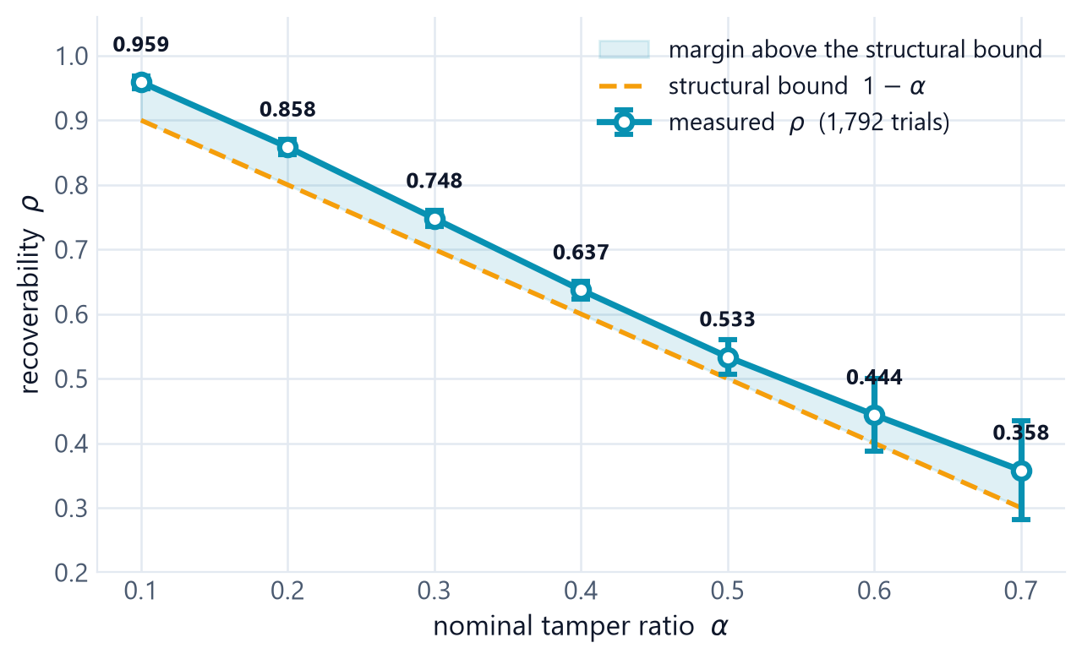
10 · RESULTS
Recovery — coverage follows the structural bound
ρ does not fall off a cliff
Monotone and near-linear from 0.959 at α = 0.10 to 0.358 at α = 0.70. The seven-ratio grid refutes the collapse this project originally expected to find.
It stays above the bound
ρ sits 3–6 points above 1 − α at every ratio: contiguous tamper regions coincide with their own partners slightly less than uniform placement predicts.
The ceiling is structural
One block, one backup. Raising the tolerable ratio needs reference sharing or fountain coding — not a better descriptor.
Watermark-Guided Tamper Localization and Recovery
19

Slide 31
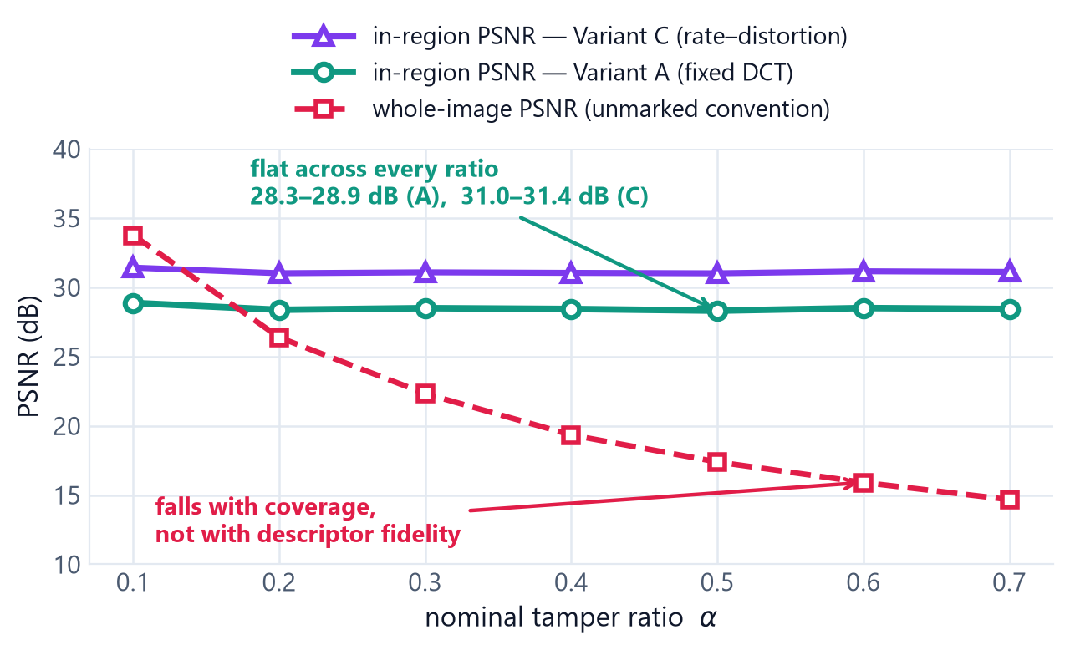
10 · RESULTS
Recovery fidelity — two different questions
In-region PSNR is flat
How good a rebuilt block looks depends on the descriptor, not on how much of the image was hit. It holds ≈28.5 dB (A) and ≈31.1 dB (C) at every ratio from 10% to 70%.
Whole-image PSNR falls
That number is driven by coverage ρ, not fidelity: at high α more blocks are unrecoverable, and each one is left declared rather than rebuilt.
Variant C earns its default
Rate–distortion descriptor allocation buys ≈2.6 dB of in-region quality at identical watermark PSNR.
Watermark-Guided Tamper Localization and Recovery
20

Slide 32
10 · RESULTS
Comparison with published work
CITED FROM PUBLICATIONS, NOT RE-IMPLEMENTED
Method
WM PSNR
WM SSIM
Recovered PSNR
Note
AuSR1 (Aminuddin & Ernawan 2022)
45.57
≈0.99
27.64
worst case reported; 2×2 blocks
Wu et al. (CMC 2026)
> 41
—
> 30 @ 50% tamper
0% FPR/FNR reported
Korus & Dziech (IEEE TIP 2013)
—
—
37 @ 50% damage
fountain codes, > 10,000 images
Ours (measured, Variant A)
45.48
0.9885
17.39 @ 50% tamper
marked (honest) output: 12.40 dB
The gap is real and it is ours
Two conventions, stated plainly
What is defensible here
Korus & Dziech report 37 dB at 50% damage where this scheme reaches 17.39 dB. Fountain coding degrades gracefully; one-to-one mapping does not.
Not recovery itself. Zero training data, zero GPU, deterministic output, and every decision re-checkable by a third party holding the key.
17.39 dB leaves unrecoverable regions as received, the convention those papers use. Our actual default marks them instead — 12.40 dB, and honest.
Watermark-Guided Tamper Localization and Recovery
21

Slide 33
10 · RESULTS
Limitations, stated before anyone asks
LIMITATIONS
FUTURE SCOPE
Fragile to benign processing
Reference sharing / fountain codes
JPEG, resizing and filtering destroy the mark. The pipeline must be lossless end to end.
The single highest-value upgrade — it is what buys Korus & Dziech their 37 dB. A rate-1/3 prototype already holds ρ = 1.000 up to a sharp cliff at α ≈ 0.64.
Legacy images cannot be checked
Nothing to verify against unless the image was marked before distribution.
Hierarchical verification
Decouple localization resolution from per-block payload (Lin et al. 2005).
Recovery is approximate
A 96-bit descriptor is not a copy. ≈28–31 dB in-region, not pixel-exact.
Semi-fragile extension
Tolerate a bounded, declared amount of JPEG re-compression.
Large-area tampering
Block and partner both destroyed ⇒ unrecoverable. ρ tracks 1 − α.
Reversible embedding
Bit-exact restoration of images that verify as authentic.
Security is key-dependent
The whole guarantee rests on the key staying secret.
Video and colour-space extension
Inter-frame mapping widens the recovery-data space.
Block-size trade-off
4×4 localizes better but drops the tag to 16 bits, raising false-accept to 2⁻¹⁶.
Hybrid with passive forensics
Use the exact mask as a trusted prior for unmarked images.
Watermark-Guided Tamper Localization and Recovery
22

Slide 34
11
SECTION 11
Conclusion
What was delivered, what it costs, and what comes next.

Slide 35
11 · CONCLUSION
What was built, measured and learned
45.49 dB
1.0000
28.5 / 31.1 dB
3,232
imperceptibility
localization precision
in-region recovery
measured runs
SSIM ≥ 0.978 on every image
recall 1.000 on 3 of 4 classes
Variant A / C, flat in α
32-image public corpus
Delivered
Learned
Honest about cost
A complete self-embedding pipeline — protect, detect, localize, recover — with a web application, a reproducible experiment grid, an IEEE-format paper and a deployment guide.
The collapse this project set out to characterize does not exist in this design. Across seven ratios ρ is monotone, near-linear, and consistently above 1 − α.
Fragile by construction, approximate by design, and roughly 20 dB behind a fountain-coded scheme at 50% tampering. All three are reported, none are worked around.
A conventional detector tells you an image is probably fake. This one names the blocks, proves the rest untouched, rebuilds what it can — and declares what it cannot.
Watermark-Guided Tamper Localization and Recovery
23

Slide 36
REFERENCES
Selected references
[1] J. Fridrich and M. Goljan, “Protection of digital images using self-embedding,” Proc. Symp. Content Security and Data Hiding in Digital Media, 1999.
[2] J. Fridrich and M. Goljan, “Images with self-correcting capabilities,” Proc. IEEE ICIP, vol. 3, 1999, pp. 792–796.
[3] C.-Y. Lin and S.-F. Chang, “Semi-fragile watermarking for authenticating JPEG visual content,” Proc. SPIE 3971, 2000, pp. 140–151.
[4] M. Holliman and N. Memon, “Counterfeiting attacks on oblivious block-wise independent invisible watermarking schemes,” IEEE TIP, vol. 9, no. 3, 2000.
[5] P. W. Wong and N. Memon, “Secret and public key image watermarking schemes,” IEEE TIP, vol. 10, no. 10, 2001, pp. 1593–1601.
[6] J. Fridrich, “Security of fragile authentication watermarks with localization,” Proc. SPIE 4675, 2002, pp. 691–700.
[7] C. Rey and J.-L. Dugelay, “A survey of watermarking algorithms for image authentication,” EURASIP J. Appl. Signal Process., 2002.
[8] P.-L. Lin, C.-K. Hsieh, and P.-W. Huang, “A hierarchical digital watermarking method for image tamper detection and recovery,” Pattern Recognit., vol. 38, no. 12, 2005.
[9] X. Zhang and S. Wang, “Fragile watermarking with error-free restoration capability,” IEEE Trans. Multimedia, vol. 10, no. 8, 2008.
[10] X. Zhang, S. Wang, Z. Qian, and G. Feng, “Reference sharing mechanism for watermark self-embedding,” IEEE TIP, vol. 20, no. 2, 2011, pp. 485–495.
[11] P. Korus and A. Dziech, “Efficient method for content reconstruction with self-embedding,” IEEE TIP, vol. 22, no. 3, 2013, pp. 1134–1147.
[12] I. J. Cox, J. Kilian, F. T. Leighton, and T. Shamoon, “Secure spread spectrum watermarking for multimedia,” IEEE TIP, vol. 6, no. 12, 1997.
[13] Z. Wang, A. C. Bovik, H. R. Sheikh, and E. P. Simoncelli, “Image quality assessment: from error visibility to structural similarity,” IEEE TIP, vol. 13, no. 4, 2004.
[14] P. Zhou, X. Han, V. I. Morariu, and L. S. Davis, “Learning rich features for image manipulation detection,” Proc. IEEE/CVF CVPR, 2018.
[15] Y. Wu, W. AbdAlmageed, and P. Natarajan, “ManTra-Net: manipulation tracing network,” Proc. IEEE/CVF CVPR, 2019.
[16] A. Aminuddin and F. Ernawan, “AuSR1: authentication and self-recovery with LSB shifting in fragile image watermarking,” J. King Saud Univ. – CIS, 2022.
[17] A. Aminuddin and F. Ernawan, “AuSR2: watermarking for authentication and self-recovery with texture preservation,” Comput. Electr. Eng., vol. 102, 2022.
[18] A. Aminuddin and F. Ernawan, “AuSR3: a new block mapping technique to avoid the tamper coincidence problem,” J. King Saud Univ. – CIS, vol. 35, no. 9, 2023.
[19] A. Aminuddin et al., “TCBR and TCBD: evaluation metrics for the tamper coincidence problem,” Eng. Sci. Technol. Int. J., vol. 56, 2024.
[20] X. Zhang, R. Li, J. Yu, Y. Xu, W. Li, and J. Zhang, “EditGuard: versatile image watermarking for tamper localization and copyright protection,” Proc. IEEE/CVF CVPR, 2024.
[21] Q. Wu, H. Li, M. Li, and M. Wang, “Multi-feature fragile image watermarking for tampering blind-detection and content self-recovery,” CMC, vol. 86, no. 1, 2026.
[22] NIST, “Secure Hash Standard (SHS),” FIPS PUB 180-4, 2015. · USC-SIPI Image Database, sipi.usc.edu/database. · Kodak Lossless True Color Image Suite.
Watermark-Guided Tamper Localization and Recovery
24

Slide 37
Thank you
Protect
embed in seconds
Verify
Questions and discussion — a live demonstration is available: upload an image, tamper it, and watch the system name the damage and repair it.
block-exact mask
Recover
rebuild or declare
[Student Name 1] · [Student Name 2] · [Student Name 3] · [Student Name 4]
Guide: [Guide Name, Designation]
Department of Computer Science & Engineering / Information Technology, Ajeenkya D Y Patil School of Engineering, Charholi Bk., Pune

