Slide 1
Computational models
Prof. Ariel Felner
050-2029736
felner@bgu.ac.il

Slide 2
Computation
CPU
memory

Slide 3
temporary memory
input memory
CPU
output memory
Program memory

Slide 4



Example:
temporary memory
input memory
CPU
output memory
Program memory
compute
compute

Slide 5

temporary memory
input memory
CPU
output memory
Program memory
compute
compute

Slide 6


temporary memory
input memory
CPU
output memory
Program memory
compute
compute

Slide 7
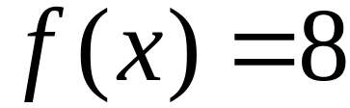
temporary memory
input memory
CPU
Program memory
output memory
compute
compute

Slide 8
Automaton
temporary memory
Automaton
input memory
CPU
output memory
Program memory

Slide 9
Different Kinds of Automata
Automata are distinguished by the temporary memory
  Finite Automata: no temporary memory
  Pushdown Automata: stack
  Turing Machines: random access memory

Slide 10
Finite Automaton
temporary memory
input memory
Finite
Automaton
output memory
Example: Vending Machines
(small computing power)

Slide 11
Pushdown Automaton
Stack
Push, Pop
input memory
Pushdown
Automaton
output memory
Example: Compilers for Programming Languages
(medium computing power)

Slide 12
Turing Machine
Random Access Memory
input memory
Turing
Machine
output memory
Examples: Any Algorithm
(highest computing power)

Slide 13
Power of Automata
Finite
Automata
Pushdown
Automata
Turing
Machine
Less power
More power
Solve more
computational problems

Slide 14
Languages

Slide 15
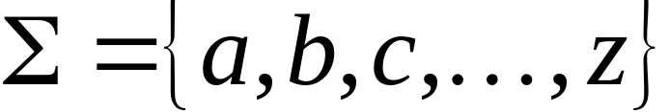
A language is a set of strings
String: A sequence of letters
  Examples: “cat”, “dog”, “house”, …
  Defined over an alphabet:

Slide 16

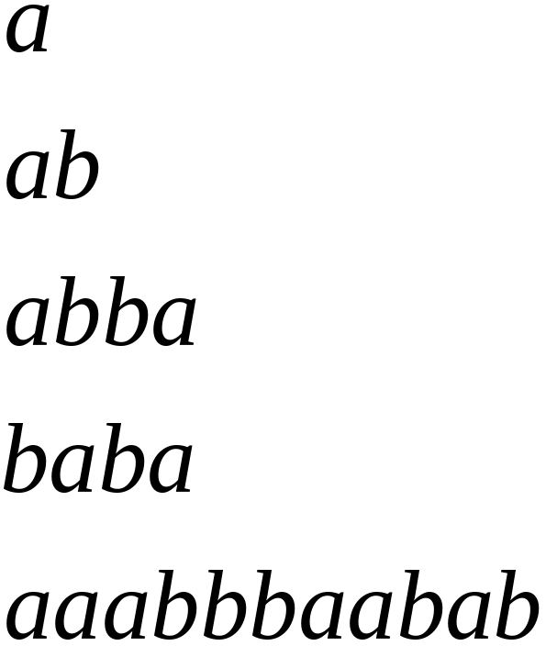
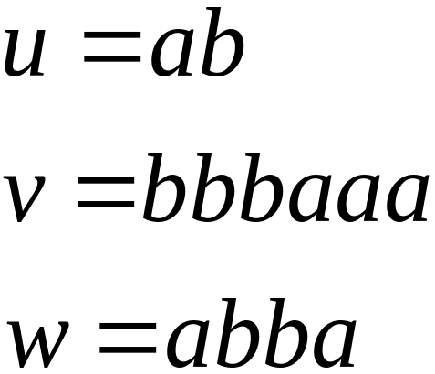
Alphabets and Strings
We will use small alphabets:
Strings

Slide 17
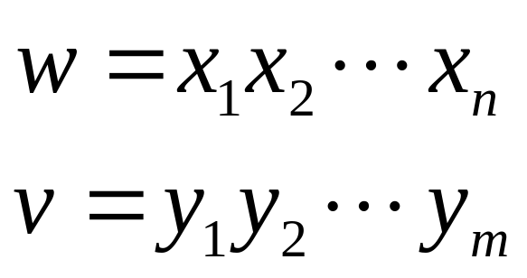
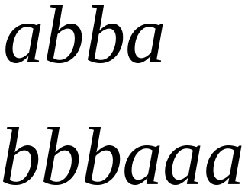
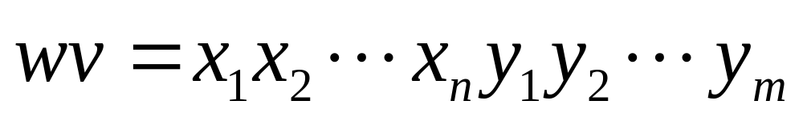

String Operations
Concatenation

Slide 18




Reverse

Slide 19


String Length
Length:
Examples:

Slide 20


Length of Concatenation
Example:

Slide 21

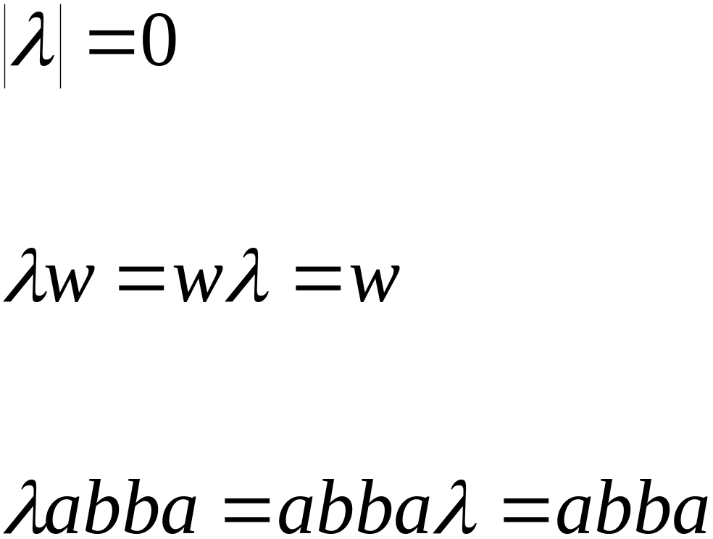
Empty String
A string with no letters:
Observations:

Slide 22


Substring
Substring of string:
  a subsequence of consecutive characters
String Substring

Slide 23




Prefix and Suffix
Prefixes Suffixes
prefix
suffix

Slide 24




Another Operation
Example:
Definition:

Slide 25



The * Operation
: the set of all possible strings from
alphabet

Slide 26

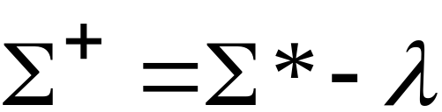
The + Operation
: the set of all possible strings from
alphabet except

Slide 27


Languages
A language is any subset of
Example:
Languages:

Slide 28
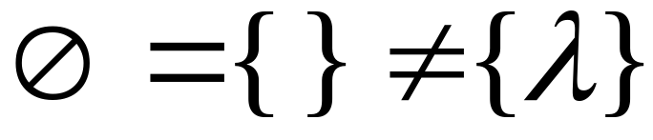



Note that:
Sets
Set size
Set size
String length

Slide 29




Another Example
An infinite language

Slide 30


Operations on Languages
The usual set operations
Complement:

Slide 31



Reverse
Definition:
Examples:

Slide 32


Concatenation
Definition:
Example:

Slide 33



Another Operation
Definition:
Special case:

Slide 34



More Examples

Slide 35


Star-Closure (Kleene *)
Definition:
Example:

Slide 36
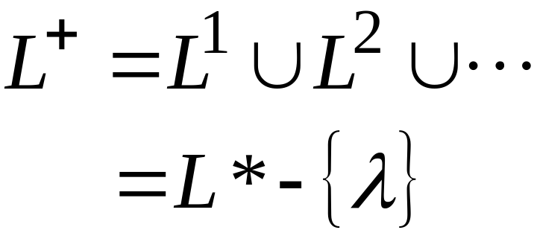

Positive Closure
Definition:

Slide 37
Regular Languages
Can we write an program (automaton) to recognize languages??
Given a word w and a language L
is a word w is w in L?
Definition of Regular Languages:
Basis:, {φ}, {λ},and {a} are regular languages for all a in alphabet A.
Induction: If L and M are Regular Languages then so are the following languages: LUM, MoL and L*

Slide 38
Regular Languages
Example: say we have the following alphabet
A={a,b}
The following are languages: {φ}, {λ}, {a}, {b}
Is {λ,b} regualr?
Sure because {λ,b}={λ}U{b}
Is {a,ab} regular?
it is a product of {a} and {λ,b}
{a,ab}={a}o{λ,b}

Slide 39
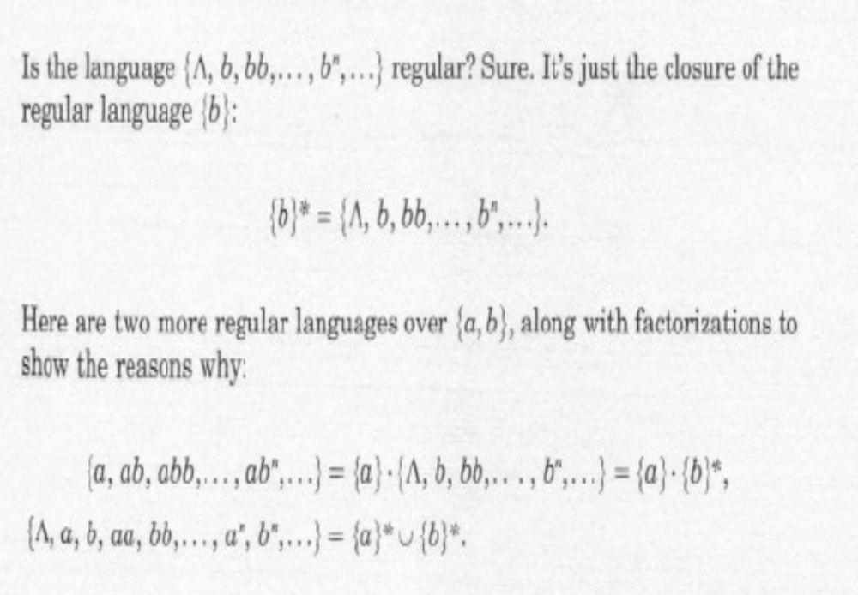
Regular Languages

Slide 40
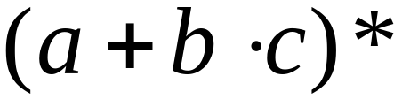
Regular Expressions
Regular expressions
describe regular languages
Example:
describes the language

Slide 41
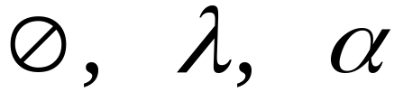



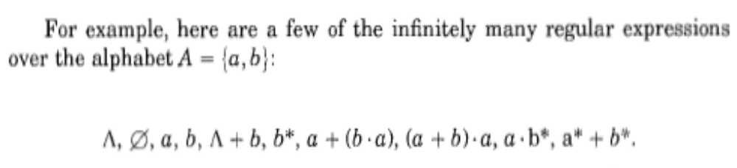
Recursive Definition
Primitive regular expressions:
Given regular expressions and
Are regular expressions

Slide 42
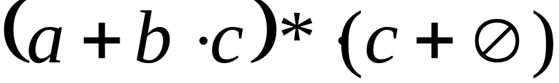
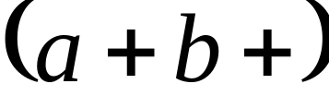
Examples
A regular expression:
Not a regular expression:

Slide 43
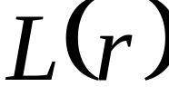

Languages of Regular Expressions
: language of regular expression
Example

Slide 44
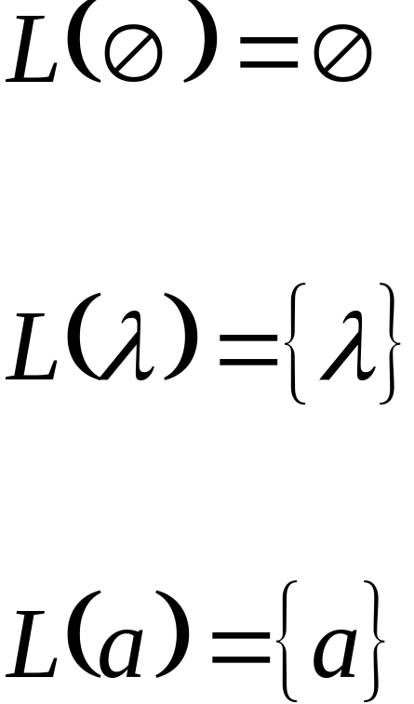
Definition
For primitive regular expressions:

Slide 45




Definition (continued)
For regular expressions and

Slide 46

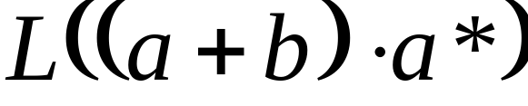


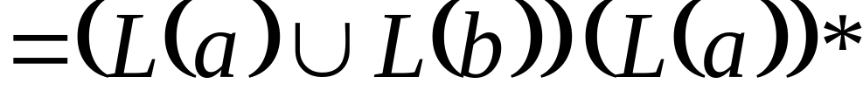

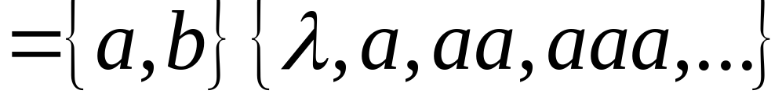
Example
Regular expression:

Slide 47
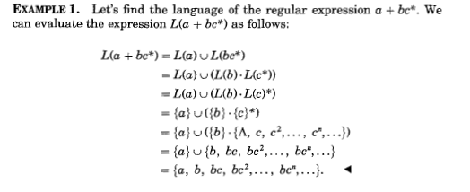
Example

Slide 48

Example
Regular expression
Proof: TARGIL

Slide 49


Example
Regular expression

Slide 50


Example
Regular expression
= { all strings with at least
two consecutive 0 }

Slide 51
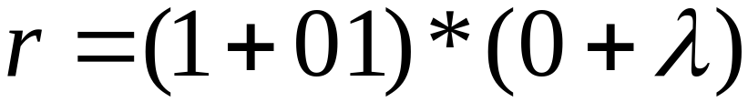
Example
Regular expression
= { all strings without
two consecutive 0 }

Slide 52

Equivalent Regular Expressions
Definition:
Regular expressions and
are equivalent if

Slide 53

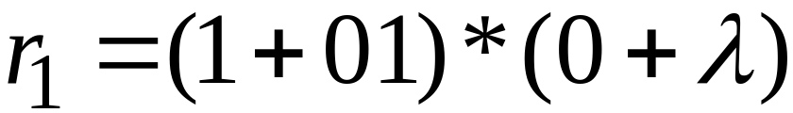

Example
= { all strings without
two consecutive 0 }
and
are equivalent
regular expr.

Slide 54
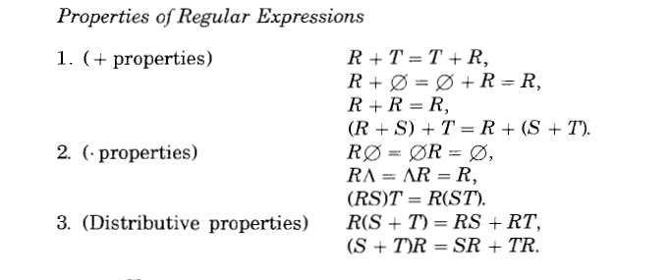
Regular Experssions

Slide 55
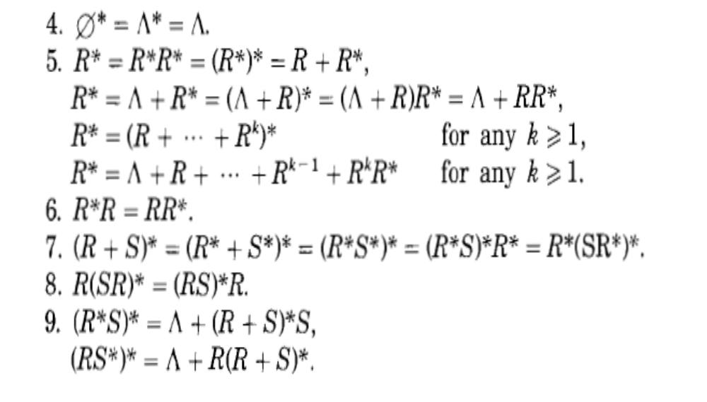
Regular Experssions

Slide 56
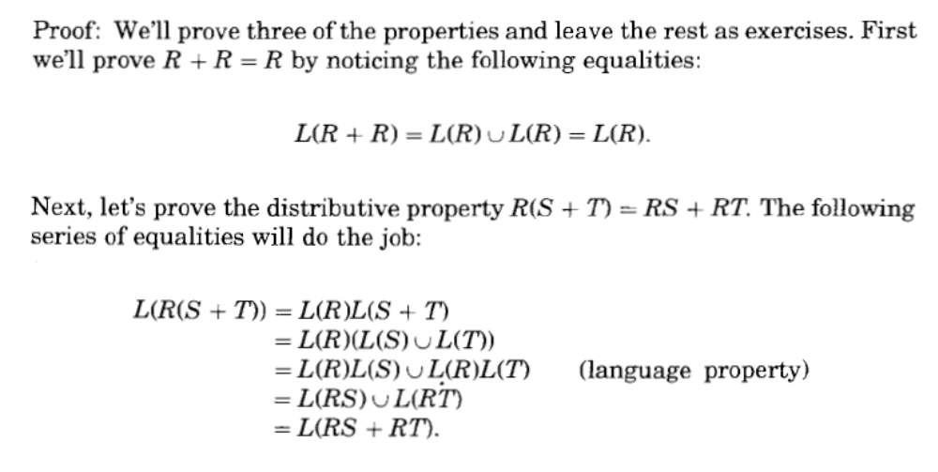
Regular Experssions

