Slide 1
P and NP
Poly time algorithm: input size n (in some encoding), worst case running time – O(n^{c}) for some constant c.
Three classes of problems (sktech)
  P: problems solvable in poly time.
  NP: (nondeterministic polynomial)
  problems verifiable in poly time.
  NPC: problems in NP and as hard as any problem in NP. (any NP problem can be reduced to an an NPC problem)

Slide 2
The class P
Poly time algorithm: input size n (in some encoding), worst case running time – O(n^{c}) for some constant c.
P = all problems with poly time algorithms.
P = all languages acceptable/decidable by machines in poly time.
For example, the language: Clique
Clique={{G,k}| such that there is a clique of size in G}.
An automaton will accept or reject any input of languages in P in polytime (poly in the size of the input)

Slide 3
The class NP: nondeterministic polynomial.
NP are those problems that are
Verifiable in poly time: given a certificate of a solution, could verify the certificate is correct in poly time.
Examples:
  Vertex Cover ∈P. Given a certificate of a set of nodes (v₁,v₂,…, v_{n}), easily verified in poly time.
  → Go over all the edges and verify.
  3-Color ∈P., given a certificate of a coloring easily verified in poly time.
  → Go over all the edges and verify.
  Clique∈P. given a certificate of a k-clique easily verified in poly time.
  → Go over all the k^2 edges and verify.

Slide 4
NP
  NP: a problem that has a nondetrministic algorithm that runs in polynomial time.
  For example:
  we guess the solution (with non-determinisim we are always correct in the first guess!!).
  We then verify that the solution is correct in polytime
  So → → NP: the class of problems witch solutions can be verified in polynomial time

Slide 5
NP (equivalent definitions)
  NP: a problem that has a nondeterministic algorithm that runs in polynomial time.
  NP: a problem that can be verified in polynomial time.
  NP: The nondeterministic algorithm is in fact a polynomial lower bound (must at least verify correctness)
  NP: The nondeterministic algorithm is a best case for the deterministic algorithm
  NP: Algorithmic gap between a polynomial lower bound (nondeterministic algorithm) to the exponential upper bound (deterministic algorithm)

Slide 6
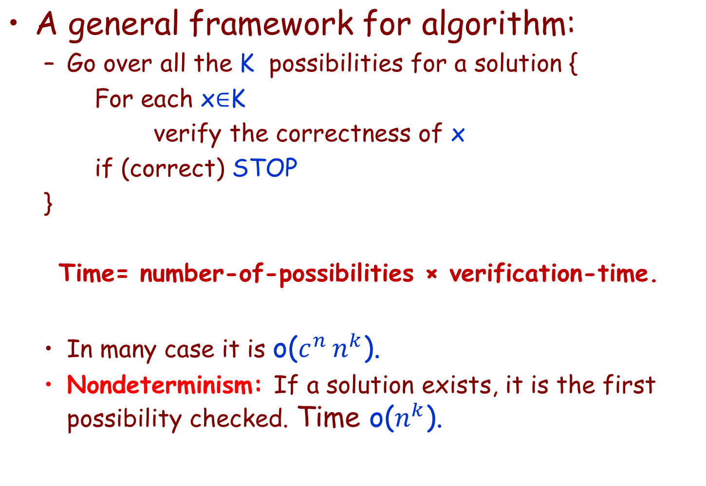
NP

Slide 7
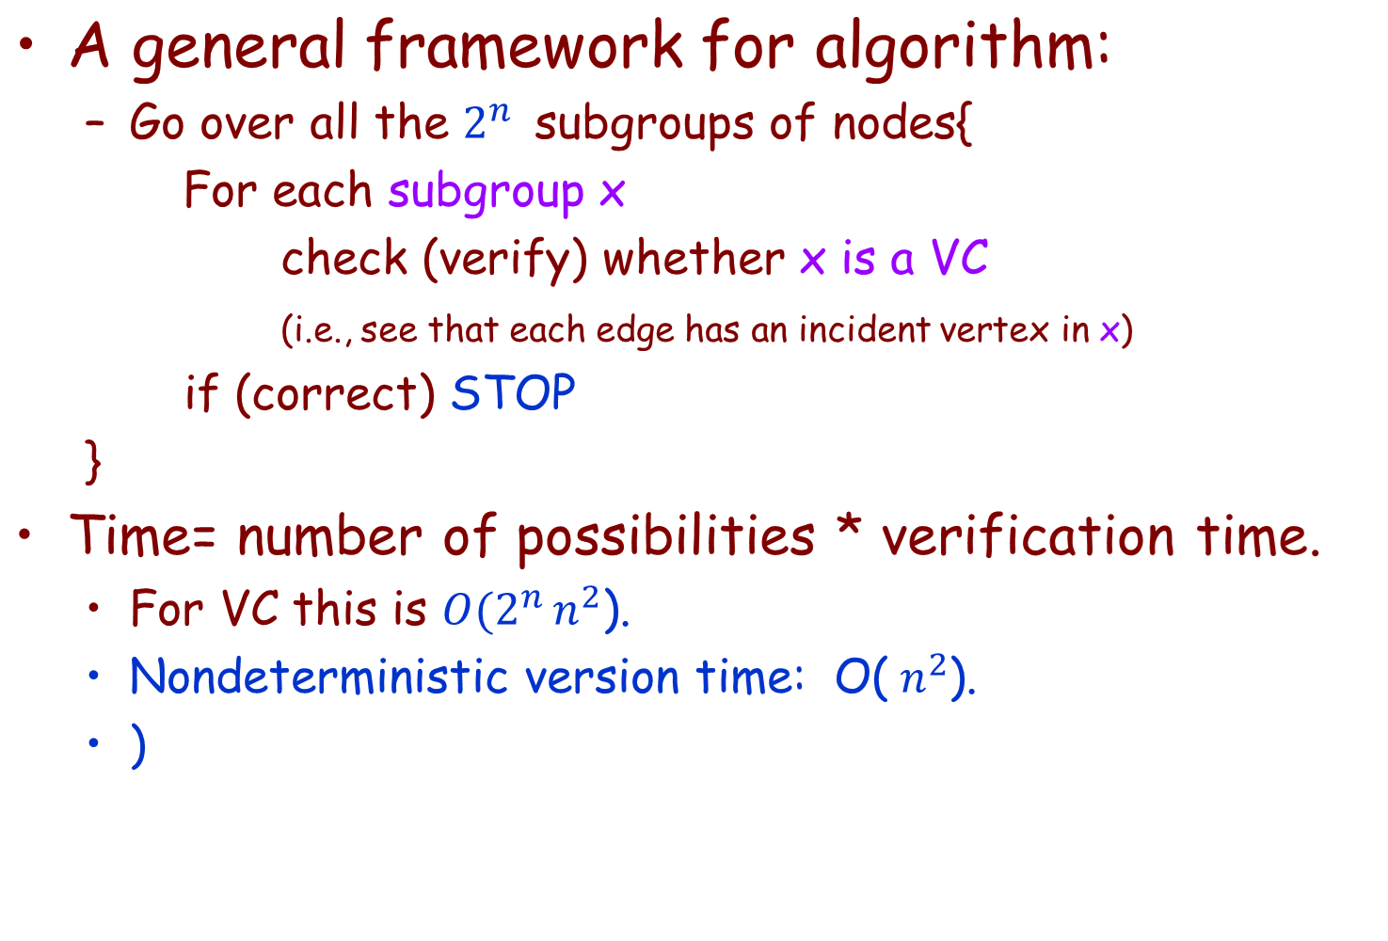
NP Example: VC

Slide 8
Reductions in P
Polynomial reductions: a reduction that can be done in polynomial time.
Example: Clique ≤poly VC
f is polynomial. Why? f(G,k)=[G*,|V|-k].
Given G, G* can be computed in poly time.
Given k, |V|-k can be computed in poly time.
p-easier ≤poly p-harder
A
yes
no
f
f
B
yes
no

Slide 9
(Poly) reduction between decision problems
Problem (class) and problem instance
Instance α of decision problem A and instance β of decision problem B
A poly reduction from A to B is a transformation f with the following properties:
  The transformation f takes poly time
  The answer is the same (the answer for α is YES if and only if the answer for β is YES).
Lower bound
A
α
yes
no
f
f
Upper bound
β
B
yes
no

Slide 10
Poly time reduction
Assume the input is n
Assume the reduction from A to B takes n^k
Assume that solving B takes n^q
In the worst case the reduction expanded the input to be n^k.
  So, the running time is (n^k)^q = n^(k+q), still polynomial in n.
In the best case it is n^k+n^q, again polynomial in n.

Slide 11
Reductions
p_{easier} ≤_{poly} p_{harder}
If there is a fast
algorithm for p_{easier}
If there is no fast
algorithm for p_{easier}
?
then there is no fast
algorithm for p_{harder}
then there is a fast
algorithm for p_{easier}
?
If there is a fast
algorithm for p_{harder}
If there is not a fast
algorithm for p_{harder}

Slide 12
Decision VS. Optimization Problems
Decision problem: solving the problem by giving an answer “YES” or “NO”
Optimization problem: solving the problem by finding the optimal solution.
Examples:
  SHORTEST-PATH (optimization)
    Given G, u,v, find a path from u to v with fewest edges.
  PATH (decision)
    Given G, u,v, and k, whether exist a path from u to v consisting of at most k edges.

Slide 13
Decision VS. Optimization Problems (Cont.)
Decision is no harder than optimization and vise-versa
If there is a polynomial algorithm for an optimization problem, the algorithm can be used to solve the corresponding decision problem and vise versa.
Example: Vertex cover.
If there If there is an algorithm for an optimized VC, say q, then for the decision problem the answer is NO if k<q and yes if k≥q
If there is an algorithm for a decision whether G has a VC of K then we try k=1, k=2, k=3 until we get the YES answer

Slide 14
Decision VS. Optimization Problems
If optimization is easy, its corresponding decision is also easy. Or in another way, if provide evidence that decision problem is hard, then the corresponding optimization problem is also hard.
The NPC theory is confined to decision problem. (but also applicable to optimization problem.)
  Another reason is that: easy to define reduction between decision problems.

Slide 15
NP-Complete (NPC)
A problem p∈NPC if
1) p ∈NP,
2) Any other problem p′ can be reduced to p
in polynomial time.
So if p can be solved in polynomial time, then all problems in NP can be solved in polynomial time.
All NP problems
Polinomial
reductions
Problem p

Slide 16
NP-completeness and Reducibility (cont.)
A problem p is NP-complete if
  1) p ∈ NP and
  2) p'≤_{p} p for every p' ∈ NP. (p is NP-hard.)
Theorem 34.4 (page 986)
if any NP-compete problem is poly-time solvable, then P=NP.
  (upper bound goes up to all NP)
if any problem in NP is not poly-time solvable, then no NP-complete problem is poly-time solvable.
  (lower bound goes down)

Slide 17
Arguments about P, NP, NPC
No poly algorithm found for any NPC problem (even so many NPC problems)
No proof that a poly algorithm cannot exist for any of NPC problems, (even having tried so long so hard).
Most theoretical computer scientists believe that NPC is intractable (i.e., hard, and P ≠ NP).

Slide 18
Relation among P, NP, NPC
P ⊆ NP (Sure)
NPC ⊆ NP (sure)
P = NP ??? (or P ⊂ NP, or P = NP)
NPC = NP ??? (or NPC ⊂ NP, or NPC = NP)
This is one of the deepest, most perplexing open research problems in (theoretical) computer science since 1971.

Slide 19
View of Theoretical Computer Scientists on P, NP, NPC
NP
NPC
P
P ⊂ NP, NPC ⊂ NP, P ∩ NPC = ∅

Slide 20
Why discussion on NPC
If a problem is proved to be NPC, a good evidence for its intractability (hardness).
Not waste time on trying to find efficient algorithm for it
Instead, focus on design approximate algorithm or a solution for a special case of the problem
Some problems looks very easy on the surface, but in fact, is hard (NPC).

Slide 21
Usual steps of problems
Problem X is in NP (very easy, algorithmic gap)
Problem X is in P
(Harder to prove)
Problem X is in NPC
(Harder to prove)
MST
Matix-multiplication
Many more….
Clique
3-color
Many more…
No algorithmic gap
Algorithmic gap remains

Slide 22
First NPC problem: Formula Satisfiability
Satisfiability (SAT) definition
  n boolean variables: x₁, x₂,…, x_{n}.
  M boolean connectives: any boolean function with one or two inputs and one output, such as ∧,∨,¬,→,↔,… and Parentheses.
A SAT φ is satisfiable if there exists an true assignment which causes φ to evaluate to 1.
SAT={< φ>: φ is a satifiable boolean formula}.
The historical honor of the first NP-complete problem ever shown.

Slide 23
SAT is NP-complete
Theorem 34.9: (page 997)
  SAT is NP-complete.
Proof:
  SAT belongs to NP.
    Given a satisfying assignment, the verifying algorithm replaces each variable with its value and evaluate the formula, in poly time.
  SAT is NP-hard (show All NP problems≤_{p} SAT).

Slide 24
SAT is NP-complete (cont.)
Sat is NP hard. (fast description of the proof)
Any problem in NP can be decoded as a SAT problem.
Example: VC,: the nodes are variables the values are YES and NO.
For each edge (v1,v2) we write that (v1∨v2)
This is a reduction from VC to SAT
VC
yes
no
f
f
SAT
yes
no

Slide 25
NP-completeness proof basis
Lemma 34.8 (page 995)
  If p is a problem such that p'≤_{p} p for some p' ∈ NPC, then p is NP-hard. Moreover, if p∈ NP, then p∈ NPC.
p’
yes
no
p’ is NPC
f
f
p
yes
no
p is also
NPC

Slide 26
Template: Steps to prove p is NP-complete
  Prove p∈ NP.
    1) Show that given a solution it can be verified in poly time,
  Prove p is NP-hard.
    2) Select a known NP-complete p'.
    3) Describe a transformation function f that maps every instance x of p' into an instance f(x) of p.
    4) Prove f satisfies that the answer to x∈p' is YES if and only if the answer to f(x)∈p is YES for all instance x ∈p'.
    5) Prove that the algorithm computing f runs in poly-time.

Slide 27
Clique is in NPC
Claim: Clique is NP-complete
Below are the 5 stages for the proof.
  1) Clique is in NP:
Given a set of K vertices, it takes polynomial time to verify that it is a clique. Why?, we go over all (k over 2) edges and verify that they exist.
  2) We select 3-CNF-SAT and show a polynomial reduction to Clique

Slide 28
3) Transformation from 3-CNF-SAT to CLUQUE
Suppose φ=C₁∧ C₂∧… ∧C_{k} be a boolean formula in 3-CNF with k clauses.
  We construct a graph G=(V,E) as follows:
    For each clause C_{r} =(l₁^{r}∨ l₂^{r}∨ l₃^{r}), place a triple of v₁^{r}, v₂^{r}, v₃^{r} into V
    Put the edge between two vertices v_{i}^{r} and v_{j}^{s} when:
      r≠s, that is v_{i}^{r} and v_{j}^{s} are in different triples, and
      Their corresponding literals are consistent, i.e, l_{i}^{r} is not negation of l_{j}^{s}

Slide 29
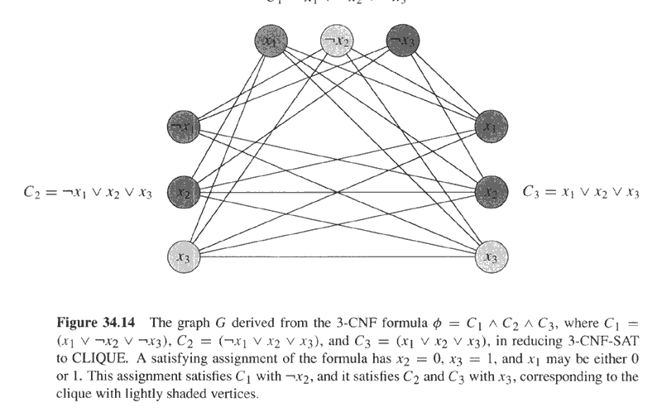
φ=(x₁∨¬x₂∨¬x₃)∧(¬x₁∨x₂∨x₃)∧(x₁∨x₂∨x₃) and its reduced graph G

Slide 30
4: Prove that the transformation is a reduction
Claim: φ is satisfiable if and only if G has a clique of size k.
Direction 1: If φ is satisfiable, then there exists a satisfying assignment, which makes at least one literal in each clause to evaluate to 1. Pick one this kind of literal in each clause. Then consider the subgraph V' consisting of the corresponding vertex of each such literal. For each pair v_{i}^{r},v_{j}^{s} ∈V', where r≠s. Since l_{i}^{r},l_{j}^{s} are both evaluated to 1, so l_{i}^{r} is not negation of l_{j}^{s}, thus there is an edge between v_{i}^{r} and v_{j}^{s}. So V' is a clique of size k.
Direction 2: If G has a clique V' of size k, then V' contains exact one vertex from each triple. Assign all the literals corresponding the vertices in V' to 1, and other literals to 1 or 0, then each clause will be evaluated to 1. So φ is satisfiable.

Slide 31
5) The reduction is polynomial
The reduction (transformation) from 3-CNF-SAT to Clique takes polynomial time.
Why? we draw exactly 3*K vertices. And we then draw at most (3*K)^2 edges.

Slide 32
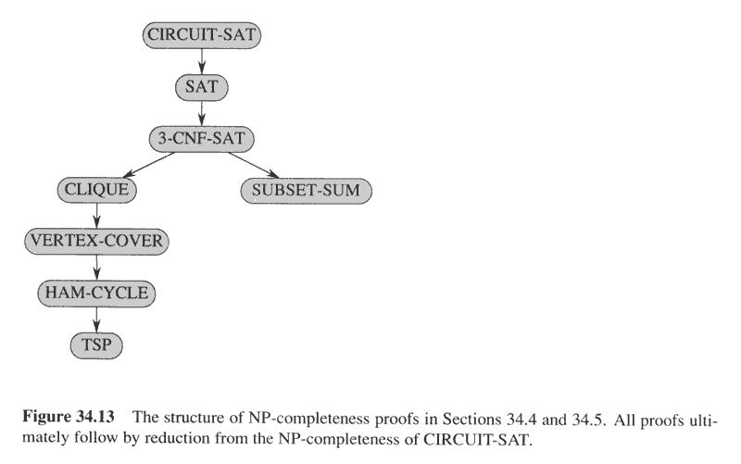
NP-completeness proof structure

Slide 33
Important to remember
To prove NPC, we perform the reduction from a known problem (that is NPC) to an unkown problem which we want to prove that it is NPC.
  This is against the intuition of intelligent people which do a reduction from an unknown problem to a known problem.

Slide 34
Example
The lecturers problem:
Input: given P professors and M courses. for each professor a list of the course he can teach.
Given a number K, Can K (out of P) professors teach the M courses.
Claim: lecturers problem is NPC
Hint - (Vertex cover)

Slide 35
The lecturers problem:
Wrong Answer:
Two types of vertices
Cover all the “lecturers” vertices.
This problem is known as
Full matching in a bibartite graph (FMBG)
Why is this wrong?
A) FMBG not vertex cover
B) The reduction is in the wrong direction!!
It brings an upper bound from FMBG to
the lecturers problem
courses
Lecturers

Slide 36
The lecturers problem:
Correct answer
1) Lecturers problem is in NP
2) We choose VC (known to be NP-compete)
3) A reduction from VC to the lecturers problem:
  Each vertex → a lecturer
  Each edge → a course.
  K → K
Lecturers teach courses whose edged were attached to them
Now we have a strange university in which each course can be taught by exactly two lecturers!!
This is a special case of all lecturers problem.
c
a
1
2
Parameters in VC:
  (V,E, k)
Parameters in Lectures:
(Lecturers, Courses, k)
Important
Each parameter in Lectures must be a function of the parameters of VC!
b
Lecturers-courses
a 1,2
b 2
c 1

Slide 37
The lecturers problem:
It is easy to see that:
4) If there is a vertex cover to the graph then there is an assignment of lecturers to the university and vise versa
5) The reduction is polynomial
The reduction is from VC to the lecturers problem!!

Slide 38
The lecturers problem:
1) Lecturers problem is in NP
Given a set of K professors, we iterate over all classes and see that each of them is assigned a professor
2) We pick Vertex-Cover
3) Transformation from VC to Lecturers problem:
Each vertex → becomes a lecturer
Each edge → becomes a course.
K→ K
Lecturers teach courses if the edge of the course
was attached to the vertex of the lecturer.

Slide 39
The lecturers problem:
4) The transformation is a reduction:
Direction 1: If there is a vertex cover of size K to the graph then there is an assignment of K lecturers to the university that teach all courses. Why? Take the same set of K lecturers, it is easy to see that they can teach all the courses.
Direction 2: If there is an assignment of K lecturers to the university that teach all courses, there is a VC of size K in the graph. Why? Take the same set of K vertices
5) The transformation takes polynomial time:
For each vertex we add one lecturer and for each edge we add one course. This is even polynomial in the number of vertices and or edges.

Slide 40
NP-complete problems

Slide 41
K-CRAYOLA Problem:
Colour each node.
Nodes with lines between them must have different colours.
Given a graph G and a k,
find a way to coloured G with k colours.
Rudich www.discretemath.com

Slide 42
3-color
Given a graph, can it be colored with 3 colors such that adjacent nodes are colored by different colors.
Let’s concentrate on the 2-color problem.
It is easy to see that a graph can be colored by two colors if it is a
bibartite graph ( (גרף דו צדדי
A graph with two sets of vertices
Such that each edge is between
vertices of the two sets.

Slide 43
2-color
So: run breadth first search:
Color the start with black.
Each odd level - color with white.
Each even level – color with black.
Stop when a vertex is colored in both white and black or when the BFS ends.

Slide 44
The 3-color problem
Claim: 3-color is NP-complete
Proof:
3-color is in NP. Why, given a graph and a 3-color certificate, we iterate over all the |E|^2 edges and see that each edge is colored with two colores.
This takes O(n^2)
2) 3-color is NP-Hard.
we will show 3-SAT <p 3-COLOR

Slide 45
The 3-color problem
The reduction: For each 3-sat formula f, we will build a graph G such that:
f is in 3-sat iff G is in 3-color
Note again that the transformation is from the formula to the graph!!
Transformation: For each triple l11,l12,l13
we will build the
following triangle:
We have three
colors: T, F, A
l11
out node
Inner node
Inner triangle nodes
l12
l13

Slide 46
3-SAT <p 3-COLOR
If l11=~l23
l23
l11
l13
l12
T
Base triangle
A
F

Slide 47
The transformation
Create a base triangle such that:
The A node is connected to all out nodes.
The T node is connected to all in nodes.
Out nodes which are in different triples and are negations are also connected.
See above drawings.

Slide 48
The transformation is a reduction
Direction 1) G in 3-color→ F is 3-sat
If G in 3-color then we color the base triangle with T,F,A as shown. (also all other triangles are T,F,A
For each triangle consider the out nodes. one of them must be colored with T. Why?
They can be either T or F (as they are all connected to A)
They cannot be all F, because in this case all the inner nodes are A and the
Inner triangle nodes cannot be T,F,A
→ At least one of the out nodes is T
→ Assign true to that literal !! (f is in 3-sat)

Slide 49
Direction 2) F is 3-sat → G in 3-color
If F is 3-sat then each literal is T or F and there is at least one T in each triple
Color the out nodes with T or F.
Three cases for the inner nodes and for the inner triangle nodes
Case 1 (All T)
T
A
F
T
A
F
F
T
T

Slide 50
T
Case 2 (two T)
F
T
F
A
A
F
F
T
T
Case 3 (one T)
F
A
T
F
A
A
F
F

Slide 51
The transformation takes polynomial time. For each 3-CNF we build a triangle and add linear number of vertices to it. The number of edges is at most polynomial (quadratic in this case)

Slide 52
4-color (from 2007 test)
Claim: 4-color is NP-complete
1) 4-color is in NP:
Given a correct color assignment (certificate) it is easy to verify that it is a valid color assignment.
2) Let’s pick 3-color (which we know it is NP-complete)
3) Transformation: Given a graph G create a new graph G’ as follows: (a) Copy G into G’. But add a new vertex V. (b) Connect V to all vertices in G.
G
G’
v

Slide 53
4-color
4) Transformation is a reduction
Direction 1: Assume G is 3-colorable. Keep the colors in G’ and color V with the new color.
Direction 2: Assume G’ is 4-color and that V is colored white. Since V is connected to all vertices of G, then non of them is colored white. This means that they are all colored in the remaining 3 colors.
5) Transformation is polytime.
We added 1 vertex and n edges.
What about K-color for K>3??
G
G’
v

Slide 54
Subset Sum is NPC
SUBSET-SUM={<S,t>: S is a set of integers and there exists a S'⊆S such that t=∑_{s∈S'}s.}
Theorem 34.15: (page 1014)
  SUBSET-SUM is NP-complete.

Slide 55
SUBSET-SUM is NPC
SUBSET-SUM belongs to NP.
  Given a certificate S', check whether t is the sum of S‘. This can be finished in poly time.
SUBSET-SUM is NP-hard (show 3-CNF-SAT≤_{p}SUBSET-SUM).

Slide 56
SUBSET-SUM is NPC
Given a 3-CNF formula φ=C₁∧ C₂∧… ∧C_{k} with literals x₁, x₂,…, x_{n}. Construct a SUBSET-SUM instance as follows:
  Two assumptions: no clause contains both a literal and its negation, and either a literal or its negation appears in at least one clause.
  The numbers in S are based on 10 and have n+k digits, each digit corresponds to (or is labeled by) a literal or a clause.
  Target t=1….1||4…4 (n 1’s and k 4’s)
  For each literal x_{i}, create two integers:
    v_{i}=0…01_{(i)}0…0||0…01_{(l)}0…01_{(w)}0…0, where x_{i} appears in C_{l},…,C_{w.}
    v_{i}'=0…01_{(i)}0…0||0…01_{(m)}0…01_{(p)}0…0, where ¬x_{i} appears in C_{m},…,C_{q.} .
    Clearly, v_{i} and v_{i}' can not be equal in right k digits, moreover all v_{i} and v_{i}' in S are distinct.
  For each clause C_{j}, create two integers:
    s_{j}=0…0||0…01_{(j)}0…0,
    s_{j}'=0…0||0…02_{(j)}0…0.
    all s_{j} and s_{j}' are called “slack number”. Clearly, all s_{j} and s_{j}' in S are distinct.
  Note: the sum of digits in any one digit position is 2 or 6, so when there is no carries when adding any subset of the above integers.

Slide 57
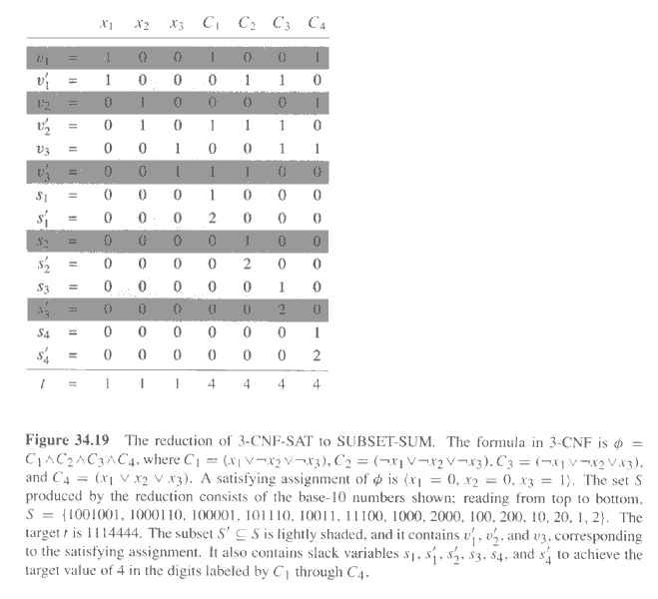
Copyright © The McGraw-Hill Companies, Inc. Permission required for reproduction or display.

Slide 58
SUBSET-SUM is NPC
The above reduction is done in poly time.
The 3-CNF formula φ is satisfiable if and only if there is a subset S' whose sum is t.
  suppose φ has a satisfying assignment.
    Then for i=1,…,n, if x_{i}=1 in the assignment, then v_{i} is put in S', otherwise, then v_{i}' is put in S'.
    The digits labeled by literals will sum to 1.
    Moreover, for each digit labeled by a clause C_{j} and in its three literals, there may be 1, 2, or 3 assignments to be 1. correspondingly, both s_{j} and s_{j}' or s_{j}', or s_{j} is added to S' to make the sum of the digit to 4.
    So S' will sum to 1…14…4.
  Suppose there is a S' which sums to 1…14…4. then S' contains exact one of v_{i} and v_{i}' for i=1,…,n. if v_{i}∈ S', then set x_{i}=1, otherwise, v_{i}'∈ S', then set x_{i}=0. It can be seen that this assignment makes each clause of φ to evaluate to 1. so φ is satisfiable.

Slide 59
Traveling-salesman problem is NPC
TSP={<G,c,k>:
G=(V,E) is a complete graph,
c is a function from V×V→Z,
G has a traveling salesman tour with cost at most k.}
Theorem 34.14: (page 1012)
  TSP is NP-complete.

Slide 60
TSP is NP-complete
TSP belongs to NP:
  Given a certificate of a sequence of vertices in the tour, the verifying algorithm checks whether each vertex appears once, sums up the cost and checks whether at most k. in poly time.
TSP is NP-hard (show HAM-CYCLE≤_{p}TSP)
  Given an instance G=(V,E) of HAM-CYCLE, construct a TSP instance <G',c,0) as follows (in poly time):
    G'=(V,E'), where E'={<i,j>: i,j∈ V and i≠j} and
    Cost function c is defined as c(i,j)=0 if (i,j) ∈E, 1, otherwise.
  If G has a hamiltonian cycle h, then h is also a tour in G' with cost at most 0.
  If G' has a tour h' of cost at most 0, then each edge in h' is 0, so each edge belong to E, so h' is also a hilmitonian cycle in G.

Slide 61
Unsolvable problems

Slide 62
Unsolvable problems
There are problems that cannot be solved.
→ We cannot write an algorithm that solves them
→ There is no Turing machine that can recognize them.
If P is unsolvable and P ≤ P’
Then P’ is also unsolvable.
“unsolvable” is like lower bound.
To prove that P’ is unsolvable make a reduction from another known unsolvable problem P.

Slide 63
The most famous undecidable/unsolvable
problem:
The halting problem

Slide 64
Halting problem
Same proof in a modern programming langauge.
Boolean Halt(Program P, Input x)
{
if (p halts on input x)
return(TRUE)
else
return(FALSE)
}

Slide 65
Halting problem
Program p1(Prgram p2)
{
if (halt(P2,P2)==TRUE)
loop forever;
else
exit;
}
Now run this:
Void main()
{
p1(p1)
}

Slide 66
Halting problem
If p1 halts on p1 then p1 with with input p1 never halts.
If p1 never halts on p1 then p1 with with input p1 halts.
Contradiction!!!
Thus, the halting problem is unsolvable.
Now reduce HALT to other problems and they are also unsolvable.
Similar to SAT.

Slide 67
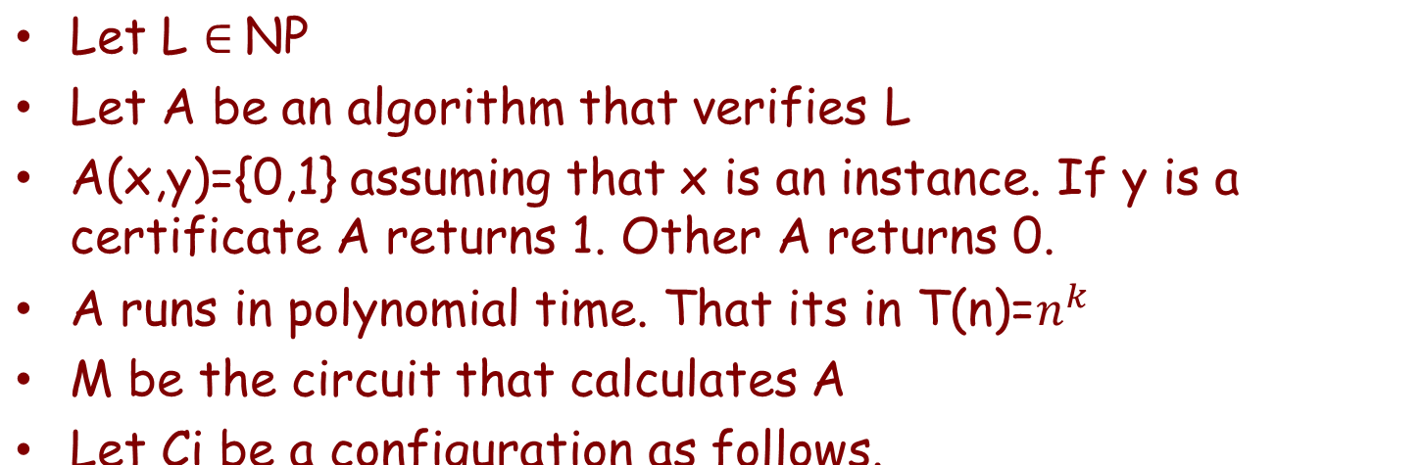
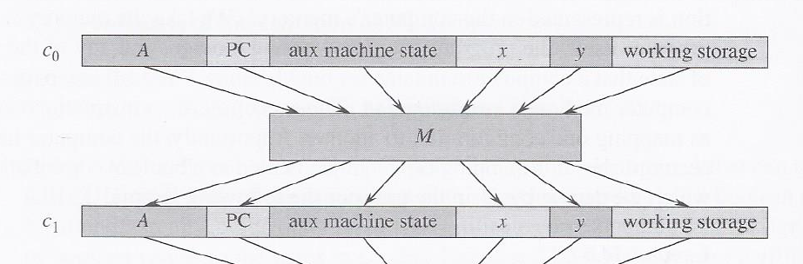
SAT is NP-complete

Slide 68
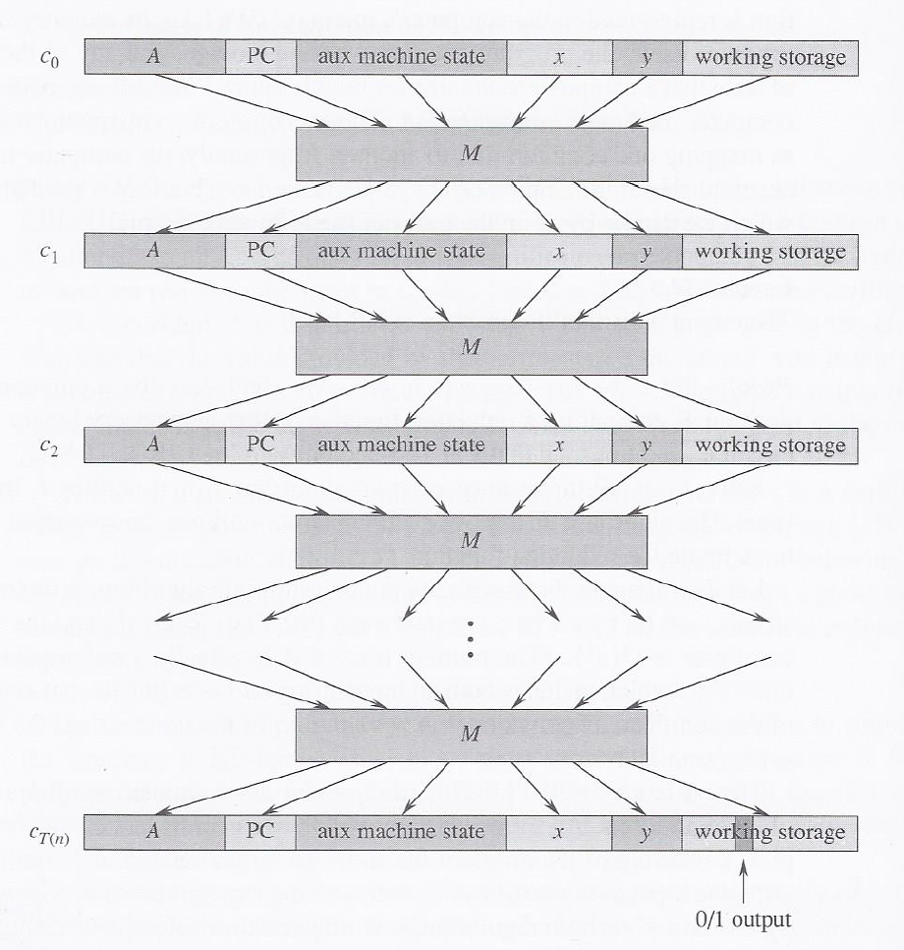
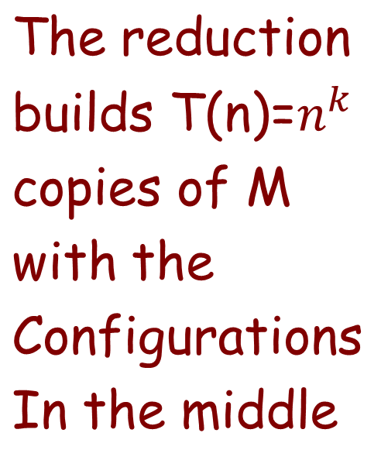

Slide 69
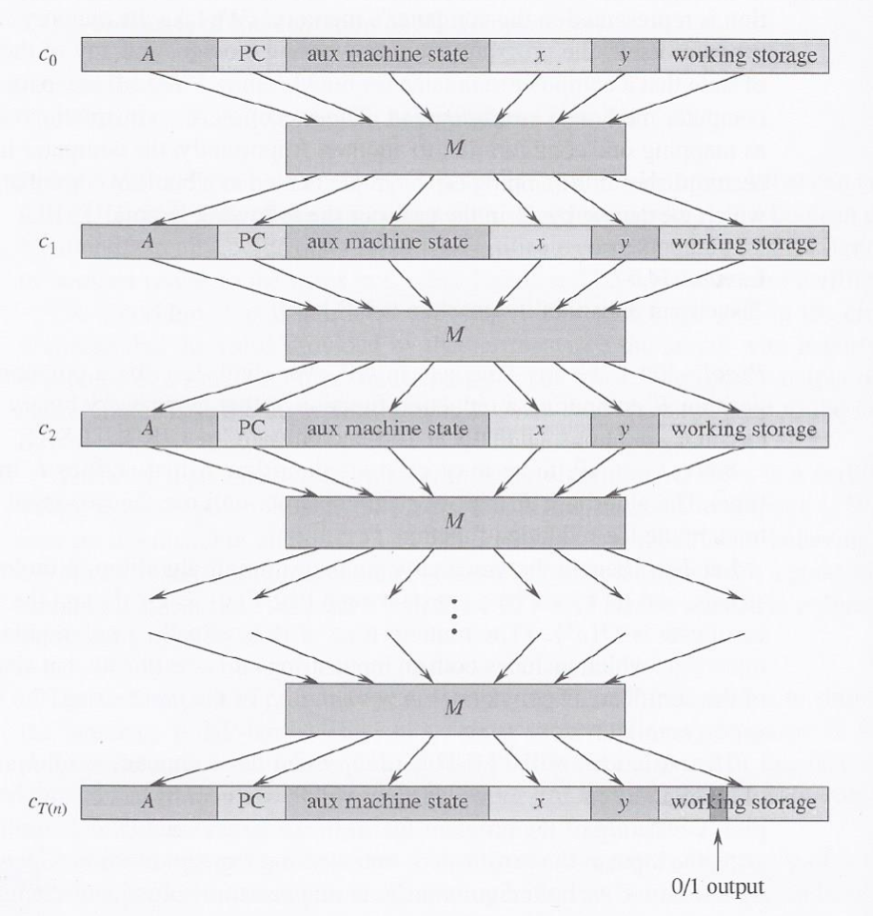
The reduction F builds T(n) copies of M with the configurations in the middle
Adds y in the beginning
Adds the output in the end
C is a circuit.
Bits (literals) of y
C
0,1

Slide 70
SAT is NP-complete
Proof that F is a reduction:
C is satisfaiable iff there exist y such that A(x,y)=1
Why? If A(x,y)=1 then y is a correct assignment to C.
If there is a correct assignment to C it can serve as y the certificate to A.
Proof for polynomial time of F
|x|=n. |y|= polynomial of n.
Depth of C = polynomial of n. (n^k).
Thus, we built C in polynomial time.

Slide 71
SAT is NP-complete
If C can be solved in polynomial time it means that we can find a certificate to X in polynomial time.
Thus P=NP

