Slide 1

Introduction to Operating Systems
Practical Session 6 – Deadlocks
Ben-Gurion University of the Negev

Slide 2
Conditions for Deadlock
Mutual exclusion:
Resource is used by only one process at any given time.
Hold and wait:
Process can request resource while holding another resource.
No preemption:
Only a process can release a resource it holds.
Circular wait:
Two or more processes waiting for resources held by other (waiting) processes.
Absence can cause loss of control of resources and harmful violations.
Absence can make programs run for longer times with more waiting time.
Absence can cause loss of important data that was not backed-up.
Almost impossible to implement, and if so, not scalable.
Absence of one of those conditions allows us to treat a deadlock that may happen in the system.

Slide 3
Solving Deadlock
Deadlock Detection & Recovery:
Detect a deadlock by finding a cyclic graph of processes and resources and recover.
Deadlock Avoidance:
Detect “safe” and “unsafe” states, for example, banker’s algorithm.
Deadlock Prevention:
Ensure that at least one of the four conditions for a deadlock is never satisfied.

Slide 4
The Banker’s Algorithm
This algorithm is one of the “deadlock avoidance” algorithms that are used to determine the system state - if the system is deadlocked.
The system state can be one of two:
Safe
The system is not deadlocked.
There is some scheduling order in which every process can run to completion, even if all of them suddenly request their maximum number of resources immediately.
Unsafe.

Slide 5
The Banker’s Algorithm
Resources:
Vectors:
E Number of Existing resources of each type.
P Number of resources of each type in Possession by the processes.
A Number of Available resources of each type.
Matrices (rows-processes, columns-resources):
C Current allocation matrix.
R Request matrix.

Slide 6
The Banker’s Algorithm
Look for a row in matrix R whose unmet resource needs are all smaller than or equal to A. If no such row exists, the system may eventually deadlock.
Assume the process of the row chosen finishes (which is possible). Mark that process as terminated and add all its resources to the A vector.
Repeat steps 1 and 2 until either all processes are marked as terminated, which means the system is safe, or until a deadlock occurs, which means the system is unsafe.

Slide 7

Question 1 : The Banker’s Algorithm
Consider the following snapshot of a system with five processes ($P1, …, P5$) and four resources ($R1,…, R4$).
A=
R₁ | R₂ | R₃ | R₄
2 | 1 | 0 | 0
 | current allocation |  |  |  | max demand |  |  |  | still needs
Process | R₁ | R₂ | R₃ | R₄ | R₁ | R₂ | R₃ | R₄ | R₁ | R₂ | R₃ | R₄
P₁ | 0 | 0 | 1 | 2 | 0 | 0 | 1 | 2
P₂ | 2 | 0 | 0 | 0 | 2 | 7 | 5 | 0
P₃ | 0 | 0 | 3 | 4 | 6 | 6 | 5 | 6
P₄ | 2 | 3 | 5 | 4 | 4 | 3 | 5 | 6
P₅ | 0 | 3 | 3 | 2 | 0 | 6 | 5 | 2

Slide 8
Question 1 – Solution
Compute what each process still might request and fill in the “still needs” columns.
 | current allocation |  |  |  | max demand |  |  |  | still needs
Process | R₁ | R₂ | R₃ | R₄ | R₁ | R₂ | R₃ | R₄ | R₁ | R₂ | R₃ | R₄
P₁ | 0 | 0 | 1 | 2 | 0 | 0 | 1 | 2
P₂ | 2 | 0 | 0 | 0 | 2 | 7 | 5 | 0
P₃ | 0 | 0 | 3 | 4 | 6 | 6 | 5 | 6
P₄ | 2 | 3 | 5 | 4 | 4 | 3 | 5 | 6
P₅ | 0 | 3 | 3 | 2 | 0 | 6 | 5 | 2
 | current allocation |  |  |  | max demand |  |  |  | still needs
Process | R₁ | R₂ | R₃ | R₄ | R₁ | R₂ | R₃ | R₄ | R₁ | R₂ | R₃ | R₄
P₁ | 0 | 0 | 1 | 2 | 0 | 0 | 1 | 2 | 0 | 0 | 0 | 0
P₂ | 2 | 0 | 0 | 0 | 2 | 7 | 5 | 0 | 0 | 7 | 5 | 0
P₃ | 0 | 0 | 3 | 4 | 6 | 6 | 5 | 6 | 6 | 6 | 2 | 2
P₄ | 2 | 3 | 5 | 4 | 4 | 3 | 5 | 6 | 2 | 0 | 0 | 2
P₅ | 0 | 3 | 3 | 2 | 0 | 6 | 5 | 2 | 0 | 3 | 2 | 0

Slide 9
Question 1 – Solution
Is this system currently deadlocked, or will any process become deadlocked? Use banker’s algorithm to support your answer.
A=
R₁ | R₂ | R₃ | R₄
2 | 1 | 0 | 0
 | current allocation |  |  |  | max demand |  |  |  | still needs
Process | R₁ | R₂ | R₃ | R₄ | R₁ | R₂ | R₃ | R₄ | R₁ | R₂ | R₃ | R₄
P₁ | 0 | 0 | 1 | 2 | 0 | 0 | 1 | 2 | 0 | 0 | 0 | 0
P₂ | 2 | 0 | 0 | 0 | 2 | 7 | 5 | 0 | 0 | 7 | 5 | 0
P₃ | 0 | 0 | 3 | 4 | 6 | 6 | 5 | 6 | 6 | 6 | 2 | 2
P₄ | 2 | 3 | 5 | 4 | 4 | 3 | 5 | 6 | 2 | 0 | 0 | 2
P₅ | 0 | 3 | 3 | 2 | 0 | 6 | 5 | 2 | 0 | 3 | 2 | 0

Slide 10
Question 1 – Solution
A=
A=
A=
A=
A=
A=
R₁ | R₂ | R₃ | R₄
2 | 1 | 0 | 0
R₁ | R₂ | R₃ | R₄
2 | 1 | 1 | 2
 | current allocation |  |  |  | still needs
Process | R₁ | R₂ | R₃ | R₄ | R₁ | R₂ | R₃ | R₄
P₁ | 0 | 0 | 1 | 2 | 0 | 0 | 0 | 0
P₂ | 2 | 0 | 0 | 0 | 0 | 7 | 5 | 0
P₃ | 0 | 0 | 3 | 4 | 6 | 6 | 2 | 2
P₄ | 2 | 3 | 5 | 4 | 2 | 0 | 0 | 2
P₅ | 0 | 3 | 3 | 2 | 0 | 3 | 2 | 0
R₁ | R₂ | R₃ | R₄
4 | 4 | 6 | 6
R₁ | R₂ | R₃ | R₄
4 | 7 | 9 | 8
R₁ | R₂ | R₃ | R₄
6 | 7 | 9 | 8
R₁ | R₂ | R₃ | R₄
6 | 7 | 12 | 12
This is the total amount of resources of the system.

Slide 11
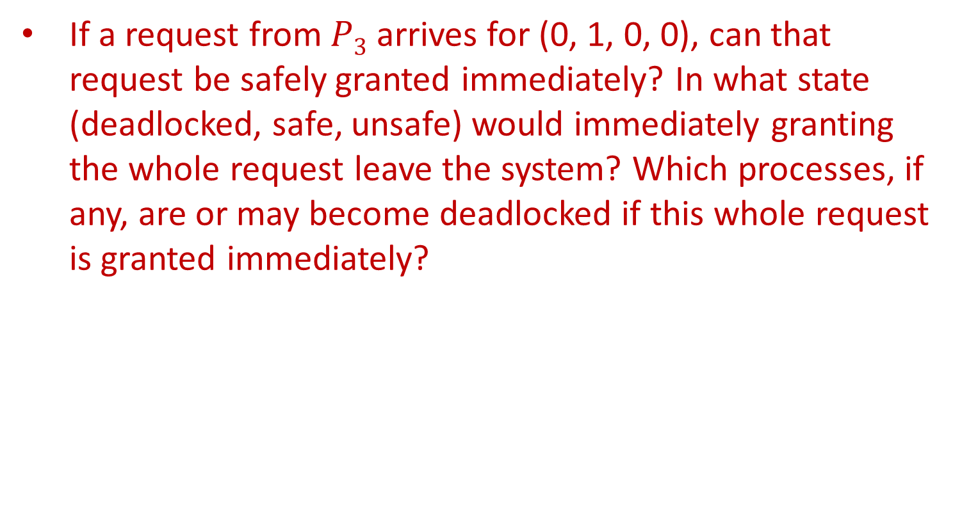
Question 1 – Solution
If a request from $P3$ arrives for (0, 1, 0, 0), can that request be safely granted immediately? In what state (deadlocked, safe, unsafe) would immediately granting the whole request leave the system? Which processes, if any, are or may become deadlocked if this whole request is granted immediately?

Slide 12

Question 1 – Solution
Let’s see what may happen if the request of $P3$would grant immediately:
A=
R₁ | R₂ | R₃ | R₄
2 | 0 | 0 | 0
 | current allocation |  |  |  | max demand |  |  |  | still needs
Process | R₁ | R₂ | R₃ | R₄ | R₁ | R₂ | R₃ | R₄ | R₁ | R₂ | R₃ | R₄
P₁ | 0 | 0 | 1 | 2 | 0 | 0 | 1 | 2 | 0 | 0 | 0 | 0
P₂ | 2 | 0 | 0 | 0 | 2 | 7 | 5 | 0 | 0 | 7 | 5 | 0
P₃ | 0 | 0 | 3 | 4 | 6 | 6 | 5 | 6 | 6 | 5 | 2 | 2
P₄ | 2 | 3 | 5 | 4 | 4 | 3 | 5 | 6 | 2 | 0 | 0 | 2
P₅ | 0 | 3 | 3 | 2 | 0 | 6 | 5 | 2 | 0 | 3 | 2 | 0

Slide 13
Question 1 – Solution
A=
A=
A=
A=
A=
A=
R₁ | R₂ | R₃ | R₄
2 | 0 | 0 | 0
R₁ | R₂ | R₃ | R₄
2 | 0 | 1 | 2
 | current allocation |  |  |  | still needs
Process | R₁ | R₂ | R₃ | R₄ | R₁ | R₂ | R₃ | R₄
P₁ | 0 | 0 | 1 | 2 | 0 | 0 | 0 | 0
P₂ | 2 | 0 | 0 | 0 | 0 | 7 | 5 | 0
P₃ | 0 | 0 | 3 | 4 | 6 | 5 | 2 | 2
P₄ | 2 | 3 | 5 | 4 | 2 | 0 | 0 | 2
P₅ | 0 | 3 | 3 | 2 | 0 | 3 | 2 | 0
R₁ | R₂ | R₃ | R₄
4 | 3 | 6 | 6
R₁ | R₂ | R₃ | R₄
4 | 6 | 9 | 8

Slide 14
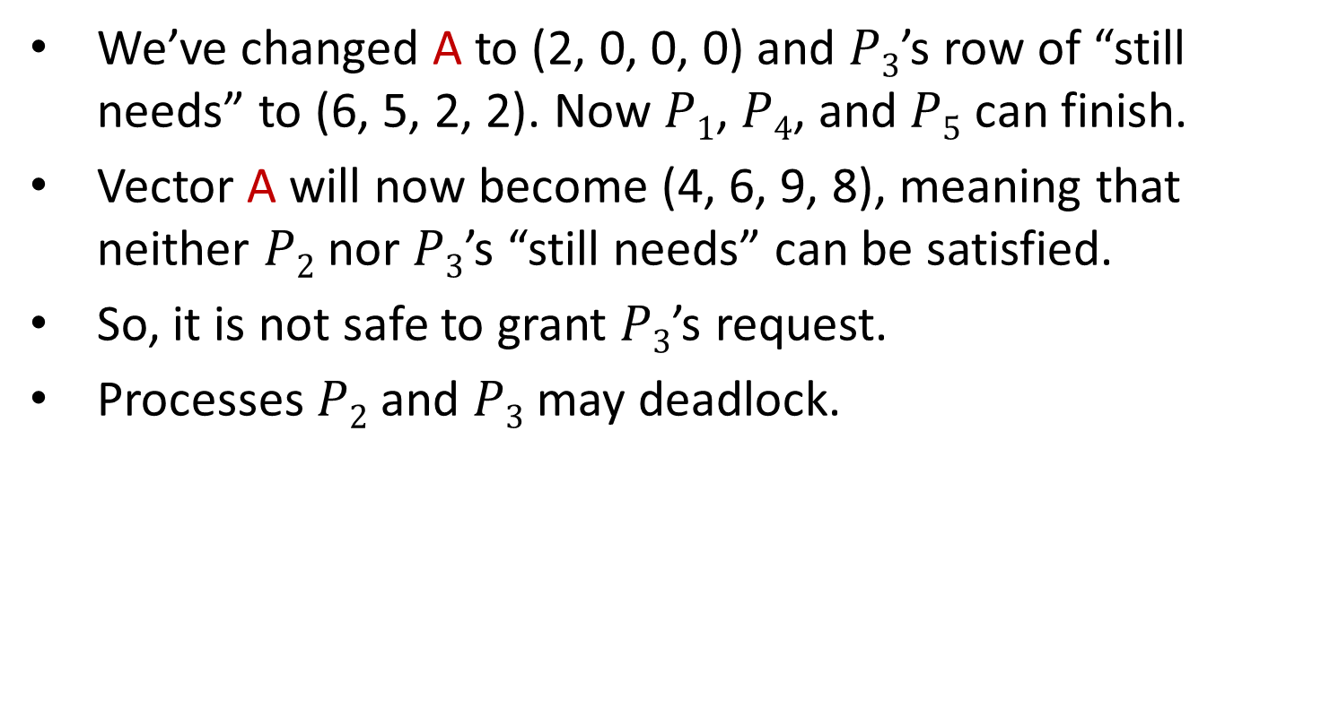
Question 1 – Solution
We’ve changed A to (2, 0, 0, 0) and $P3$’s row of “still needs” to (6, 5, 2, 2). Now $P1$, $P4$, and $P5$ can finish.
Vector A will now become (4, 6, 9, 8), meaning that neither $P2$ nor $P3$’s “still needs” can be satisfied.
So, it is not safe to grant $P3$’s request.
Processes $P2$ and $P3$ may deadlock.

Slide 15
Question 3
(7.6 from Silberschatz)
If deadlocks are controlled (avoided) by applying the banker‘s algorithm, which of the following changes can be made safely and under what circumstances:
Increase Available (add new resources).
Decrease Available (remove resources).
Increase Max for one process.
Increase the number of processes.

Slide 16
Question 3 – Solution
Increase Available (add new resources).
Increasing the number of available resources can't create a deadlock that does not exist currently, since it can only decrease the number of processes that have to wait for resources and more options to satisfy processes needs are added.

Slide 17
Question 3 – Solution
Decrease Available (remove resources).
Decreasing the number of resources can cause a deadlock, as we’ve seen in question 2.
Increase Max for one process.
Unsafe modes be created for two possible reasons:
From banker's algorithm aspect, the process can become unsafe, even if it has been safe before.
The process can ask for more than the system has in total.

Slide 18
Question 3 – Solution
Increase the number of processes.
If the number of processes is increased, the state remains safe since we can first run the “old” processes, until they terminate, and release all the resources they’re holding.
Next, we can choose a “new” process and give it all its demands. When it will finish, all of the system’s resources will be free Again, so we can choose a new process and give it all its demands, etc.

