Slide 1
Java FX
Practice 11
SISE Department at BGU
GUY SCHLESINGER ,2020
1

Slide 2
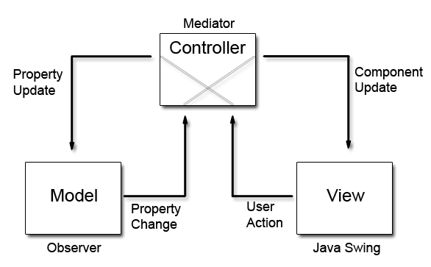
MVC
Model - the “brain” that handles the data (DB) and logic behind the program
View – responsible for the visualization of the program. It handles all the “visual logic” in the program
Controller – responsible to manage the entire program. It communicates with the model and the view and mediates between them

Slide 3
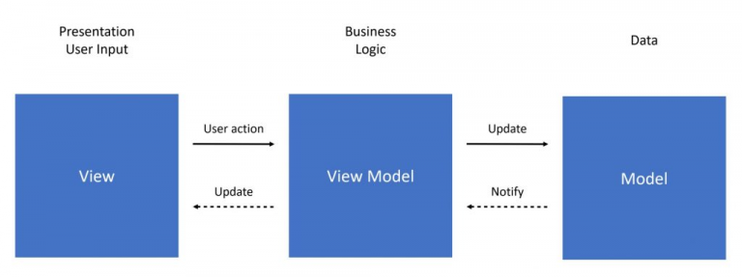
MVVM
Model - the “brain” that handles the data (DB) and logic behind the program
View Model – acts as the connection between the Model and View. Mediates between thee View and the Model
View – responsible for the visualization of the program. It handles all the “visual logic” in the program

Slide 4
MVVM vs MVC
The Model and View in both MVC and MVVM have the same role in the design pattern
The are 4 key differences between the design patterns:
Dependencies
View Model vs controller
Communication methods
Inheritance

Slide 5
Dependencies
MVVM
The View class contains an instance of the ViewModel class.
The ViewModel class contains an instance of the Model class.
The Model class is not aware of both the View and the ViewModel classes
MVC
The Controller class contains an instance of the Model class and an instance of the View class
Both View and Model classes are not aware of each other and the Controller class

Slide 6
View Model vs Controller
MVVM
Contains the ViewModel class
ViewModel only transfers data between the Model and the View while making sure the data is valid (input validation, etc.)
MVC
Contains the Controller class
the Controller is the object that manages the View and the Model + making sure the data is valid.
Notes:
The Controller does everything that the ViewModel does and more

Slide 7
Communication Methods
MVVM
The View is the object that gets notified when there is an event
The View will call the appropriate function from the ViewModel and will wait to get notified
Then, The ViewModel will call the appropriate function from the Model class and will wait to get notified.
Next, the Model will execute its function and will notify the ViewModel that it is done. After that, the ViewModel will notify the View that it is done, and the view will make the final changes.
MVC
The Controller is the object that gets notified when there is an event
The Controller will call the appropriate functions from both the Model and the View and will handle the event.

Slide 8
Inheritance
MVVM
The MVVM design pattern is based on Observer and Observable
The Model is only being observed (by the ViewModel) so it will inherit from Observable class
The ViewModel is being both observed (by the View) and observer (observes the Model). So the lass will inherit from the Observable class and will implement the Observer interface
The View only observes (The ViewModel) so it will implement the Observer interface
MVC
There is no special inheritance and implementation of interfaces

Slide 9
Lab 11
Open a new javafx project
Copy the files from the previous lab (lab 10) to the new project.
Convert the code’s architecture to MVVM

