Slide 1
Advanced Topics in Programming
LAB 8 – Java.util.concurrent

Slide 2
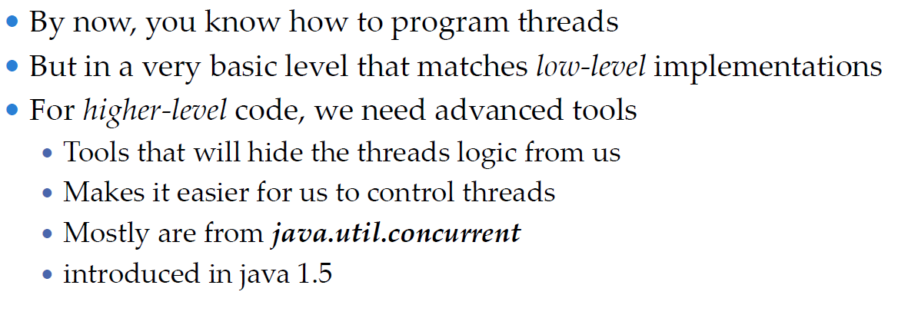
Introduction

Slide 3

Threads Scheduling
With simpler tools…

Slide 4
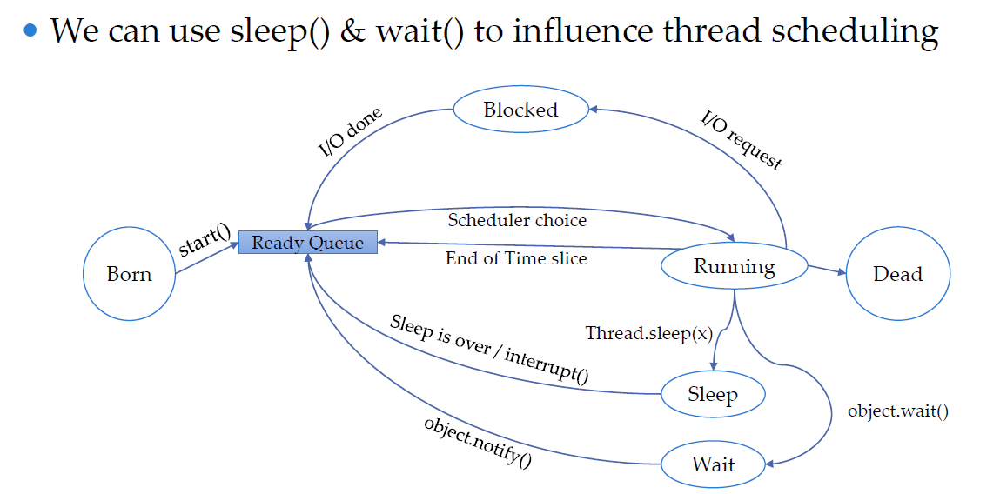
Scheduling

Slide 5
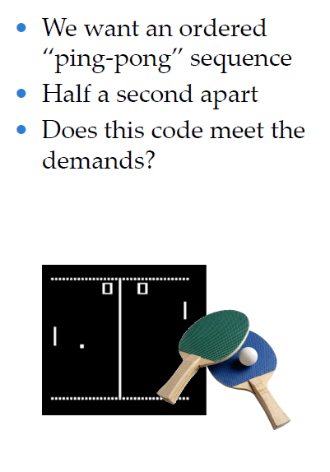
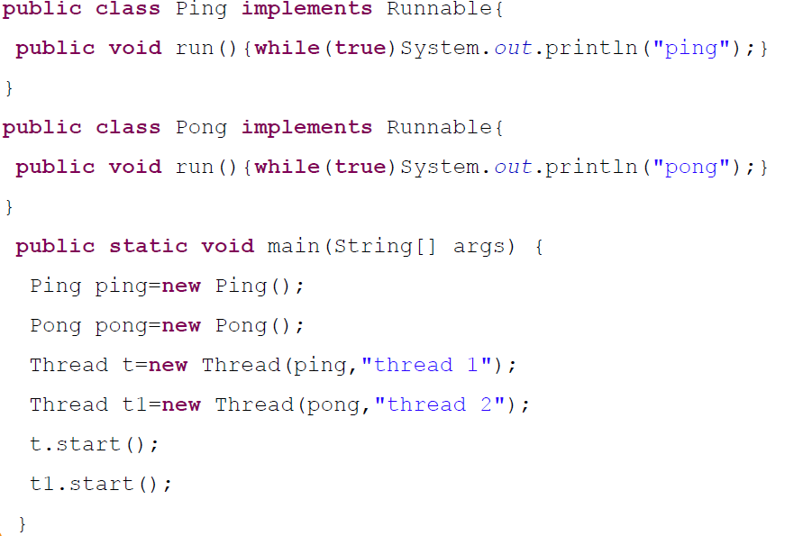
Scheduling Tasks

Slide 6
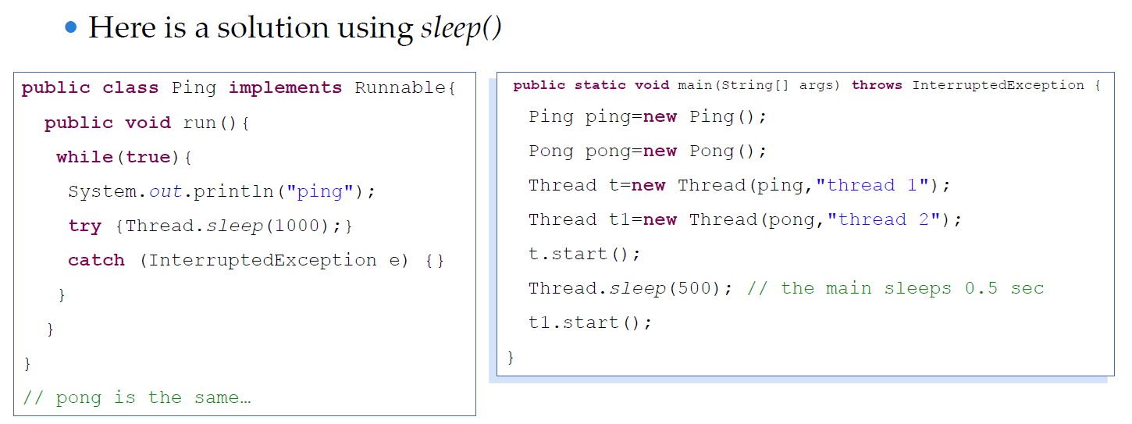
Scheduling Tasks

Slide 7
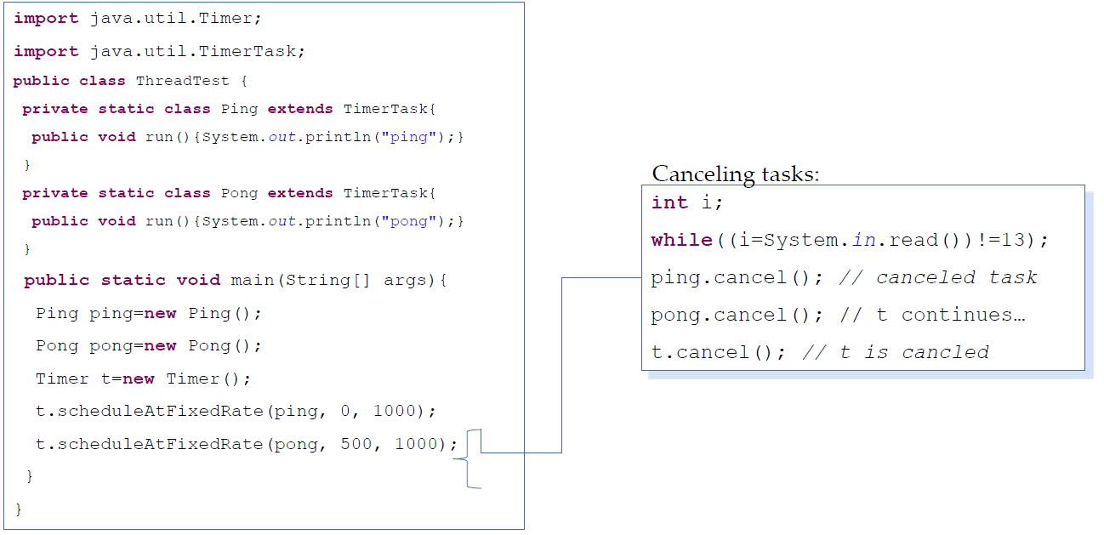
Scheduling Tasks – with a simple Timer

Slide 8
Replacing Synchronized
With faster/none-blocking locks

Slide 9
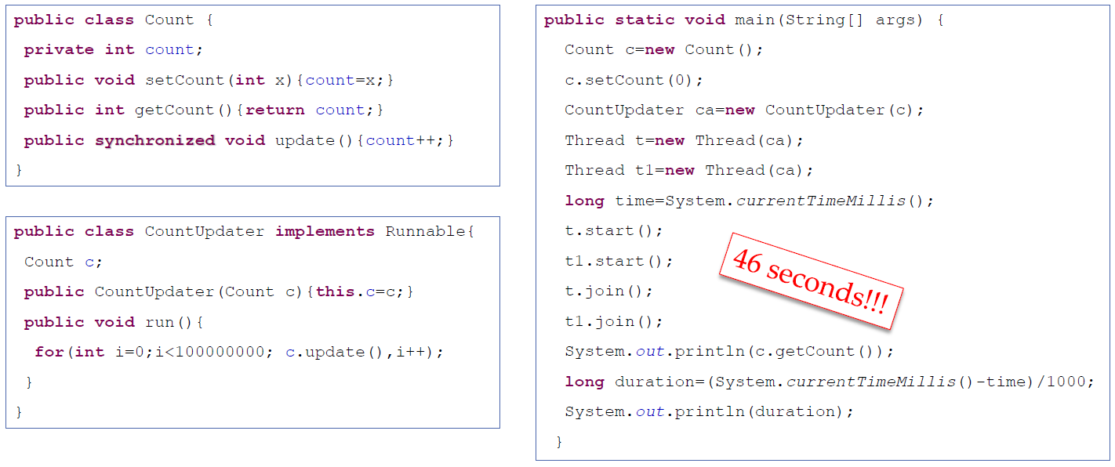
Using Synchronized is slow…

Slide 10
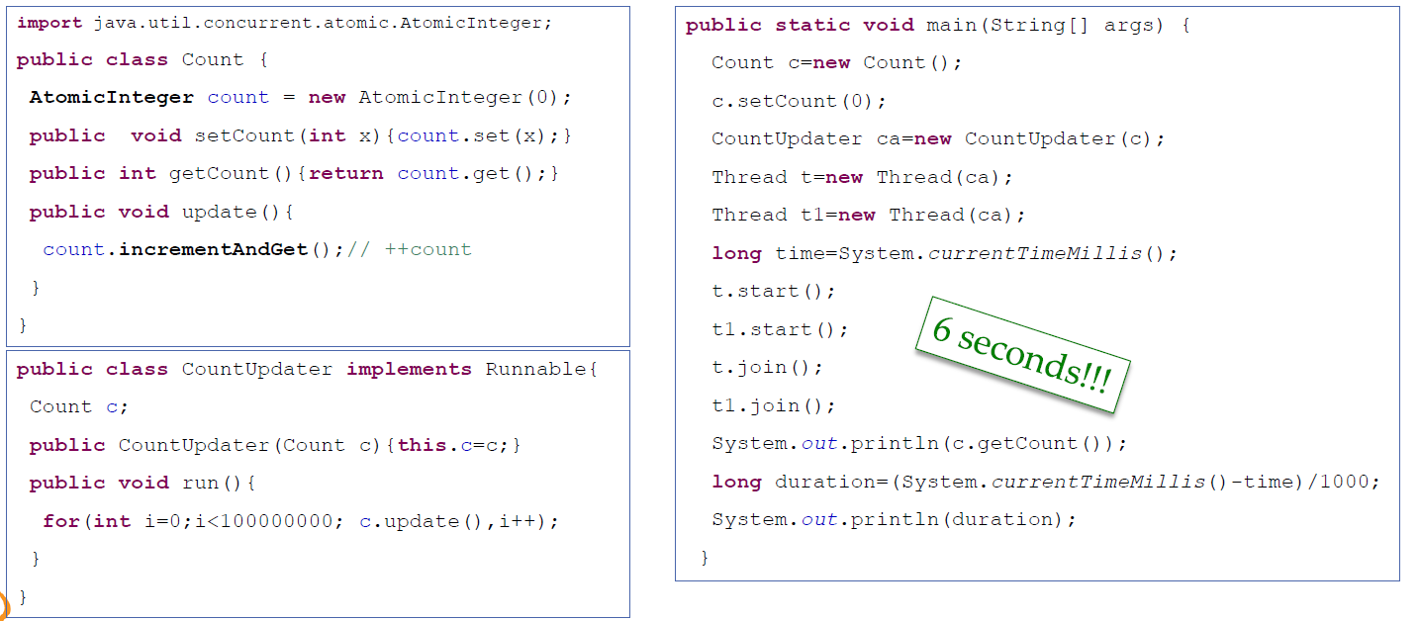
Using Atomic variables

Slide 11
Thread Pools
Executing tasks with different executors!

Slide 12
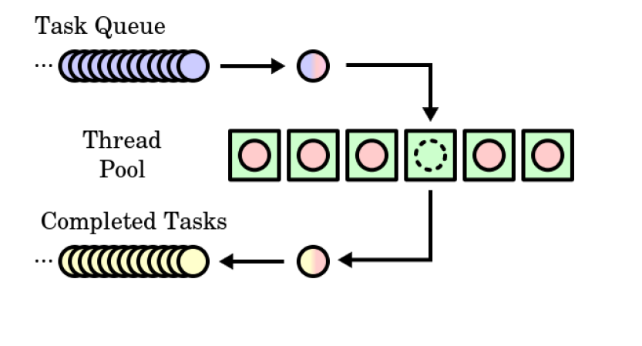
Thread Pool

Slide 13
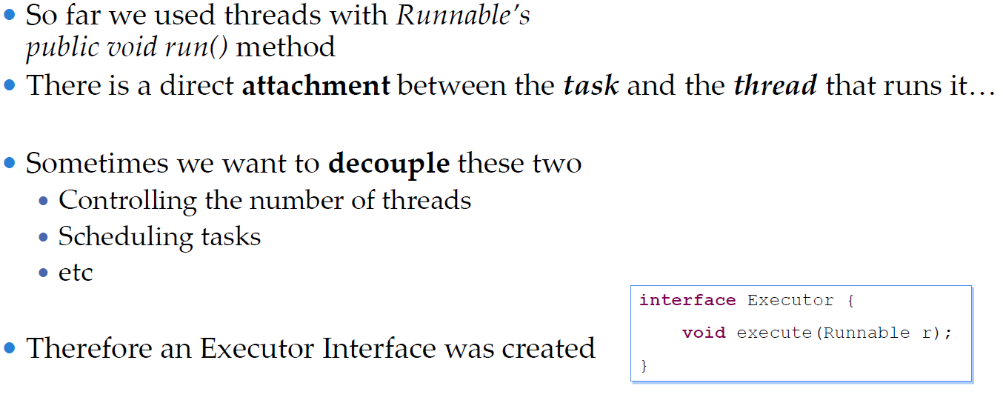
Executor Interface

Slide 14
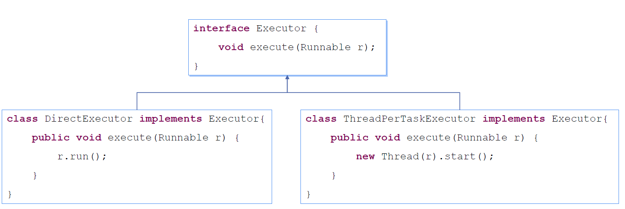
Executor Implementations Example

Slide 15
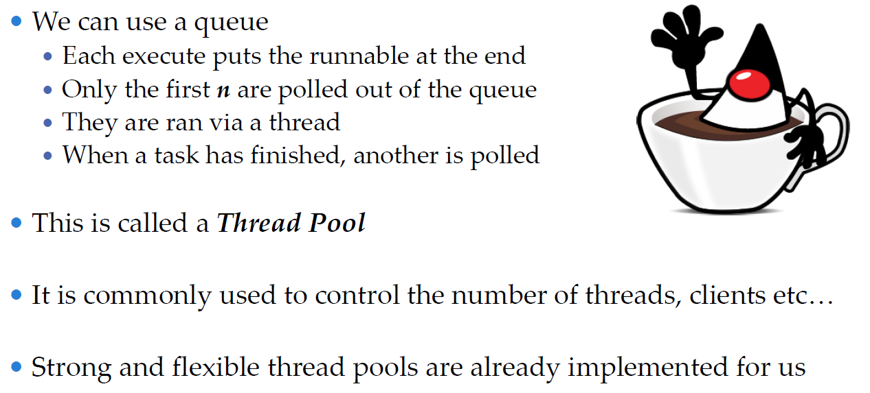
Thread Pool

Slide 16
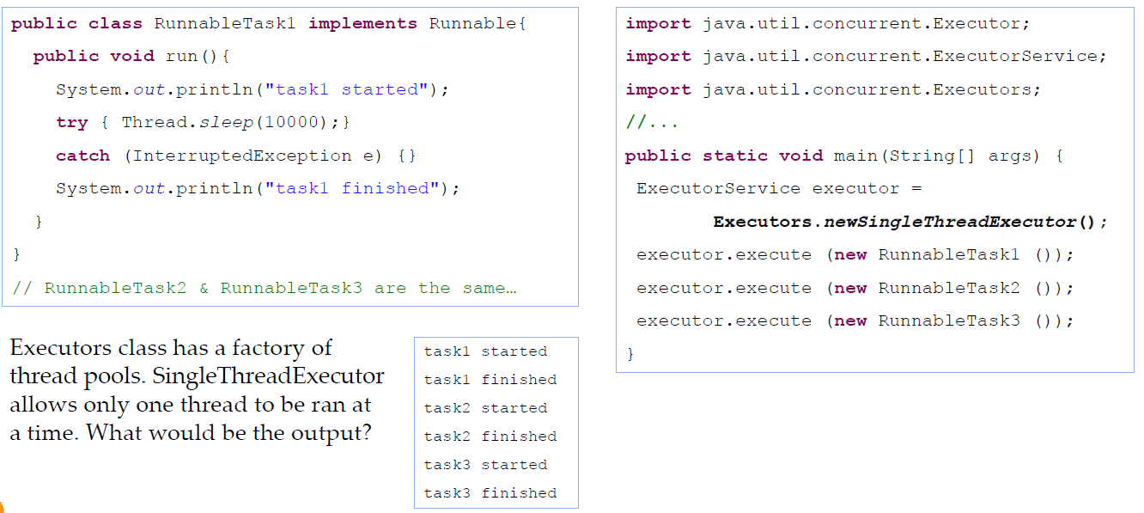
Thread Pool Example

Slide 17
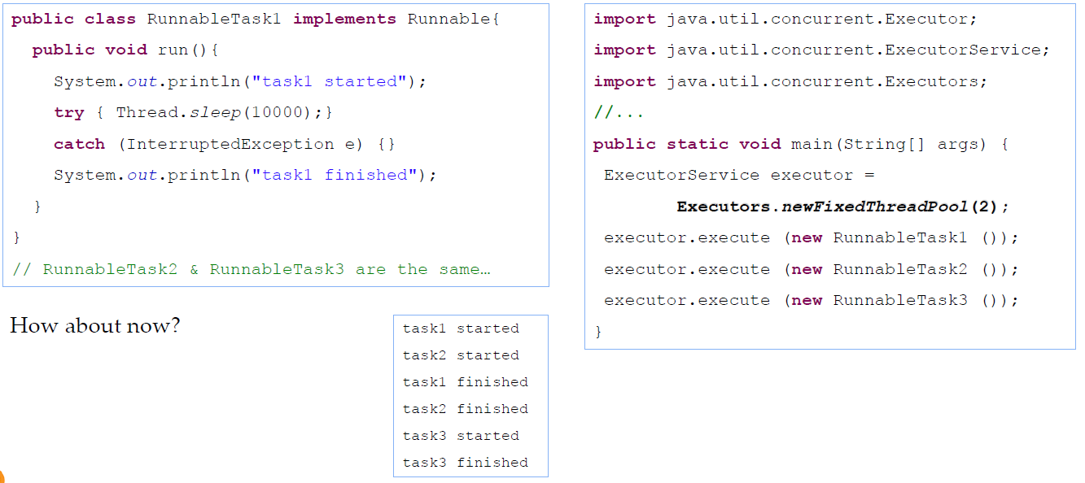
Thread Pool Example

Slide 18
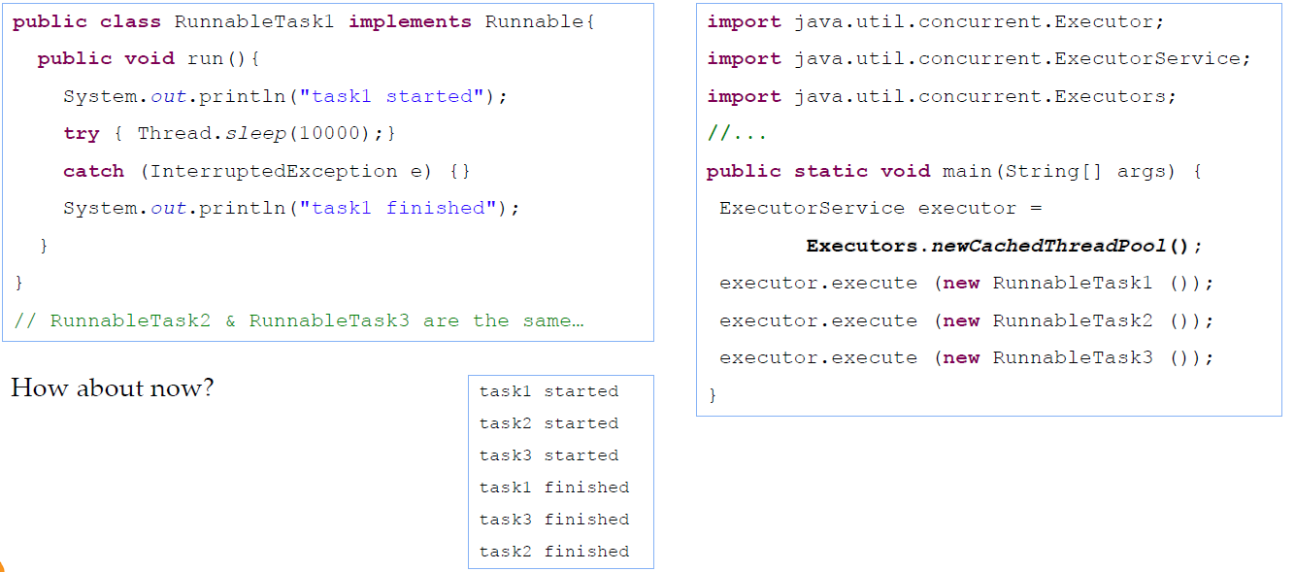
Thread Pool Example

Slide 19
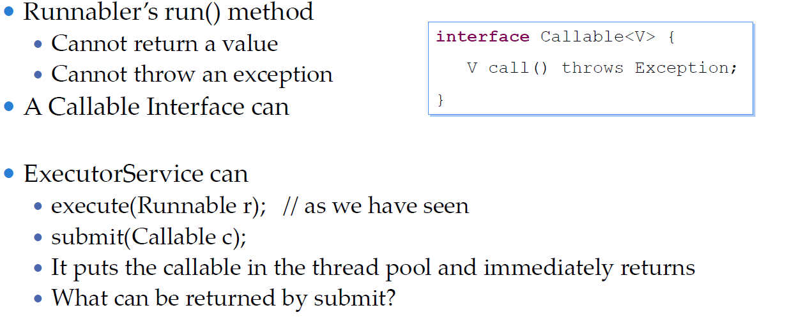
Callable

Slide 20
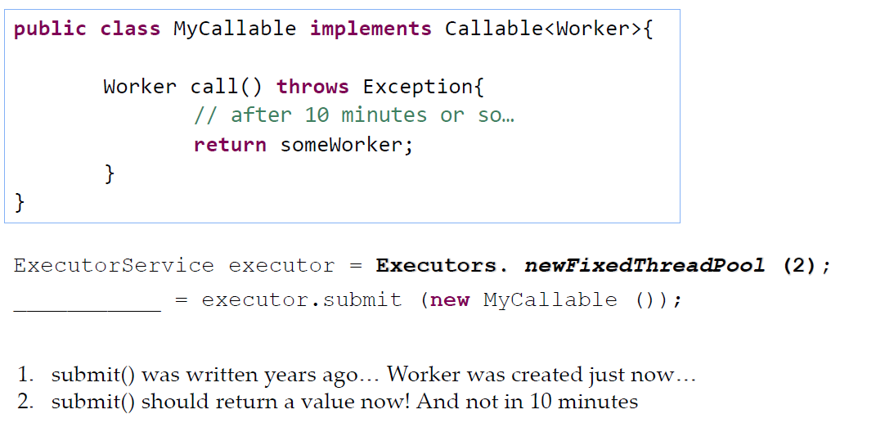
The problem

Slide 21
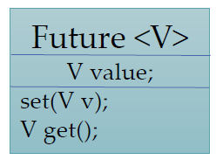
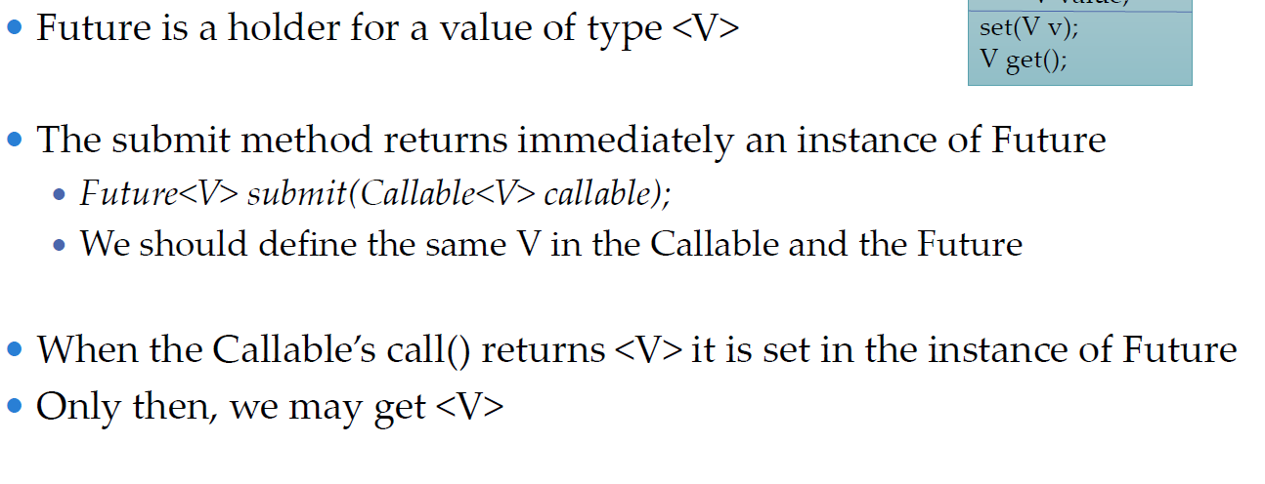
The Solution – Future!

Slide 22
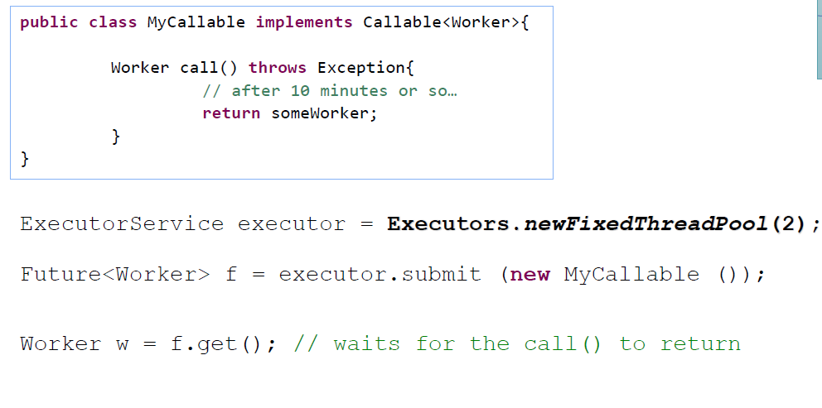
The Solution – Future!

Slide 23
Lab 8 Task
Implement the server (from the last lab) with
Thread Pool

