Slide 1
Java FX
Practice 9
SISE Department at BGU
GUY SCHLESINGER ,2020
1

Slide 2
Procedural Programing vs Event Driven Programing
Procedural Programing
Describes a sequence of steps/actions the program needs to take in order to achieve its goal
Example:
Finding largest number in an array of numbers:
Go through all the cells in the array
While preforming 1, keep in a variable “max” the largest cell that has been found until a certain point
After finishing 1, return “max”
Even Driven Programing
Describes the handling a collection of events. The control flow of the program is determined by the events that occur
Example:
Watching a Youtube video
In order to watch the video you need to click the “play” button
In order to pause the video you need to click the “pause” button

Slide 3
Listener vs Handler
Listener
An object that “listens” for an event and notify when it occurs.
Examples:
Listener that listens to keyboard press events
Listener that listens to a click of the mouse
Listener that listens to mouse movement
Handler
An object that “handles” an event after is occurred.
Examples:
handler that types a character in a Text Area after a keyboard press event
Handler that handles the case of mouse click (for example, pauses the Youtube video)
Handler that handles mouse movements (for example, Drawing the cursor)

Slide 4

Listener vs Handler example
Listener – The listener here “listens” to mouse movement events.
Handler – The handler here handles the mouse movement events. When the mouse move, the trajectory of the snake changes accordingly

Slide 5
Java FX components
Stage – Represents the GUI/window itself. We can set the size of the Stage (width & length)
Scene – Represents a collection of physical components in the stage
Layout – Defines the layout (positioning) of the GUI controls in the Scene
GUI controls – Button, Image, Text Area, etc.

Slide 6

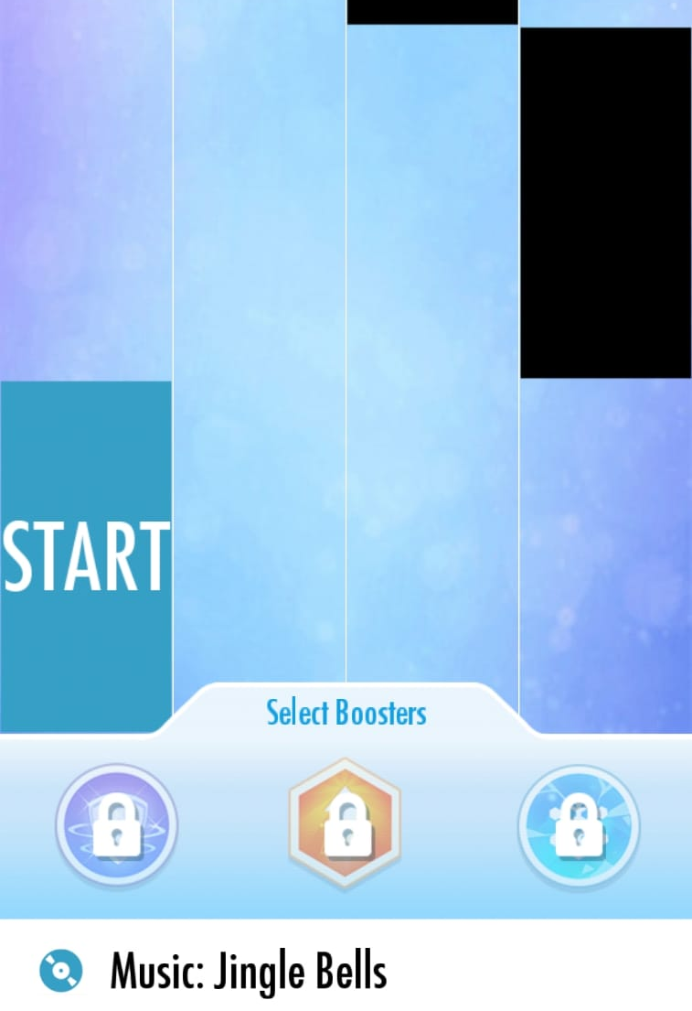
Stage vs Scene example
The Stage in this case is the window itself.
The scenes in the stage can change (like clicking the play button in order to move to the “play” scene).
Different scenes in the same stage

Slide 7
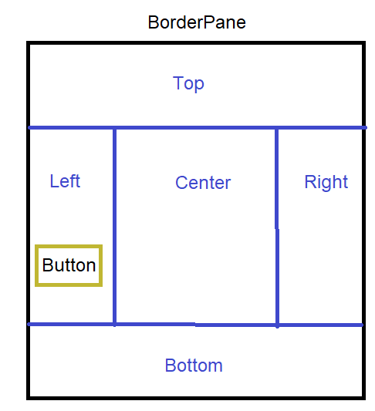
FXML file
Defines the static scene using xml-like structure. At runtime, the program will load the file and create the scene.
The FXML file is hierarchical. The tags define the static scene. Each tag has an “open” tag (<tag>) and a “close” tag (</tag>). Every tag that is between the two tags is considered inside the component.
Example:
<BorderPane>
<Left>
<Button …/>
</Left>
<BorderPane>

Slide 8
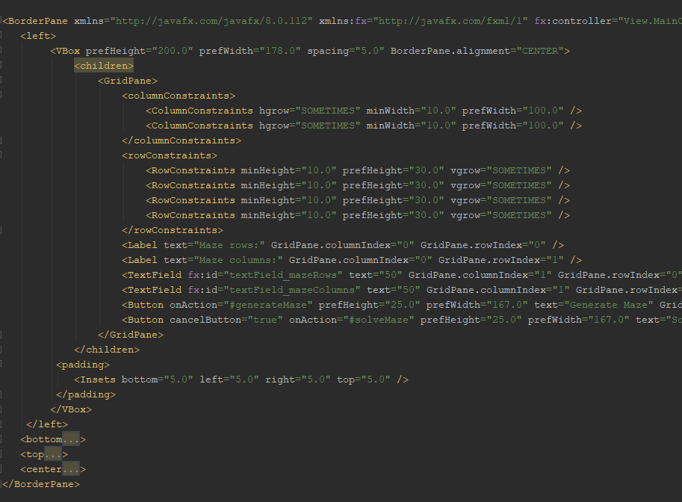
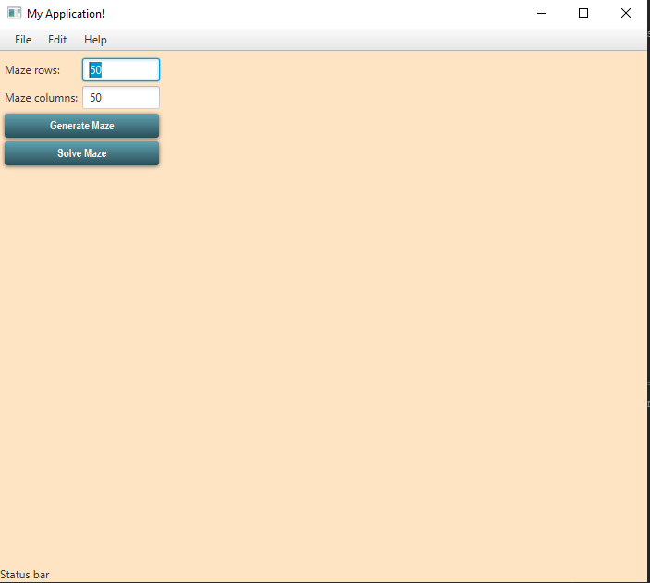
FXML file example

Slide 9
CSS file
CSS – Cascading Style Sheet. CSS is a style sheet language used for describing the presentation of a document written in a markup language like HTML.
In other words, this file is responsible for the design of the physical components in the scene.

Slide 10
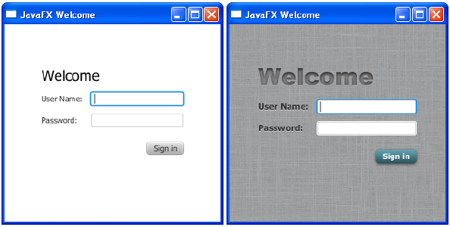
CSS Effect

Slide 11
Lab 9
Open a new Java FX project in Intelij.
Create a simple program that van generate random maze given the height and length of the maze.
Create a GUI for the program that allows the user to enter the height and width of the maze and press a button that generates a random maze (with the given size) and displays it. You will create a Ui control called MazeDisplayer that is responsible for displaying the Maze. The class will extend the canvas class.
Add a button that “solves the maze”. By pressing the button the program will create an alert with the text “solving maze”. You don’t actually need to solve the maze, only generate the Alert.

Slide 12
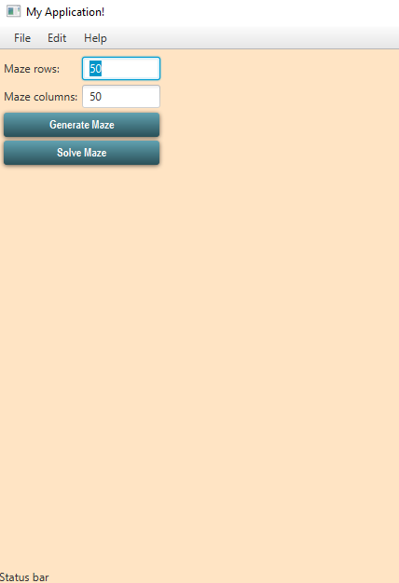
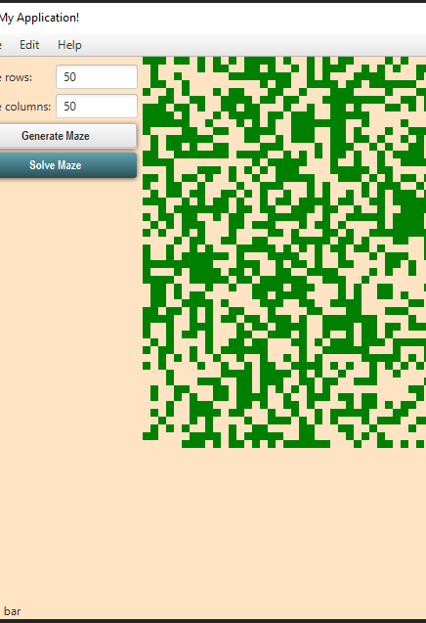
Lab 9 (cont.)
Example for The mentioned GUI:

