Slide 1
Before we start, please…
Join Slack bit.ly/binfo_slack
You will find all of these links and code in the #install channel
Download the data https://github.com/BIGslu/2022_ASM_Microbe_RNAseq/blob/main/0_data/0_data.zip
Install R cran.r-project.org
Install RStudio www.rstudio.com/products/rstudio
Install packages in RStudio console
install.packages(c("tidyverse", "lme4", "lmerTest", "BiocManager", "devtools"))
BiocManager::install(c("edgeR", "biomaRt", "limma"))
devtools::install_github("BIGslu/RNAetc")
devtools::install_github("BIGslu/kimma")

Slide 2
RNA-seq analysis in R
Kim Dill-McFarland (she/her)
Kelly Sovacool (she/her)
Holly Hartman (she/her)
Candace Williams (she/her)

Slide 3
Code of conduct
We are dedicated to providing a welcoming and supportive environment for all people, regardless of background or identity. By participating in this community, participants accept to abide by The Carpentries’ Code of Conduct. Any form of behavior to exclude, intimidate, or cause discomfort is a violation of the Code of Conduct. In order to foster a positive and professional learning environment, we encourage the following kinds of behaviors in all platforms and events:
Use welcoming and inclusive language
Be respectful of different viewpoints and experiences
Gracefully accept constructive criticism
Focus on what is best for the community
Show courtesy and respect towards other community members
https://docs.carpentries.org/topic_folders/policies/code-of-conduct.html

Slide 4
Outline
PST | MST | CST | EST
8 AM | 9 AM | 10 AM | 11 AM | Introduction and install check
8:20 AM | 9:20 AM | 10:20 AM | 11:20 AM | Introduction to R and the tidyverse
11 AM | 12 PM | 1 PM | 2 PM | Break
12 PM | 1 PM | 2 PM | 3 PM | RNAseq data cleaning
1 PM | 2 PM | 3 PM | 4 PM | Linear modeling
3 PM | 4 PM | 5 PM | 6PM | End

Slide 5
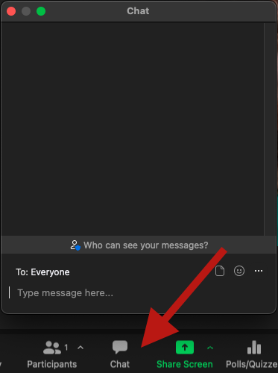
Zoom
Cameras encouraged but not required
Pet, child, and roommate cameos welcome!
Feel free to step away at any time as needed
Use Zoom chat for reactions and comments,
NOT for questions

Slide 6
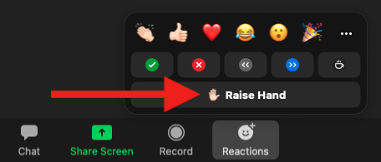
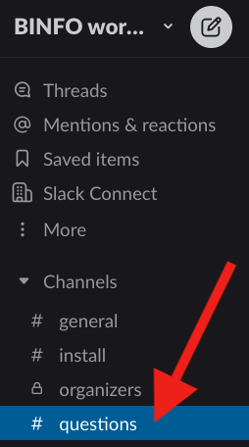
How to ask questions
In Zoom, raise hand and once called upon, use microphone
Write in the Slack channel #questions
Once an instructor is working on it, you will see ✍🏻
Once it is complete, you will see ✅
Please do not use the Zoom chat for questions as they are likely to get lost in the chatter!

Slide 7
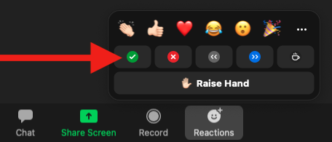
Instructors checking in
We will periodically check in to see if we can move to the next section
Use Zoom reactions to let us know
✅ You are ready to move on
❌ You need more time or have an error
If you have an error or question, be sure to ask in the #questions Slack channel!

Slide 8
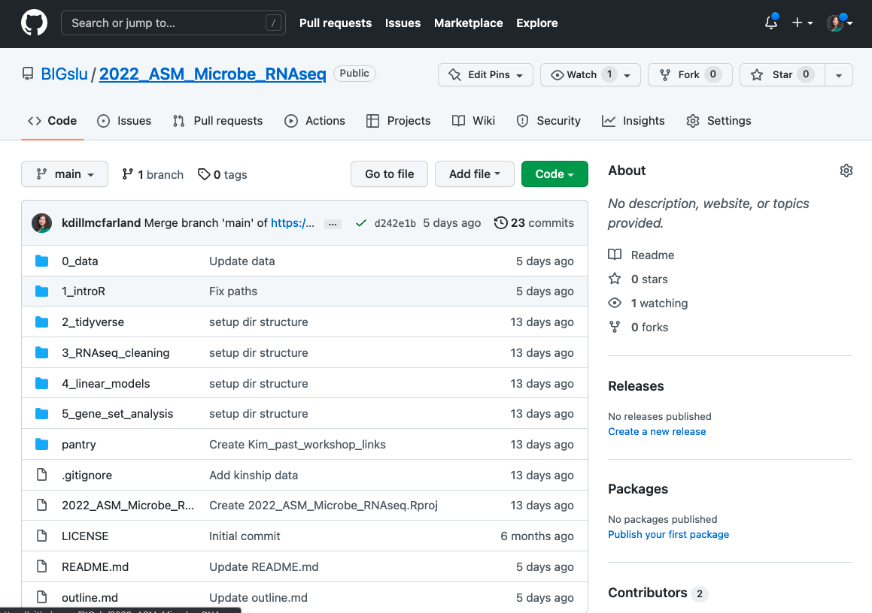
Materials
https://github.com/BIGslu/2022_ASM_Microbe_RNAseq

Slide 9
Motivation
Why write code?
More reproducible (scripts!)
Customization and control
Access high-performance and high-throughput resources
Why R?
Open-source and free
Supportive community
Statistical foundation
Well-documented and popular packages for RNAseq
We could go on… We 💜 R

Slide 10
Introduction to the data
Simmons JD, Dill-McFarland KA, et al. 2022. Monocyte transcriptional responses to Mycobacterium tuberculosis associate with resistance to tuberculin skin test and interferon gamma release assay conversion. mSphere. In press.
https://github.com/hawn-lab/RSTR_RNAseq_Mtb_public

Slide 11
Introduction to the data
Mycobacterium tuberculosis (Mtb) is the causative agent of tuberculosis (TB)
TB is among the top infectious killers worldwide… and had been for centuries
Mtb predominantly infects lung macrophages
Exposure to Mtb results in infection that is cleared, contained, or progresses to disease
Mechanisms that distinguish these outcomes are unknown

Slide 12
Experimental pipeline
Whole blood from individuals with latent tuberculosis infection (LTBI)
Media or M. tuberculosis infection, 6 hrs
Bulk RNA-sequencing
Quality filter
Align to human genome GRCh38
Count reads in exons
Isolate CD14+ monocytes from peripheral blood mononuclear cells (PBMC)

Slide 13
Raw counts data
hgnc_symbol | pt01_Media | pt01_Mtb | pt02_Media | pt02_Mtb | …
5_8S_rRNA | 20.05 | 20.01 | 7.11 | 6.06
5S_rRNA | 28.07 | 28.18 | 22.81 | 22.29
7SK | 2.28 | 1.28 | 3.1 | 1.04
A1BG | 25 | 18.3 | 16.68 | 10.79
A1BG-AS1 | 46.71 | 46.97 | 40.93 | 27.34
A1CF | 0 | 0 | 0 | 0
A2M | 1271 | 585.93 | 495.99 | 210
A2M-AS1 | 19.99 | 16.06 | 6 | 8
…

Slide 14
Sample metadata
libID | ptID | condition | age_dys | sex | ptID_old | RNAseq | methylation | total_seq
pt01_Media | pt01 | Media | 12410 | M | pt00001 | TRUE | FALSE | 9114402.2
pt01_Mtb | pt01 | Mtb | 12410 | M | pt00001 | TRUE | FALSE | 8918699.42
pt02_Media | pt02 | Media | 12775 | M | pt00002 | TRUE | FALSE | 9221554.97
pt02_Mtb | pt02 | Mtb | 12775 | M | pt00002 | TRUE | FALSE | 7733260.22
…

