Slide 1
Before we start, please…
Download the data https://github.com/BIGslu/2023.01.30_RNAseq.i4TB/blob/main/data/data.zip
Install R cran.r-project.org
Install RStudio www.rstudio.com/products/rstudio
Install packages in RStudio console
install.packages(c("tidyverse", "BiocManager", "devtools"))
BiocManager::install(c("edgeR", "biomaRt", "limma"))
devtools::install_github("BIGslu/kimma")
devtools::install_github("BIGslu/BIGpicture")

Slide 2
RNAseq differential gene and pathway expression in R
Kim Dill-McFarland, PhD (she/her)
Materials modified from a workshop in collaboration with
Kelly Sovacool, Holly Hartman PhD, Candace Williams PhD

Slide 3
Code of conduct
We are dedicated to providing a welcoming and supportive environment for all people, regardless of background or identity. By participating in this community, participants accept to abide by The Carpentries’ Code of Conduct. Any form of behavior to exclude, intimidate, or cause discomfort is a violation of the Code of Conduct. In order to foster a positive and professional learning environment, we encourage the following kinds of behaviors in all platforms and events:
Use welcoming and inclusive language
Be respectful of different viewpoints and experiences
Gracefully accept constructive criticism
Focus on what is best for the community
Show courtesy and respect towards other community members
https://docs.carpentries.org/topic_folders/policies/code-of-conduct.html

Slide 4
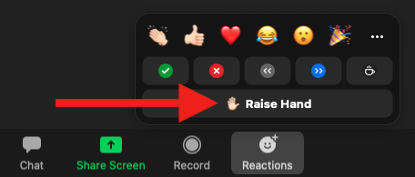
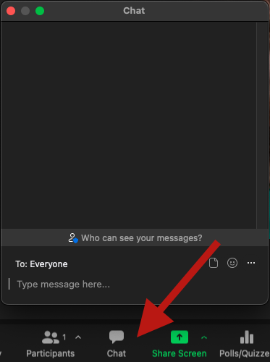
How to ask questions
In Zoom, raise hand and once called upon, use microphone
Or use Zoom chat for reactions, comments, and questions

Slide 5
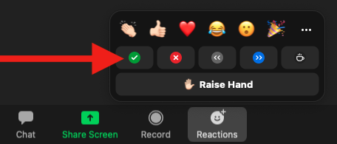
Instructors checking in
We will periodically check in to see if we can move to the next section
Use Zoom reactions to let us know
✅ You are ready to move on
❌ You need more time or have an error

Slide 6
Recording
This workshop will be recorded and made publicly available on YouTube
We will pause recording periodically to allow questions from those who do not wish to be recorded

Slide 7
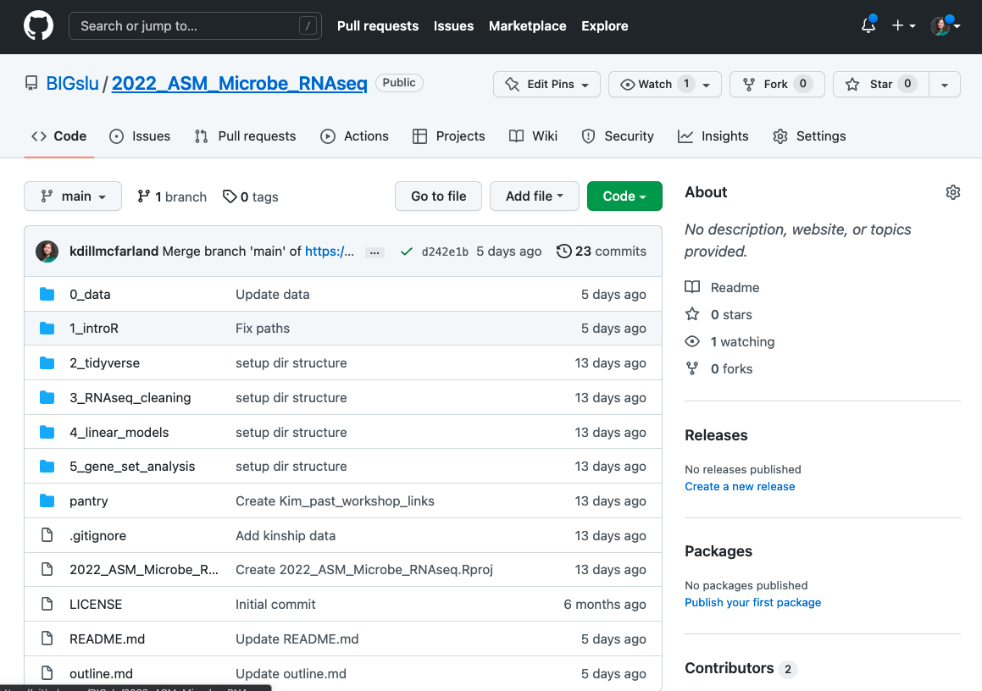
Materials
https://github.com/BIGslu/2022_ASM_Microbe_RNAseq

Slide 8
Introduction to the data
Simmons JD, Dill-McFarland KA, et al. 2022. Monocyte transcriptional responses to Mycobacterium tuberculosis associate with resistance to tuberculin skin test and interferon gamma release assay conversion. mSphere. In press.
https://github.com/hawn-lab/RSTR_RNAseq_Mtb_public

Slide 9
Introduction to the data
Mycobacterium tuberculosis (Mtb) is the causative agent of tuberculosis (TB)
TB is among the top infectious killers worldwide… and had been for centuries
Mtb predominantly infects lung macrophages
Exposure to Mtb results in infection that is cleared, contained, or progresses to disease
Mechanisms that distinguish these outcomes are unknown

Slide 10
Experimental pipeline
Whole blood from individuals with latent tuberculosis infection (LTBI)
Media or M. tuberculosis infection, 6 hrs
Bulk RNA-sequencing
Isolate CD14+ monocytes from peripheral blood mononuclear cells (PBMC)

Slide 11
Analytical pipeline
Quality filter sequences
Align to human genome GRCh38
Count reads in exons
Filter abundant, protein-coding genes
Normalize and log2 transform
Quality filter samples (total sequences, median CV, PCA)
Details at
https://bigslu.github.io/SEAsnake/
Details at https://bigslu.github.io/tutorials/RNAseq/2.RNAseq_counts.to.voom.html

Slide 12
Normalized counts data
rowname | pt01_Media | pt01_Mtb | pt02_Media | pt02_Mtb | …
A1BG | 1.62 | 1.72 | 1.09 | 1.1
A2M | 7.26 | 6.68 | 5.94 | 5.32
A2ML1 | -4.05 | -3.52 | -4.02 | -1.82
A4GALT | -0.88 | 2.16 | -1.21 | 0.99
AAAS | 4.03 | 3.58 | 3.75 | 3.89
AACS | 3.28 | 3.56 | 3.66 | 3.39
AAGAB | 5.33 | 5.26 | 5.21 | 5.05
AAK1 | 7.25 | 6.67 | 6.99 | 6.64
…

Slide 13
Sample metadata
libID | ptID | condition | age_dys | sex | ptID_old | RNAseq | methylation | total_seq
pt01_Media | pt01 | Media | 12410 | M | pt00001 | TRUE | FALSE | 9114402.2
pt01_Mtb | pt01 | Mtb | 12410 | M | pt00001 | TRUE | FALSE | 8918699.42
pt02_Media | pt02 | Media | 12775 | M | pt00002 | TRUE | FALSE | 9221554.97
pt02_Mtb | pt02 | Mtb | 12775 | M | pt00002 | TRUE | FALSE | 7733260.22
…

