Slide 1
Before we start, please…
Download the data https://github.com/BIGslu/workshops/raw/main/setup/data/data.zip
Install R cran.r-project.org
Install RStudio www.rstudio.com/products/rstudio
Install packages in RStudio console
install.packages("tidyverse")
install.packages("BiocManager")
BiocManager::install("limma")

Slide 2
Introduction to R R-Ladies workshop
Kim Dill-McFarland (she/her)
Senior bioinformatician, U. of Washington

Slide 3

A local chapter of R-Ladies Global, R-Ladies Seattle exists to promote diversity in the R community, both in the US and worldwide. We are pro-actively inclusive of queer, trans, and all minority identities with additional sensitivity to intersectional identities (which many lead R-Ladies are). Our priority is to provide a safe community space for anyone identifying as a minority gender who is interested in R.
https://rladiesseattle.org/

Slide 4
Code of conduct
R-Ladies is dedicated to providing a harassment-free experience for everyone. We do not tolerate harassment of participants in any form.
This code of conduct applies to all R-Ladies spaces, including meetups, Twitter, Slack, mailing lists, both online and offline. Anyone who violates this code of conduct may be sanctioned or expelled from these spaces at the discretion of the Global Leadership Team.
Reporting at reporting@rladies.org
https://rladies.org/code-of-conduct/

Slide 5
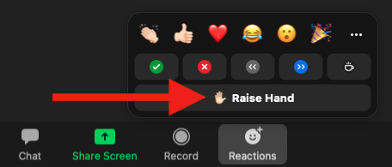
Questions
Zoom
In Zoom, raise hand and once called upon, use microphone
Post in the chat

Slide 6
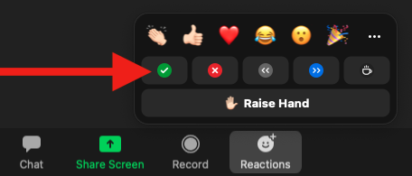
Checking in
Zoom
Use Zoom reactions
✅ You are ready to move on
❌ You need more time or have an error

Slide 7
Recording
This workshop will be recorded and shared on YouTube (private link)
We will pause recording periodically to allow questions from those who do not wish to be recorded

Slide 8
Motivation
Why write code?
More reproducible (scripts!)
Customization and control
Access high-performance and high-throughput resources
Why R?
Open-source and free
Supportive community
Statistical foundation
Well-documented and popular packages for RNAseq
We could go on… We 💜 R

Slide 9
Introduction to the data
Simmons JD, Dill-McFarland KA, et al. 2022. Monocyte transcriptional responses to Mycobacterium tuberculosis associate with resistance to tuberculin skin test and interferon gamma release assay conversion. mSphere. In press.
https://github.com/hawn-lab/RSTR_RNAseq_Mtb_public

Slide 10
Introduction to the data
Mycobacterium tuberculosis (Mtb) is the causative agent of tuberculosis (TB)
TB is among the top infectious killers worldwide… and had been for centuries
Mtb predominantly infects lung macrophages
Exposure to Mtb results in infection that is cleared, contained, or progresses to disease
Mechanisms that distinguish these outcomes are unknown

Slide 11
Experimental pipeline
Whole blood from individuals with latent tuberculosis infection (LTBI)
Media or M. tuberculosis infection, 6 hrs
Bulk RNA-sequencing
Quality filter
Align to human genome GRCh38
Count reads in exons
Isolate CD14+ monocytes from peripheral blood mononuclear cells (PBMC)

