Slide 1
Before we start, please…
Install R cran.r-project.org
Install RStudio www.rstudio.com/products/rstudio
Install packages in RStudio console
install.packages(c("tidyverse”, "BiocManager”, "devtools"))
BiocManager::install(c("edgeR", "biomaRt", "limma"))
devtools::install_github("BIGslu/RNAetc")
devtools::install_github("BIGslu/kimma")
devtools::install_github("BIGslu/SEARchways")
devtools::install_github("BIGslu/BIGpicture")
(Can copy from https://bigslu.github.io/workshops/setup/setup.html)

Slide 2
RNAseq differential gene and pathway expression in R
Kim Dill-McFarland, PhD (she/her)
Materials modified from a workshop in collaboration with
Kelly Sovacool MSc, Holly Hartman PhD, Candace Williams PhD

Slide 3
Code of conduct
We are dedicated to providing a welcoming and supportive environment for all people, regardless of background or identity. By participating in this community, participants accept to abide by The Carpentries’ Code of Conduct. Any form of behavior to exclude, intimidate, or cause discomfort is a violation of the Code of Conduct. In order to foster a positive and professional learning environment, we encourage the following kinds of behaviors in all platforms and events:
Use welcoming and inclusive language
Be respectful of different viewpoints and experiences
Gracefully accept constructive criticism
Focus on what is best for the community
Show courtesy and respect towards other community members
https://docs.carpentries.org/topic_folders/policies/code-of-conduct.html

Slide 4
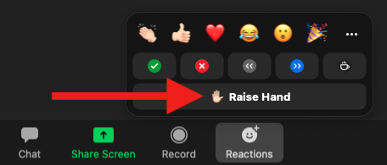
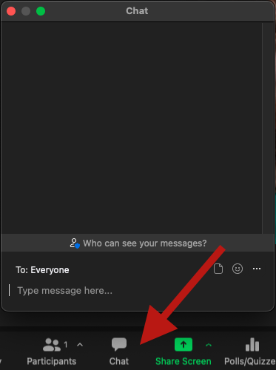
How to ask questions
In Zoom, raise hand and once called upon, use microphone
Or use Zoom chat for reactions, comments, and questions

Slide 5
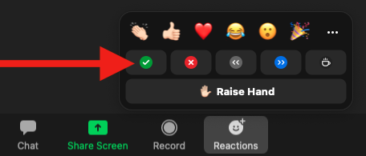
Instructors checking in
We will periodically check in to see if we can move to the next section
Use Zoom reactions to let us know
✅ You are ready to move on
❌ You need more time or have an error

Slide 6
Recording
This workshop will be recorded and made available on YouTube
We will pause recording periodically to allow questions from those who do not wish to be recorded

Slide 7
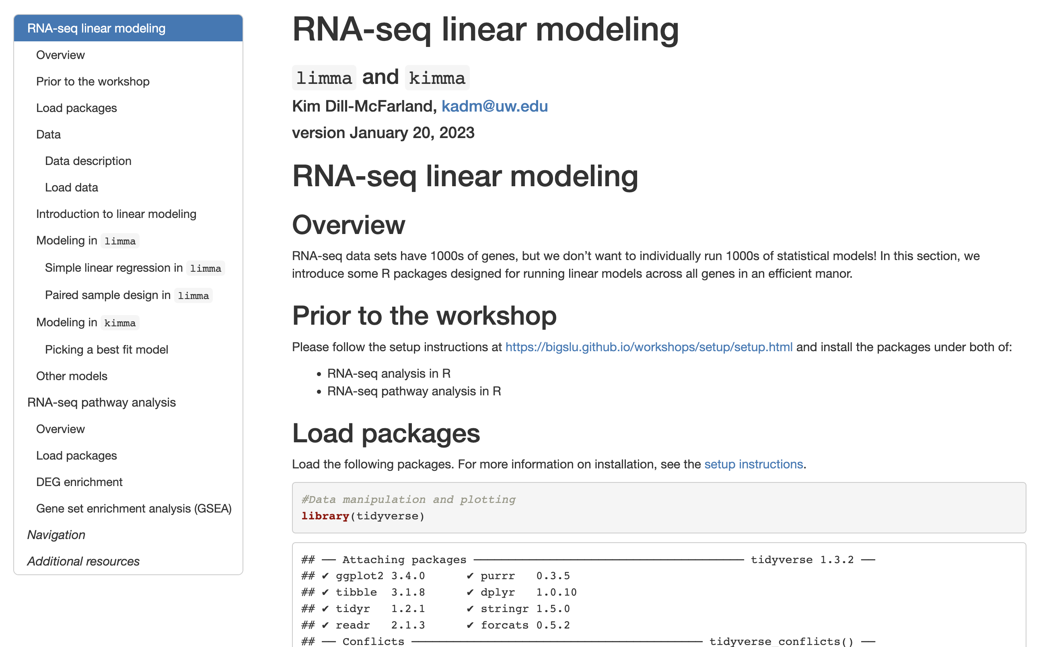
Materials
https://bigslu.github.io/workshops/2023.01.30_RNAseq.i4TB/2_linear_model_rnaseq.html

Slide 8
Introduction to the data
Dill-McFarland KA, Schwartz JT, Zhao H, Shao B, Fulkerson PC, Altman MC, Gill MA. 2022. Eosinophil-mediated suppression and Anti-IL-5 enhancement of plasmacytoid dendritic cell interferon responses in asthma. J Allergy Clin Immunol. 150(3): 666-675
10.1016/j.jaci.2022.03.025
https://github.com/altman-lab/P259_pDC_public

Slide 9
Introduction to the data
Human plasmacytoid dendritic cells (pDC)
+/- Rhinovirus (RV)
+/- Asthma
+/- Anti-IL-5Ra therapy (not explored in this workshop)
pDC are antigen-presenting cells with high IFNα response to virus
RV is a leading cause of exacerbation among asthmatic children (commonly referred to as “asthma attack”)

Slide 10
Experimental pipeline
Whole blood
Media or RV infection, 24 hrs
Bulk RNA-sequencing
Isolate pDC

Slide 11
Analytical pipeline
Quality filter sequences
Align to human genome GRCh38
Count reads in exons
Filter abundant, protein-coding genes
Normalize and log2 transform
Quality filter samples (total sequences, median CV, PCA)
Details at
https://bigslu.github.io/SEAsnake/
Details at https://bigslu.github.io/tutorials/RNAseq/2.RNAseq_counts.to.voom.html

Slide 12
Normalized counts data
rowname | lib1 | lib2 | lib3 | lib4 | …
ENSG00000000460 | 1.62 | 1.72 | 1.09 | 1.1
ENSG00000001460 | 7.26 | 6.68 | 5.94 | 5.32
ENSG00000002587 | -4.05 | -3.52 | -4.02 | -1.82
ENSG00000005189 | -0.88 | 2.16 | -1.21 | 0.99
ENSG00000005801 | 4.03 | 3.58 | 3.75 | 3.89
ENSG00000005884 | 3.28 | 3.56 | 3.66 | 3.39
ENSG00000006025 | 5.33 | 5.26 | 5.21 | 5.05
ENSG00000006118 | 7.25 | 6.67 | 6.99 | 6.64
…

