Slide 1
Before we start, please…
Join Slack bit.ly/BIGslu and the channel #2022-08_r-workshop
Download the data https://github.com/BIGslu/workshops/raw/main/2022.08.15_R.tidyverse.workshop/data/data.zip
Install R cran.r-project.org
Install RStudio www.rstudio.com/products/rstudio
Install packages in RStudio console
install.packages(c("tidyverse", "BiocManager", ”ggrepel"))
BiocManager::install(c("limma"))

Slide 2
Introduction to R and the tidyverse: RNA-seq edition
Kim Dill-McFarland (she/her)
Madison Cox (she/her)
Tomasz Janczyk (he/him)
Basilin Benson (he/him)

Slide 3
Code of conduct
We are dedicated to providing a welcoming and supportive environment for all people, regardless of background or identity. By participating in this community, participants accept to abide by The Carpentries’ Code of Conduct. Any form of behavior to exclude, intimidate, or cause discomfort is a violation of the Code of Conduct. In order to foster a positive and professional learning environment, we encourage the following kinds of behaviors in all platforms and events:
Use welcoming and inclusive language
Be respectful of different viewpoints and experiences
Gracefully accept constructive criticism
Focus on what is best for the community
Show courtesy and respect towards other community members
https://docs.carpentries.org/topic_folders/policies/code-of-conduct.html

Slide 4
Outline
Date | PST
Mon 8/15 | 1 - 2 PM | Introduction to R and RStudio, session 1
 | 3 - 4 PM | Introduction to R and RStudio, session 2
Wed 8/17 | 1 - 4:30 PM | Data manipulation in dplyr and tidyr
Thu 8/18 | 1 - 4:30 PM | Data visualization in ggplot

Slide 5
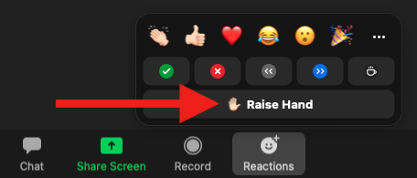
Questions
In-person
Zoom
Raise hand at any time
Use Pink Post-It
In Zoom, raise hand and once called upon, use microphone
Please do not use the chat for questions
Write in the Slack channel #2022-08_r-workshop
Once it is complete, you will see ✅
If relevant to the larger group, instructor will repeat aloud and address it

Slide 6
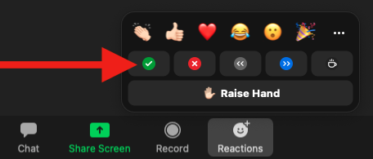
Checking in
In-person
Zoom
Use Post-Its
Green: Ready to move on
Pink: You need more time or have an error
Use Zoom reactions
✅ You are ready to move on
❌ You need more time or have an error

Slide 7
Recording
This workshop will be recorded and shared on YouTube
We will pause recording periodically to allow questions from those who do not wish to be recorded
You can also always post questions in Slack to avoid being recorded

Slide 8
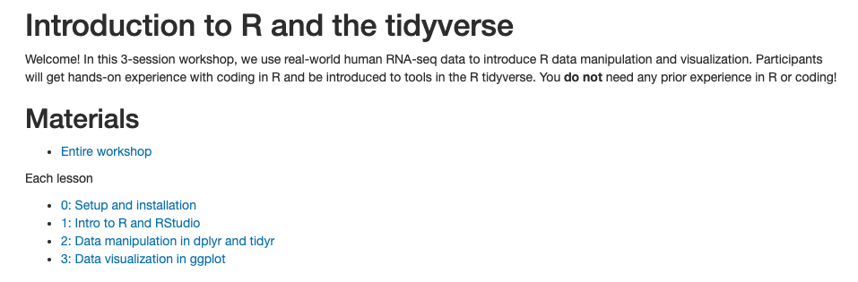
Materials
https://bigslu.github.io/workshops/2022.08.15_R.tidyverse.workshop/index.html

Slide 9
Motivation
Why write code?
More reproducible (scripts!)
Customization and control
Access high-performance and high-throughput resources
Why R?
Open-source and free
Supportive community
Statistical foundation
Well-documented and popular packages for RNAseq
We could go on… We 💜 R

Slide 10
Introduction to the data
Simmons JD, Dill-McFarland KA, et al. 2022. Monocyte transcriptional responses to Mycobacterium tuberculosis associate with resistance to tuberculin skin test and interferon gamma release assay conversion. mSphere. In press.
https://github.com/hawn-lab/RSTR_RNAseq_Mtb_public

Slide 11
Introduction to the data
Mycobacterium tuberculosis (Mtb) is the causative agent of tuberculosis (TB)
TB is among the top infectious killers worldwide… and had been for centuries
Mtb predominantly infects lung macrophages
Exposure to Mtb results in infection that is cleared, contained, or progresses to disease
Mechanisms that distinguish these outcomes are unknown

Slide 12
Experimental pipeline
Whole blood from individuals with latent tuberculosis infection (LTBI)
Media or M. tuberculosis infection, 6 hrs
Bulk RNA-sequencing
Quality filter
Align to human genome GRCh38
Count reads in exons
Isolate CD14+ monocytes from peripheral blood mononuclear cells (PBMC)

