Slide 1
Qubit vs Neuron
A comparative case study of quantum and classical neural networks
Variational Quantum Classifier vs PyTorch MLP
Iris · Two Moons · Concentric Circles · QDataSet quantum dynamics
Ry
σ
x
θ
⟨Z⟩
ŷ
When does a quantum model’s inductive bias justify its extra computational cost?
Nitansh Shankar | GramHanssen Deepak
01
Notes:
Based on the BIJJUDAMA/Qubit-vs-Neuron repository and its case study manuscript.

Slide 2
Research question and comparison strategy
The goal is not to declare a universal winner, but to identify task-dependent behaviour.
Research motivation
Primary research question
• Quantum state spaces are expressive, but expressivity alone does not guarantee useful learning.
• NISQ-era circuits face depth, noise and optimization constraints.
On which data geometries does a small variational quantum classifier (VQC) compete with classical MLP baselines?
Quantum path
Classical path
• Encode standardized features as Ry angles.
• Apply trainable rotations and optional CNOT entanglement.
• Measure Pauli-Z expectations; train a classical readout.
• Feed the same standardized features to an MLP.
• Use ReLU hidden units and a binary output logit.
• Optimize with Adam and binary cross-entropy.
Control principle: same held-out examples per seed; different architectures and parameterizations.
02
Notes:
VQC = parameterized quantum circuit trained in a hybrid loop; compared against a classical MLP under identical splits.

Slide 3
Four benchmarks, four different geometries
All tasks are binary classification; synthetic data are regenerated deterministically for each seed.
Iris: overlapping real data
Two Moons: non-convex boundary
• 100 samples total; 50 per class.
• Versicolor vs virginica using petal length and width.
• Tests a small, realistic tabular boundary.
• 500 generated samples per seed.
• Interleaving crescents with noise σ = 0.25.
• Tests representation of curved, irregular regions.
Concentric Circles: radial symmetry
QDataSet: two-qubit dynamics
• 500 generated samples per seed.
• Factor 0.5; noise 0.08.
• Tests whether rotation-based features align with ring geometry.
• 500 samples per seed from a Hamiltonian dynamics task.
• Labels separable local drift vs interacting X⊗X dynamics.
• Features: ⟨XI⟩, ⟨IX⟩, ⟨XX⟩, ⟨ZZ⟩.
Protocol: stratified 75/25 train/test split; scaler fit on training data only.
03
Notes:
All are binary classification tasks.

Slide 4
Implementation pipeline and model verification
A reproducible workflow links data preparation, training, evaluation and manuscript outputs.
01
02
03
04
05
Prepare data
Build models
Train
Evaluate
Publish
›
›
›
›
Load datasets; create stratified 75/25 splits; fit StandardScaler on train data only.
Compact and wide PyTorch MLPs; PennyLane VQC; independent PyTorch statevector reference.
Full-batch Adam for 100 epochs; BCE-with-logits; weight decay and gradient clipping.
Accuracy, F1, ROC AUC, log loss, runtime; paired tests and shot-sensitivity checks.
CSV/JSON artifacts, plots, LaTeX macros and compiled manuscript.
Verification: CNOT direction, probability normalization and gradient propagation are covered by tests.
Primary backend: PennyLane default.qubit, Torch interface, analytic expectations (shots=None).
04
Notes:
Primary backend: PennyLane default.qubit QNodes with the Torch interface and simulator backpropagation (shots=None).

Slide 5
Experimental design and reproducibility
Matched splits reduce confounding when comparing model families.
Evaluation protocol
Controls and caveats
• 10 paired seeds (0–9).
• Identical stratified 75/25 split for all models within each seed.
• Scaler fit on training data only.
• Full-batch training for 100 epochs.
• Report mean and sample SD across runs.
• Paired t-test, Wilcoxon test and 95% CI for paired differences.
• Compact MLPs control parameter count; wide MLPs provide stronger references.
• QNN depths 1, 2 and 3; depth-2 CNOT ablation.
• Finite-shot inference only; trained weights remain fixed.
• PennyLane expectations and gradients checked against statevector reference.
• No exhaustive hyperparameter search.
Interpretation: the protocol supports a controlled small-scale comparison, not a universal ranking of all QNNs and MLPs.
05
Notes:
Every figure and table in the manuscript is generated from actual PennyLane executions.

Slide 6
Reproducibility artifacts and evidence
Outputs are machine-readable and generated by the experiment pipeline.
run_metrics.csv
summary.json
Per-seed and per-model metrics for the benchmark runs.
Aggregate metrics, standard deviations, paired tests and execution metadata.
shot_sensitivity.csv
Figures and LaTeX macros
Inference results for analytic expectations and finite-shot resampling.
Decision boundaries, loss curves, confusion matrices, ablations and shot sensitivity.
Reproduction command documented in the manuscript: python main.py --backend pennylane --seeds 10 --qnn-epochs 100 --mlp-epochs 100 --output-dir results
06
Notes:
Artifacts live in the results/ folder of the repository.

Slide 7
Inside the variational quantum classifier
Architecture used in the report: two qubits for 2D tasks and four qubits for QDataSet.
1 · Encode
2 · Transform
3 · Measure
4 · Classify
Standardized feature zᵢ is clipped and mapped to a rotation angle.
Each layer applies trainable Ry(θℓ,ᵢ) rotations; optional CNOT gates couple qubits.
Read out Pauli-Z expectation values from the final state.
A trainable linear readout maps measurements to a binary probability.
→
→
→
xᵢ(q) = π · clip(zᵢ / 2.5, −1, 1)
Depth L ∈ {1, 2, 3}
h(x, θ) = [⟨Z₀⟩, …, ⟨Zₙ₋₁⟩]
p(y=1|x) = σ(wᵀh + b)
Training objective
Binary cross-entropy with logits; PennyLane QNode and PyTorch readout are optimized in a hybrid quantum-classical loop.
07
Notes:
Stated by the authors in the repository README.

Slide 8
Parameter budgets: compact vs wide models
Parameter matching helps separate inductive bias from raw model capacity.
Input features | Compact MLP | Wide MLP | Depth-2 QNN
2D benchmarks | 9 | 193 | 7
4D QDataSet | 13 | 225 | 13
What compact models test
What wide models test
Whether a small classical network can compete with a similarly small circuit.
How the QNN compares with a stronger, overparameterized classical reference.
Parameter count alone is not a complete measure of capacity: feature maps, inductive bias and optimization differ.
08

Slide 9
Primary results: classical MLPs usually lead
Test accuracy, mean ± sample standard deviation across ten runs.
Dataset | Compact MLP | Wide MLP | QNN depth 2
Iris | 0.960 ± 0.027 | 0.956 ± 0.030 | 0.912 ± 0.037
Two Moons | 0.838 ± 0.021 | 0.938 ± 0.024 | 0.763 ± 0.030
Concentric Circles | 0.584 ± 0.109 | 0.999 ± 0.003 | 0.770 ± 0.083
QDataSet Dynamics | 0.818 ± 0.082 | 0.890 ± 0.022 | 0.742 ± 0.047
Main pattern
Important exception
The wide MLP has the highest mean accuracy on all four primary comparisons.
Against the 9-parameter compact MLP, the QNN is stronger on circles, but not against the wide MLP.
09

Slide 10
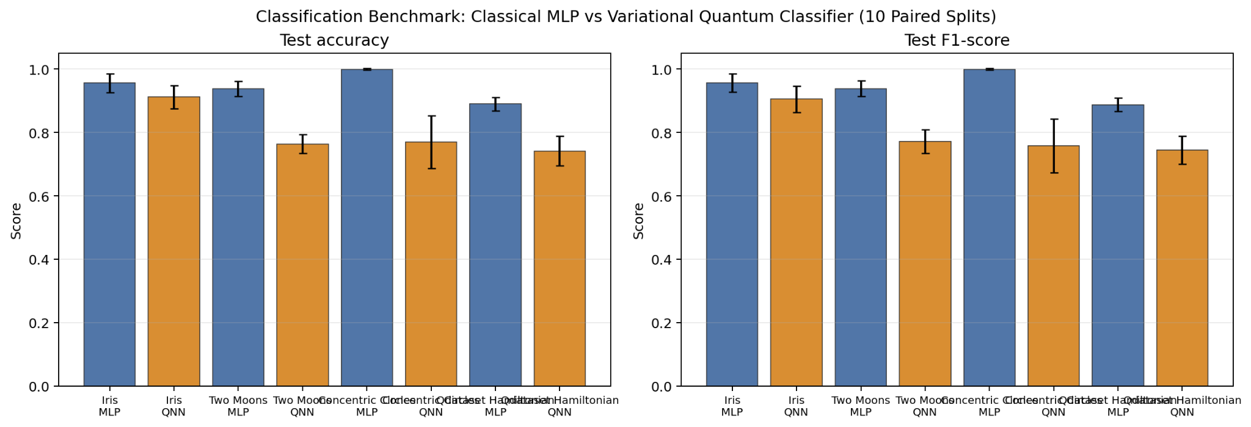
Performance across benchmarks
The source figure reports accuracy and F1 across the ten paired splits.
Readout: classical performance is strongest on Two Moons and circles; QNN results vary with data geometry and circuit depth.
10

Slide 11
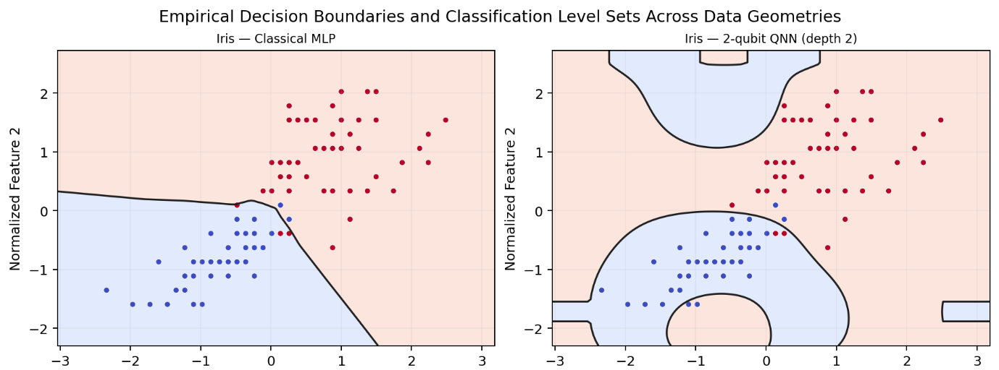
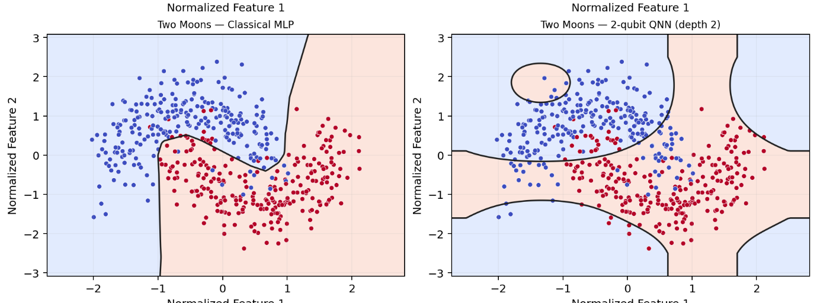
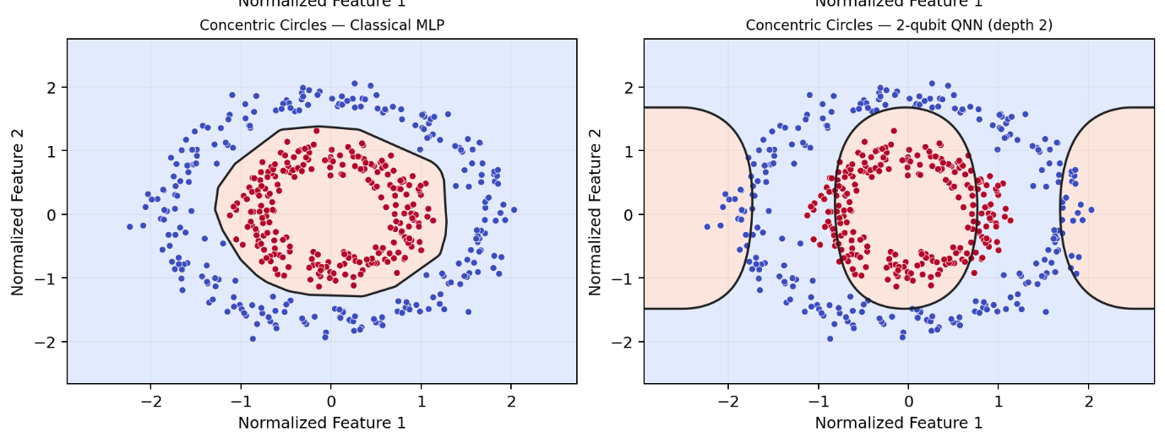
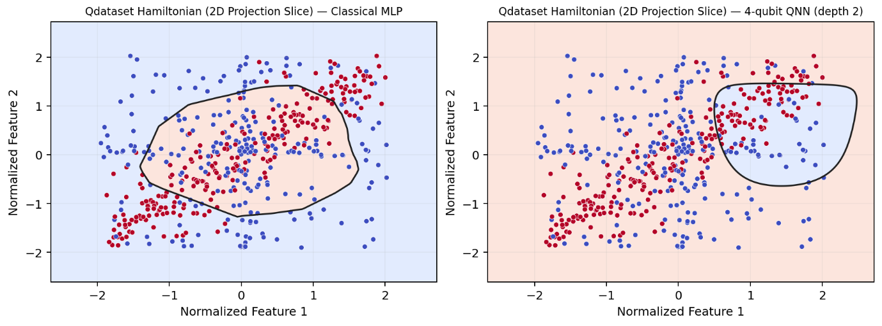
Decision boundaries reveal model inductive bias
Seed-0 visualization from the case study; QDataSet panel is a 2D projection slice.
Crescents expose boundary mismatch; concentric rings reveal the compact MLP’s capacity limit. QDataSet is shown as a 2D projection.
11

Slide 12
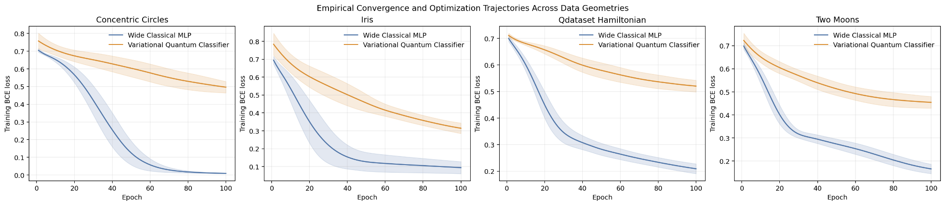
Training dynamics: loss convergence
Training BCE loss over 100 epochs; shaded regions indicate across-run variability.
Classical MLP
Quantum classifier
Typically reaches lower training loss faster.
Uses a trigonometric landscape; lower training loss alone does not prove quantum advantage.
12

Slide 13
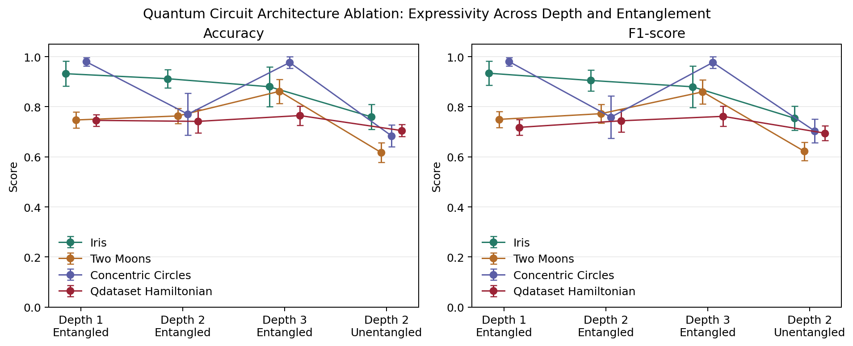
Circuit depth and entanglement ablation
Test accuracy, mean ± SD; depth-2 entangled is the primary QNN configuration.
Depth is task-dependent
CNOT ablation
Depth 3 improves Two Moons; circles perform best at depths 1 and 3.
Removing entanglement lowers accuracy across all four tasks in the reported setup.
14

Slide 14
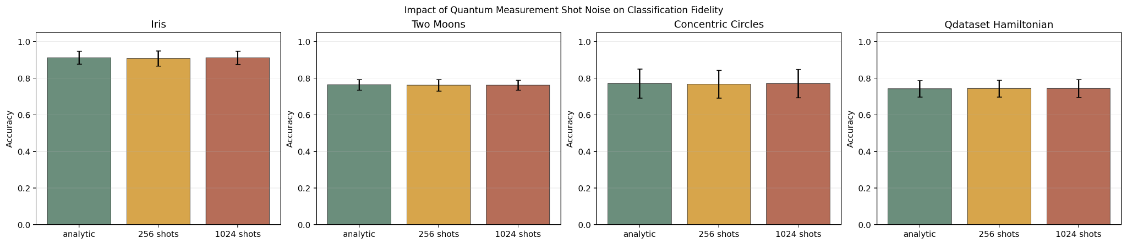
Finite-shot inference: sampling noise is small here
The trained QNN weights were fixed; only inference measurement sampling changed.
Dataset | Analytic | 256 shots | 1,024 shots
Iris | 0.912 ± 0.035 | 0.907 ± 0.042 | 0.912 ± 0.036
Two Moons | 0.763 ± 0.029 | 0.761 ± 0.031 | 0.762 ± 0.027
Concentric Circles | 0.770 ± 0.080 | 0.767 ± 0.076 | 0.771 ± 0.078
QDataSet Dynamics | 0.742 ± 0.045 | 0.743 ± 0.046 | 0.743 ± 0.049
Within these simulations, accuracy changes only slightly; this does not model gate errors, decoherence or noisy training gradients.
16

Slide 15
Final takeaways
Use the evidence to make a nuanced argument rather than a universal claim.
1 · Baseline matters
2 · Geometry matters
The wide MLP is the strongest tested model on all four primary benchmarks.
A shallow quantum circuit can align with circular symmetry, but depth-2 does not consistently beat classical baselines.
3 · Claims need bounds
4 · No hardware speedup shown
Small circuits, limited tasks and ten seeds support cautious, task-specific conclusions.
The experiments use classical simulation; they do not demonstrate quantum runtime or complexity advantage.
Discussion prompt: which data-access assumptions and classical baselines would be required to establish a genuine quantum advantage?
15

Slide 16
Paired tests: where differences are supported
Exploratory tests compare seed-matched test accuracy differences.
Paired comparison | Mean accuracy difference | Paired t-test p
Iris: QNN − wide MLP | −0.0440 | 0.00324
Two Moons: QNN − wide MLP | −0.1752 | 5.84 × 10⁻⁸
Circles: QNN − wide MLP | −0.2288 | 1.03 × 10⁻⁵
Circles: QNN − compact MLP | +0.1864 | 0.00334
QDataSet: QNN − wide MLP | −0.1480 | 8.00 × 10⁻⁸
Interpretation
The circle result is the controlled exception: depth-2 QNN exceeds the 9-parameter compact MLP by 0.1864 mean accuracy, yet remains below the wide MLP. Ten seeds make these exploratory, not universal, claims.
13

Slide 17
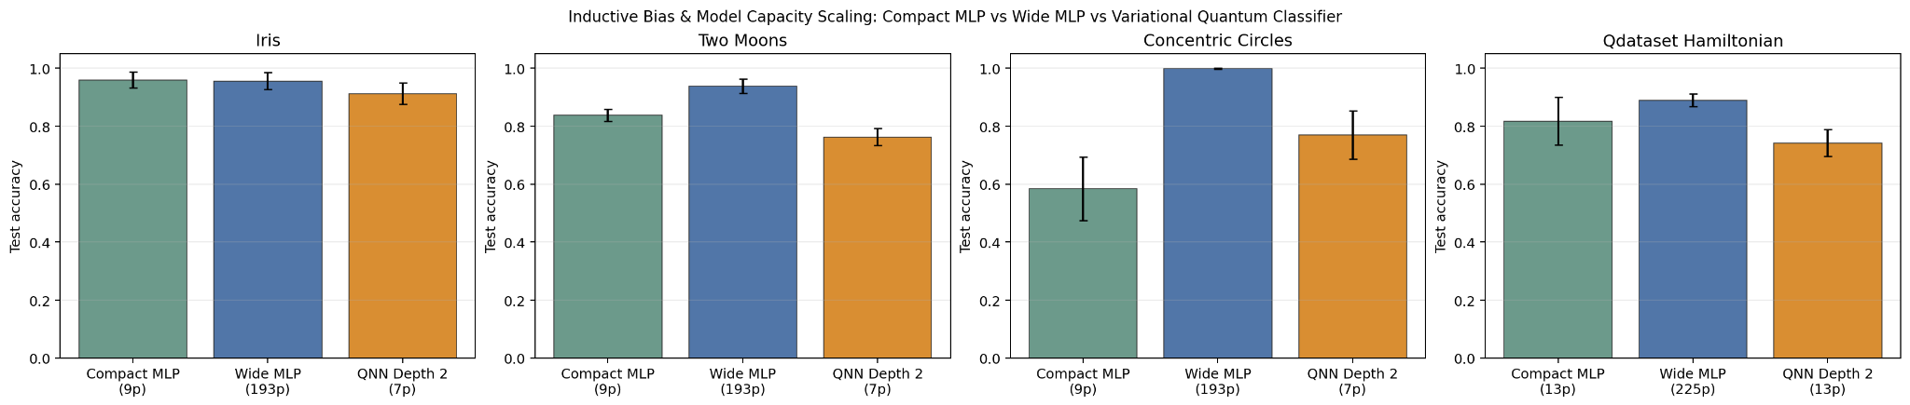
Capacity control: small models change the interpretation
Compact MLPs are useful controls, but are not substitutes for stronger classical baselines.
Parameter-matched view
Takeaway
QNN has 7 parameters on 2D tasks and 13 on QDataSet.
A quantum advantage claim depends on which classical baseline is used.
15

Slide 18
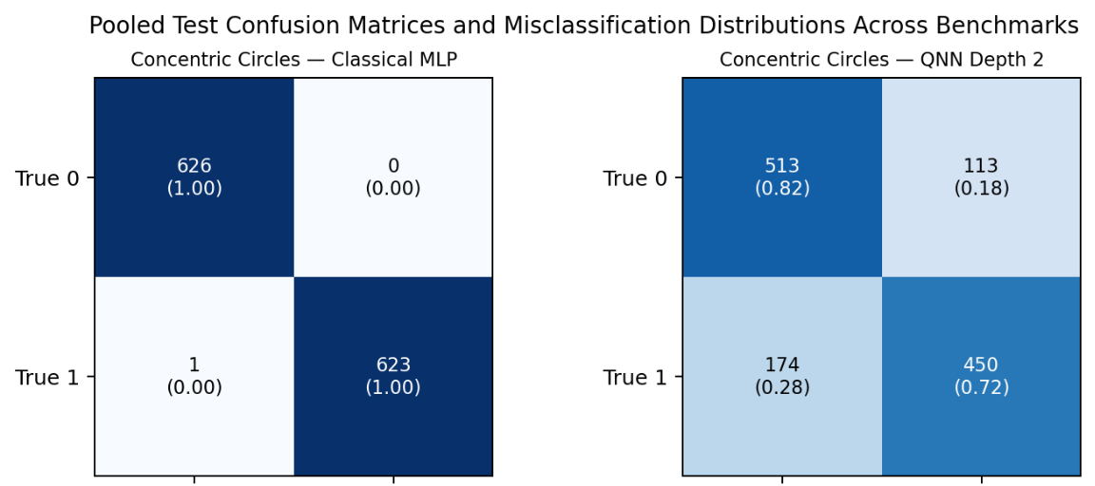
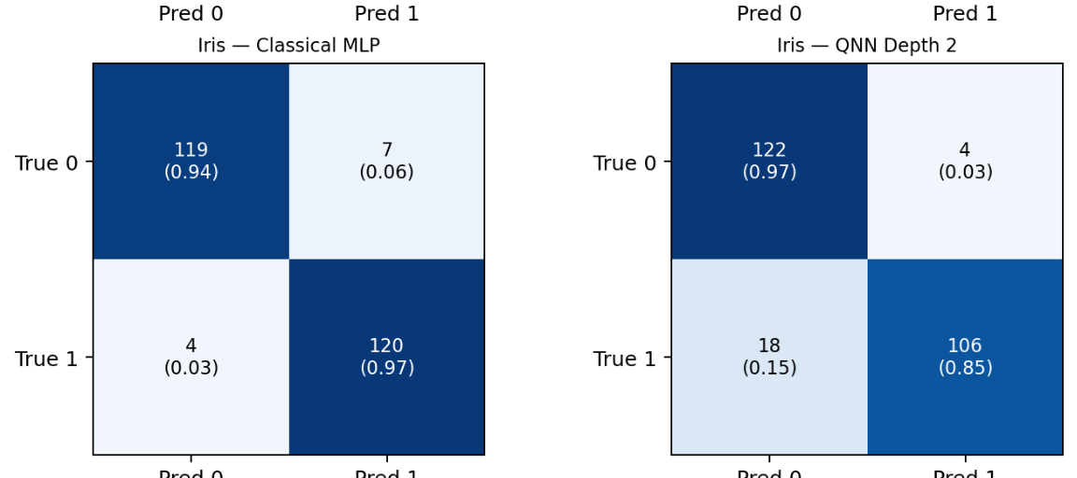
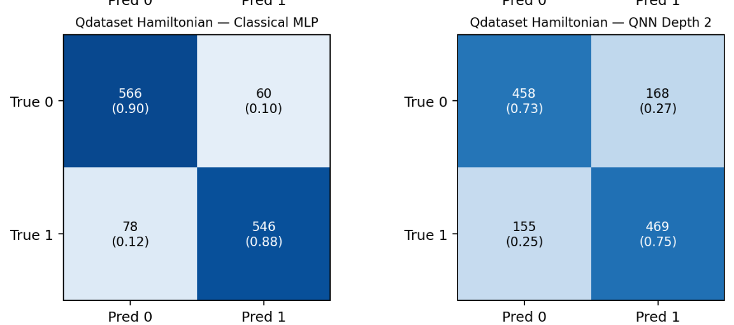
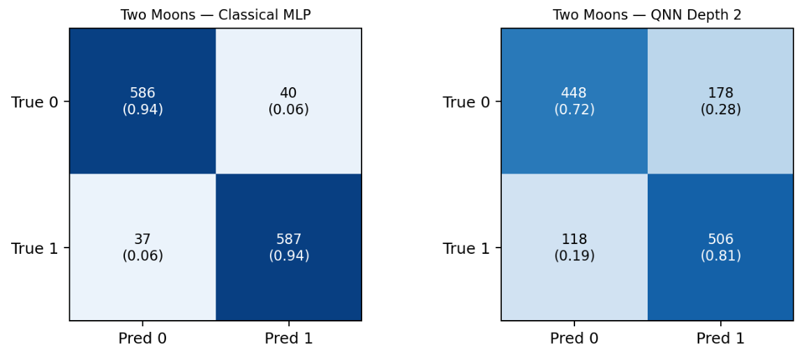
Confusion matrices: inspect error balance, not only accuracy
Pooled held-out predictions across ten splits, as visualized in the source manuscript.
Each pair contrasts classical MLP and depth-2 QNN errors for one benchmark; the pattern is task-dependent.
17

Slide 19
Conclusions: match the model to the problem
The evidence supports a nuanced claim about inductive bias, not a universal quantum advantage.
What the study shows
What it does not show
• Wide MLPs lead on all four primary depth-2 comparisons.
• QNN depth and entanglement effects depend on dataset geometry.
• No physical quantum speedup: all primary training uses classical simulation.
• Finite-shot experiment covers inference sampling only.
Important limitations
Closing takeaway
• Four small binary tasks; fixed architectures and learning rates.
• No exhaustive hyperparameter search or hardware noise model.
The clearest positive result is task-specific: the depth-2 QNN beats the compact MLP on circles, while the wide MLP remains strongest overall.
Discussion question: what baseline and data-access assumptions would be required to demonstrate a genuine quantum advantage?
Qubit vs Neuron · Case study by Nitansh Shankar and GramHanssen Deepak
18

