Slide 1
PWM drawer
Mark Nady Kamal
Group: D22

Slide 2
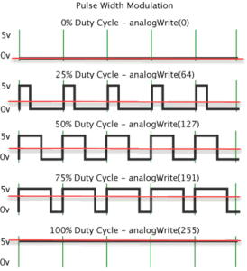
What is PWM?
A Pulse Width Modulation (PWM) Signal is a method for generating an analog signal using a digital source. ... The frequency determines how fast the PWM completes a cycle (i.e. 1000 Hz would be 1000 cycles per second), and therefore how fast it switches between high and low states.

Slide 3
What is PWM?
PWM is a way to control analog devices with a digital output. Another way to put it is that you can output a modulating signal from a digital device such as an MCU to drive an analog device. It’s one of the primary means by which MCUs drive analog devices like variable-speed motors, dimmable lights, actuators, and speakers. PWM is not true analog output, however. PWM “fakes” an analog-like result by applying power in pulses, or short bursts of regulated voltage. PWM is a way to control analog devices with a digital output. Another way to put it is that you can output a modulating signal from a digital device such as an MCU to drive an analog device. It’s one of the primary means by which MCUs drive analog devices like variable-speed motors, dimmable lights, actuators, and speakers. PWM is not true analog output, however. PWM “fakes” an analog-like result by applying power in pulses, or short bursts of regulated voltage.

Slide 4
Input capture mode
Input capture is a method of dealing with input signals in an embedded system. Embedded systems using input capture will record a timestamp in memory when an input signal is received. ... The interrupts can be programmed to occur at the rising or falling edge of the input signal, depending on requirements.

Slide 5
Input capture mode In AVR
What is input capture in AVR?
Input capture is simply giving a timestamp to an external event. For PWM these events are rising edge and falling edge. Once enabled, the timer of ATMEGA starts incrementing with clock. Whenever an event occurs, it copies the timer value at that moment to an input capture register and generates an interrupt.

Slide 6

Frequency Calculations
For phase correct $f=\frac{f_{cpu}}{N∗510}$
For fast pwm $f=\frac{f_{cpu}}{N∗256}$

Slide 7

Duty cycle Calculations
Duty cycle is the ratio of time a load or circuit is ON compared to the time the load or circuit is OFF. Duty cycle, sometimes called "duty factor," is expressed as a percentage of ON time. A 60% duty cycle is a signal that is ON 60% of the time and OFF the other 40%
Duty cycle=$\frac{t_{on}}{t_{on}+t_off}$

