Slide 1
British Airways – Booking Completion Prediction
Predicting customer booking behavior using Machine Learning
Presented by: Bikrant Rawat
Domain: Aviation Analytics
Github link : Click here
Linkedin Profile : Click here
Data ScienceTools: Python, Machine Learning, LightGBM

Slide 2
Business Problem
- Airlines face significant revenue loss due to incomplete bookings
- Customers often abandon bookings at the final stage
- Lack of early visibility into which bookings are likely to fail
- Goal: Predict whether a booking will be completed or abandoned

Slide 3
Dataset Overview
Source: British Airways (via Forage)
Records: ~50,000 bookings
Features: 14
Target Variable: booking_complete (0 = No, 1 = Yes)

Slide 4
Project Workflow
Data Preprocessing
Exploratory Data Analysis (EDA)
Feature Engineering
Model Evaluation & Interpretation
Deployment via Streamlit

Slide 5
Exploratory Data Analysis (EDA)
Longer purchase lead time increases completion probability
Customers opting for extra services show higher intent
Booking completion varies by flight day and time
Behavioral features outperform simple flight attributes

Slide 6
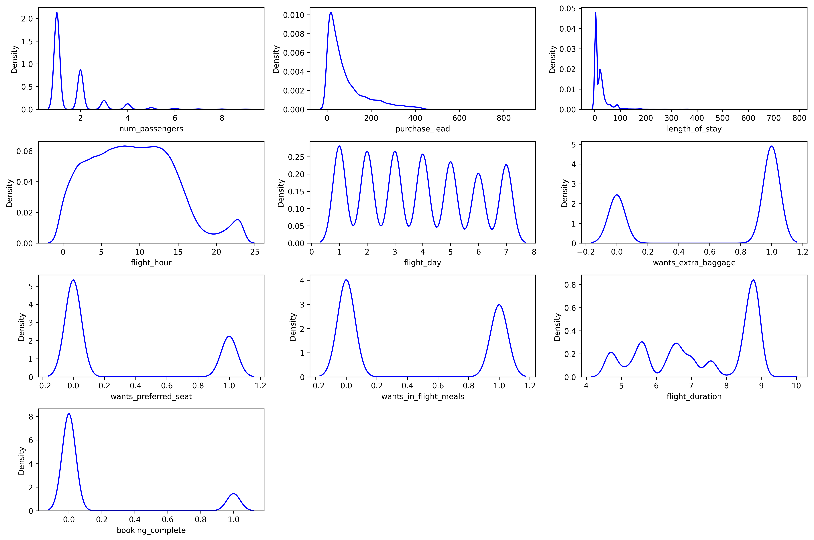
KDE Plot
num_passengers: The distribution shows a high density around 1 and 2 passengers, with fewer bookings for larger groups.
purchase_lead: Most bookings have a short lead time, with density rapidly decreasing as the number of days before arrival increases.
length_of_stay: The majority of stays are short, with the highest density near 0-10 days.
flight_hour: Bookings are distributed across the day, with peaks in the morning/early afternoon and again in the evening.
flight_day: The data exhibits a cyclical pattern, indicating relatively uniform booking density across the days of the week.
wants_extra_baggage: This shows people who wants extra baggage (1) are twice more than who don't (0).
wants_preferred_seat: Passengers who want preferred seat are half the number who don't want.
wants_in_flight_meals: Those who want meals (1) and those who do not (0), are nearly same.
flight_duration: Flight durations show a multimodal distribution, with distinct peaks around 4.5, 6, 7, and 9 hours.
booking_complete: The vast majority of instances show incomplete booking (0), while a smaller, separate group indicates otherwise (1).

Slide 7
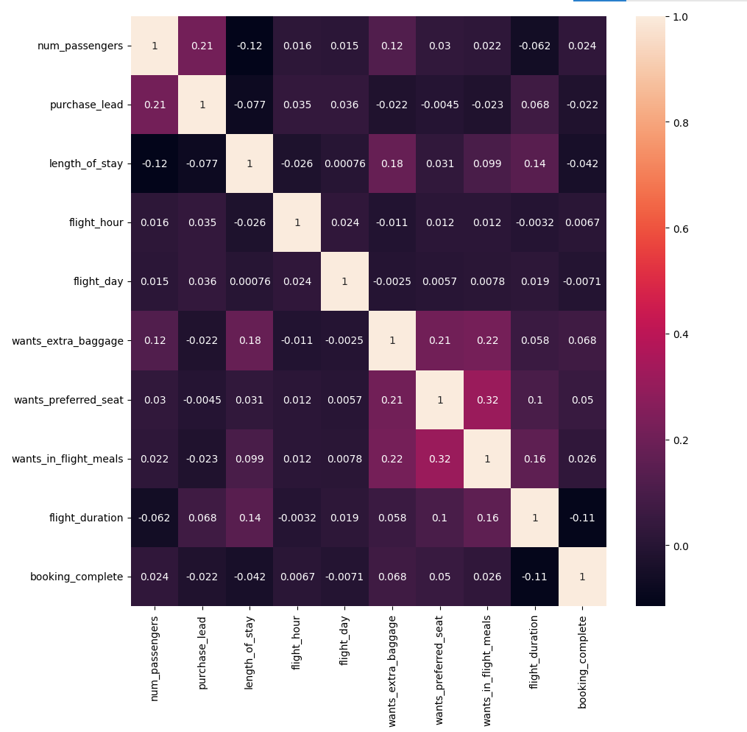
HeatMap
length_of_stay and wants_extra_baggage: There is a positive correlation of 0.18, suggesting that people staying longer are slightly more likely to want extra baggage.
wants_preferred_seat and wants_in_flight_meals: A moderate positive correlation of 0.32 is observed, indicating a tendency for passengers who want one to also want the other.
flight_duration and booking_complete: There is a negative correlation of -0.11, suggesting that longer flights are slightly less likely to have completed bookings in this dataset.
purchase_lead and length_of_stay: These two variables show a negative correlation of -0.077, implying that booking further in advance is slightly associated with shorter stays.

Slide 8
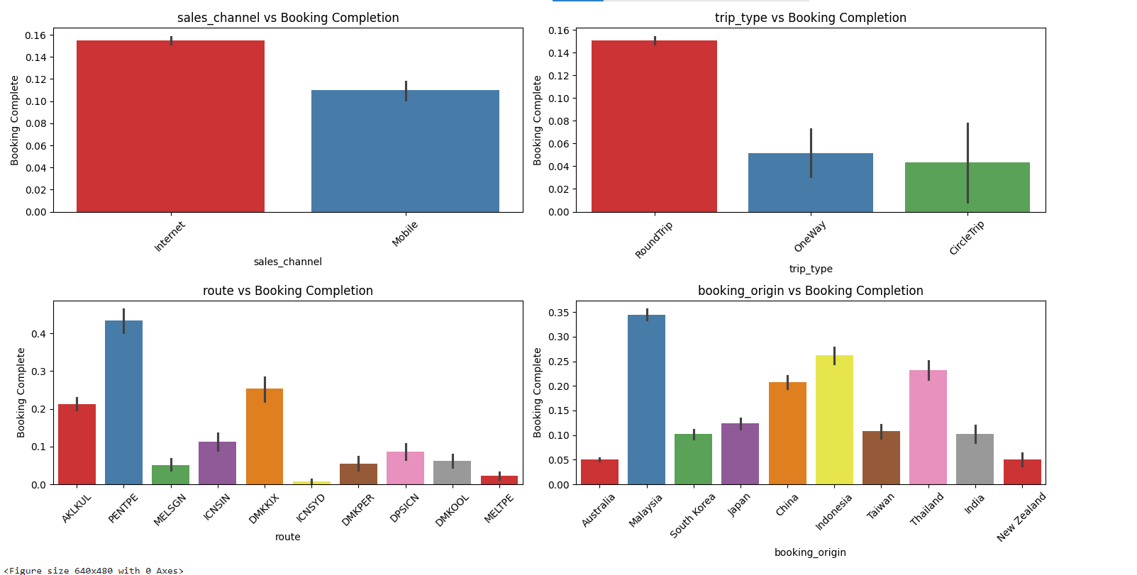
Categorical Columns vs Booking Completion
Sales Channel: Internet bookings have a higher completion rate than mobile bookings.
Trip Type: Round trip bookings have a significantly higher completion rate compared to one-way or circle trip bookings.
Route: The PENTPE route shows the highest booking completion rate among the displayed routes.
Booking Origin: Bookings originating from Malaysia have the highest completion rate, while those from Australia have the lowest.

Slide 9
Feature Engineering
Transformed temporal features (weekday, flight hour)
Derived behavioral indicators from customer preferences
Ensured proper handling of numerical and binary variables
Prepared data for machine learning models

Slide 10
Models Trained
Logistic Regression (baseline)
Random Forest
XGBoost Classifier
LightGBM (Best Model)

Slide 11
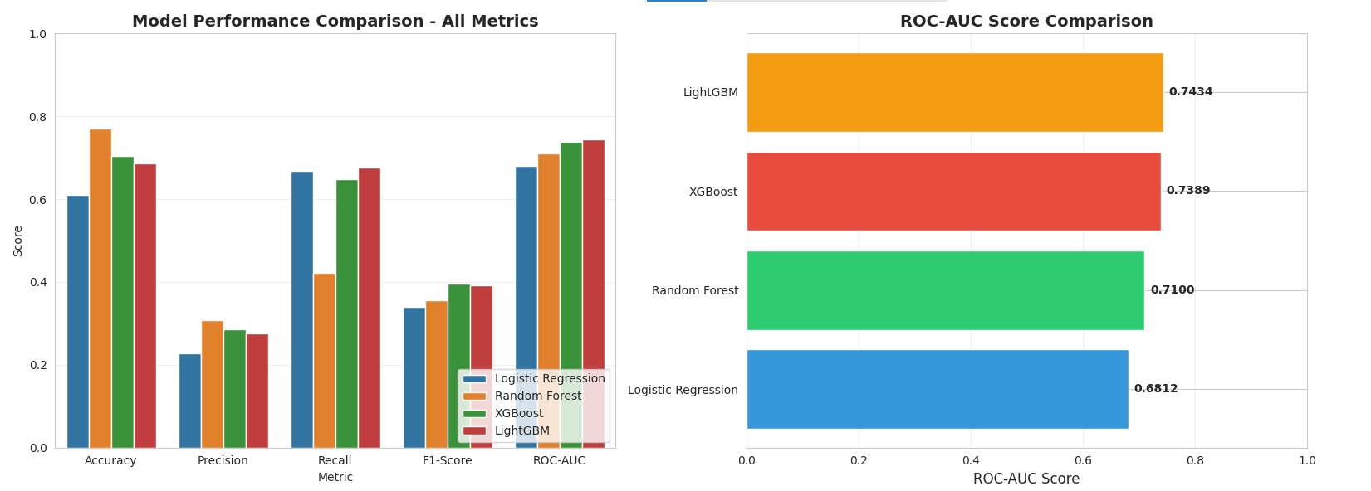
Model Evaluation Metrics

Slide 12
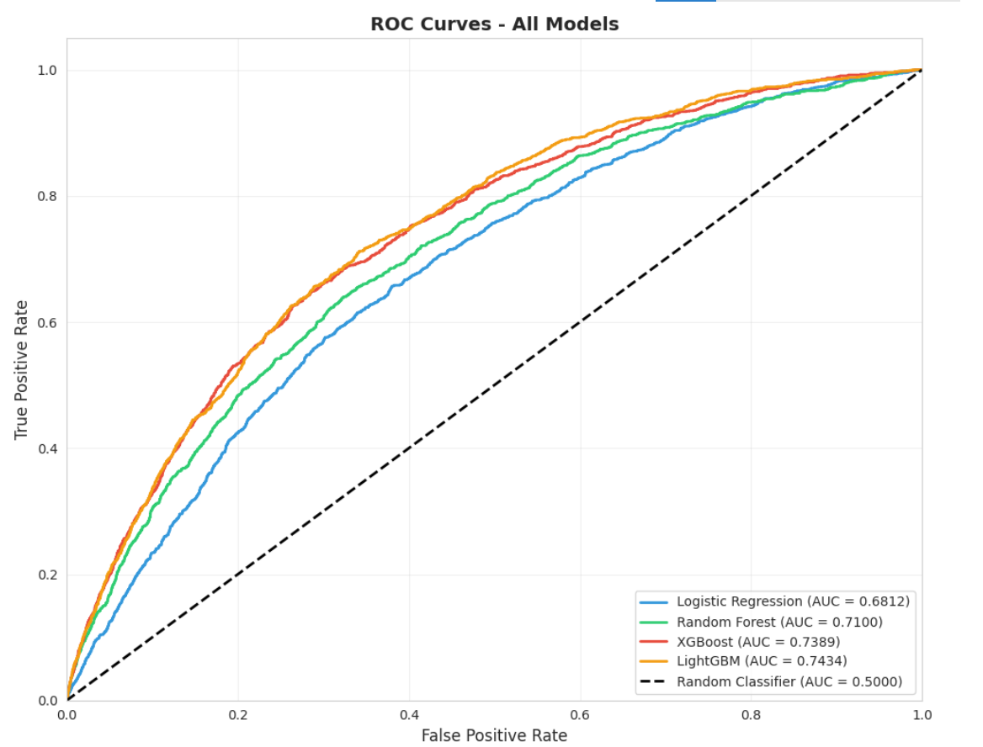
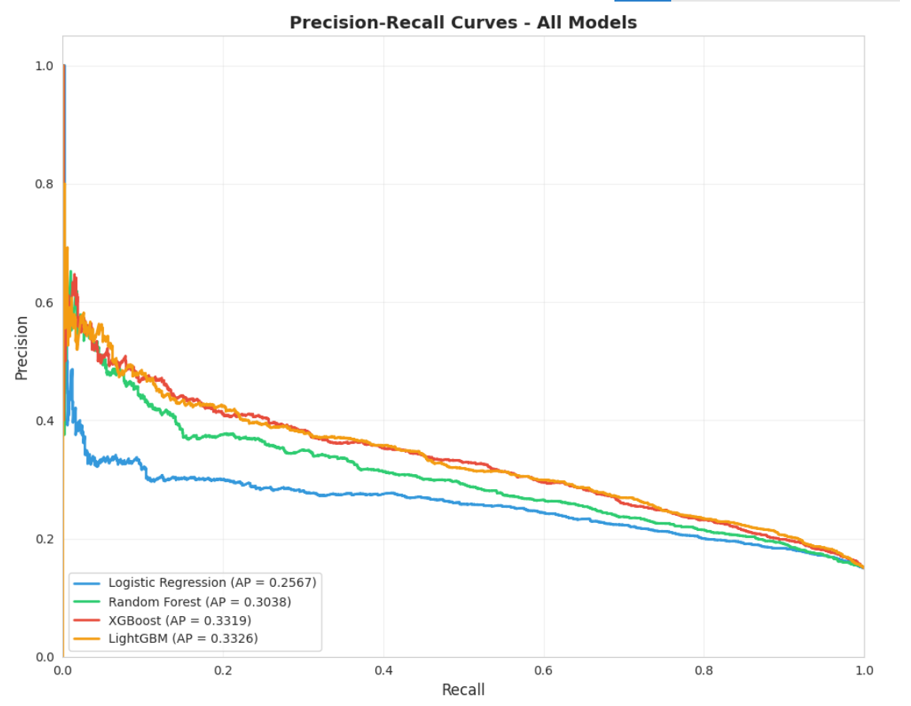
Roc Curve and Precision Recall curve

Slide 13
Hyperparameter Tuned Best Model
Best Model: LightGBM Classifier
ROC-AUC: 0.7476
Recall: 0.69
F1-Score: 0.74
Indicates strong ability to identify genuine booking completions
while minimizing missed opportunities

Slide 14
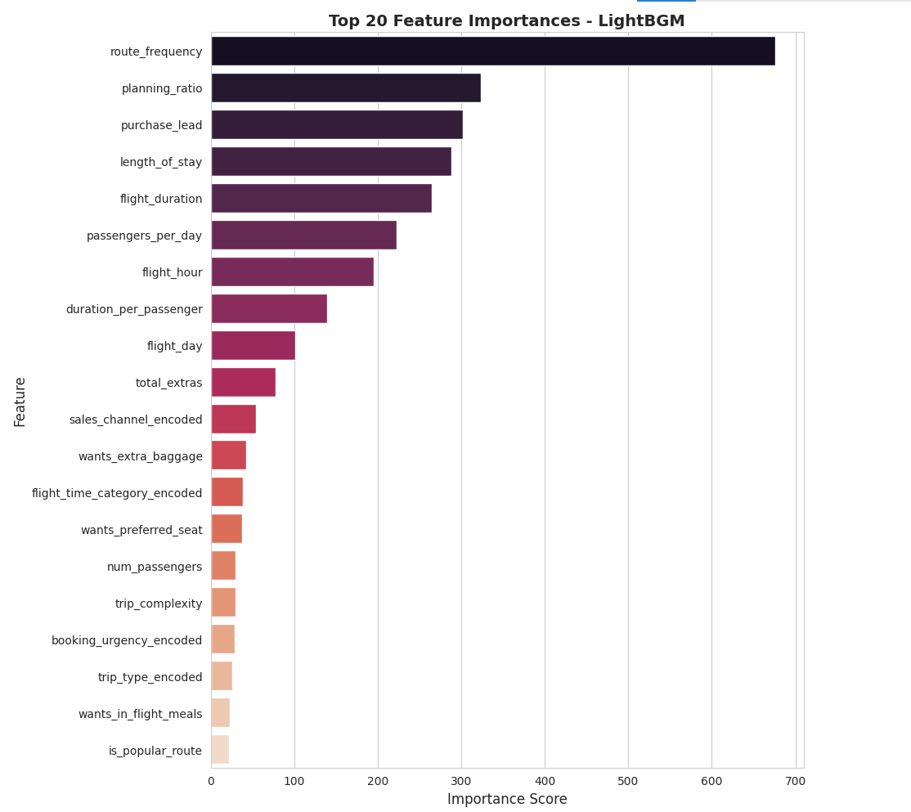
Top 20 feature Importance

Slide 15
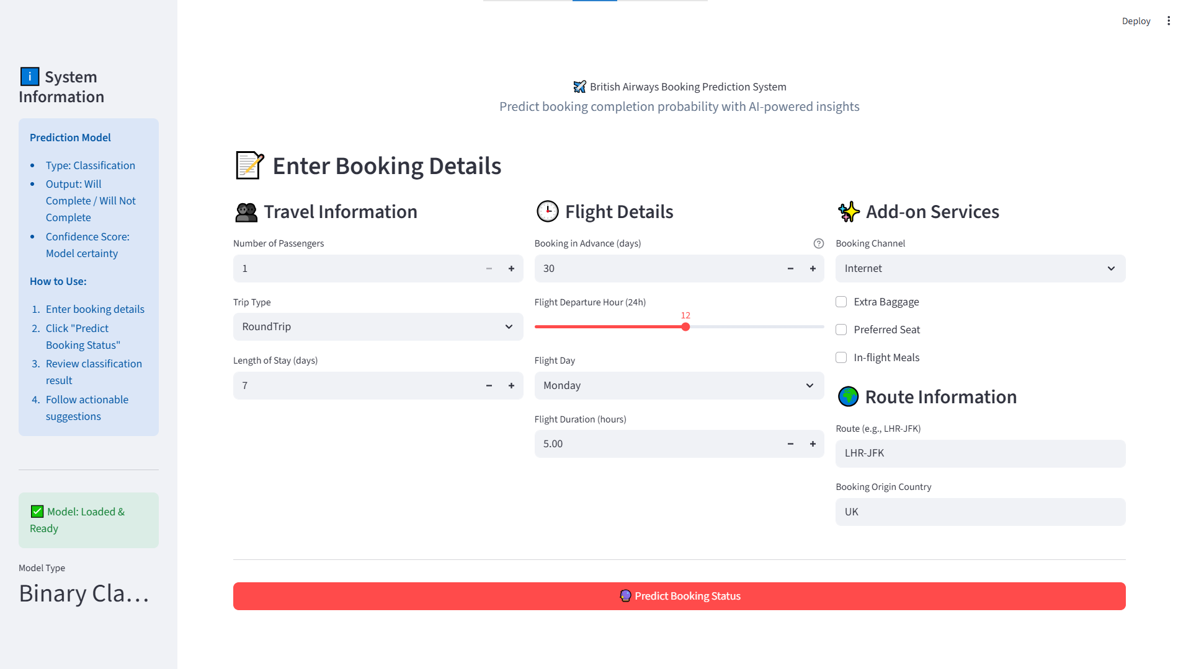
Deployed via Streamlit
Interface of the Project

Slide 16
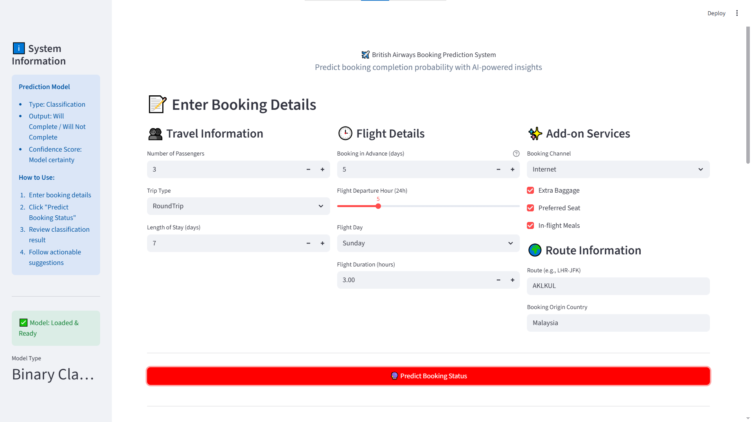
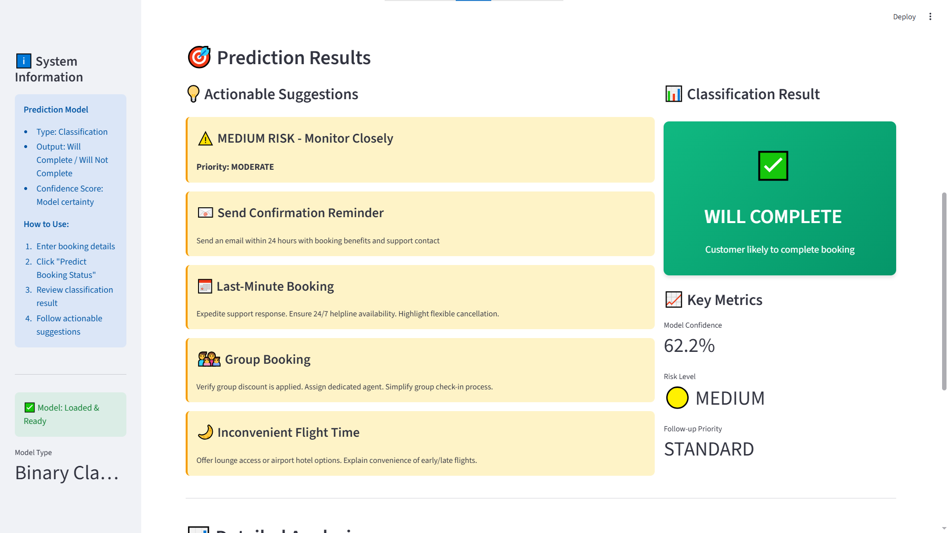
Model predicted Positive

Slide 17
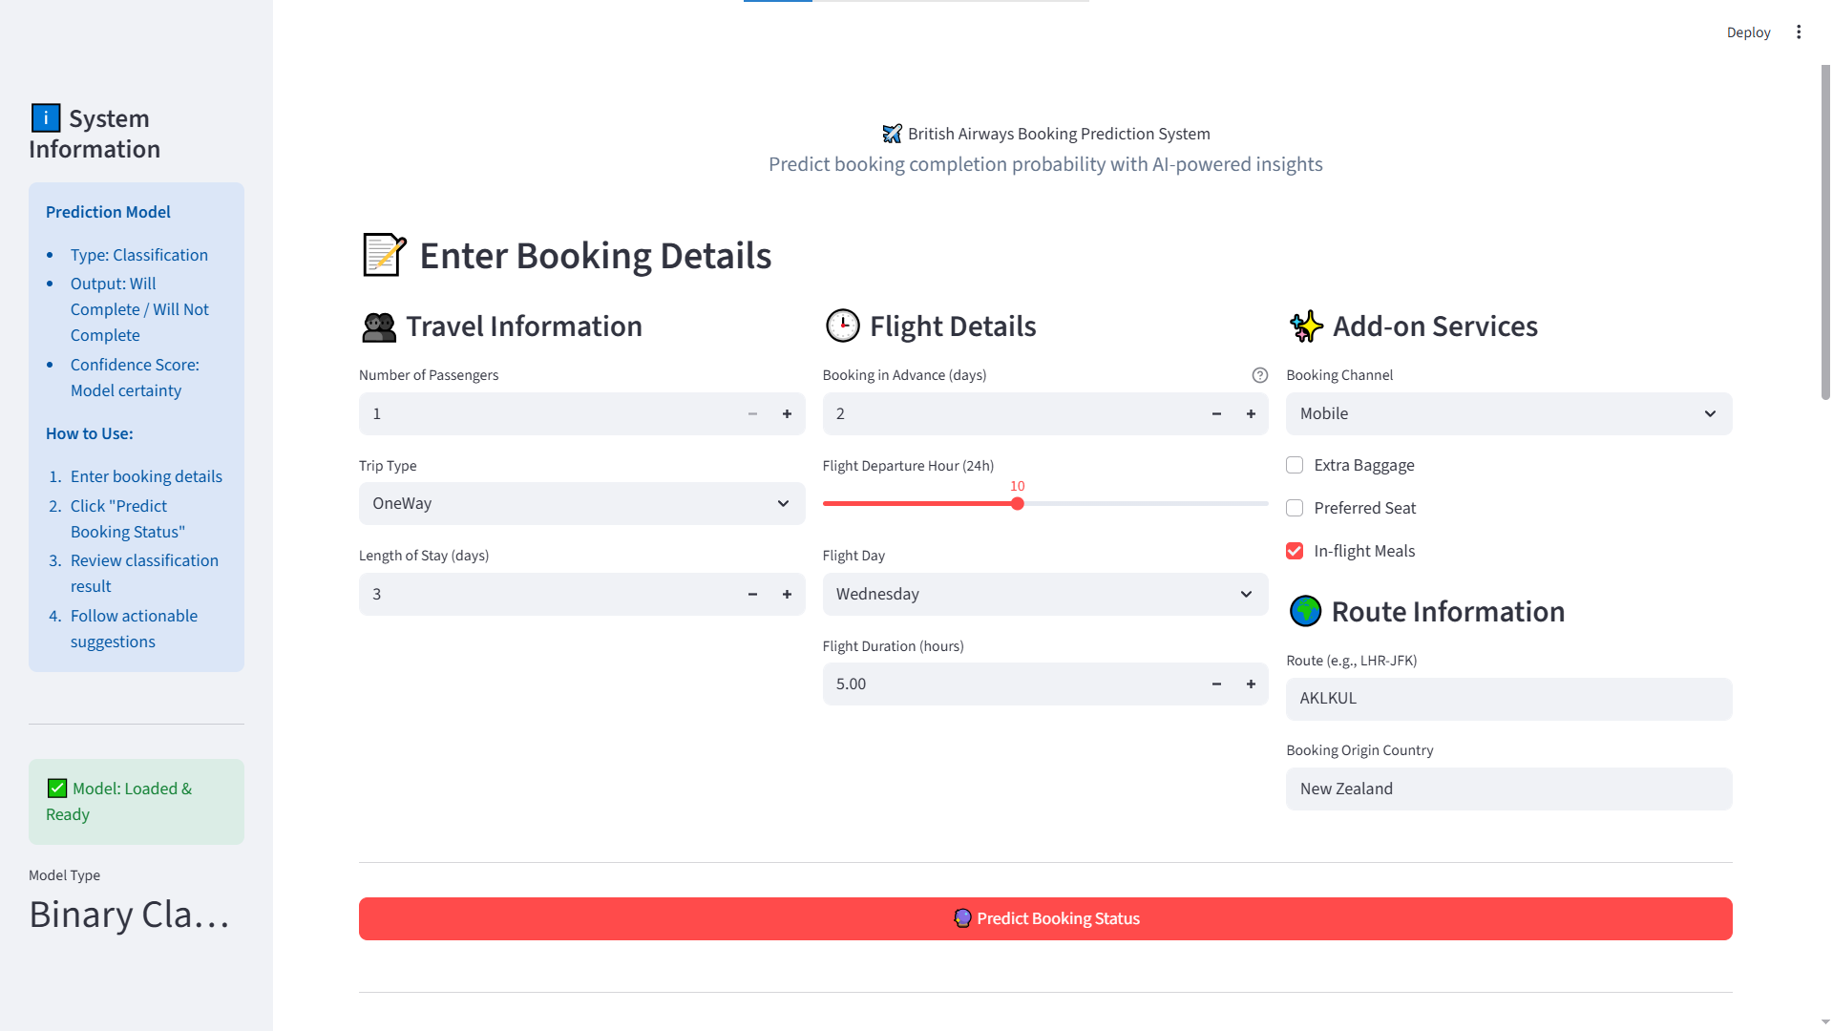
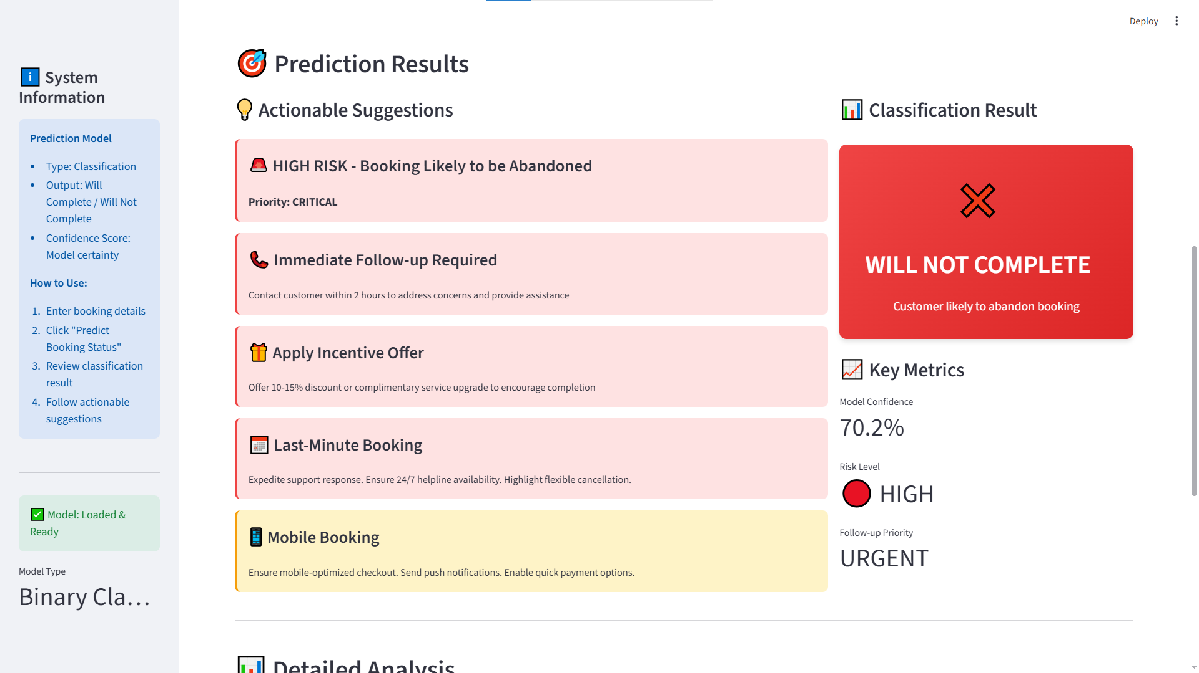
Model Predicted False

Slide 18
Business Interpretation of Results
High recall ensures fewer genuine customers are missed
Balanced F1-score supports real-world decision-making
Model focuses on early abandonment detection

Slide 19
Real-World Use Case
Example Scenario:
Model flags a booking with high abandonment risk
System triggers:
  Limited-time discount
  Email or app notification
  Higher chance of booking completion

Slide 20
Future Enhancements
Real-time prediction during booking flow
Integration with customer loyalty data
Cost-sensitive modeling for high-value customers
Deployment as an API or dashboard

Slide 21
Acknowledgements
British Airways – Dataset & business context
Forage – Project framework
Open-source Python & ML community

