Slide 1
Updates 4/15/20
Akash Levy

Slide 2
Overview
FORMing scheme with good sweep properties
Cycling and minimum resistance across 64 cells
WL sweep across 100ns, 200ns, 300ns pulse widths
Preliminary SDR implementation
ISPP with different step sizes
Comparison across algorithms
TODO: try with lower resistance range, more cells, yield, opt

Slide 3
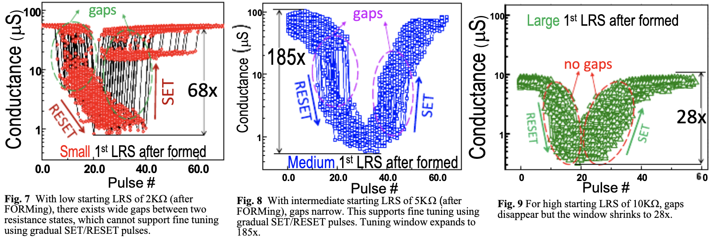
FORMing scheme
Used insight from Ray’s figure in our IEDM paper

Slide 4
FORMing scheme
PW = 1000ns, WL = 2V
BL voltage from 0-5V in steps of 0.05V
Aim for medium post-FORM resistance
Medium post-FORM resistance
6-7kOhm
No over-FORM, no under-FORM

Slide 5
Cycling and Minimum Resistance
300 cycles per cell (74 cells)
Two pulses per cycle per cell
SET pulse
PW=100ns, BLV=3.3V, WLV=3V
RESET pulse
PW=100ns, SLV=2.3V, WLV=4V
Maximum SET resistance across cells, minimized over all
Lower Bound: 6.0 kOhm
Recommend trying several lower bounds: 5.5k, 6k, 6.5k, 7k

Slide 6
WL Sweeps: Improved & Ready for Paper
Could display slope differences in the plot?
Smarter FORMing reduces the variation!
95% confidence intervals shown ☺

Slide 7
ISPP Algorithm
Start with WLV = 2.1V (TODO: adjust?)
Increase WLV by step size
Pulse until in range, RESET if gone past
Step size swept from 0.01V to 0.15V
Should there be step size per level?
Key metrics
Avg. # of attempts needed
Avg. # of total pulses needed
(Distribution of pulses needed)
(Per bin and overall)
Best step size: 0.03V, success: 100%
Mean pulses: 11.23, Stdev pulses: 8.74
Mean resets: 1.81, Stdev resets: 1.39

Slide 8
ISPP Algorithm
Start with WLV = 2.1V (TODO: adjust?)
Increase WLV by step size
Pulse until in range, RESET if gone past
Step size swept from 0.01V to 0.15V
Should there be step size per level?
Key metrics
Avg. # of attempts needed
Avg. # of total pulses needed
(Distribution of pulses needed)
(Per bin and overall)
Best step size: 0.03V, success rate: 100%
Mean pulses: 11.23, Stdev pulses: 8.74
Mean resets: 1.81, Stdev resets: 1.39

Slide 9
ISPP Step Size Dependence

Slide 10
FPPV Algorithm
SET with optimal WLV
RESET and retry if miss
Clearly still needs to be optimized
Range | Median WL Voltage | Expt. WL Voltage
0 | 3.0 | 3.0
1 | 2.46 | 2.38
2 | 2.40 | 2.34
3 | 2.36 | 2.31
4 | 2.31 | 2.27
5 | 2.28 | 2.25
6 | 2.25 | 2.20
7 | RESET | RESET
Success rate: 92.2%
Mean pulses: 11.03, Stdev pulses: 12.22

Slide 11
FPPV Algorithm
SET with optimal WLV
RESET and retry if miss
Clearly still needs to be optimized
Range | Median WL Voltage | Expt. WL Voltage
0 | 3.0 | 3.0
1 | 2.46 | 2.38
2 | 2.40 | 2.34
3 | 2.36 | 2.31
4 | 2.31 | 2.27
5 | 2.28 | 2.25
6 | 2.25 | 2.20
7 | RESET | RESET
Success rate: 92.2%
Mean pulses: 11.03, Stdev pulses: 12.22

Slide 12
Preliminary SDR Implementation
Uses ISPP starting from FPPV-specified WL voltage
No gradual RESET yet
How to do gradual RESET?
Sweep SL voltage with WL fully ON?
Doesn’t current compliance method only work with SET?
Can do full RESET BL/WL sweep the same way SET sweep was done

Slide 13
Preliminary SDR Results
Use optimal WLV from FPPV
Increase WLV by step size (0.01V)
Keep pulsing until in range
RESET if miss
Key metrics:
Avg. # of attempts needed
Avg. # of total pulses needed
(Distribution of pulses needed)
(Per bin and overall)
Step size: 0.01V, success rate: 100%
Mean pulses: 6.62, Stdev pulses: 7.14
Mean resets: 3.33, Stdev resets: 3.17

Slide 14
Preliminary SDR Results
Use optimal WLV from FPPV
Increase WLV by step size (0.01V)
Keep pulsing until in range
RESET if miss
Key metrics:
Avg. # of attempts needed
Avg. # of total pulses needed
(Distribution of pulses needed)
(Per bin and overall)
Step size: 0.01V, success rate: 100%
Mean pulses: 6.62, Stdev pulses: 7.14
Mean resets: 3.33, Stdev resets: 3.17

Slide 15
Algorithm Comparison

Slide 16
EAG Success Rates

Slide 17
EAG Pulse Counts

Slide 18
TODOs
Finish SDR algorithm properly
Try with different resistance ranges
Tune all algorithms
Test on 256 or 1024 cells

