Slide 1
Updates 4/15/20
Akash Levy

Slide 2
Summary
FORMing scheme with good sweep properties
Cycling and minimum resistance across 64 cells
WL sweep across 100ns, 200ns, 300ns pulse widths
Final figure done
Preliminary SDR implementation
ISPP with different step sizes
Comparison across algorithms
TODO: try with lower resistance range, more cells, yield

Slide 3
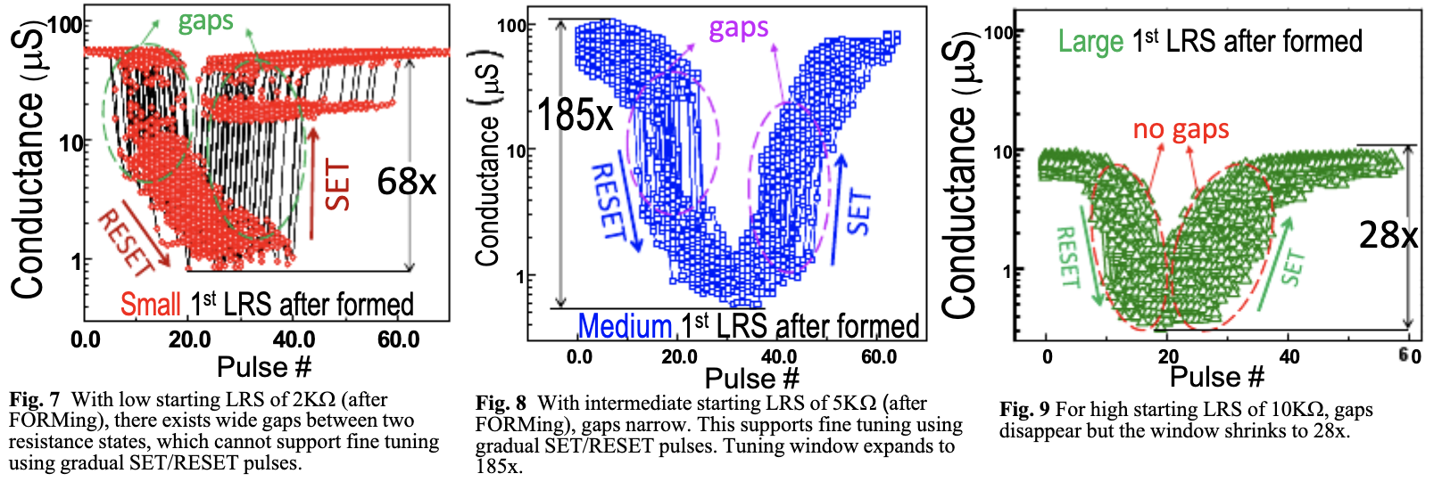
FORMing scheme
Used insight from Ray’s figure in our IEDM paper

Slide 4
FORMing scheme
FORMing algorithm
PW = 1000ns, WL = 2V
BL voltage from 0-5V in steps of 0.05V
Aim for medium post-FORM resistance
Medium post-FORM resistance: 6-7kOhm
Do not over-FORM, do not under-FORM

Slide 5
Cycling and Minimum Resistance
300 cycles per cell (74 cells)
Two pulses per cycle per cell
SET pulse
PW=100ns, BLV=3.3V, WLV=3V
RESET pulse
PW=100ns, SLV=2.3V, WLV=4V
Maximum SET resistance across cells, minimized over all
Lower Bound: 6.0 kOhm
Recommend trying several lower bounds: 5.5k, 6k, 6.5k, 7k

Slide 6
WL Sweeps: Improved & Ready for Paper
Could display slope differences in the plot?
Smarter FORMing reduces the variation!
95% confidence intervals shown ☺

Slide 7
ISPP Algorithm
Start with WLV = 2.1V
Increase WLV by step size
Keep pulsing until in range
RESET if miss
Step size swept from 0.01V to 0.15V
Key metrics:
Avg. # of attempts needed
Avg. # of total pulses needed
(Distribution of pulses needed)
(Per bin and overall)
Best result here per bin: TODO
With summary stats: TODO
TODO? Different sweep rate per level?

Slide 8
ISPP Step Size Dependence
Avg # of attempts (overall): TODO
Avg # of total pulses needed (overall): TODO

Slide 9
FPPV Algorithm
SET with optimal WLV
RESET and retry if miss
Result here per bin (TODO)
Range | Median WL Voltage | Expt. WL Voltage
0 | 3.0 | 3.0
1 | 2.46 | 2.38
2 | 2.40 | 2.34
3 | 2.36 | 2.31
4 | 2.31 | 2.27
5 | 2.28 | 2.25
6 | 2.25 | 2.20
7 | RESET | RESET

Slide 10
Preliminary SDR Implementation
Uses ISPP starting from FPPV-specified WL voltage
No gradual RESET yet
How to do gradual RESET?
Sweep SL voltage with WL fully ON?
Doesn’t current compliance method only work with SET?
Can do full RESET BL/WL sweep the same way SET sweep was done

Slide 11
SDR Algorithm
Use optimal WLV
Increase WLV by step size (0.01V)
Keep pulsing until in range
RESET if miss
Key metrics:
Avg. # of attempts needed
Avg. # of total pulses needed
(Distribution of pulses needed)
(Per bin and overall)
Result here per bin (TODO)

