Slide 1
New Figures

Slide 2
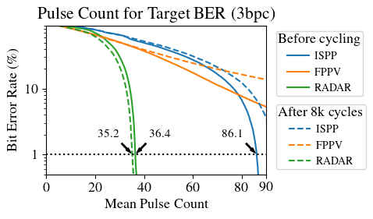
Figure 10

Slide 3
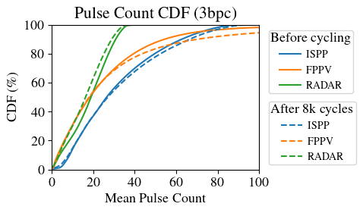
Figure 11

Slide 4
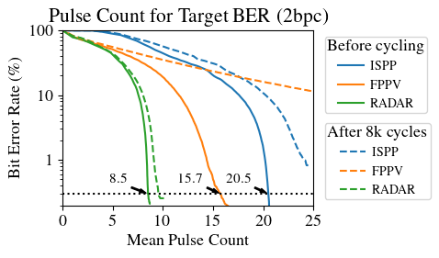
2bpc BER plot

Slide 5
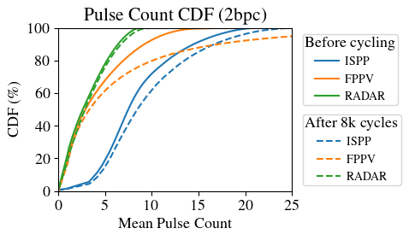
2bpc CDF plot

