Slide 1






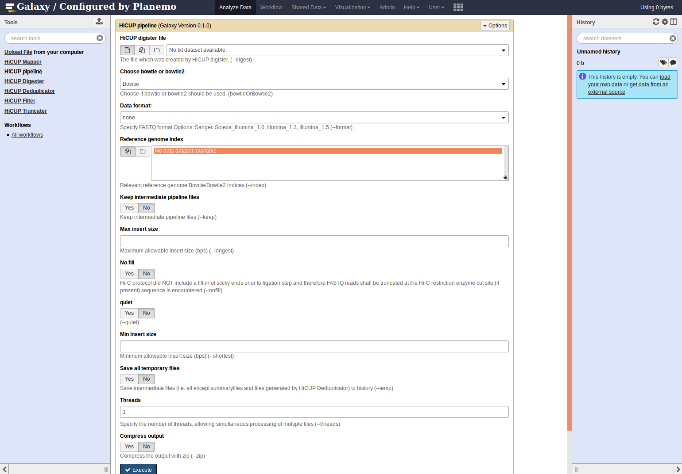






de.NBI − German Network for Bioinformatics Infrastructure
de.NBI-epi
RNA Bioinformatics Center
University of Freiburg
Chair of Prof. Rolf Backofen
Rolf Backofen, Bjoern Gruening, Joachim Wolff
Dept. of Bioinformatics, Albert-Ludwigs University Freiburg, Germany
Short description of the project
de.NBI services
The de.NBI-epi project in Freiburg offers visualization, normalization and quality assessment of epigenetic datasets as well as integration of CHIP-seq and bisulfite sequencing analysis pipelines into Galaxy.
Description of de.NBI services offered and carried out by the project
Progress report
de. NBI training and education
Implementation of tools for Galaxy to provide easy access for epigentic analysis software:
HiCExplorer
DeepTools
Bismark
HiCUP
ChiCAGO
Beacons
Initiative to create, distribute and maintain bioinformatics software in an easy way. For these goals we contribute actively to Bioconda and Biocontainers.
Description of de.NBI training and education activities offered and carried out
Publications
Ramírez, F., Ryan, D.P., Grüning, B., Bhardwaj, V., Kilpert, F., Richter, A.S., Heyne, S., Dündar, F. and Manke, T., 2016. deepTools2: a next generation web server for deep-sequencing data analysis. Nucleic acids research, p.gkw257.
Förderkennzeichen Nr…..
http://www.denbi.de

