Slide 1





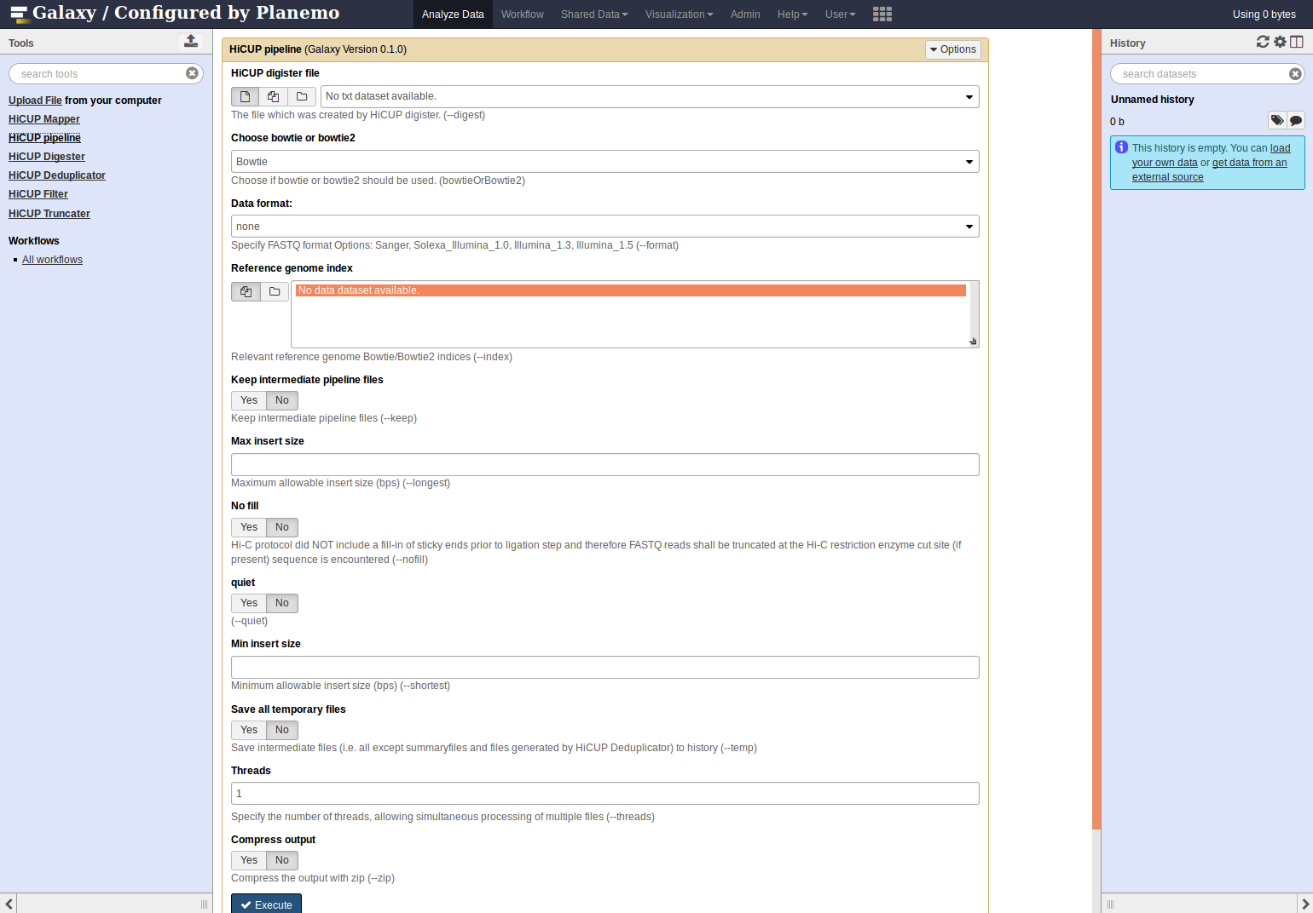
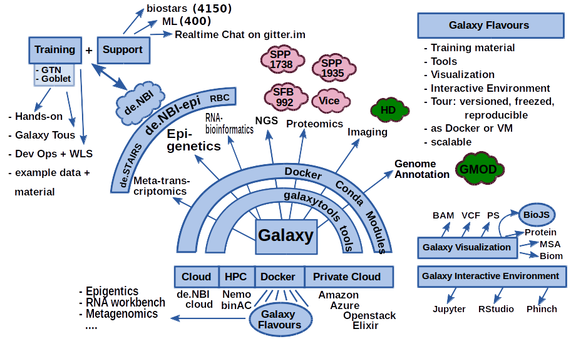
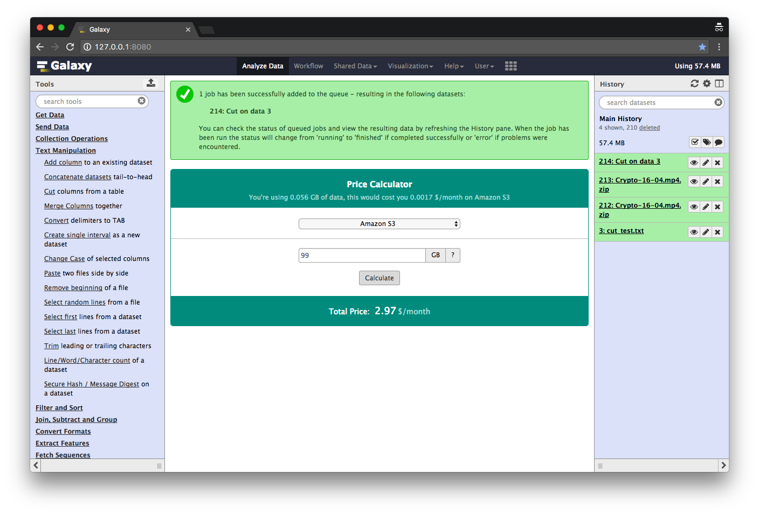
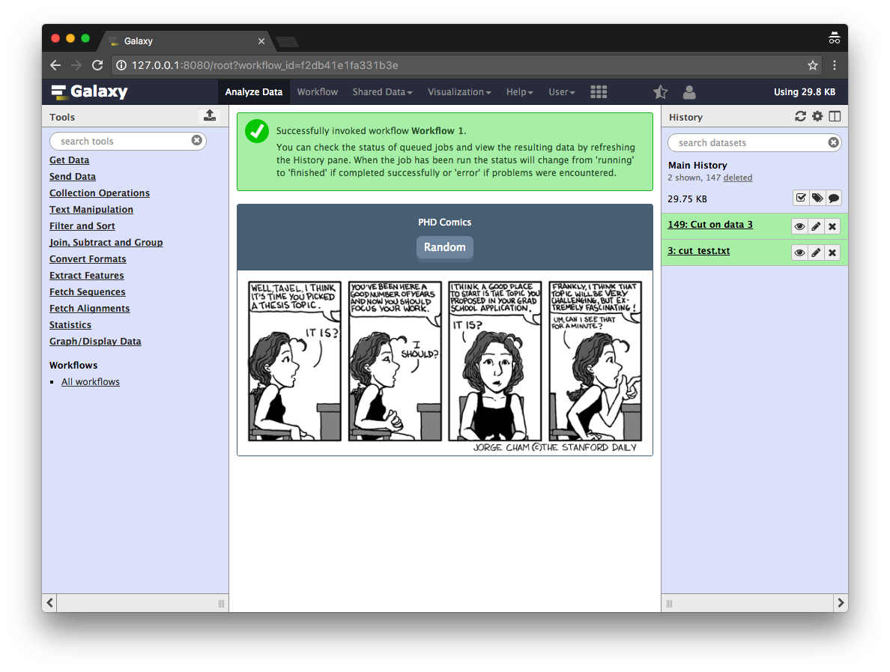








de.NBI − German Network for Bioinformatics Infrastructure
de.NBI-epi
RNA Bioinformatics Center
University of Freiburg
Chair of Prof. Rolf Backofen
Rolf Backofen, Bjoern Gruening, Joachim Wolff
Dept. of Bioinformatics, Albert-Ludwigs University Freiburg, Germany
Short description of the project
de.NBI services
The de.NBI-epi project in Freiburg offers visualization, normalization and quality assessment of epigenetic datasets as well as integration of CHIP-seq and bisulfite sequencing analysis pipelines into Galaxy.
Integration of software to Galaxy to provide easy access for epigentic analysis software:
HiCExplorer
DeepTools
Bismark
HiCUP
CHiCAGO
Beacons
Developed a plugin system for Galaxy:
Community based infrastructure
Pricing system: How much would it cost to compute and store your data on Amazon EC2?
Comics: Have fun while Galaxy is computing your data.
Contribute to open source projects to create, distribute and maintain bioinformatics software in an easy way. To achieve these goals we contribute actively to Bioconda, Biocontainers and Galaxy.
de.NBI training and education
Two one week training courses on NGS-data analysis in 2016 with ~30 participants each
One RNA-seq course in December
Bioconda is a conda channel which provides software for biomedical research:
8600 commits on github
150 contributers
> 1500 packages
BioContainers provides system-agnostic executable environments for bioinformatics software.
Based on docker.
200 commits on github
8 contributers
Galaxy is an open, web-based platform for data intensive biomedical research.
25550 commits
131 contributers
Our own galaxy instance is the biggest in Europe: http://galaxy.uni-freiburg.de/
Publications
Ramírez, F., Ryan, D.P., Grüning, B., Bhardwaj, V., Kilpert, F., Richter, A.S., Heyne, S., Dündar, F. and Manke, T., 2016. deepTools2: a next generation web server for deep-sequencing data analysis. Nucleic acids research, p.gkw257.
Förderkennzeichen Nr…..
http://www.denbi.de

