Slide 1










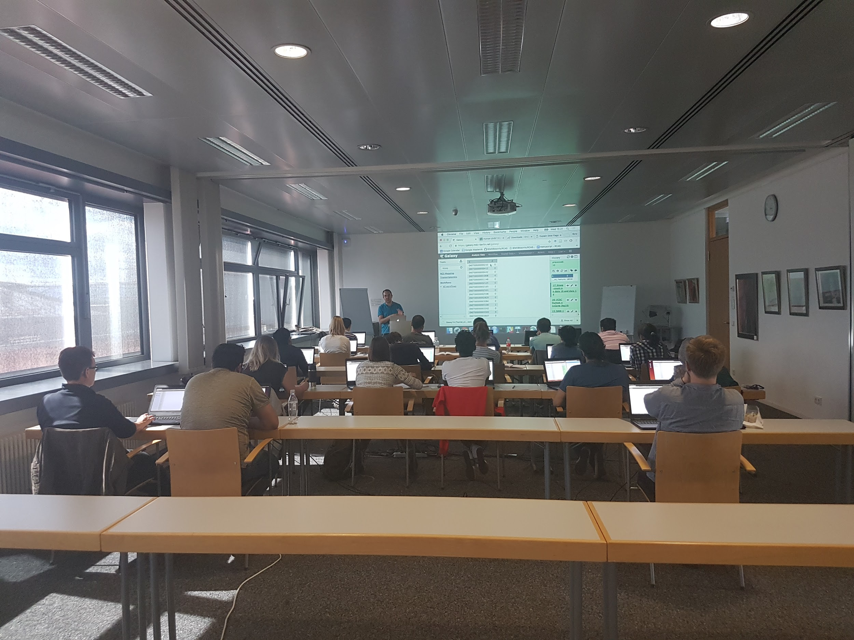
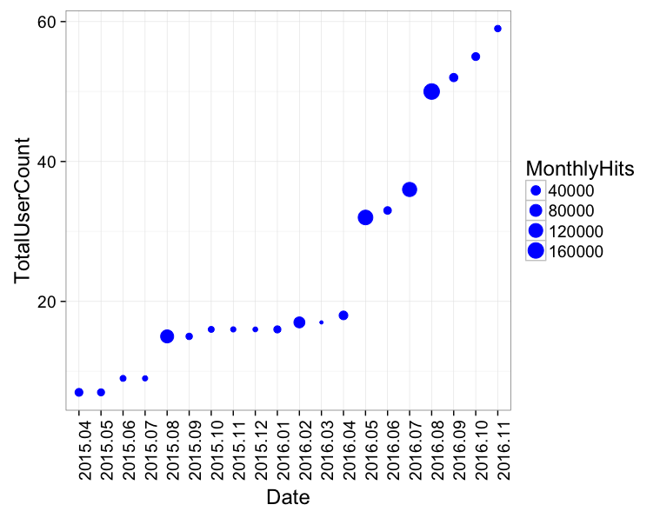



de.NBI − German Network for Bioinformatics Infrastructure
RBC:
BIMSB
RNA Bioinformatics Center:
The Berlin Institute for Medical Systems Biology
Uwe Ohler, Nikolaus Rajewsky, Altuna Akalin, Dilmurat Yusuf, Bora Uyar, Ricardo Wurmus, Dan Munteanu
The Berlin Institute for Medical Systems Biology, Max-Delbrueck Center for Molecular Medicine, Berlin, Germany
Short description of the project
de.NBI services
We offer tools, services and training for the analysis of
RNA-binding proteins and
post-transcriptional regulation
Local Galaxy Server
User support
Tool/workflow development
Server Maintenance
Tools and Databases
RCAS: RNA-centric annotation system
doRiNA: Database for binding sites of RNA-binding proteins and miRNAs
RiboTaper: A toolbox for analysis of Ribosome profiling data
microMummie: MicroRNA target site identification tool
PARalyzer: RNA binding site detection from PAR-CLIP dataset
Progress report
Progress up to October 2016
Galaxy Server
Offered two courses on RNA-Seq analysis
Integrated public/in-house tools based on user-demand
Developed workflows and tested tools for users
Switched to production server
RCAS (RNA Centric Annotation System)
Developed an R/Bioconductor package for systematic annotation of regions of interest from RNA-based omics datasets
Available in Galaxy, Bioconda, Docker, Guix
Available as a web-service
http://rcas.mdc-berlin.de/
Tasks planned for next year
Offer more training on Galaxy
Chip-Seq analysis
Variant analysis
Integrate more in-house tools to Galaxy server
PIPmir (Pipeline for plant miRNA identification)
PARalyzer (PAR-CLIP analysis pipeline)
Update the doRiNA database
More content and functionality
de.NBI training and education
Offered two workshops for
RNA-seq analysis using Galaxy
We have a growing number of Galaxy users
Second
Galaxy
Workshop
First
Galaxy
Workshop
Publications
Uyar B, Yusuf D, Wurmus R, Rajewsky N, Ohler U, Akalin A. RCAS: an RNA Centric Annotation System for Transcriptome-wide Regions of Interest. (Submitted to Nucleic Acids Research)
Förderkennzeichen Nr…..
http://www.denbi.de

