Slide 1


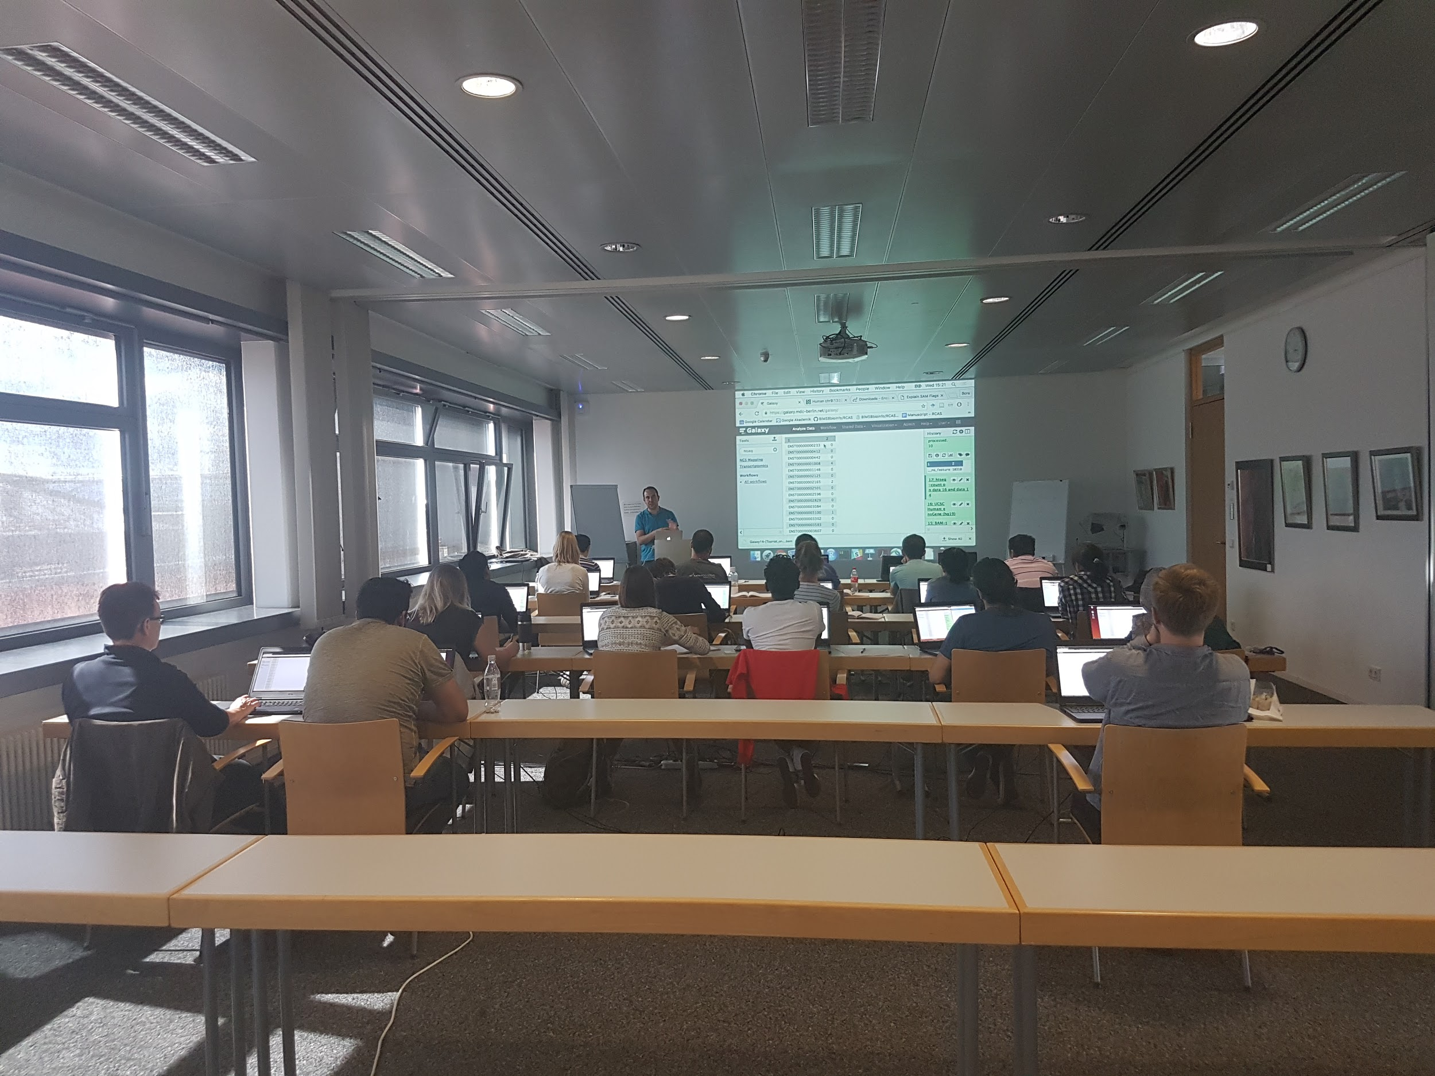







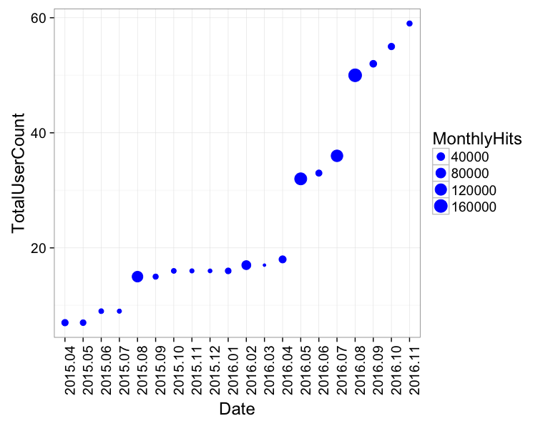


RBC 3&4 – For RNA-binding proteins and post-transcriptional regulation
Galaxy Server
Tools and Databases
Training
RCAS
RNA-centric annotation system
(Manuscript submitted)
DoRiNA database
Database for binding sites of RNA-binding proteins and miRNAs
RiboTaper
A toolbox for analysis of Ribosome profiling data
microMummie
MicroRNA target site identification tool
PARalyzer
RNA binding site detection from PAR-CLIP datasets
Offered two workshops for RNA-seq analysis using Galaxy
We have a growing user base
We do:
User consultation
Tool and workflow development & integration
Server maintenance

