Slide 1

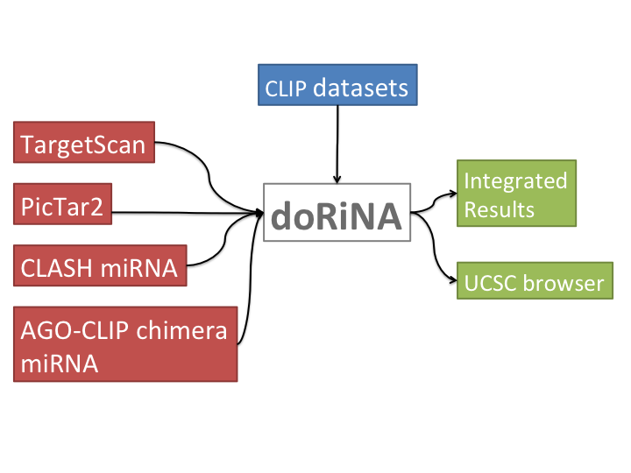
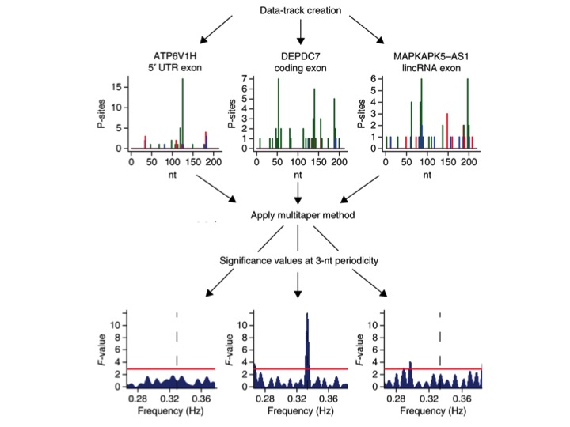
RBC 3&4 – For RNA-binding proteins and post-transcriptional regulation
DoRiNA database – Database for RNA-binding protein binding sites and miRNA binding sites from various resources including our in-house tool PicTar2
RiboTaper – A toolbox for analysis of Ribosome profiling data
RCAS – A pipeline for annotation of RNA-specific features such as RNA-modification sites and RBP binding sites.
microMummie – MicroRNA target site identification by integrating sequence and binding information
PARalyzer - definition of RNA binding sites from PAR-CLIP short-read sequence data
Local Galaxy server – aimed for wetlab researchers being able to run bioinformatics tools and analysis pipelines developed for.
DoRiNA integrates experimental and computational datasets for RBP and miRNA binding sites. (Blin et al. NAR 2015)
RiboTaper: P-site positions are color-coded by the frame; the method estimates the significance of each frequency component. Exons from different transcript classes are shown with their periodicity significance (Calviello et al. Nature Met. 2016)

