Slide 1





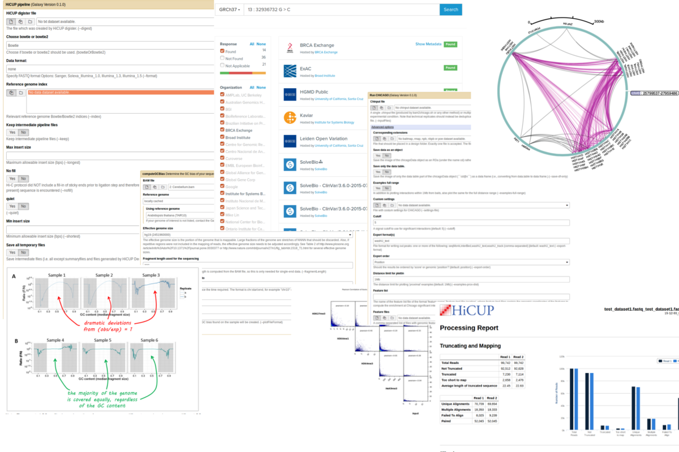
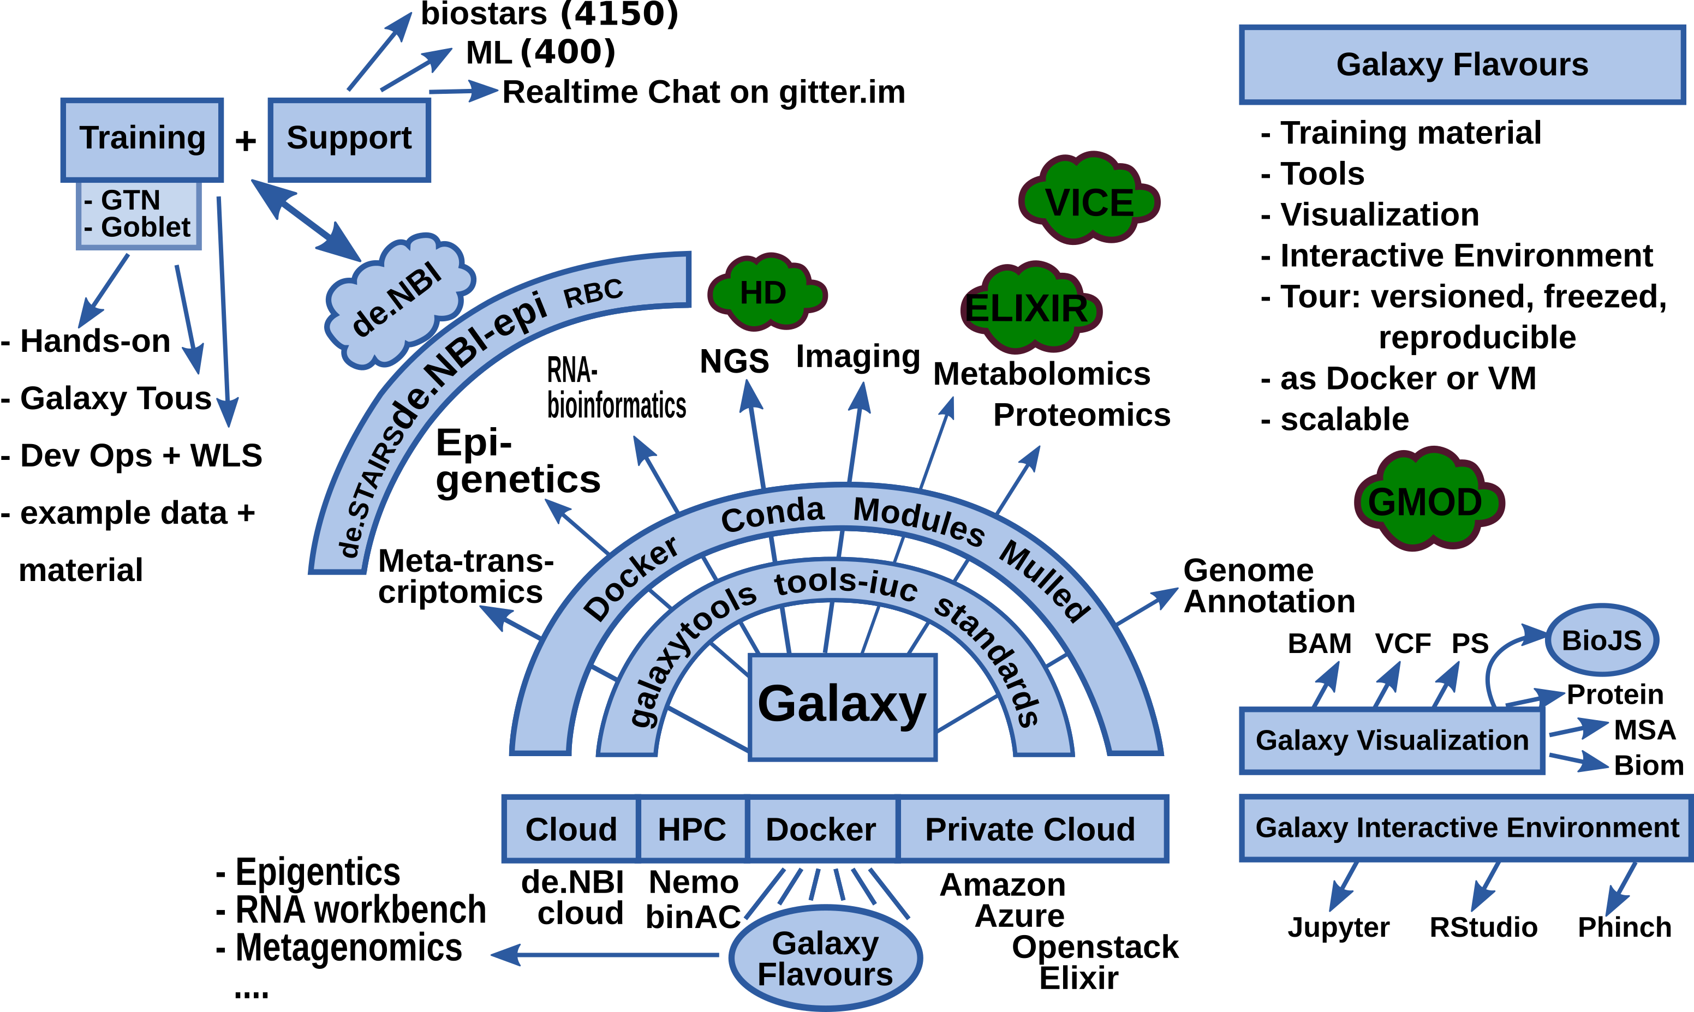
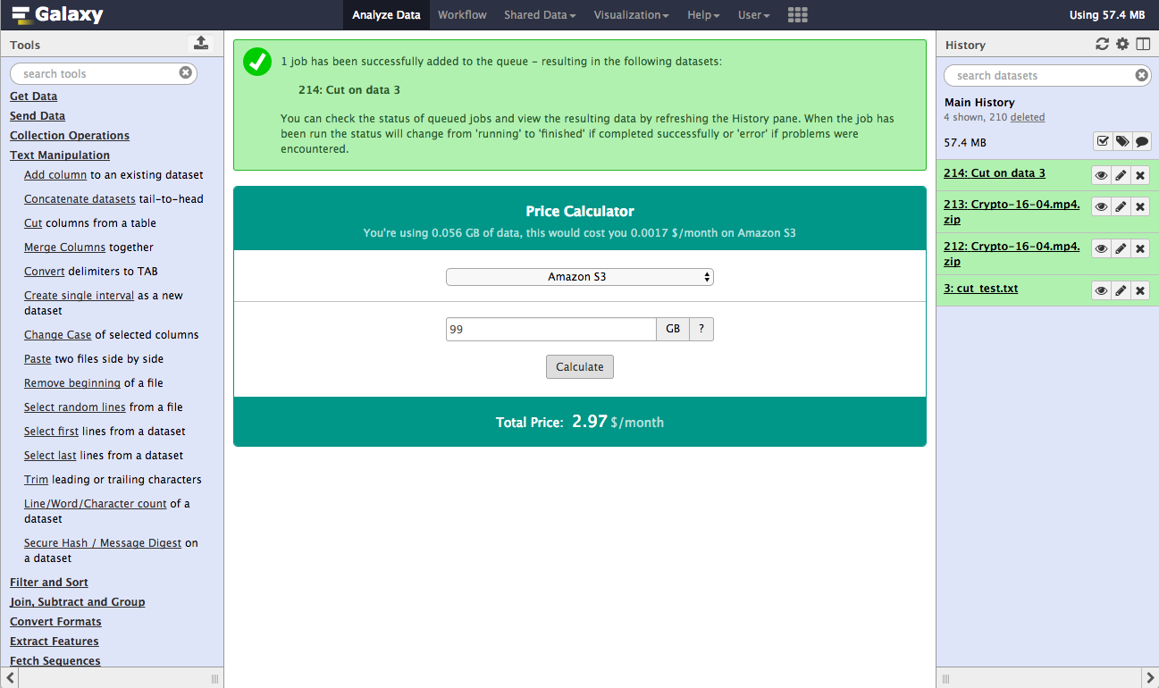
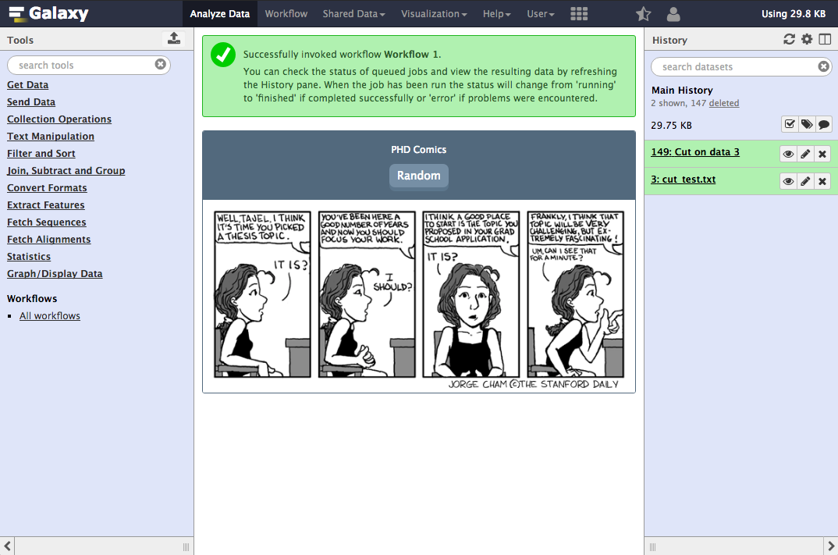





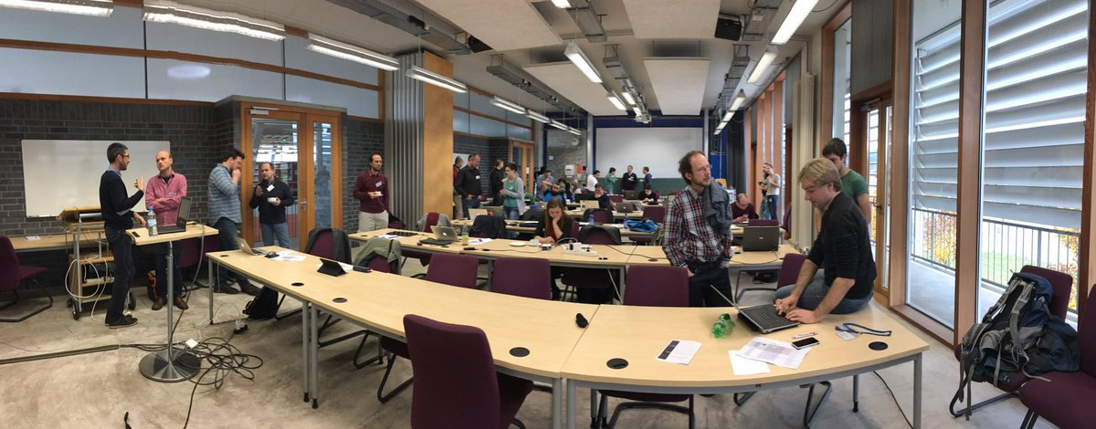
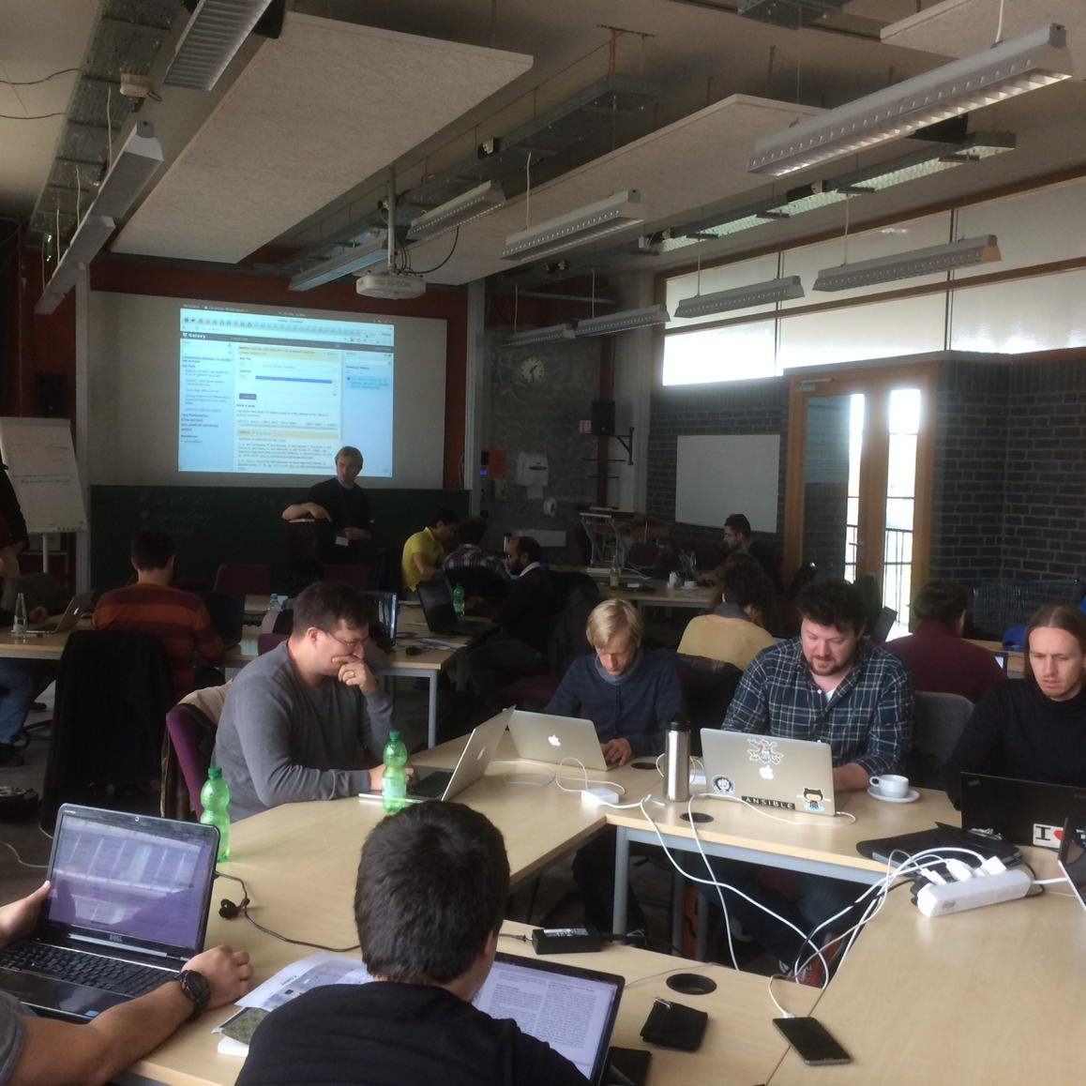




de.NBI − German Network for Bioinformatics Infrastructure
de.NBI-epi
RNA Bioinformatics Center
University of Freiburg
Chair of Prof. Rolf Backofen
Rolf Backofen, Bjoern Gruening, Joachim Wolff
RNAx Bioinformatics Center, University of Freiburg, Germany
Short description of the project
de.NBI services
The de.NBI-epi project in Freiburg offers visualization, normalization and quality assessment of epigenetic datasets as well as integration of CHIP-seq and bisulfite sequencing analysis pipelines into Galaxy.
Maintenance and Integration of software into Galaxy to provide easy access for epigentic analysis software:
HiCExplorer
deepTools
Bismark
HiCUP
CHiCAGO
PileOMeth
Beacons
Galaxy WebHooks as playground for SIG-2 and SIG-4 with Gamification:
Community based infrastructure
Pricing system: How much would it cost to compute and store your data on Amazon EC2?
Comics: Have fun while Galaxy is computing your data.
Bioconda is a conda channel which provides software for biomedical research.
8600 commits on GitHub
155 contributors
> 1800 packages
BioContainers provides system-agnostic executable environments for bioinformatics software.
based on Docker & rkt
> 1800 Images
automatic builds from BioConda
Galaxy is an open, web-based platform for data intensive research.
25550 commits
131 contributors
One of the biggest Galaxy instances available for de.NBI: http://galaxy.uni-freiburg.de/
And a lot more:
RSS-Reader
Pubmed
Tool prediction
Runtime graphs
de.NBI training and education
Galaxy Tours
For users:
as easy as a video
Interactive as hands-on
For developers/trainers
Easier than you can imagine
Two one week training courses on NGS-data analysis in 2016 with ~30 participants each
06th – 07th Oct 2016 Swiss German Galaxy workshop
02nd – 03rd Nov 2016 BioConda hackathon
15th – 16th Dec 2016 Galaxy RNA-seq data analysis workshop
Publications
Ramírez, F., Ryan, D.P., Grüning, B., Bhardwaj, V., Kilpert, F., Richter, A.S., Heyne, S., Dündar, F. and Manke, T., 2016. deepTools2: a next generation web server for deep-sequencing data analysis. Nucleic acids research, p.gkw257.
Tools and data services registry: a community effort to document bioinformatics resources.
doi: 10.1093/nar/gkv1116
The Galaxy platform for accessible, reproducible and collaborative biomedical analyses: 2016 update.
doi: 10.1093/nar/gkw343
Förderkennzeichen Nr. 031A538A
http://www.denbi.de

