Slide 1



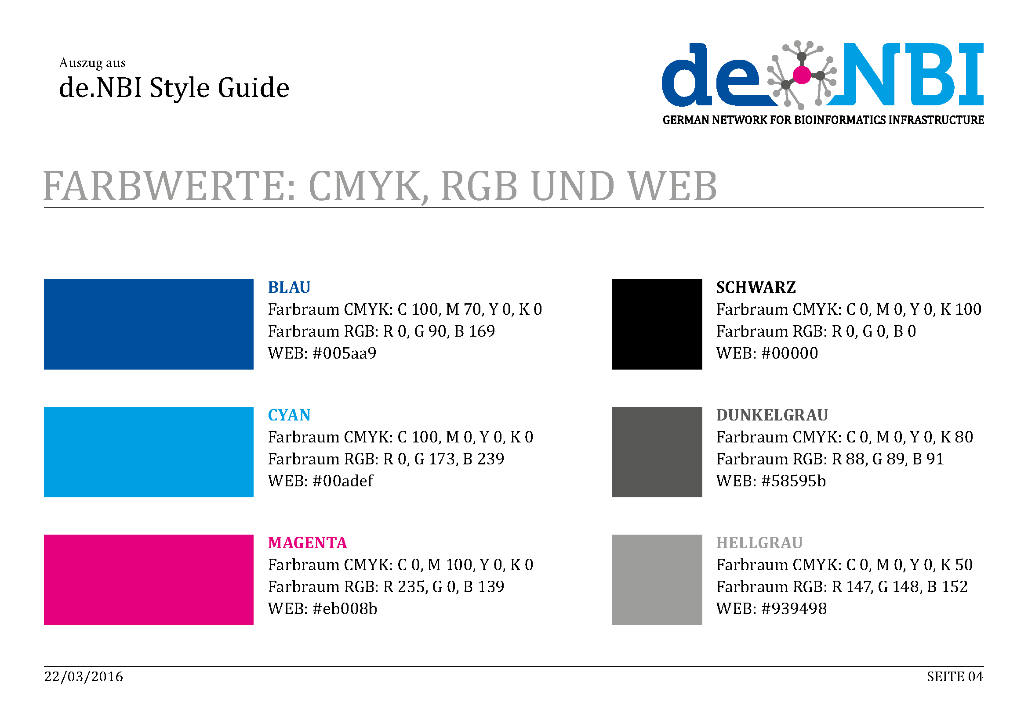





de.NBI − German Network for Bioinformatics Infrastructure
RBC:
BIMSB
RNA Bioinformatics Center:
The Berlin Institute for Medical Systems Biology
Altuna Akalin, Uwe Ohler, Nikolaus Rajewsky, Dilmurat Yusuf, Bora Uyar, Ricardo Wurmus, Dan Munteanu
The Berlin Institute for Medical Systems Biology, Max-Delbrueck Center for Molecular Medicine, Berlin, Germany
Short description of the project
de.NBI services
We offer tools, services and training for the analysis of
RNA-binding proteins and
post-transcriptional regulation
DoRiNA database – Database for RNA-binding protein binding sites and miRNA binding sites from various resources including our in-house tool PicTar2
RiboTaper – A toolbox for analysis of Ribosome profiling data
RCAS – A pipeline for annotation of RNA-specific features such as RNA-modification sites and RBP binding sites.
microMummie – MicroRNA target site identification by integrating sequence and binding information
PARalyzer - definition of RNA binding sites from PAR-CLIP short-read sequence data
Local Galaxy server – aimed for wetlab researchers being able to run bioinformatics tools and analysis pipelines developed for.
Progress report
Tasks performed up to October 2016
RCAS
Galaxy tools
Bioconda
Guix
Galaxy training
Set up and optimisation of Galaxy production server
Tasks planned for the next 12 months
-
Publications
de. NBI training and education
RCAS - manuscript submitted
doRiNA
RiboTaper
Galaxy courses
17-18 May
17-18 August
Förderkennzeichen Nr…..
http://www.denbi.de

