Slide 1


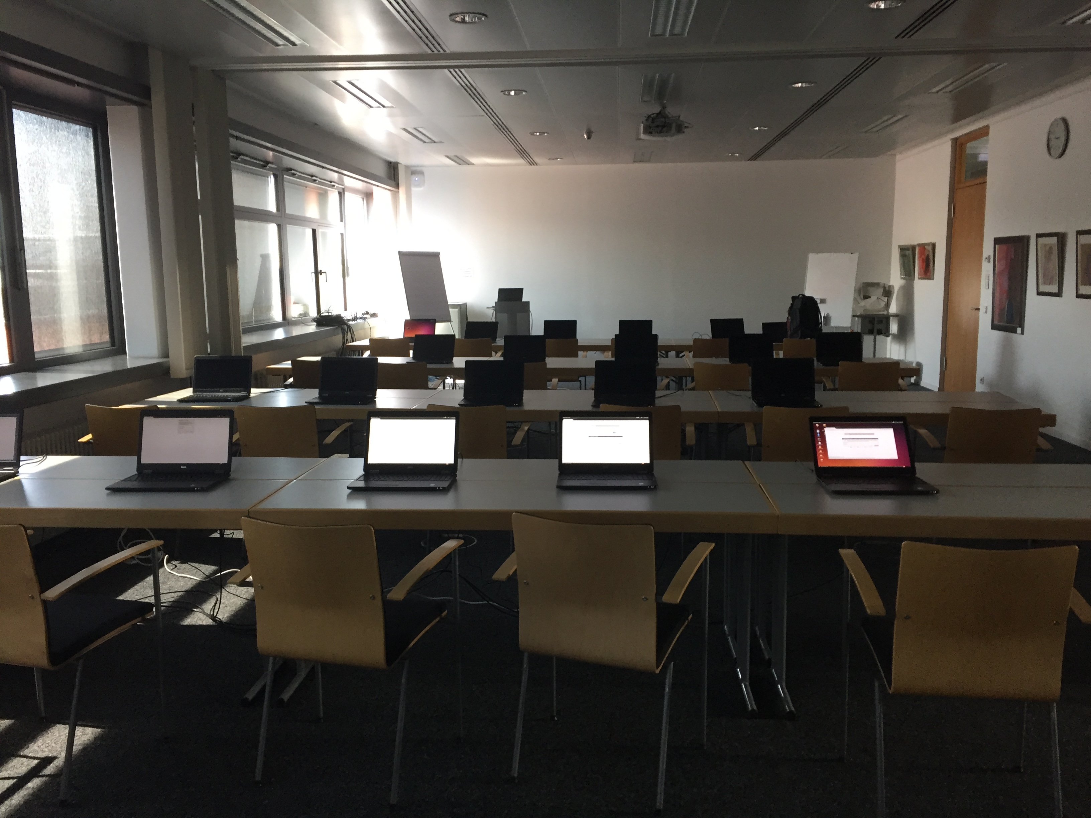
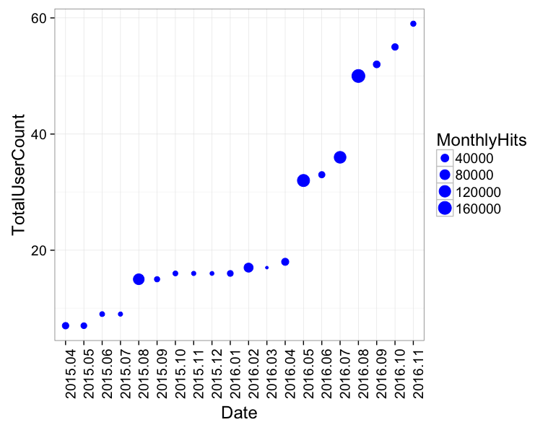
RBC 3&4 – For RNA-binding proteins and post-transcriptional regulation
Galaxy Server
Tools and Databases
Training
RCAS – RNA-centric annotation system (Manuscript submitted – available on Bioconductor)
DoRiNA database – Database for binding sites of RNA-binding proteins and miRNAs
RiboTaper – A toolbox for analysis of Ribosome profiling data
microMummie – MicroRNA target site identification tool
PARalyzer - definition of RNA binding sites from PAR-CLIP short-read sequence data
Offered two workshops for RNA-seq analysis using Galaxy
We have a growing user base
We do:
User consultation
Tool and workflow development & integration
Database maintenance

