Slide 1




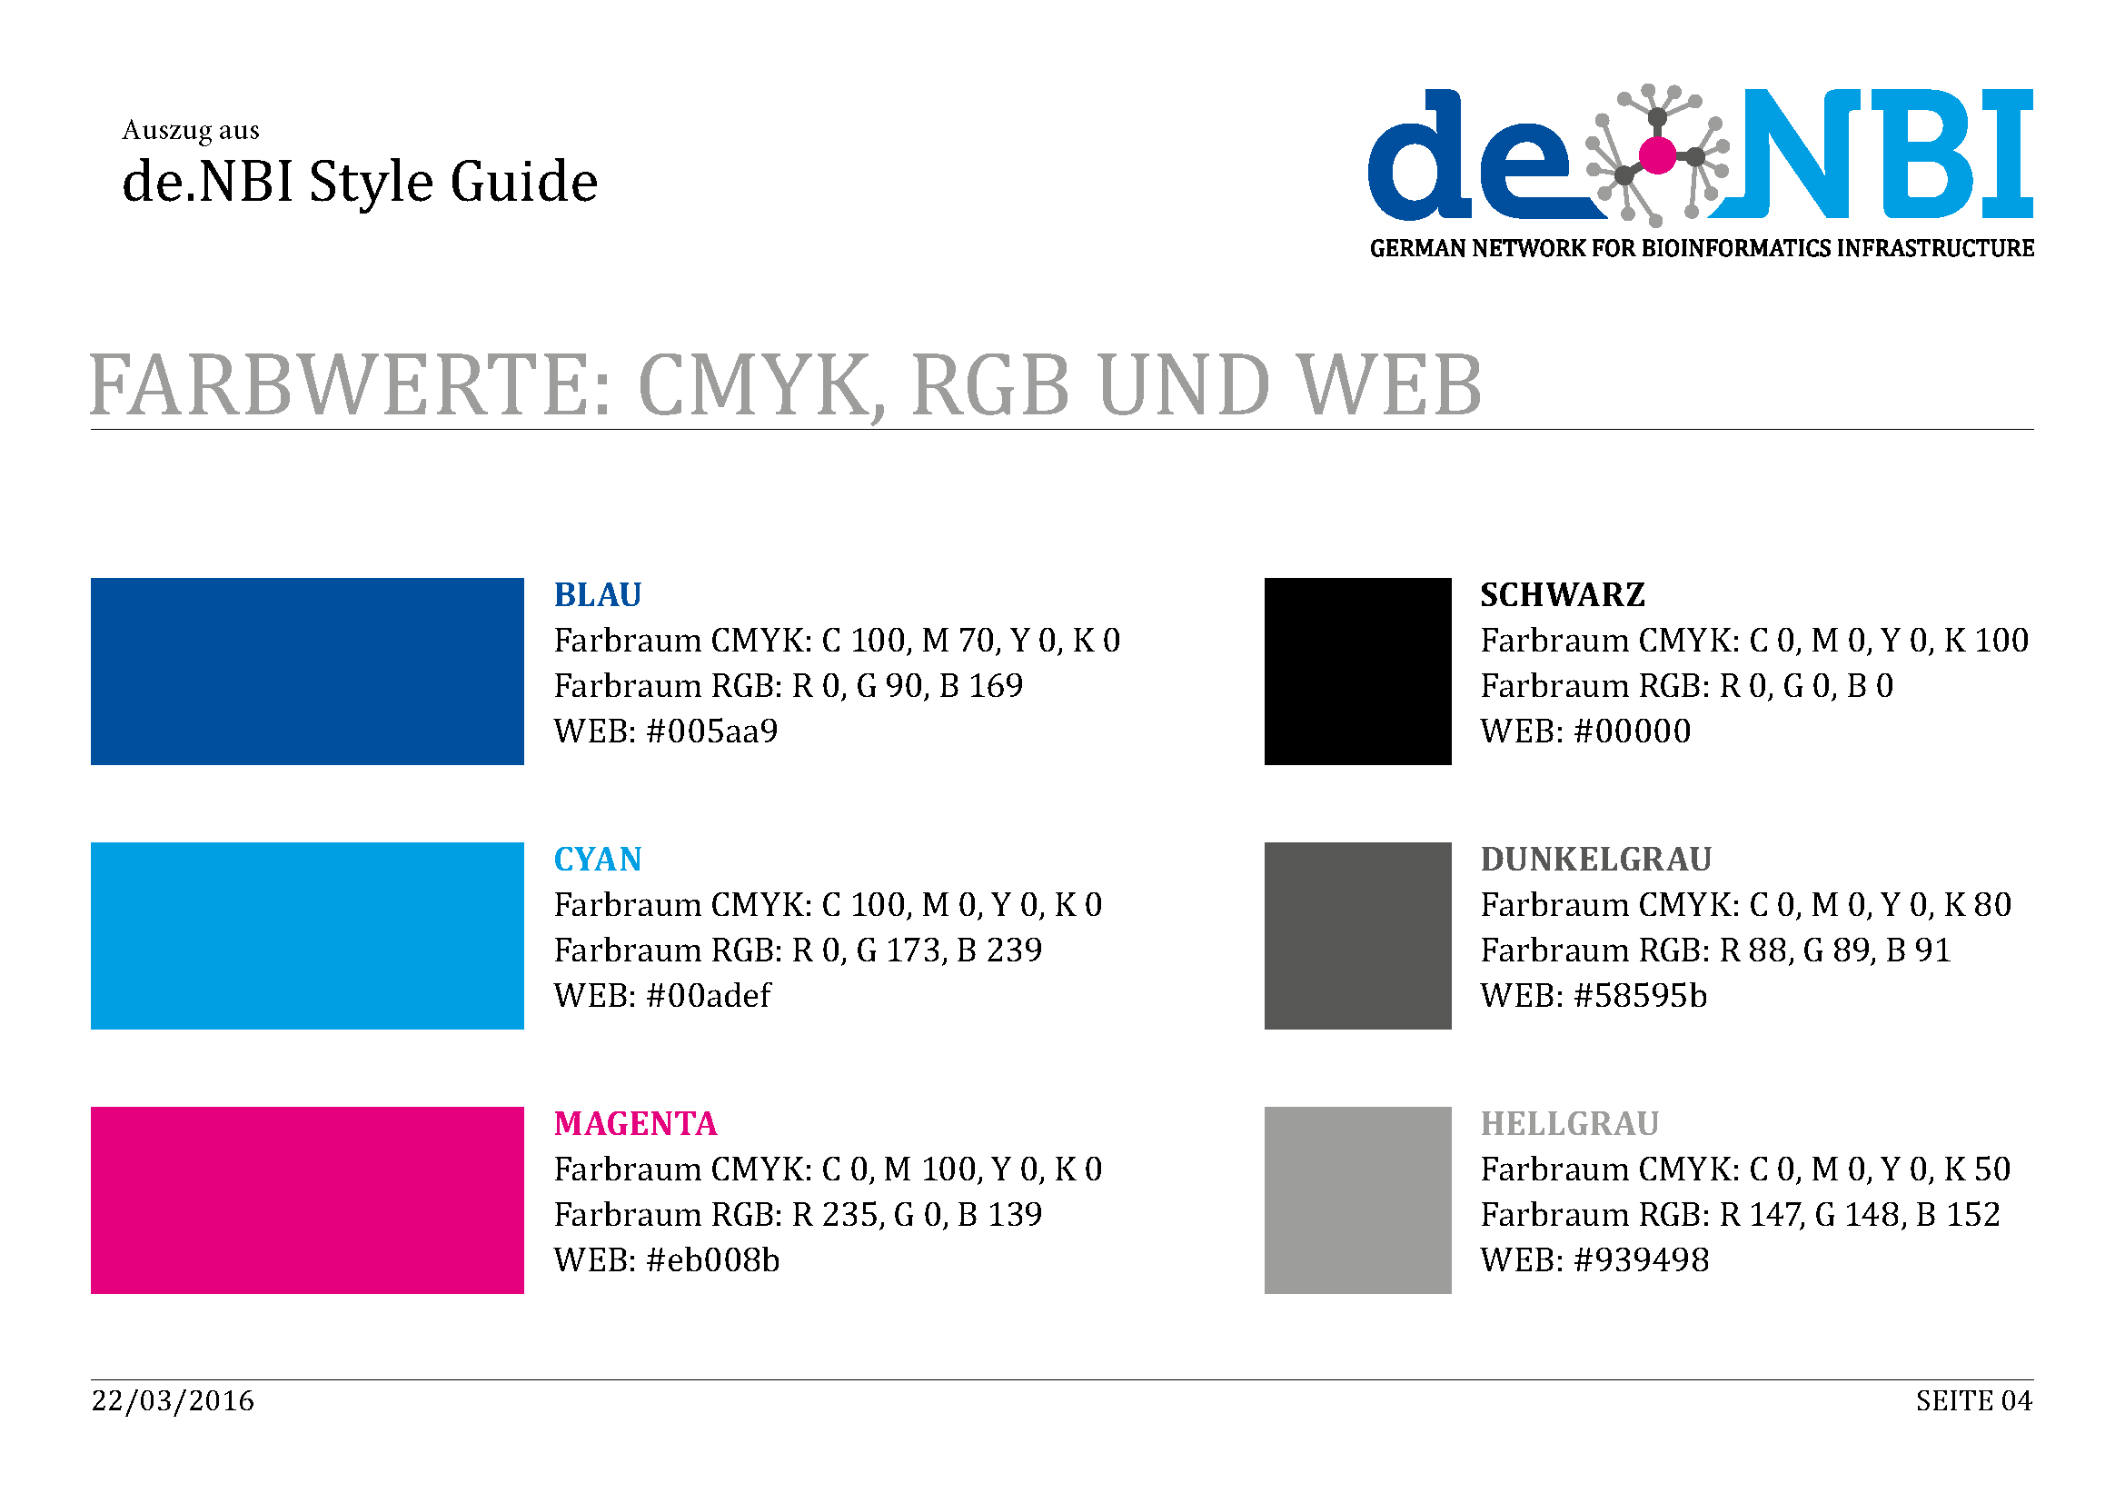





de.NBI − German Network for Bioinformatics Infrastructure
RBC:
BIMSB
RNA Bioinformatics Center:
The Berlin Institute for Medical Systems Biology
Altuna Akalin, Uwe Ohler, Nikolaus Rajewsky, Dilmurat Yusuf, Bora Uyar, Ricardo Wurmus, Dan Munteanu
The Berlin Institute for Medical Systems Biology, Max-Delbrueck Center for Molecular Medicine, Berlin, Germany
Short description of the project
de.NBI services
Hinweis:
Description of de.NBI services offered and carried out by the project
Progress report
de. NBI training and education
Tasks performed up to October 2016 and planned for the next 12 months
Description of de.NBI training and education activities offered and carried out
Publications
(If applicable)
Förderkennzeichen Nr…..
http://www.denbi.de

