Slide 1





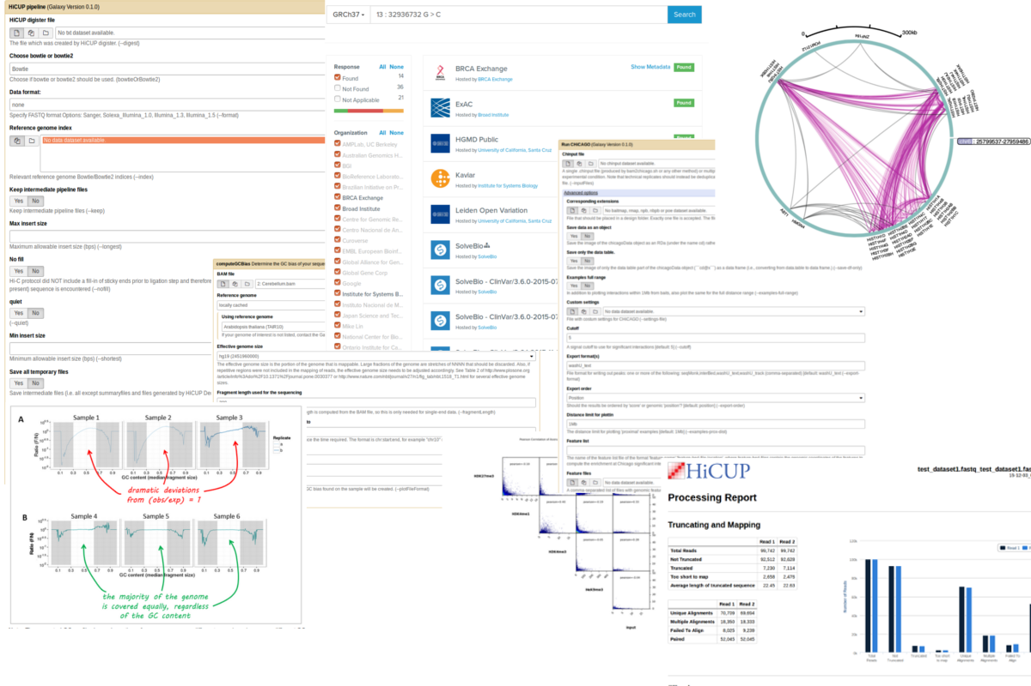
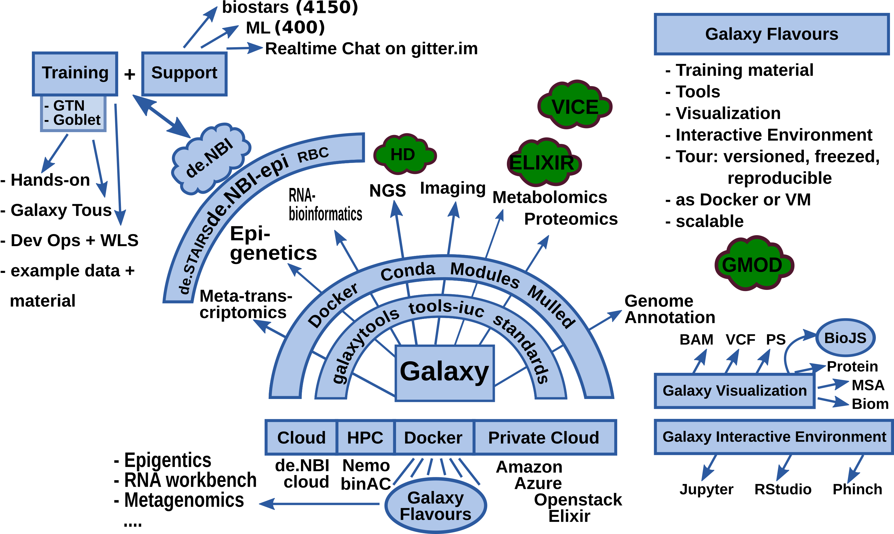
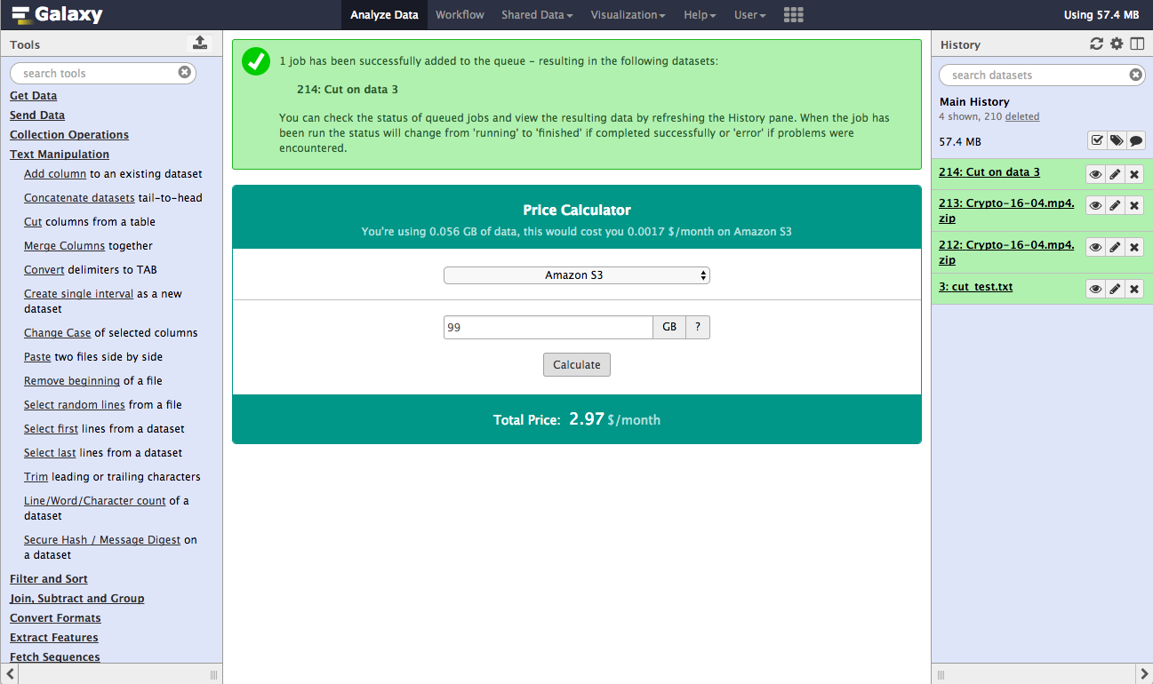
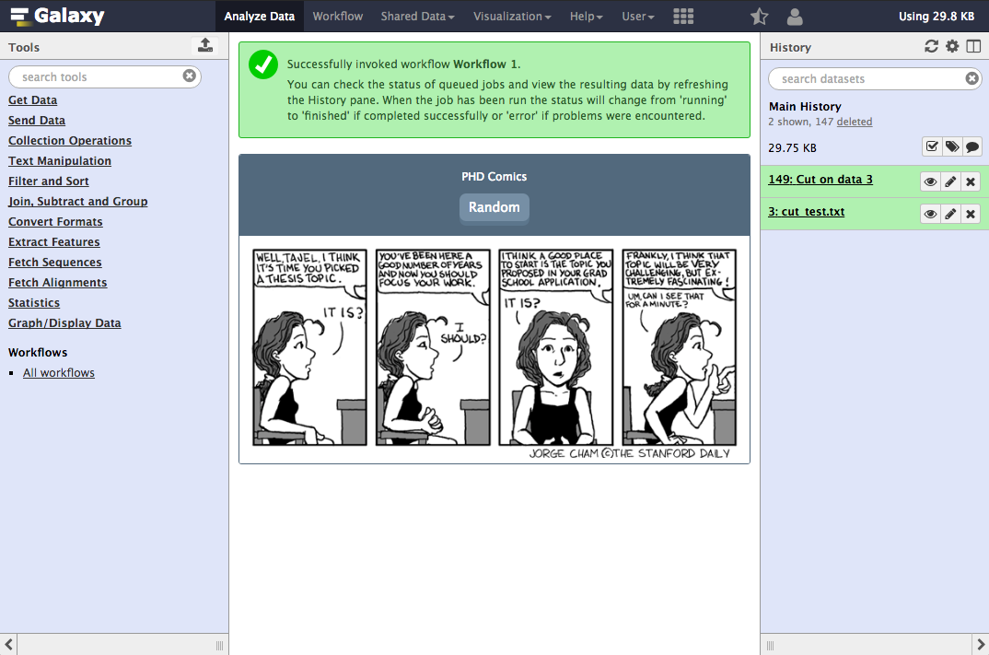




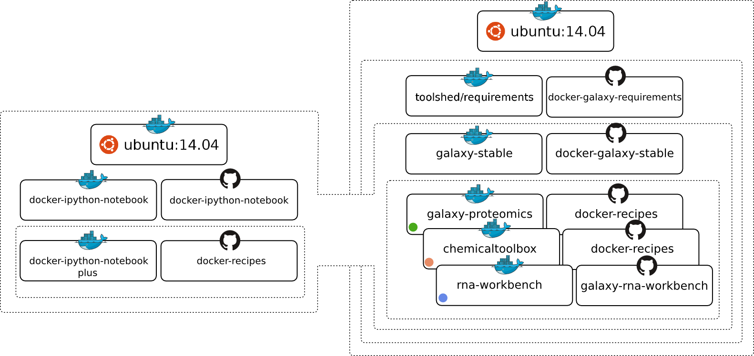


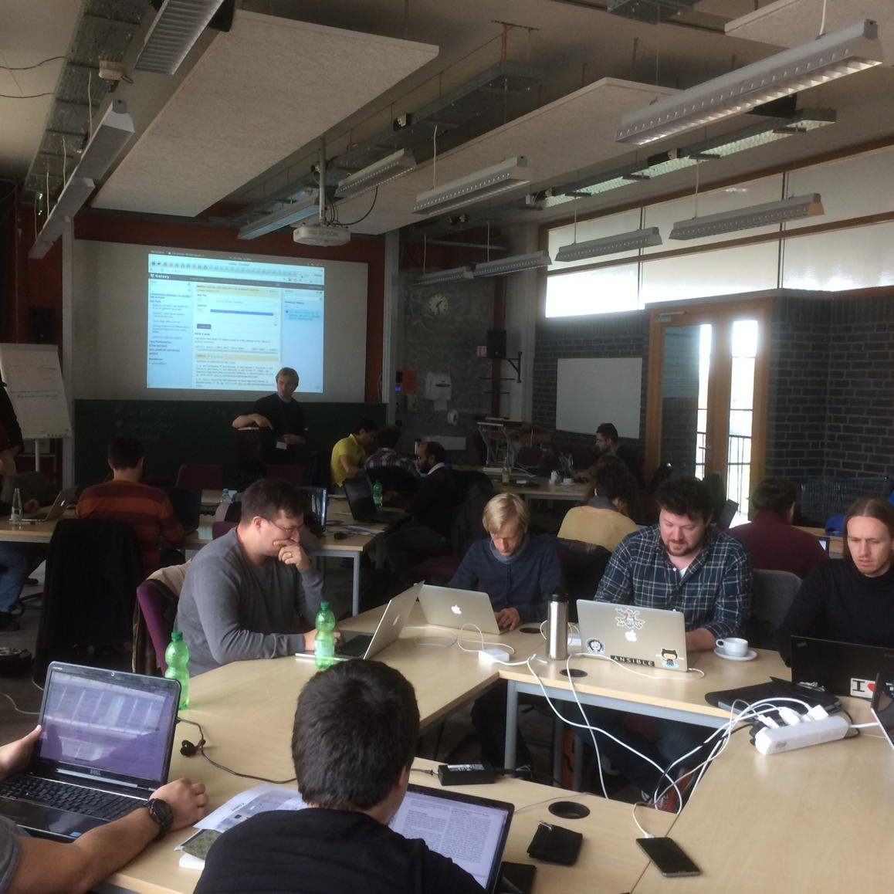
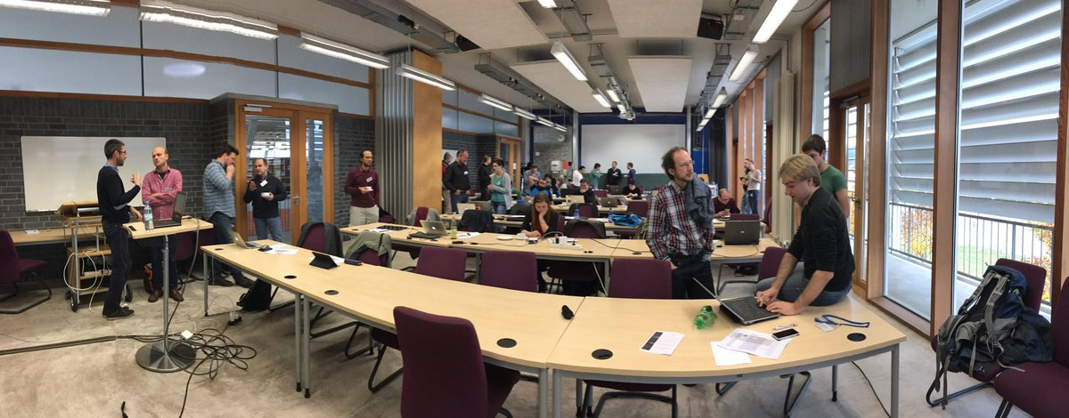




de.NBI − German Network for Bioinformatics Infrastructure
de.NBI-epi
RNA Bioinformatics Center
University of Freiburg
Chair of Bioinformatics
Björn Grüning, Joachim Wolff, Rolf Backofen
RNA Bioinformatics Center, University of Freiburg, Germany
Description of de.NBI-epi
de.NBI services
The de.NBI-epi project in Freiburg offers visualisation, normalisation and quality assessment of epigenetic datasets as well as integration of CHIP-seq and bisulfite sequencing analysis pipelines into Galaxy.
Maintenance and integration of software into Galaxy to provide easy access for epigenetic analysis software:
HiCExplorer
deepTools
Bismark
HiCUP
CHiCAGO
PileOMeth
Methtools
Beacons
Galaxy WebHooks as playground for SIG-2 and SIG-4 with gamification:
Community based infrastructure
Pricing system: How much would it cost to compute and store your data on Amazon EC2?
Comics: Have fun while Galaxy is computing your data.
BioConda is a conda channel which
provides software for biomedical research.
8,600 commits on GitHub
155 contributors
> 1,800 packages
BioContainers provides system-agnostic executable environments for bioinformatics software.
Based on Docker & rkt
> 1,800 Images
Automatic builds from BioConda
Galaxy is an open, web-based platform for data intensive research.
25,550 commits
131 contributors
One of the biggest
Galaxy instances
available for de.NBI
And a lot more: RSS-Reader, PubMed recommendations, tool recommendation, runtime graphs… (leave a Post-it with your ideas!)
de.NBI training and education
Galaxy Tours – Bioinformatics Training 2.0
For users: As easy as a video, but interactive
as a hands-on training
For trainers: Dead simple to create!
http://galaxy.uni-freiburg.de
2016 past and planned events
06th – 7th Oct 2016 | Swiss German Galaxy workshop | Freiburg
24th – 26th Oct 2016 | CHARME, EMBnet and NETTAB Workshop | Rome
02nd – 03rd Nov 2016 | BioConda hackathon | Freiburg
15th – 16th Dec 2016 | Galaxy RNA-seq data analysis workshop | Freiburg
2017 planned events
16th – 19th Jan 2017 | European Galaxy Developer workshop | Strasbourg
13th – 17th Feb 2017 | Galaxy HTS data analysis workshop | Freiburg
4th – 5th Apr 2017 | ELIXIR – de.NBI AAI workshop | Freiburg
14th – 18th Sep 2017 | Galaxy HTS data analysis workshop | Freiburg
The Galaxy Docker Project
The Galaxy Docker Image is an easy distributable full-fledged Galaxy installation, that can be used for testing, teaching and presenting new tools and features.
Portable data analysis in a box!
Hands-on training material for self-study available:
https://bgruening.github.io/training-material
https://github.com/bgruening/docker-galaxy-epigenetic
Global Organisation for Bioinformatics Learning, Education & Training
Publications
deepTools2: a next generation web server for deep-sequencing data analysis.
doi:10.1093/nar/gkw257
Tools and data services registry: a community effort to document bioinformatics resources.
doi: 10.1093/nar/gkv1116
The Galaxy platform for accessible, reproducible and collaborative biomedical analyses: 2016 update.
doi: 10.1093/nar/gkw343
Förderkennzeichen Nr. 031L0101C
http://www.denbi.de

