Slide 1





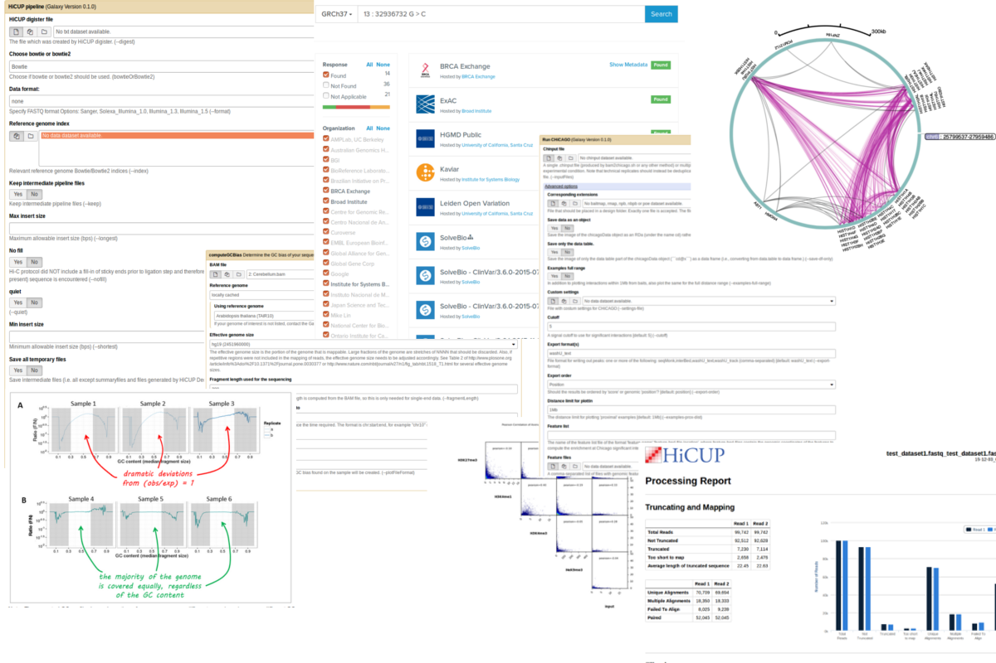
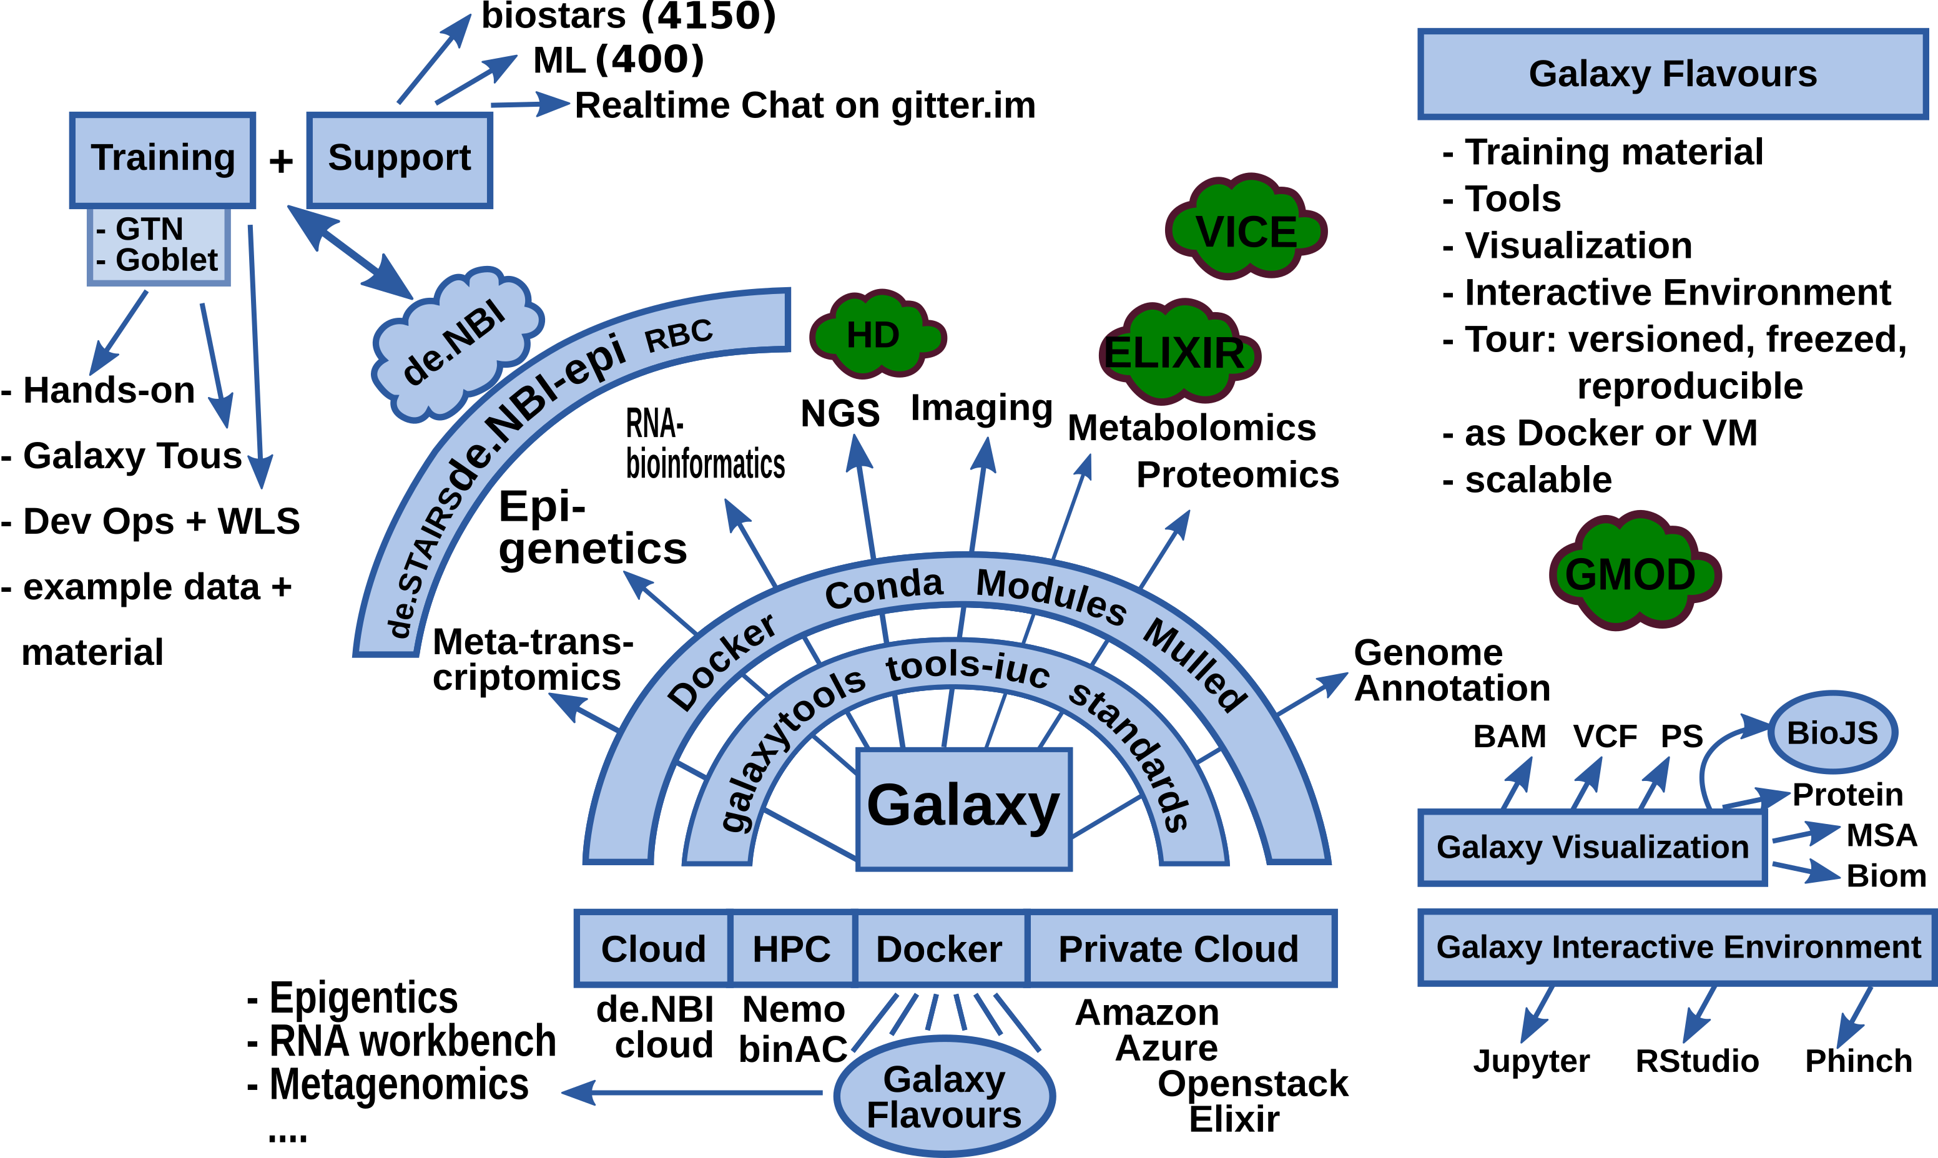
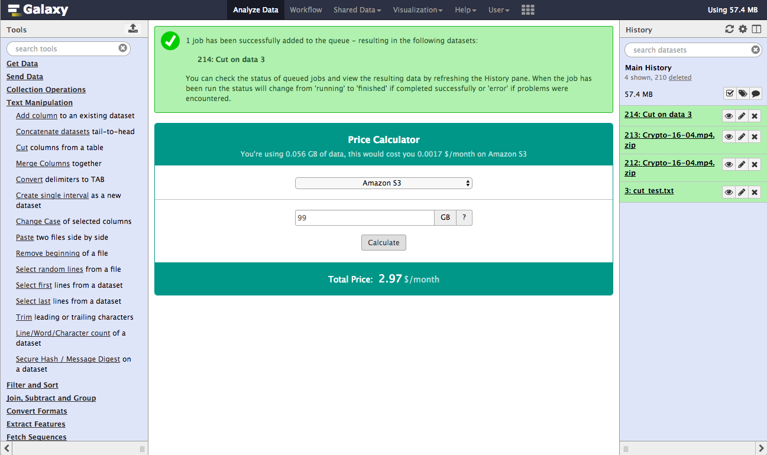
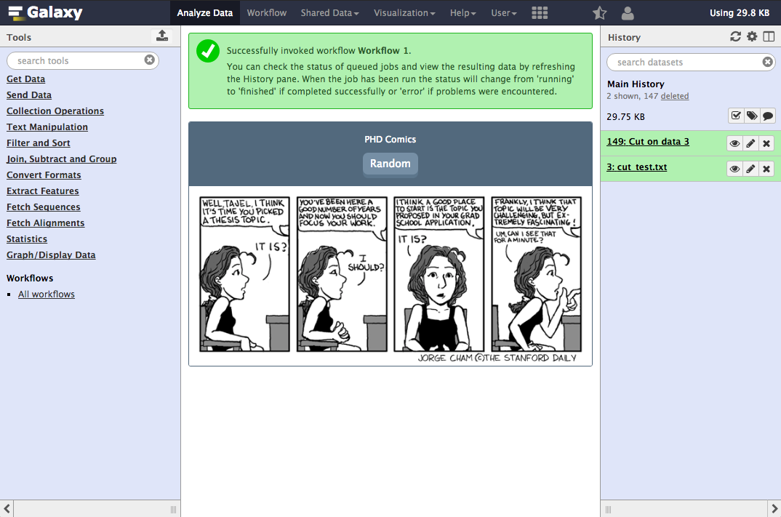




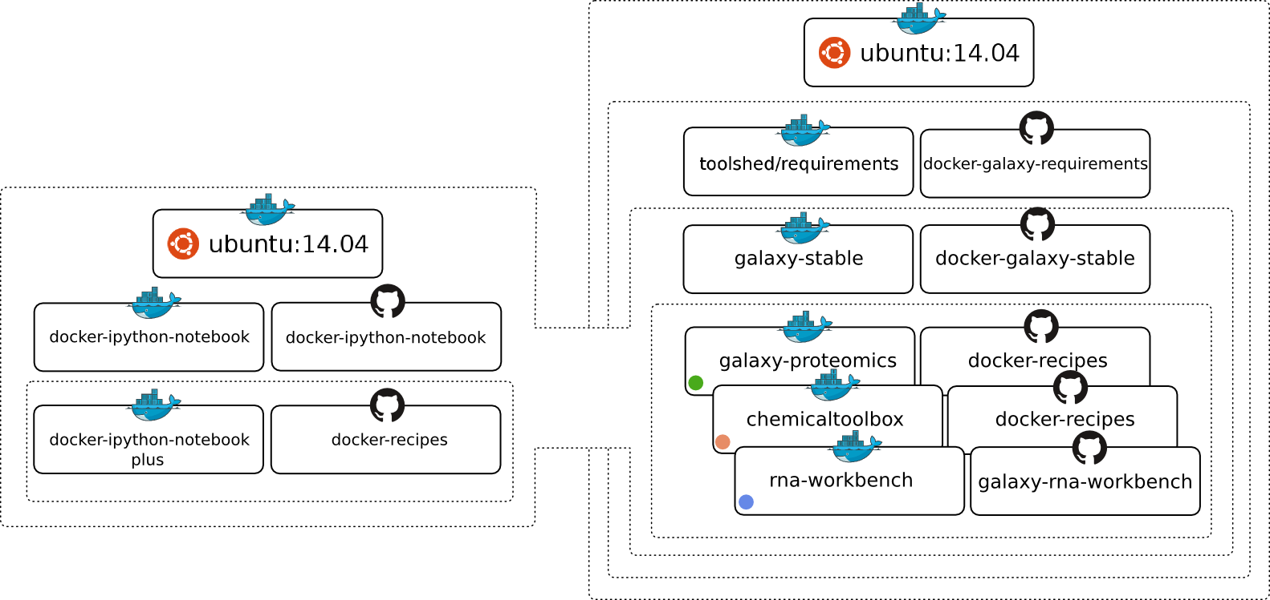
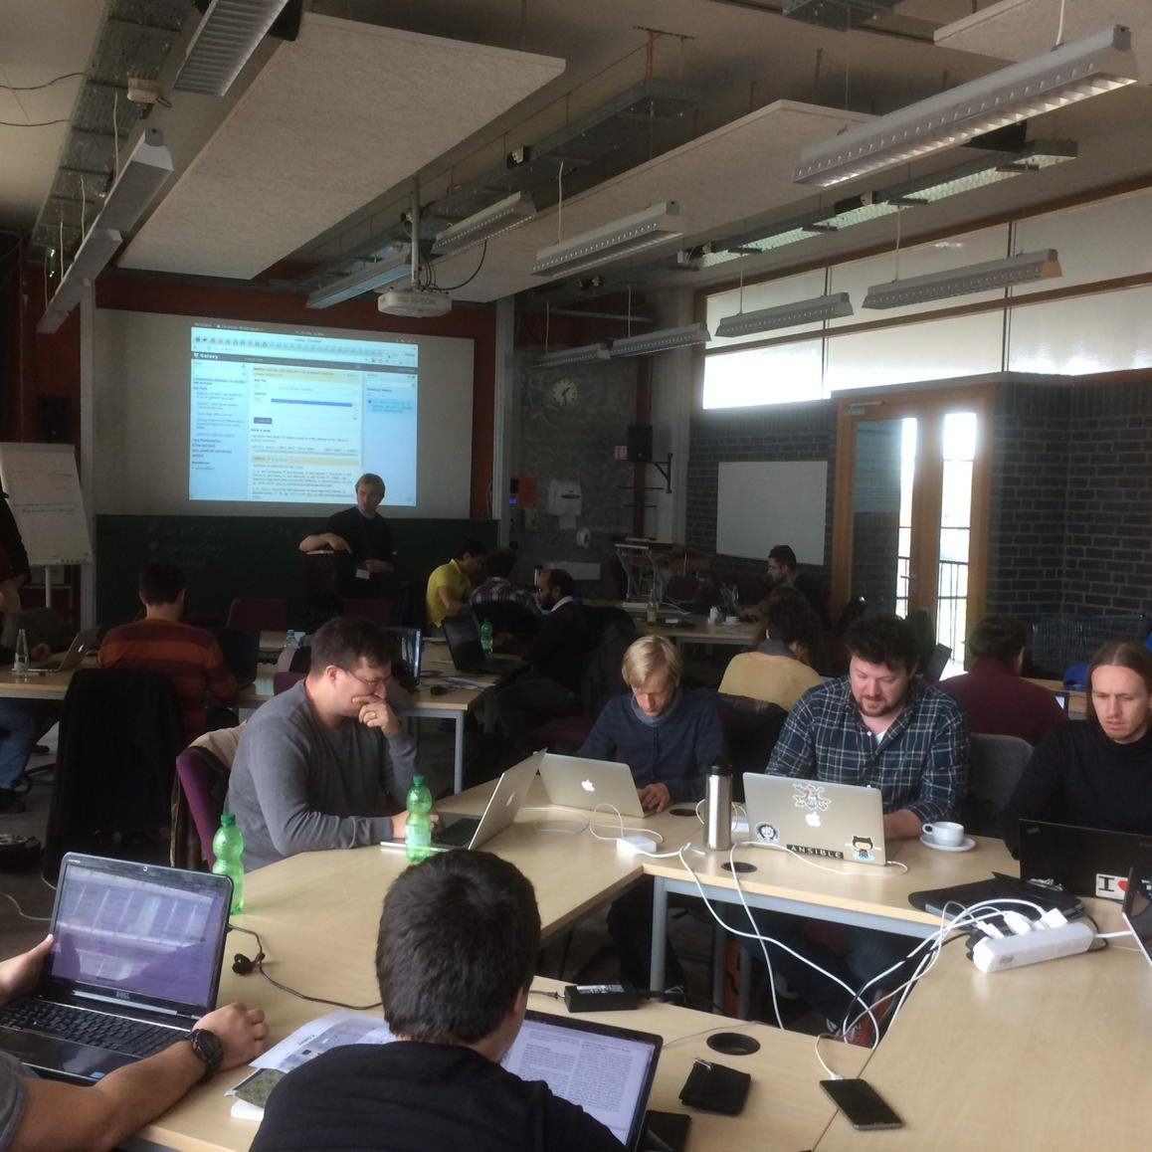
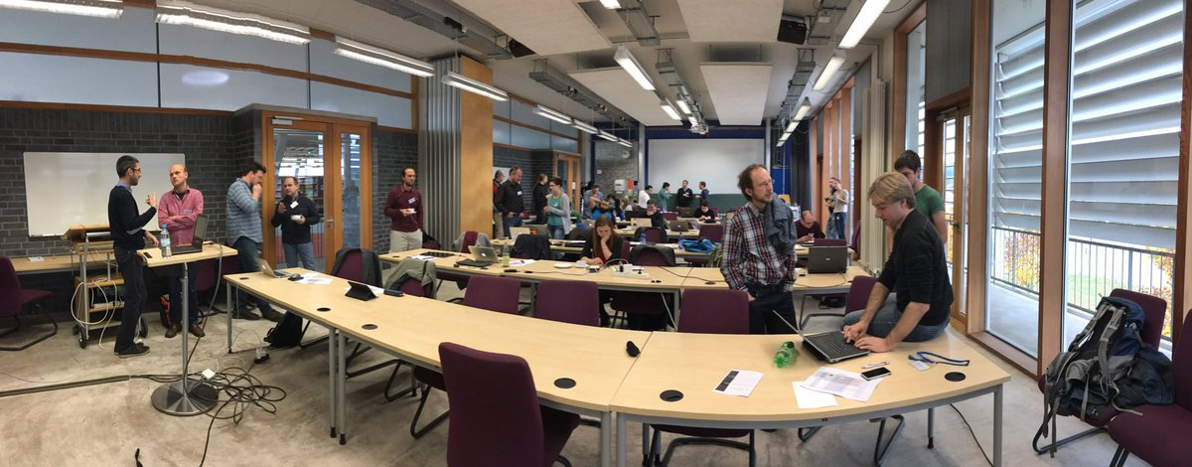




de.NBI − German Network for Bioinformatics Infrastructure
de.NBI-epi
RNA Bioinformatics Center
University of Freiburg
Chair of Prof. Rolf Backofen
Rolf Backofen, Björn Grüning, Joachim Wolff
RNA Bioinformatics Center, University of Freiburg, Germany
Short description of the project
de.NBI services
The de.NBI-epi project in Freiburg offers visualization, normalization and quality assessment of epigenetic datasets as well as integration of CHIP-seq and bisulfite sequencing analysis pipelines into Galaxy.
Maintenance and Integration of software into Galaxy to provide easy access for epigentic analysis software:
HiCExplorer
deepTools
Bismark
HiCUP
CHiCAGO
PileOMeth
Beacons
Galaxy WebHooks as playground for SIG-2 and SIG-4 with Gamification:
Community based infrastructure
Pricing system: How much would it cost to compute and store your data on Amazon EC2?
Comics: Have fun while Galaxy is computing your data.
Bioconda is a conda channel which provides software for biomedical research.
8600 commits on GitHub
155 contributors
> 1800 packages
BioContainers provides system-agnostic executable environments for bioinformatics software.
based on Docker & rkt
> 1800 Images
automatic builds from BioConda
Galaxy is an open, web-based platform for data intensive research.
25550 commits
131 contributors
One of the biggest Galaxy instances available for de.NBI: http://galaxy.uni-freiburg.de
And a lot more: RSS-Reader, PubMed recommendations, Tool recommendation, Runtime graphs … (leave a post-it with your ideas!)
de.NBI training and education
Galaxy Tours – Bioinformatics Training 2.0
For users: As easy as a video, but interactive
as a hands-on training
For trainers: Dead simple to create!
2016 past and planned events
06th – 7th Oct 2016 Swiss German Galaxy workshop
02nd – 03rd Nov 2016 BioConda hackathon
2017 past and planned events
15th – 16th Dec 2016 Galaxy RNA-seq data analysis workshop
16th – 19th Jan 2017 European Galaxy Developer workshop Strasbourg
13th – 17th Feb 2017 Galaxy HTS data analysis workshop Freiburg
4th – 5th Apr 2017 ELIXIR – de.NBI AAI workshop
14th – 18th Sep 2017 Galaxy HTS data analysis workshop Freiburg
Galaxy-Docker-Epigenetics: Portable data analysis in a box!
https://github.com/bgruening/docker-galaxy-epigenetic
Publications
deepTools2: a next generation web server for deep-sequencing data analysis.
doi:10.1093/nar/gkw257
Tools and data services registry: a community effort to document bioinformatics resources.
doi: 10.1093/nar/gkv1116
The Galaxy platform for accessible, reproducible and collaborative biomedical analyses: 2016 update.
doi: 10.1093/nar/gkw343
Hands-on training material for self-study available:
https://bgruening.github.io/training-material
Förderkennzeichen Nr. 031L0101C
http://www.denbi.de

