Slide 1
🎓 Final Year Project Design
IoT-Based Smart Poultry Farm
Full name: Abdul-latif Abass Suleiman
Registration number: BITAM/10/22/091/TZ
Project title: IoT-Based Smart Poultry Farm
Supervisor name: Mr. Masoud Hamad Mmanga

Slide 2
Introduction IoT-Based Smart Poultry Farm Digitizing Poultry Farming for Smart, Sustainable Agriculture
Problem: Traditional poultry farming in Tanzania faces challenges like disease outbreaks, poor monitoring, high labor, and operational inefficiencies.
Solution: An integrated IoT and AI system for real-time monitoring, automation, and predictive analytics.
Impact: Increased productivity, reduced losses, better animal welfare, remote monitoring.
Key Features:
Real-time environmental and poultry welfare data
AI-powered disease prediction
Automated feeding and watering
Dashboard for analytics and alerts

Slide 3
Feasibility Study Summary
Operational Feasibility: Suitable for small to large farms; user-friendly mobile/web dashboard.
Economic Feasibility: Subscription model lowers cost for small farmers; long-term operational savings.
Technical Feasibility: Uses existing microcontroller + IoT tech (Arduino/RPi, sensors, Firebase).
Legal Feasibility: Compliant with agricultural safety, local ICT/data regulations.

Slide 4
Project Methodology
Approach: Agile development with iterative prototyping and user testing
Key Phases:
Requirement analysis with local poultry farmers
System design (hardware + software + AI)
Development & integration (sensors, control, dashboard)
Field simulation/testing
Final report & documentation

Slide 5
Development
Hardware: Arduino, DHT11, MQ135, LDR, motors
Backend: Django / Postgre(data logging, alerts)
Frontend: Web app using React
AI Module: Python (scikit-learn for disease prediction)
Testing Tools: Postman, breadboard simulations, cloud testing

Slide 6
Functional Requirements
Core Features:
Sensor-based real-time environmental monitoring
Feeding/watering automation
AI-based early disease detection
Web dashboard with visual alerts
Reports on productivity and performance

Slide 7
Non-Functional Requirements
Performance: Real-time updates (<5 seconds latency)
Reliability: Sensor uptime >98%
Security: Role-based access, secure API
Usability: Simple interface for farmers with low tech skills
Compatibility: Mobile, tablet, desktop browser

Slide 8
Automation & Dashboard Interface
Responsive dashboard: Real-time sensor graphs, control toggles
Notifications: Alerts for abnormal readings (e.g., high temp, poor air)
Manual Override: Activate/deactivate feeders and fans remotely
Analytics: Historical trends and cost analysis

Slide 9
Use Case Diagram – System Interactions
Actors:
Farmer – Monitors the farm, records activities, views alerts, and manages subscriptions.
System Admin – Manages device configurations and monitors performance.
Device Node – Sends sensor data to the cloud.
Use Cases:
Login/Register
View Dashboard
Monitor Sensor Data
Receive Alerts & Recommendations
Record Feeding Activity
Schedule Batch Activities
View Reports
Manage Farm Devices (Admin only)
Subscribe to Plans

Slide 10
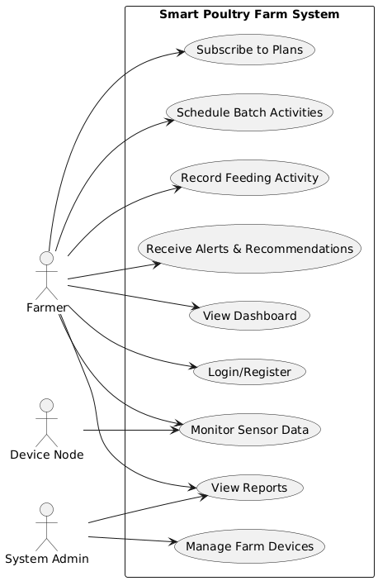
Use Case Diagram (Visual)

Slide 11
Class Diagram – System Architecture
Main Classes:
Farmer: Manages personal farm and subscriptions
Farm: Contains all data about location, name, and associated devices
Batch: Contains poultry data (age, breed, arrival) and manages feeding & activities
Breed: Classification of chickens (linked to feeding and growth logic)
Device: IoT hardware associated with each farm
Sensor: Reads environment values; tied to devices
Subscription: Plan subscribed by farmer
AlertEngine: Analyzes sensor data and provides alerts

Slide 12
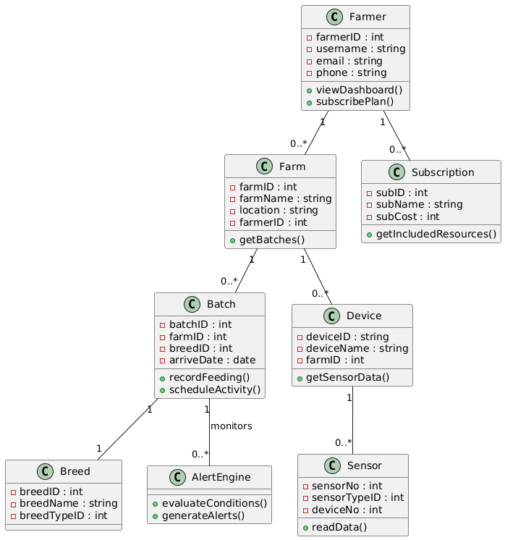
Class Diagram (Visual)

Slide 13
ERD – Data Model
Entity | Description
farmers_tb | Stores farmer account information
farm_tb | Links farms to specific farmers
batches_tb | Represents a batch of poultry on a farm, linked to a breed
breed_tb | Stores poultry breed details
breed_type_tb | Classifies breeds as egg/meat types
devices_tb | IoT devices deployed per farm
sensors_tb | Readings from each device (linked by sensor type and device)
batch_activity_tb | Activities performed on a batch (vaccination, inspection, etc.)
activity_type_tb | Lookup for activity types (e.g., cleaning, vaccine)
breed_activities_tb | Expected breed-specific activities based on age
breed_conditions | Optimal environmental conditions for each breed

Slide 14
Entity | Description
condition_type_tb | Types of environmental parameters (temperature, humidity)
batch_feeding_tb | Records of actual feed given to batches
breed_feeding_tb | Ideal feed schedule per breed and age
food_type_tb | Food types available (e.g., starter crumble)
farmers_subscription_tb | Links a farmer to a subscription plan
subsription_tb | Subscription plans with costs and services
subscription_resources | Resources/features provided per subscription
farmer_subscription_resources | Mapping between subscriptions and allocated resources
farmer_subscription_payment_tb | Payment details for subscription plans
users_tb | Authentication and user role management

Slide 15
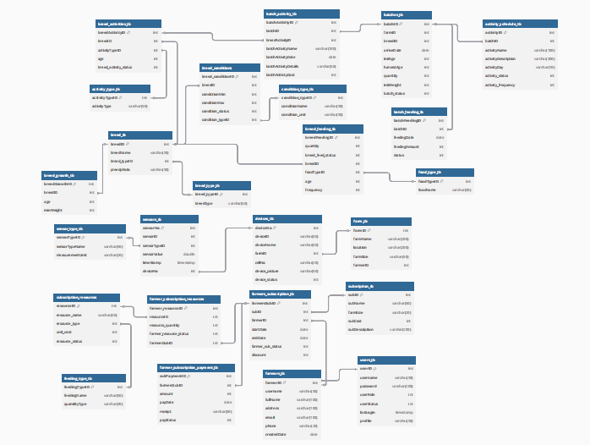
Class Diagram (Visual)

Slide 16
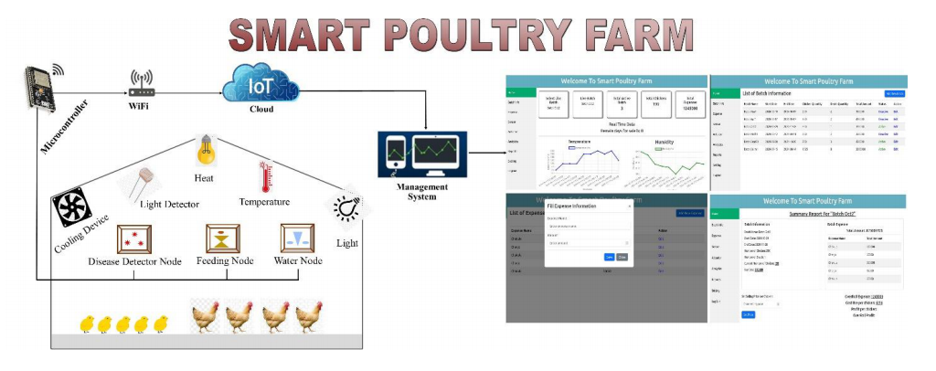
System Architecture Diagram

Slide 17
Sequence Diagram – Monitoring Flow Recording Batch Activity with AI Alerts
Description:
This sequence shows how a farmer logs a batch activity and how the system checks environmental and breed-specific thresholds to trigger alerts.
Flow:
Farmer submits a new batch activity via dashboard.
API Server stores the activity in the batch_activity_tb.
Server passes the data to the AI engine.
AI checks sensor readings against breed_conditions.
If abnormalities are detected (e.g., low temperature), an alert is raised.
Farmer receives an alert with recommendations or confirmation of normal logging.

Slide 18
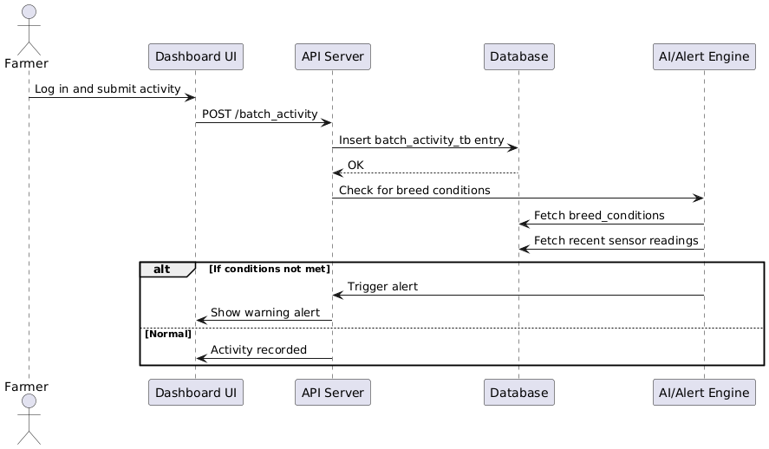
Sequence Diagram (Visual)

Slide 19
Deployment Architecture
Devices deployed on local farm
Data stored in cloud (Firebase or AWS)
Web App runs on browser/mobile
Dashboard connected to AI engine and actuator control

Slide 20
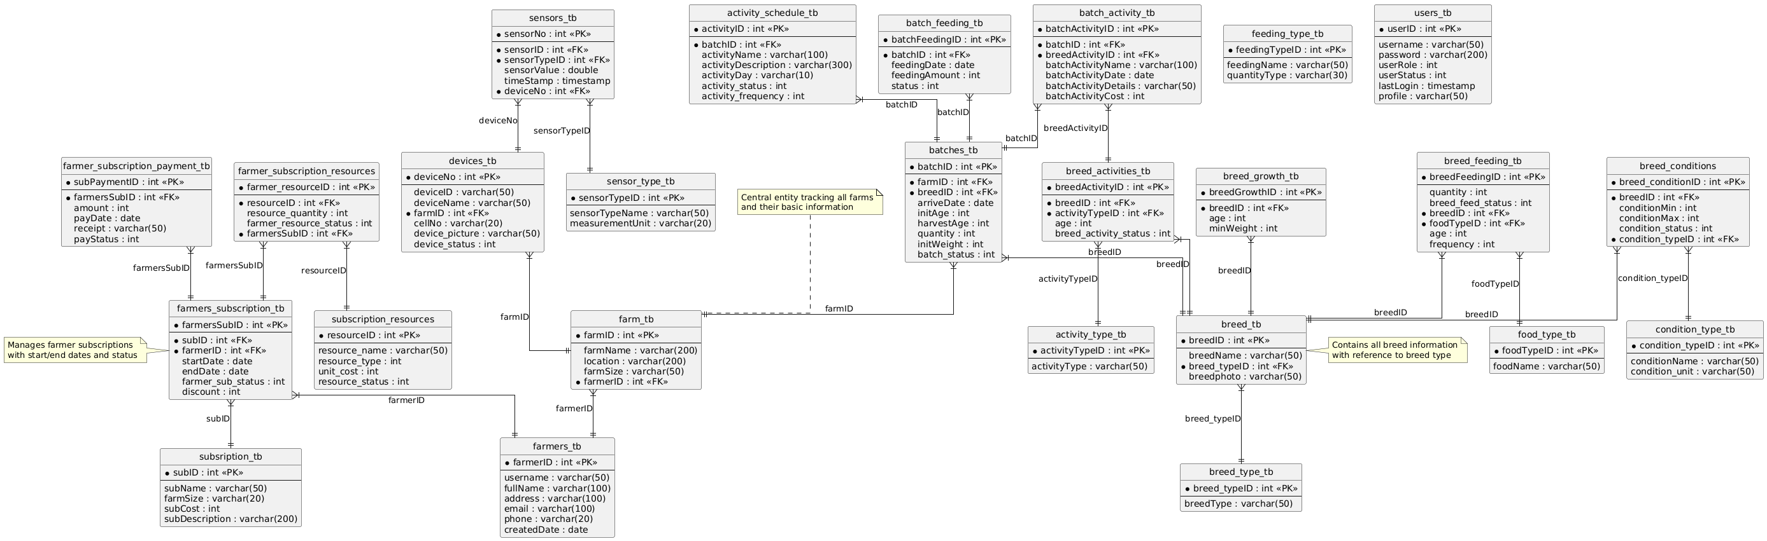
Relational Data Model

