Slide 1


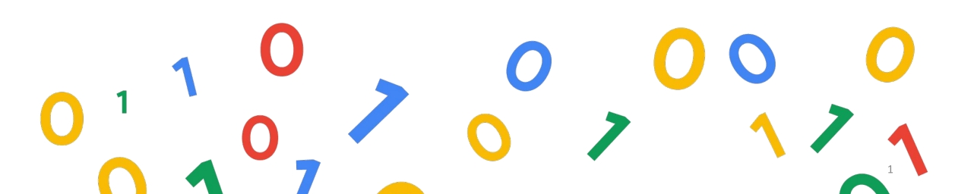
dev hack

Slide 2




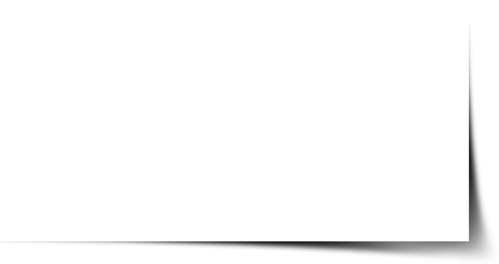
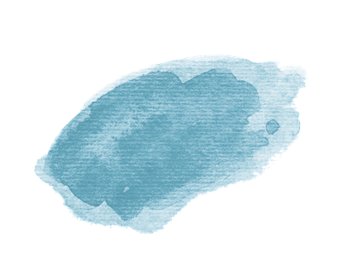
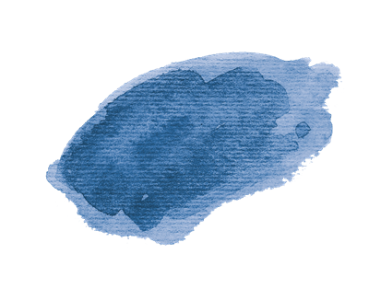
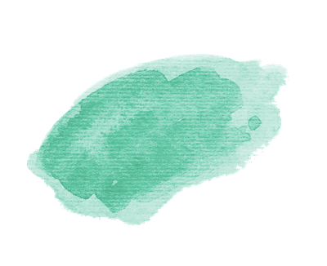

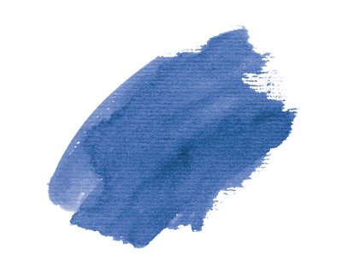

Binary Beasts:
UTSAB GHOSH
SOHAM CHAKROBORTY
BISHAL MONDAL
SUMIT SAHA

Slide 3
Due to COVID-19, a huge number of people in our country are on the streets now
with no food and shelter.
How can you use technology to help the authorities to solve the problem?

Slide 4

CONTENTS
Problem Statement
Solution
Architecture Diagram
Business Model

Slide 5

BACKGROUND OF OUR PROPOSAL:
Our proposal/idea/solution is mainly intended to the ones who has been deprived from the basic nececessities
of life - food and shelter, due to the existing national lockdown (taken as a precautionary measure against Covid-19 )
The idea is to assist the authority to provide the needy people with food and shelter with the help of technology and
look after proper utilization of available, achievable and affordable means.
Practically implementable means have been used in the idea and is expected to have a high impact.
In simple words, we will try to track the people in the streets and connect them with the respective authority(volunteers
of respective areas/zones), help them to displace the people to some nearby shelter(train, school, construction site)
keep a track of the food and shelter in the overall chain, for its proper management and utilization.

Slide 6
OVERVIEW OF OUR PROPOSAL:
The technology used mainly include a drone system with a fitted camera ( which will help in capturing vedios of the
streets by hovering over them areawise, identifying people on streets and marking their coordinates),
a mobile application that will help connecting with the authorities in the respective zone(police or civil volunteers)
with the street people and marking the schools and train compartment locations and construction sites nearby.
It also connects local area shopkeepers(for encouraging small scale businesses) with the volunteers and authorities
so that they can provide the street people with proper food amenities.
This overall plan is designed in such a way, so that minimal people interaction occurs and social distancing is maintained.

Slide 7
DISCUSSION ABOUT THE SOLUTION :
Keeping in mind that social distancing must be maintained our primary moto is to divide the overall area under
supervision into different zones and separately connect the authority (civil volunteers) with the street people in
their respective region so that the management can be done efficiently.
A hiererchy pattern is followed. The funding comes from the central government to different state government
and then distributed in several areas for benefit of people in respective region for their food and well being. A
small part from this fund can be utilized to create a great impact on the street people.
Apart from connecting the street people with the authority the solution also aims at raising small scale
businesses to help the local storekeepers/shopkeepers grow some revenue. Currently goverment authorities are
sending volunteers in several areas with a certain quantity of raw food, vegetables etc. Instead of this we can
use the local shops to do the same, so that within the same budget a lot can be done(by saving the transportation
cost for carrying the food, and growing small scale bussiness).
We also keep a track of the school which gives permission and other open areas in our database and keep a record
of number of people in a single place so that too much of congestion doesnt occur which can be result adversely.

Slide 8
The solution is based on 2 major techonological aspects as following:
Mobile Application
Drones
Drones:
The drone is used mainly to reduce the human interactions as much as possible.
Technical aspects:
The design of proposed drone plane is smaller for moving easily in congested streets during monitoring and targeting.
The drone plane is based on HD resolution camera for visionary system. The proposed drone plane contain cameras for
capturing images and recording videos, control unit based on two processing unit for controlling all operations.
Drone plane is based on two different processing units, these units are interconnected to each other for instruction
sharing and controlling all operations during monitoring such as moving between the buildings, recording and detecting
whether there is any person or not.
The 1st processing unit will handle the operation of image processing because human shape recognition and detection
required high computational power for real time object detection and classification. The people who stays in the roadside
can be identified by this system.

Slide 9
Techniacl aspect of the Drone:
It’s cumbersome in field of artificial intelligence and image processing to find accurate information in image and make
perfect decision on the behalf of extracted information. Many techniques are available for image capturing and video
recording, one of them is satellite imaging which is available online, ground information can be acquired by LANDSAT
imagery but resolution is very low. The resolution of LANDSAT is low enough that it is difficult to see the affected area.
If data is collected from Quickbird or MODIS of high resolution then it will be costly. Low resolution data can be processed
by image processing techniques but no guarantee for ideal accuracy. Different techniques such as contrast enhancement,
resolution enhancement, edge enhancement, density slicing, digital mosaics and synthetic stereo images can be used for
the enhancement of the images and vedios captured.
The 2nd processing unit will control physical movements of drone and it is about saving itself from crash against any
building and light cables. The second processing unit also controls all the mechanical operations and tracking and locating
itself in a map system by indicating and marking the geographical coordinates. The processing units with specific
information and interconnection between them and a separate map system will be made.

Slide 10
Techniacl aspect of the Drone:
Architecture of proposed drone Model The drone design is proposed for four hours monitoring in particular area
from its central maintenance location (i.e. the location of the volunteer in that location). There is limitation of flight time
in UAVs which depends on their model so the minimum flight time starts from 30 minutes to maximum time is 10 hours
and it can be extended up to 24 hours. The range and monitoring area will be divided between the drones and every drone
plane can monitor 5km circular area. Proposed drone plane can be controlled from central location via operator and also
has functionality to automatically perform all operations without intervention or control of operator. The priority of control
is given to operator to quit monitoring operation before critical condition of battery. In any kind of emergency condition
(i.e. in sudden malfunction of the drone or unexpected battery drainage) it will transfer the control of monitoring process,
its immediate location and movement direction to next cell drone plane via handshaking method of mobile communication.
The circular area monitoring concept is same like telecom cells. Every drone plane of particular area will be connected to
central location office via satellite network. Required Volunteer can act accordingly to that situation of concern.

Slide 12
Mobile Application:
The mobile application is for keeping a supervision on the whole process and also maintain transparency between the
involved authorities .
Technical Aspect of the mobile application:
The applications aims in linking the whole network into order and supervision.
It is integrated with the drones so that the location is monitored through geolocation and we also get the idea where
we find the person who needs help and thus we can keep a track of the number of people who have already been displaced
to some location and got food and those who havnt.
The application has the neccessary controls needed for the drone to work which includes deactivating the drone and
passing the control.
The application also keeps track of the location where the shelters and food are being provided thus it can be used by those
who wants any help and contact to the respective authorities (civil local volunteers).
The application keeps track of the raw foods, that needs to be supplied daily to the locations, and other cooking and other
stuffs required.The application uses radio buttons and checklists to maintain a log book for day to day activities to maintain
what has been done and what is left.
The application is meant to help the needy with the means of food and shelter which will be provided through geolocation.

Slide 13
Technical Aspects of the mobile application:
The application also has a section where the interested people and people with means can come forward and help
the needful.
The application will also be used to recruit volunteers who are willing to help the cause and it also supervises the work
that are being done in a proper manner or not with use of checklists and reminders.
The application also will be provided with constant updates and news that are provided by the government about
precautionary measures and all neccessary inforation regarding the COVID-19 .

Slide 14
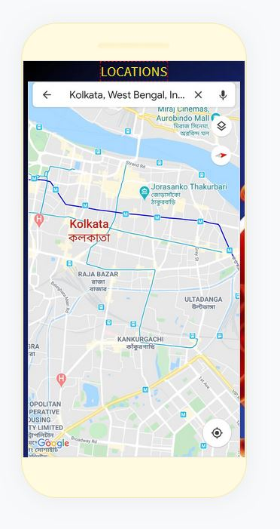
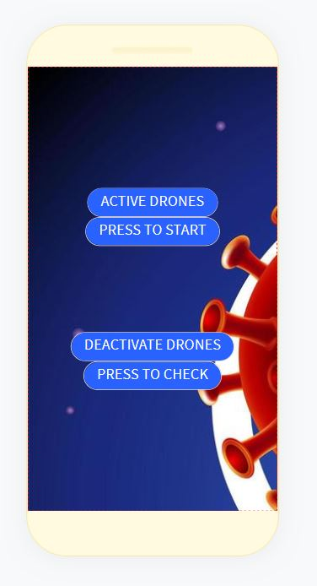
Some screenshots of our app
The link for our app prototype : https://x.thunkable.com/copy/4d50d4780f8ec75575391a3484ba7bd4

Slide 15
Requirements - The business plan includes buying the materials for the drone , and assembling and modifying it with minimal cost. Low cost affordable camera can be used , as by image processing we can improve the quality upto much extent.
Then the connections and technical details will be explained to the respective authority for the proper functioning of the whole system cycle.
The application that has been developed also includes option for donation which will allow people to donate and the money can be directly utilised.
the payments from the government can sent to small scale business owners through the heirerchy formed and thus we can grow business in every steps.
We will advertise our initiatives through broadcasting on popular TV channels and sms .
The target audience is the civilians of the country and the government so that the people in the streets can get the help directly.

Slide 16


☺

