Slide 1
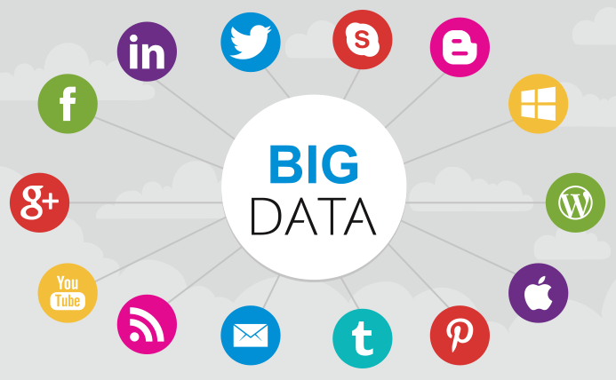

Slide 2
Introduction
Big Data refers to the large amounts of data, growing exponentially with time which is pouring in from various data sources and has different formats.
Example-
The statistic shows that 500+terabytes of new data get ingested into the databases of social media site Facebook, every day.

Slide 3
Types Of Big Data
Big Data are of three types:
Structured: Organized data format with a fixed schema. Ex: RDBMS
Semi-Structured: Partially organized data which does not have a fixed format. Ex: XML, JSON
Unstructured: Unorganized data with an unknown schema. Ex: Audio, video files etc.

Slide 4
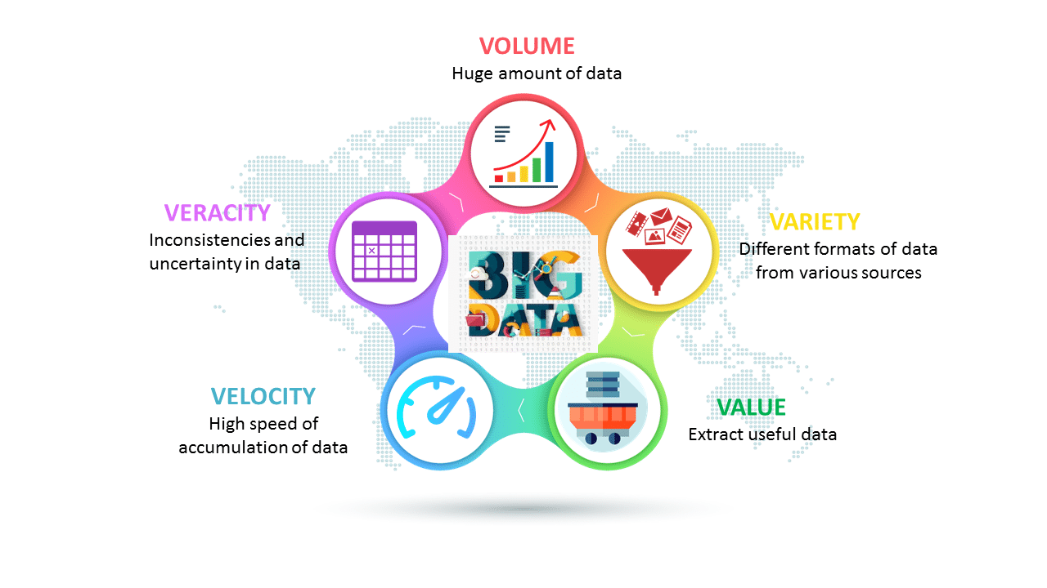
Characteristics of Big Data

Slide 5
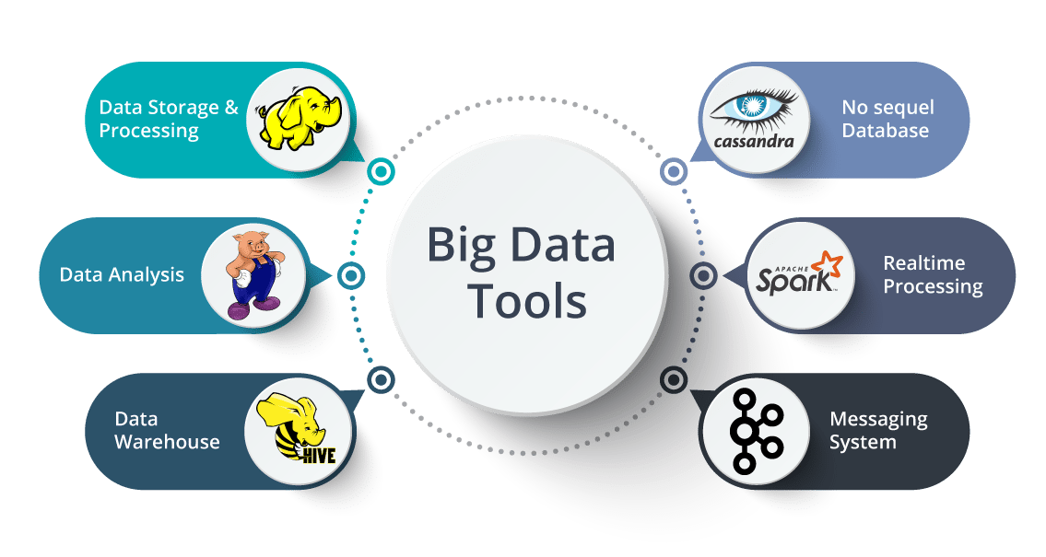
Big Data Tools

Slide 6
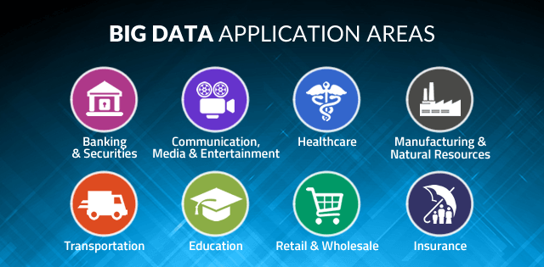

Slide 7
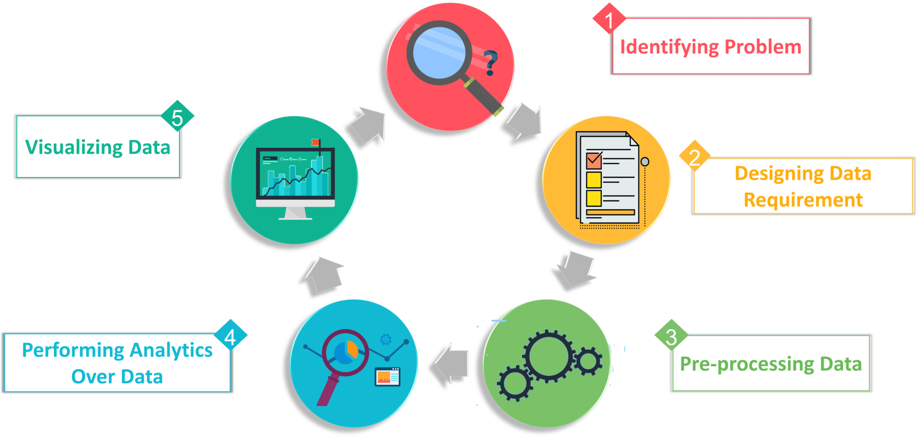
Big Data Analytics
Big data analytics examines large and different types of data to uncover hidden patterns, correlations and other insights.
Stages in Big Data Analytics

Slide 8
Types of Big Data Analytics
Descriptive Analytics: It uses data aggregation and data mining to provide insight into the past and answer: “What has happened?”
Predictive Analytics: It uses data aggregation and data mining to provide insight into the past and answer: “What has happened?”
Prescriptive Analytics: It uses optimization and simulation algorithms to advice on possible outcomes and answers: “What should we do?”
Diagnostic Analytics: It is used to determine why something happened in the past.

Slide 9
Introduction to Hadoop
Hadoop is an open-source software framework used for storing and processing Big Data in a distributed manner on large clusters of commodity hardware.
Licensed under the Apache v2 license.
Developed, based on the paper written by Google on the MapReduce system
Applies concepts of functional programming.

Slide 10
Big Data vs Hadoop
Features | Big Data | Hadoop
Definition | Big Data refers to a large volume of both structured and unstructured data. | Hadoop is a framework to handle and process this large volume of Big data
Significance | Big Data has no significance until it is processed and utilized to generate revenue. | It is a tool that makes big data more meaningful by processing the data.
Storage | It is very difficult to store big data because it comes in structured and unstructured form. | Apache Hadoop HDFS is capable of storing big data.
Accessibility | When it comes to accessing the big data, it is very difficult. | Hadoop framework lets you access and process the data very fast when compared to other tools.

