Slide 1
PhytoFit Userguide
2023-08-08
Stephanie.Clay@dfo-mpo.gc.ca
Authors
Chantelle Layton
Initial concept, preliminary design, coding, and algorithm development/improvements
Stephanie Clay
Final app design and modifications, feature addition, new datasets, maintenance, and algorithm improvements
Emmanuel Devred
Scientific support, algorithm development/improvements, review and feature recommendations
Acknowledgments
Andrea Hilborn for many valuable suggestions
How to cite
In publications, please include acknowledgments to NASA OBPG (https://oceancolor.gsfc.nasa.gov) for the raw satellite data and the BIO remote sensing
group (https://github.com/BIO-RSG) for the application, and use this citation in the references:
Stephanie Clay, Chantelle Layton, & Emmanuel Devred. (2021). BIO-RSG/PhytoFit: First release (v1.0.0). Zenodo. https://doi.org/10.5281/zenodo.4770754
BibTeX format:
@misc{clay21,
author = {Clay, Stephanie and Layton, Chantelle and Devred, Emmanuel},
title = "PhytoFit",
howpublished = "\url{https://github.com/BIO-RSG/PhytoFit}",
year = 2021
}

Slide 2
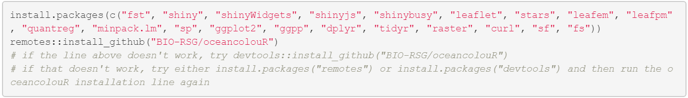
Prerequisites
1. Install the latest versions of R and RStudio.
2. Install the necessary packages:
3. Restart R after the packages have been installed.

Slide 3
Getting started
1. Download the PhytoFit repository (https://github.com/BIO-RSG/PhytoFit) one of two ways:
a. Option 1: Code --> Download ZIP
b. Option 2: Using git (this will make it easier to download updates in the future, by simply using the `git pull` command):
Open git bash terminal, navigate to the folder where you want to download the repository, and type:
git clone https://github.com/BIO-RSG/PhytoFit.git
2. Open the PhytoFit repository in Rstudio (File --> Open Project --> Navigate to the PhytoFit folder and open PhytoFit.Rproj )
3. Download (or update) the datasets of your choice:
Open 00_download_new_datasets.R from the PhytoFit folder.
Set ask_user=FALSE to download all available datasets, or ask_user=TRUE to ask before downloading each one.
Alternatively, you can run the script from the command line like:
Rscript [script directory]/00_download_new_datasets.R 'false'
* set “script directory” to the full path where the script is located
* 'false' is the ask_user argument, set to 'true' for prompts
If you already have datasets in storage, you can update them using 00_update_datasets.R. Set the ask_user argument in the script and run from RStudio, or run from the command line (e.g. Rscript [script directory]/00_update_datasets.R 'false’).
4. Run the app by opening app.R in RStudio and clicking “Run app”
WARNINGS:
Data files will be downloaded to data/[region]/ subfolders of the PhytoFit repository - Do NOT move them from there or the app will not be able to read them.
If possible, please keep the data files if you intend to use them in the future, rather than re-downloading them later, to avoid excessive traffic on the ftp server.
Any data that is < 3 months old is "Near Real Time" (NRT) quality. NRT data is replaced with "Science quality" data after it becomes available, following the 3-month lag. More info here: https://lance.modaps.eosdis.nasa.gov/data/difference.php

Slide 4
Troubleshooting
If you run into errors or the app crashes, try the following:
Check if there are any helpful error messages in the console
Clear memory: rm(list=ls())
Restart R and/or RStudio
Update packages used in the app

Slide 5
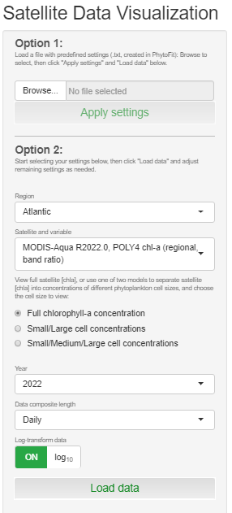
Main settings
1. If you have a settings file saved from a previous session, you can reapply it using this feature. Warning: DO NOT EDIT THE SETTINGS FILE, otherwise PhytoFit might not be able to read it properly.
2. Select your region and spatial resolution
Atlantic (42 to 71 °W, 39 to 63 °N)
Pacific (122 to 140 °W, 46 to 60 °N)
Gulf of Saint Lawrence (49 to 75 °W, 41 to 53 °N)
Baffin Bay (42 to 95 °W, 60 to 82 °N)
3. Select satellite and variable
Satellite sensors: MODIS-Aqua, SeaWiFS, VIIRS-SNPP, OLCI-A or B
Variables: Chl-a (OCI, POLY4, GSM_GS, or EOF for the Gulf region only), SST (Sea Surface Temperature)
R20XX.X indicates the reprocessing (data version). More info here: https://oceancolor.gsfc.nasa.gov/data/reprocessing
4. Select Chl-a concentration type and cell size model (this is applied to Chl-a before logging, if selected)
5. Select year
6. Select temporal binning (daily data is averaged over composite period before logging, if selected)
7. Select logged or unlogged data
8. Load data for the current selection of settings
1.
2.
3.
4.
5.
6.
7.
8.

Slide 6
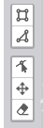
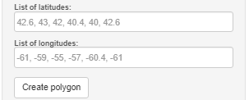
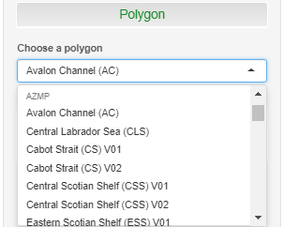
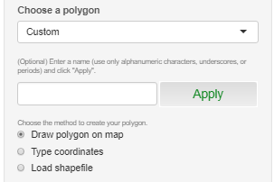
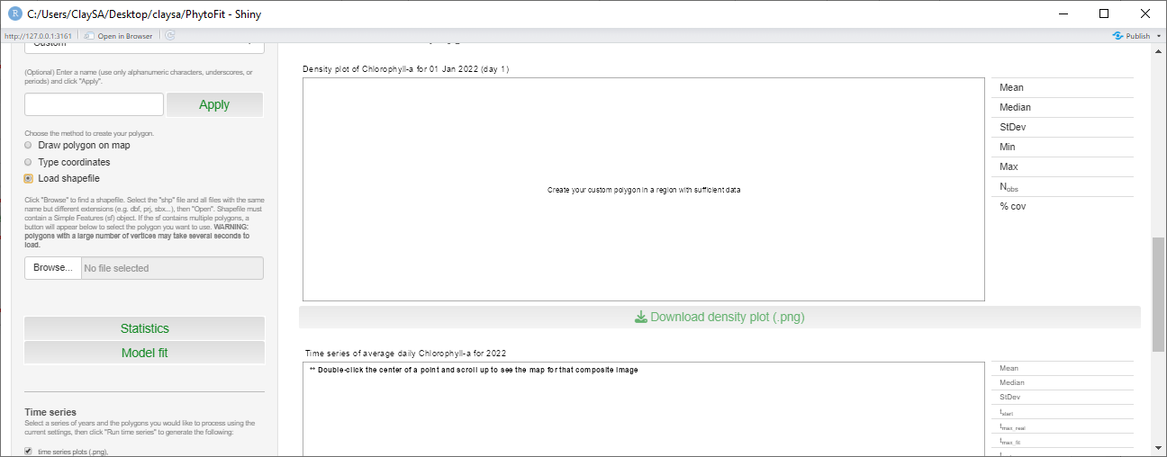
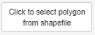
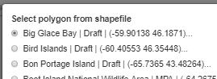
Polygon selection
3a.
To close a polygon when you’re
done editing, click on the first point.
Draw box or polygon
You can choose a polygon in order to calculate statistics and bloom metrics within that region. Click the “Polygon” button to expand this menu.
1. Choose a predefined polygon, or create your own.
2. For a custom polygon, optionally give it a name.
3. Select how you will define your custom polygon:
Draw using the controls at the top left corner of the map,
Type the coordinates, or
Select a shapefile containing a Simple Features object and click to select the polygon you want to use from the file.
Only one polygon can be drawn on
the map at a given time.
Edit vertices
Move polygon
Delete
3b.
Decimal degrees
Separate coordinates by commas
Use latitude/longitude < 0 for west/south
3c.
1.
2.
3.
Select the “shp” file and all files with the same name but different extensions (e.g. dbf, sbn, sbx, shx, prj, qix…)
If the polygon has a large number of vertices, it might take several seconds to load.

Slide 7
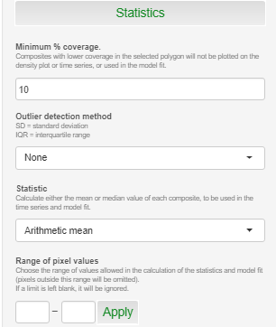
Statistics
Click the “Statistics” button to expand this menu.
1. Select the minimum percent coverage required for a point in the time series to be used in the bloom fitting procedure or displayed in the density plot. If a daily (or 4-day, 8-day) composite has insufficient coverage within your polygon, it will be ignored.
2. Select the outlier detection method.
mean ± 2 standard deviations
mean ± 3 standard deviations
median ± 1.5 * interquartile range
Outer percentiles (0.01%, 0.1%, …)
3. Select the statistic (mean or median) to use to summarize data within your polygon for each day (or 4-day or 8-day period).
4. To exclude data outside a certain range, enter the values here and click “apply”. Data outside this range will not be included in the statistics or bloom fit. To ignore a boundary, leave it blank.
1.
2.
3.
4.

Slide 8
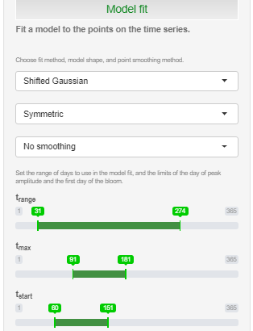
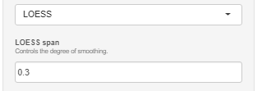
Model (bloom) fit
Click the “Model fit” button to expand this menu.
Each point in the time series and bloom fit is the daily (or 4-day, 8-day) spatial average (or median) of data after removal of outliers and points outside the desired range, using the binned data values. Only points with sufficient percent coverage inside the polygon on that day/week are used, within the range of days selected by the user.
1. Select the model to use in your fit. Default = Shifted Gaussian
2. Select the model shape around the bloom peak timing.
3. Choose whether to smooth points using LOESS locally estimated scatterplot smoothing) in the time series before fitting or just fit the raw data points. If you smooth the points, you must also set the “span”, which controls the degree of smoothing:
4. Adjust the range of days to use in the fit, and restrict to a certain time window to search for the peak timing or start of the bloom period. t_{start} and t_{max} will be restricted based on t_{range}.
1.
2.
3.
4.

Slide 9
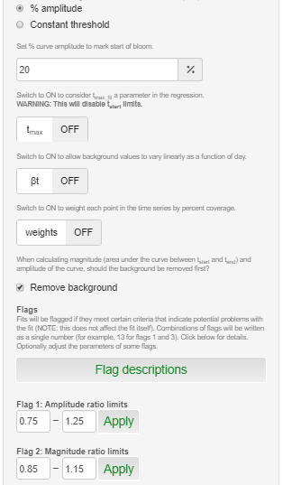
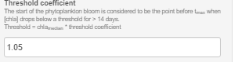
Model (bloom) fit (continued)
5a.
5. If you are modelling with a Shifted Gaussian, there are more options:
t_{start} calculation method
% amplitude: Define t_{start} as the day when the curve reaches a specified percentage of its amplitude over the background value, or
Constant threshold: Define t_{start} as the day when the curve reaches a specified threshold over the background value.
t_{max} switch
If this is ON, the bloom peak timing is allowed to vary as a parameter within the nonlinear least squares fitting procedure, rather than being a fixed value based on the actual maximum value.
WARNING: t_{start} can't be restricted if this is set to ON, because the t_{start} limits are set by restricting σ (the parameter controlling the width of the curve) relative to a known t_{max} value.
βt switch
If this is ON, the background line of the curve is allowed to vary linearly with time.
weights
If this is ON, points in the fit are weighted by the percent coverage inside the polygon.
Remove background
If this is checked, the background data line will be subtracted from the data points / curve before calculating the amplitude and magnitude.
Fits are flagged (unaffected but marked) if the following occurs:
Flag 1: Flagged if amplitude_{fit}/ amplitude_{real} is outside the selected range
Flag 2: Flagged if magnitude_{fit} / magnitude_{real} is outside the selected range
Flag 3: Flagged if sigma <= temporal composite length (i.e. 1, 4, or 8 days)
Flag 4: Flagged if the calculated t_{start} is on the boundary of the t_{start} slider
Flag 5: Flagged if the calculated t_{max} is on the boundary of the t_{max} slider
Flag 6: Flagged if the calculated t_{end} is on the boundary of the t_{range} slider
You can adjust the range of acceptable ratio limits for flags 1 and 2 and click “apply”.
6. If you are modelling with the Threshold method, set the threshold coefficient.
t_{start} is defined as the point where chlorophyll-a drops below the threshold for > 14 days, measuring the days/weeks backward from the day of maximum concentration.
threshold = (threshold coefficient) * (median data value)
median data value = median of all points used in bloom fit (within day range, with sufficient % coverage)
5b.
5c.
5d.
5e.
5f.
6.

Slide 10
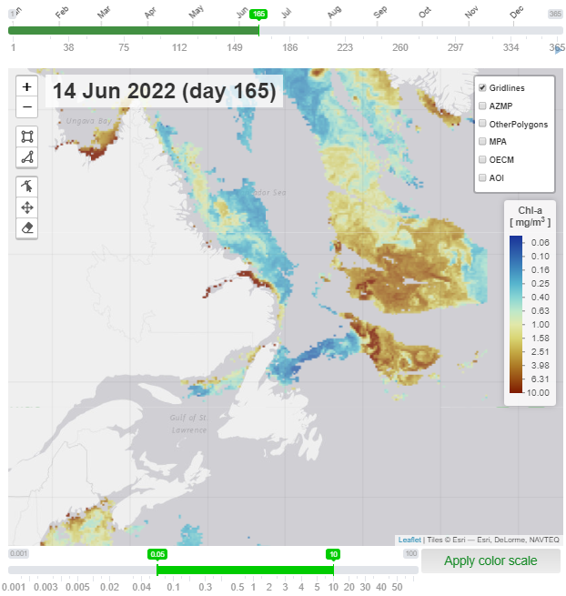
Output and display - Map
Day selector – Move the slider to view the satellite imagery for that day (or 4-day or 8-day period)
Map zoom functions
Play button to allow map to load images in sequence with a 4-second delay between each image
Toggle groups of predefined polygons on the map, for viewing only
Adjust the color scale on the map
1.
3.
2.
4.
5.

Slide 11
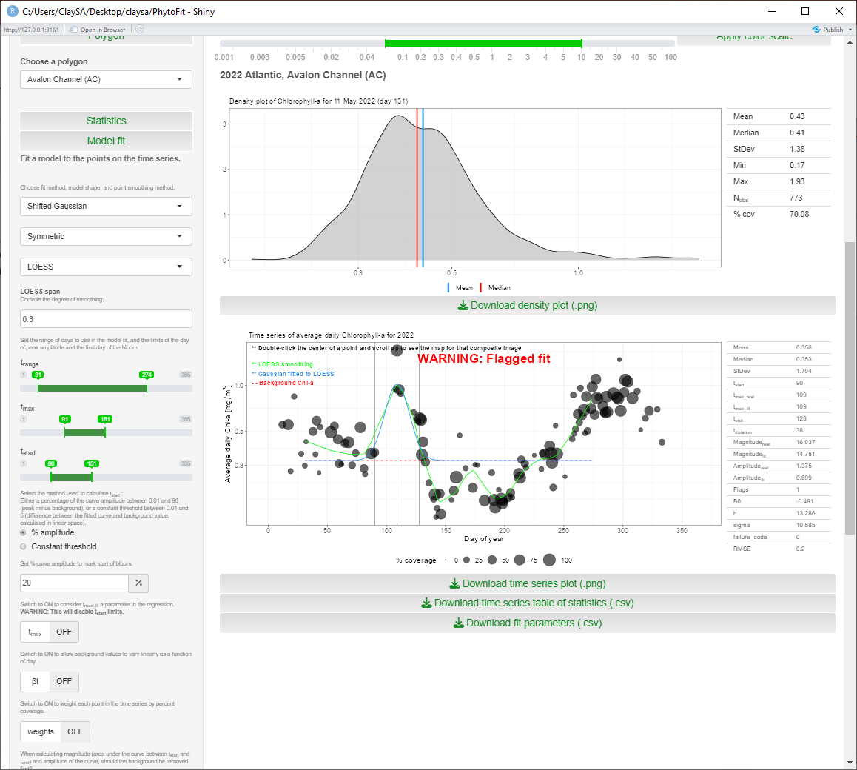
Output and display – Density plot
Daily (or 4-day, 8-day) statistics within your polygon
Click here to download this density plot with the table of statistics overlaid on the plot
1.
2.

Slide 12
Output and display – Time series plot
Instruction to double-click the center of a point in the time series to load the satellite imagery and density plot for that point
Annual statistics, model parameters, and model metrics within your polygon
Download this time series plot with the table of stats and metrics overlaid
Download a csv file containing the table of statistics within your polygon for each day (or 4-day, 8-day period) for the selected year
Download a table with the model parameters and metrics
1.
2.
3.
4.
5.

Slide 13

Model fits – Shifted Gaussian
B₀, β, h, and σ are calculated using nonlinear least squares.
t_{max} is also calculated this way if the t_{max} switch is ON.
This is done with the minpack.LM::nlsLM function in R, which uses the Levenberg-Marquardt method. Starting guesses are required for the variables listed above (4 different sets of starting guesses are attempted during the fit), and lower/upper limits are enforced. If the curve is asymmetric, the same limits and guesses are used for each side. If the data is logged, B₀ limits and starting guesses are also logged.
If a Gaussian curve can't be fitted to the points, a failure code will be given in the output. These are the code meanings:
Code 1: not enough data in the selected limits
Code 2: nls failed
Code 3: t_{start} threshold too high
Code 4: t_{start} too early (before day 1)
Code 5: t_{start} outside t_{range}
Code 6: t_{end} outside t_{range}
Code 7: data at end of bloom period is > threshold
Parameter | Units | Description | Lower limit | Upper limit | Starting guesses
 |  |  |  |  | 1 | 2 | 3 | 4
B | mg.m⁻³ | Vector of data points in the time series
t | Day of year | Vector of days, same length as B
B₀ | mg.m⁻³ | Background data value | 0 | 5 | 0.5
β (beta) | mg.m⁻³.day⁻¹ | Linear rate of change of B₀ | -0.02 | 0.01 | -0.002 | -0.002 | 0.001 | 0.001
h | Unitless | Controls the height of the curve | 0 | 350 | 50 | 50 | 10 | 10
σ (sigma) | Unitless | Controls the width of the curve | 0 | 100 | 10 | 2 | 2 | 1
t_{max} | Day of year | Day of maximum B | User-selected | User-selected | Day of maximum data value (within t_{max} limits)

Slide 14
Model fits – Shifted Gaussian (continued)
Several metrics are collected, relating to the timing of the bloom and total data values.
Some metrics are calculated using both the Gaussian curve and the real data points.
Metric | Units | Description
t_{start} | Day | Start of the bloom
t_{max_real} | Day | Timing of maximum value within bloom period
t_{max_fit} | Day | Timing of peak of Gaussian curve
t_{end} | Day | End of the bloom
t_{duration} | Day | Duration of the bloom
Amplitude_{real} | mg.m⁻³ | Maximum value within bloom period
Magnitude_{real} | mg.m⁻³.day | Area under the real data points within the bloom period
Amplitude_{fit} | mg.m⁻³ | Peak of Gaussian curve
Magnitude_{fit} | mg.m⁻³.day | Area under the Gaussian curve within the bloom period
If "remove background" has been checked, the background data will be subtracted before calculating amplitude and magnitude.
If points between t_{start} and t_{end} are below the background line and "remove background" has been selected, the magnitude (area) below the line will be negative so it will be subtracted from the final value (this only affects Magnitude_{real}).
If LOESS smoothing and point-weighting are both selected, the LOESS-smoothed curve will be calculated using the weighted real data points. The curve is then fit to the LOESS values. Note that in this case, the mean, median, Amplitude_{real}, and Magnitude_{real} are still calculated using the real data values.

Slide 15
Model fits – Rate of Change
This algorithm does not model a curve like the Shifted Gaussian, but only calculates the maximum, start, and end days of the bloom.
The maximum is selected as the day of actual maximum concentration, within the selected range.
The initiation is the day of the maximum rate of change in concentration, within the selected bounds.
If any indices cannot be computed, they will be blank and not appear on the time series plot. This might happen due to an insufficient number of data points in the time series, or within the range of days allowed for the start or day of maximum concentration of the bloom.
B₀ (the background data value) is computed using the R function quantreg::rq to perform a quantile regression (25th percentile) on the full dataset (days/weeks with sufficient percent coverage), and is subtracted from the data to calculate the final amplitude and magnitude metrics.
Metric | Units | Description
t_{start} | Day | Start of the bloom
t_{max_real} | Day | Timing of maximum value within bloom period
t_{end} | Day | End of the bloom
t_{duration} | Day | Duration of the bloom
Amplitude_{real} | mg.m⁻³ | Maximum value within bloom period
Magnitude_{real} | mg.m⁻³.day | Area under the real data points within the bloom period
If LOESS smoothing and point-weighting are both selected, the LOESS-smoothed curve will be calculated using the weighted real data points.

Slide 16
Model fits – Threshold
This model is similar to the Rate of Change:
It only calculates the maximum, start, and end days of the bloom
B₀ is calculated using quantreg::rq and subtracted from the data points to get amplitude and magnitude
The maximum is selected as the day of actual maximum concentration, within the selected range.
The initiation is defined as the day the data drops below a threshold for > 14 consecutive days, working backward from the day of the maximum value.
If your data are not logged:
Threshold = (Threshold coefficient) * (median data used in the fit)
If your data are logged:
Threshold = log10 [ (Threshold coefficient) * 10(median log10(data) used in the fit) ]
Threshold coefficient = user-selected
Metric | Units | Description
t_{start} | Day | Start of the bloom
t_{max_real} | Day | Timing of maximum value within bloom period
t_{end} | Day | End of the bloom
t_{duration} | Day | Duration of the bloom
Amplitude_{real} | mg.m⁻³ | Maximum value within bloom period
Magnitude_{real} | mg.m⁻³.day | Area under the real data points within the bloom period
If LOESS smoothing and point-weighting are both selected, the LOESS-smoothed curve will be calculated using the weighted real data points.

Slide 17
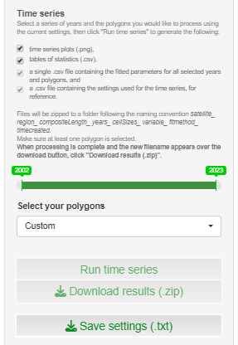
Run full time series and save settings
At the bottom of the left panel, you have the option of collecting statistics and fitting the model for multiple years of data, and downloading the collection of results in a zip file.
Check these boxes if you want to include the time series plots in png format in the output, and the table of statistics in csv format.
Adjust the slider to the range of years you want to process.
Select the polygons you want to use in the processing.
Click “Run time series” to run the calculations, then
Click “Download results” to download the zip file, which uses the following naming convention:
satellite_region_compositeLength_years_cellSizes_variable_fitmethod_timecreated
Save a settings file for the current selection of settings.
1.
2.
3.
4.
5.
6.

Slide 18
AZMP fitting parameters
Annual reporting for the AZMP (Atlantic Zone Monitoring Program, https://www.dfo-mpo.gc.ca/science/data-donnees/azmp-pmza/index-eng.html) includes statistics and bloom metrics for a set of polygons. Previously, AZMP boxes were typically fitted using a Fortran script, examining and adjusting every fit manually. Results were stored here: ftp://ftp.dfo-mpo.gc.ca/bometrics/spring-bloom. Below are the settings to use in PhytoFit to most closely replicate these fitting procedures. Unavoidable differences between the original procedure and PhytoFit are highlighted in red.
L2 and L3 flag info here: https://oceancolor.gsfc.nasa.gov/resources/atbd/ocl2flags
 | Original Fortran bloom fitting system | PhytoFit bloom fitting
Sensor | VIIRS-SNPP | VIIRS-SNPP
Spatial resolution | ~1km | 4km
Projection | Equidistant cylindrical | Binned
Level-2 flags | All L2 flags except TURBIDW | L3 flags + FILTER
Chl-a model | OCI, not logged | OCI, not logged
Temporal binning | Weekly (using a 4-week-per-month system) | 8-day
Minimum % coverage | 1% | 1%
Outliers | Not removed | Not removed
Statistic | Average | Average
Range of pixel values | <= 64 mg.m⁻³ | <= 64 mg.m⁻³
Model | Symmetric Shifted Gaussian No smoothing, no point weighting, flat background (i.e. beta OFF), t_{max} defined as day of max concentration (i.e. t_{max} switch OFF) | Symmetric Shifted Gaussian No smoothing, no point weighting, flat background (i.e. beta OFF) , t_{max} defined as day of max concentration (i.e. t_{max} switch OFF)
Range of days used in fit | Feb-July, or Feb-Aug for boxes >= 56°N | t_{range} 31-212 (boxes < 56°N), 31-244 (boxes >= 56°N)
Gaussian fit flags | Box has <10% coverage, flags 1-3 listed in PhytoFit | [See 6 flags listed in Shifted Gaussian description]
t_{start} calculation | 20% curve amplitude | 20% curve amplitude
Bloom metrics | Remove background before calculating amplitude, magnitude | Remove background before calculating amplitude, magnitude

Slide 19
Extra tools
In the tools subfolder of the repository, there are a few extra R scripts:
Scripts to create your own region and predefined polygons:
tools_01a_define_polygons.R
tools_01b_create_new_region.R
Scripts to concatenate and format the output from PhytoFit:
tools_02_format_bloommetrics.R
tools_fit_bloom_from_chla.R
This standalone script can accept a dataframe with year, doy, and chl columns, and fit a bloom to the chl using the same settings as used in the app. This is useful for fitting blooms to in situ data records that only have one value per day or week.
To use this script on your own computer, you must also download `functions.R`, `gaussFit.R`, `threshold.R`, and `rateOfChange.R`.
Required packages: `dplyr`, `oceancolouR`*, `minpack.lm`
Optional packages for plotting results: `ggplot2`, `patchwork`
*The oceancolouR package, which can be installed with one of the following commands in R:
remotes::install_github("BIO-RSG/oceancolouR", build_vignettes = TRUE)
devtools::install_github("BIO-RSG/oceancolouR", build_vignettes = TRUE)

Slide 20
References and data sources
Bloom fitting models (Shifted Gaussian, Rate of Change, and Threshold methods) :
Layton, C., Devred, E., DeTracey B.. 2022. A comparison of phytoplankton spring bloom fitting methods using MODIS satellite-derived chlorophyll-a concentration for the Maritimes region. Can. Tech. Rep. Hydrogr. Ocean Sci. 340: vii + 22 p.
https://publications.gc.ca/collections/collection_2022/mpo-dfo/Fs97-18-340-eng.pdf
Chlorophyll-a algorithm OCx:
O'Reilly, John & Maritorena, S. & Mitchell, B.G. & Siegel, David & Carder, Kendall & Garver, S.A. & Kahru, Mati & Mcclain, Charles. (1998). Ocean color chlorophyll algorithms for SeaWiFS. Journal of Geophysical Research. 103. 937-953.
https://www.researchgate.net/publication/284463756_Ocean_color_chlorophyll_algorithms_for_SeaWiFS
Chlorophyll-a algorithm GSM:
Maritorena, Stéphane & Siegel, David & Peterson, Alan. (2002). Optimization of a semianalytical ocean color model for global-scale application. Applied optics. 41. 2705-14. 10.1364/AO.41.002705.
https://www.researchgate.net/publication/11345370_Optimization_of_a_semianalytical_ocean_color_model_for_global-scale_application
Chlorophyll-a algorithms OCI, POLY4, and GSM_GS (regional tuning):
Clay, S.; Peña, A.; DeTracey, B.; Devred, E. Evaluation of Satellite-Based Algorithms to Retrieve Chlorophyll-a Concentration in the Canadian Atlantic and Pacific Oceans. Remote Sens. 2019, 11, 2609.
https://www.mdpi.com/2072-4292/11/22/2609
Chlorophyll-a algorithm EOF:
Laliberté, J.; Larouche, P.; Devred, E.; Craig, S. Chlorophyll-a Concentration Retrieval in the Optically Complex Waters of the St. Lawrence Estuary and Gulf Using Principal Component Analysis. Remote Sens. 2018, 10, 265.
https://www.mdpi.com/2072-4292/10/2/265

Slide 21
References and data sources (continued)
Phytoplankton cell size model 1 (small/large cells):
Devred, Emmanuel & Sathyendranath, S & Stuart, V & Maass, H & Ulloa, Osvaldo & Platt, T. (2006). A two-component model of phytoplankton absorption in the open ocean: Theory and applications. Journal of Geophysical Research. 111. 10.1029/2005JC002880.
https://www.researchgate.net/publication/229086123_A_two-component_model_of_phytoplankton_absorption_in_the_open_ocean_Theory_and_applications
Phytoplankton cell size model 2 (small/medium/large cells):
Devred, Emmanuel & Sathyendranath, Shubha & Stuart, Venetia & Platt, Trevor. (2011). A three component classification of phytoplankton absorption spectra: Application to ocean-color data. Remote Sensing of Environment - REMOTE SENS ENVIRON. 115. 2255-2266. 10.1016/j.rse.2011.04.025.
https://www.researchgate.net/publication/251494326_A_three_component_classification_of_phytoplankton_absorption_spectra_Application_to_ocean-color_data
Phytoplankton cell size models (updated coefficients):
Liu, Xiaohan & Devred, Emmanuel & Johnson, Catherine. (2018). Remote Sensing of Phytoplankton Size Class in Northwest Atlantic from 1998 to 2016: Bio-Optical Algorithms Comparison and Application. Remote Sensing. 10. 10.3390/rs10071028.
https://www.researchgate.net/publication/326033452_Remote_Sensing_of_Phytoplankton_Size_Class_in_Northwest_Atlantic_from_1998_to_2016_Bio-Optical_Algorithms_Comparison_and_Application#pf18
Raw data:
Daily level-3 binned files are downloaded from NASA OBPG (https://oceancolor.gsfc.nasa.gov), and weekly composites are generated by taking a simple arithmetic average of each pixel over the selected composite period (e.g. 4 days or 8 days). The binned data is used for statistics and bloom fitting, projected onto a regular grid on the map for display.
NASA OCI chlorophyll-a algorithm: https://oceancolor.gsfc.nasa.gov/resources/atbd/chlor_a
Level-3 binned files: https://oceancolor.gsfc.nasa.gov/l3
Binning scheme: https://oceancolor.gsfc.nasa.gov/resources/docs/format/l3bins
Level-2 and 3 default flags: https://oceancolor.gsfc.nasa.gov/resources/atbd/ocl2flags
(PhytoFit data uses these default flags + FILTER flag)

