Slide 1

Developing hypotheses based on public databases
Shaimar R. González Morales
Biof 309

Slide 2
Objective
This project is intended to help undergraduate and early graduate students to develop research projects.

Slide 3
Overview
Task1: Using datasets to support your hypothesis
Analyzing data from NCBI GEO database
-Cleaning data
-Building graphs
-Statistical analysis
Task2: Using web-based software to interpret data
-Looking at correlations in Ingenuity Pathway Analysis
Task3: Assessing possible implications of your hypothesis
-Looking at correlations with disease dataset
-Cleaning data
-Building graphs
-Statistical analysis

Slide 4
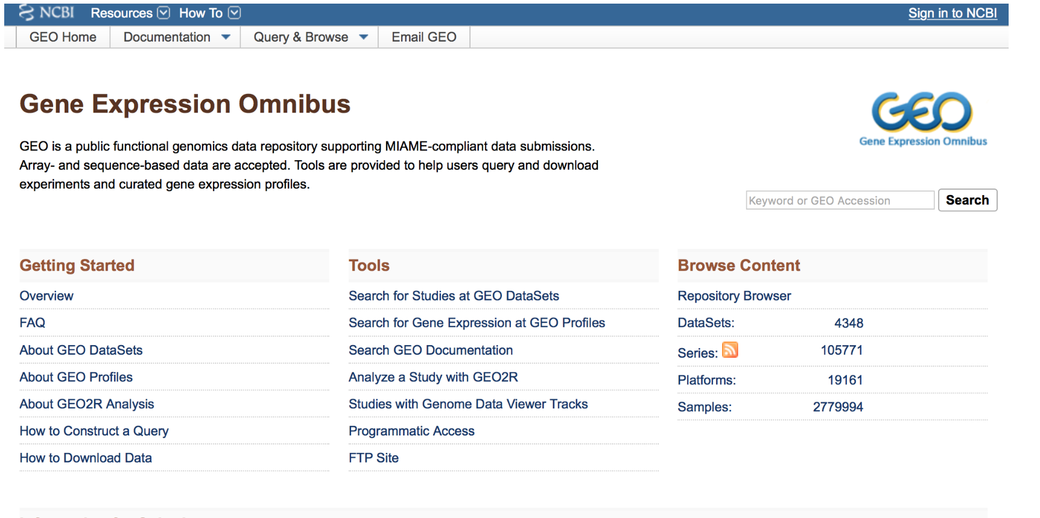
Using datasets to support your hypothesis
NCBI Gene Expression Ombnibus
"GEO is a public functional genomics data repository supporting MIAME-compliant data submissions. Array- and sequence-based data are accepted. Tools are provided to help users query and download experiments and curated gene expression profiles"
*GSM3027039 (lung10.5E expression)
*GSM3027047(lung11.5E expression)

Slide 5
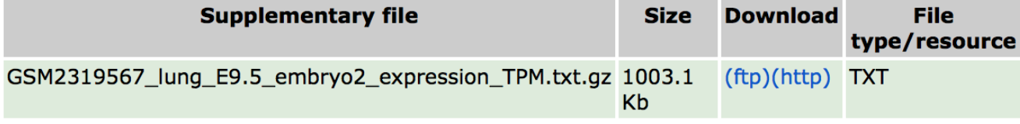
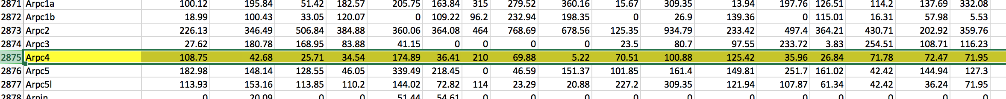
Using datasets to support your hypothesis
Save http as txt
Open txt in Excel

Slide 6
Creating arrays from the data
import numpy as np from scipy import stats E2E=np.array ([19.83, 67.81, 0.00]) E1E=np.array ([4.22, 190.49, 0.00, 0.00, 64.77, 0.00, 5.15, 0.00,79.94, 19.73, 0.00, 0.00, 0.00, 174.08,4.64, 0.00]) E2M=np.array([5.15, 0.00, 0.00, 0.00,8.77,68.86,73.01,174.58, 0.00, 23.24, 30.73, 35.16,0.00, 126.49, 73.18, 73.03]) E1M=np.array([255.61, 15.31, 0.00, 52.57, 98.65, 24.65, 46.29, 217.5]) #Combine the arrays from the different measurements into one array Epi=np.concatenate([E1E] + [E2E]) Mes=np.concatenate([E1M] + [E2M])

Slide 7
Creating the error bars
#Calculate the mean Epi_mean=np.mean(Epi) Mes_mean=np.mean(Mes) #Calculate Standard deviation Epi_std=np.std(Epi) Mes_std=np.std(Mes) # Error bars Cell_types=[‘Epi', 'Mes'] x_pos=np.arange(len(Cell_types)) meanbars=[Epi_mean, Mes_mean] error=[Epi_std, Mes_std]

Slide 8
Customizing the graphs
import matplotlib.pyplot as plt # Build the plot fig, ax = plt.subplots() ax.bar(x_pos, meanbars, color=['pink', 'blue'], yerr=error, align='center', alpha=0.5, ecolor='black', capsize=10) ax.set_ylabel('mRNA Expression') ax.set_xticks(x_pos) ax.set_xticklabels(Cell_types) ax.set_title('Timp2 expression in lung E11.5 epithelial and mesenchymal cells’) ax.yaxis.grid(True)
# Save the figure and show plt.tight_layout() plt.savefig(”Timp2_mRNAexpression_E11.5 lung.png'') plt.show()
#t-test and p-value t, p = stats.ttest_ind(Mes,Epi, equal_var=False) print("t = " + str(t)) print("p = " + str(p))

Slide 9
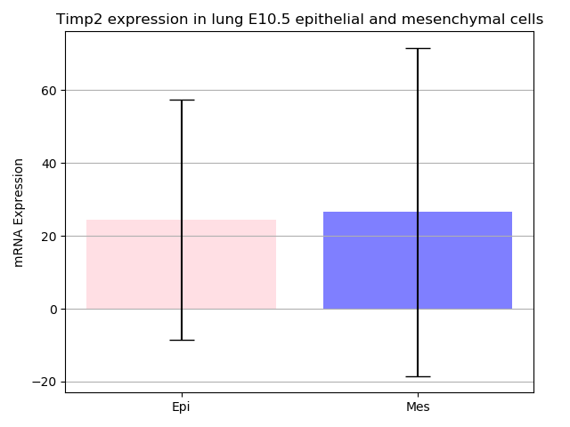
GSM3027039 (lung10.5E expression)
t = 0.18786636459852307
p = 0.8519663195255461

Slide 10
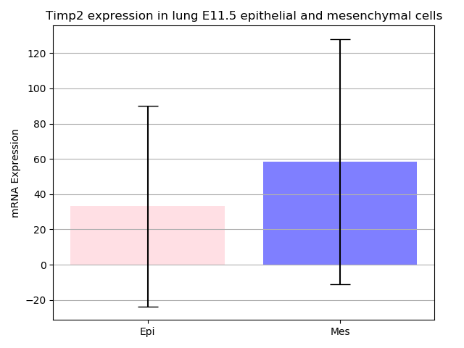
GSM3027047 (lung11.5E expression)
t =1.2774824478919518
p = 0.20863320356230441

Slide 11
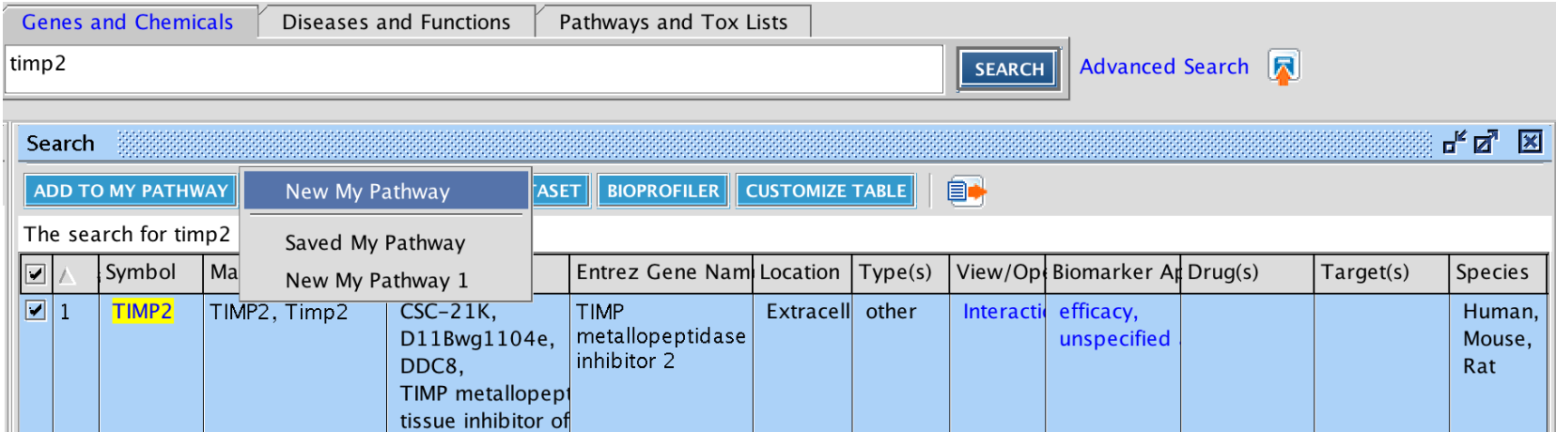
Using web-based software to interpret data
What is IPA?
Ingenuity Pathway Analysis (IPA) is a web-based software that it is used for the interpretation of omics data. You can either interpret your own data or used the data available within the software.

Slide 12
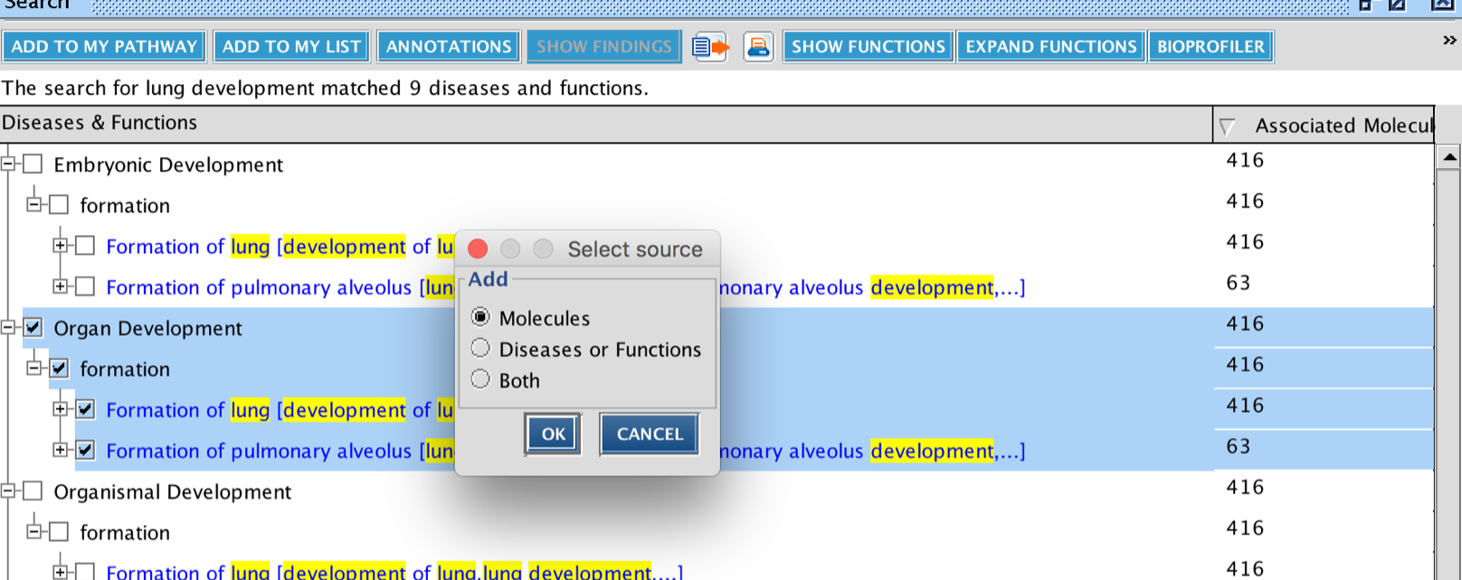
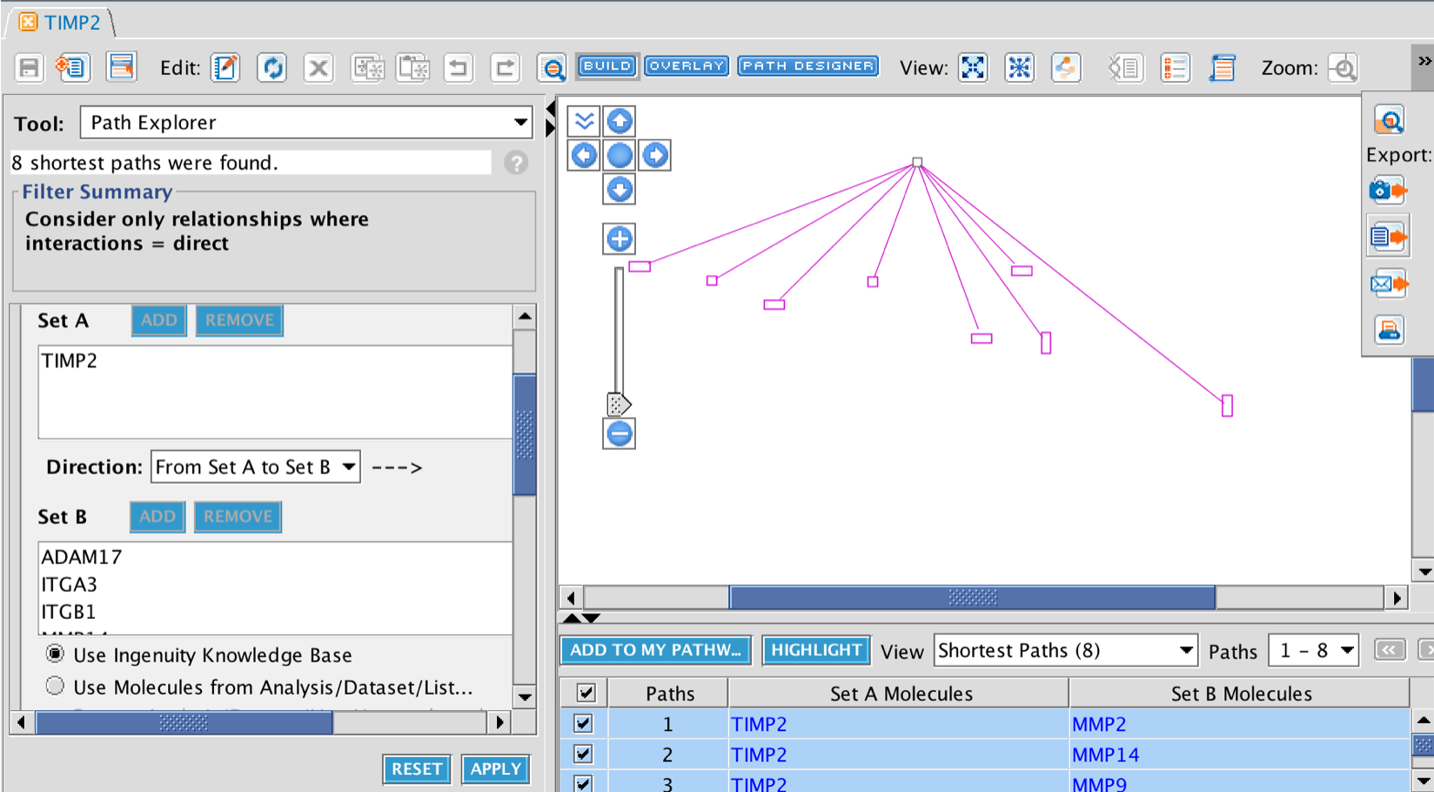
Building pathways in IPA

Slide 13
Using matplotlib venn to look for relationships
import matplotlib.pyplot as plt #from matplotlib_venn import venn2 PPI_lung_dev=['ADAM17','ITGA3', 'ITGB1', 'MMP14', 'MMP2', 'MMP9', 'RAB3A'] PPI_Fibrosis_and_lung_cancer=['IGF1R','ITGB1', 'MMP7', 'ITGA5'] set(PPI_lung_dev) & set(PPI_Fibrosis_and_lung_cancer) venn2([set(PPI_lung_dev), set(PPI_Fibrosis_and_lung_cancer)], set_labels = ('Lung development ', 'Fibrosis and lung adenocarcinoma')) plt.title('Timp2 protein-protein interactions during development vs disease\n') plt.savefig('Timp2_protein_protein_interaction_dev_vs_disease') plt.print()

Slide 14
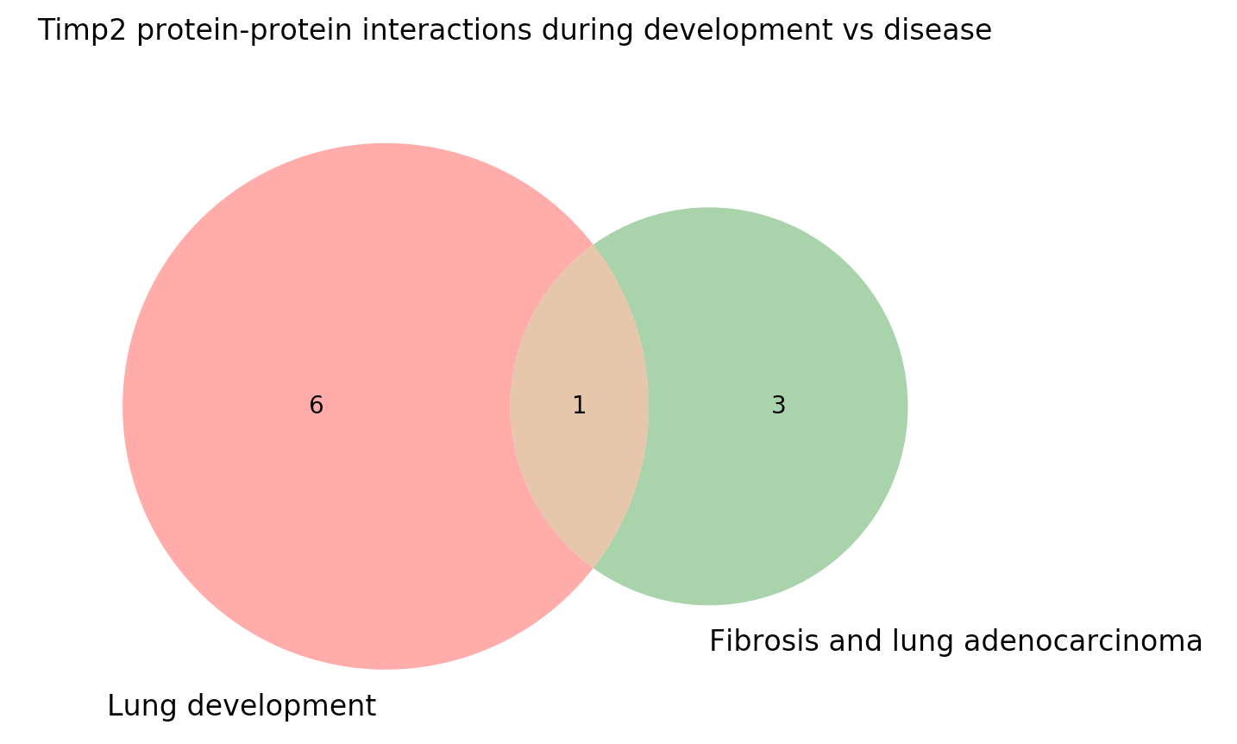
Using matplotlib venn to look for relationships

Slide 15
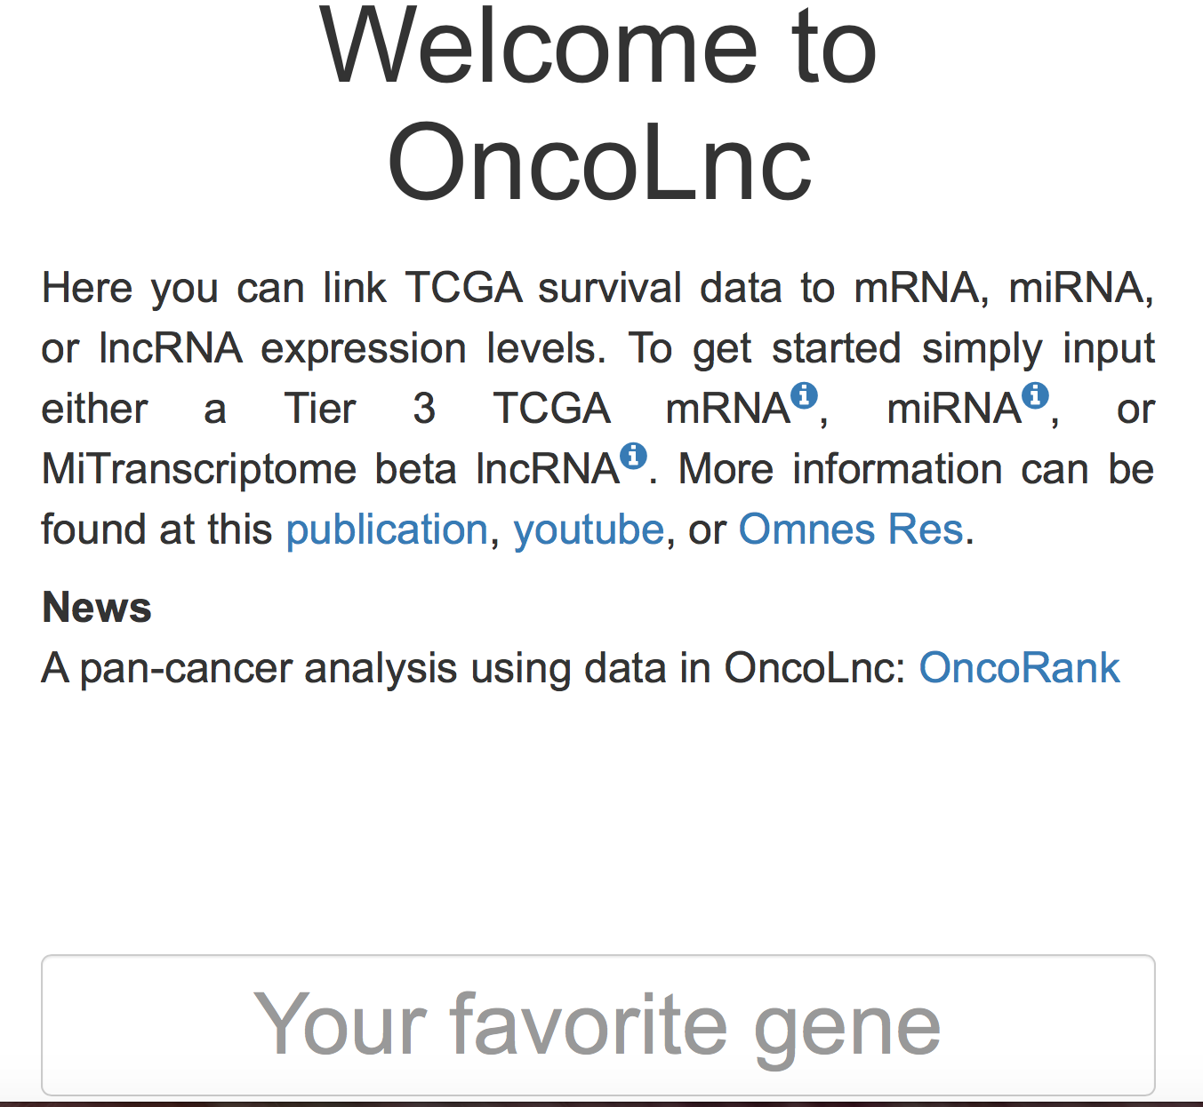
Assessing possible implications
Looking at correlations with disease dataset
“OncoLnc is a tool for interactively exploring survival correlations, and for downloading clinical data coupled to expression data for mRNAs, miRNAs, or lncRNAs. (PDF) OncoLnc: Linking TCGA survival data to mRNAs, miRNAs, and lncRNAs.” Available from: https://www.researchgate.net/publication/308718954_OncoLnc_Linking_TCGA_survival_data_to_mRNAs_miRNAs_and_lncRNAs[accessed Dec 13 2018].

Slide 16
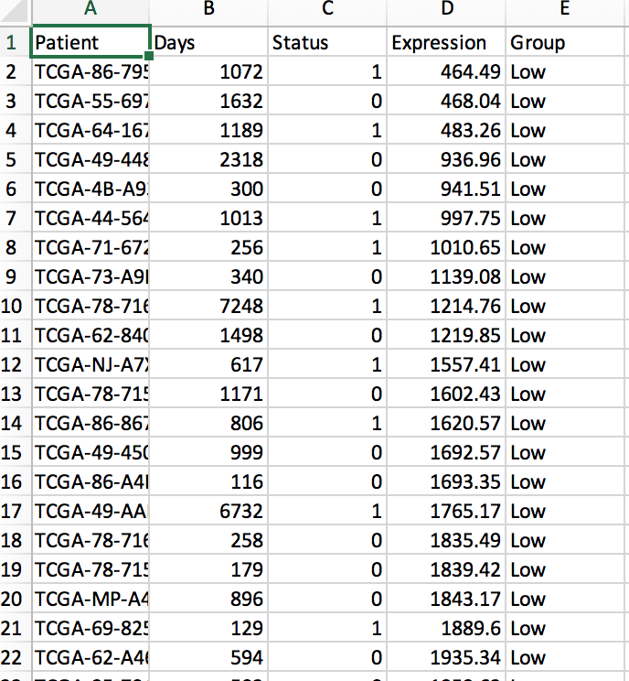
Cleaning data from OncoLnc
import pandas as pd import os filename= os.path.abspath(os.path.join('Desktop', 'LUAD_7077_25_25_1.csv')) fin= open(filename) readCSV= pd.read_csv(fin) readCSV.head() # Getting read of columns readCSV.drop(["Patient", "Expression"], axis=1, inplace=True) readCSV.head() print("Number of Observations:", readCSV.shape[0])

Slide 17
Building survival graphs
import matplotlib.pyplot as plt from lifelines import KaplanMeierFitter kmf=KaplanMeierFitter() C= readCSV['Status'] T= readCSV['Days'] kmf.fit(T,C) groups=readCSV['Group'] ix = (groups == 'Low', "High") for r in readCSV ['Group'].unique(): ix=readCSV ['Group'] ==r kmf.fit(T[~ix], C[~ix], label='Low Timp2') ax = kmf.plot() kmf.fit(T[ix], C[ix], label='High Timp2') plt.title('Survival of lung adenocarcinoma depending on Timp2 expression') kmf.plot(ax=ax) plt.show()

Slide 18
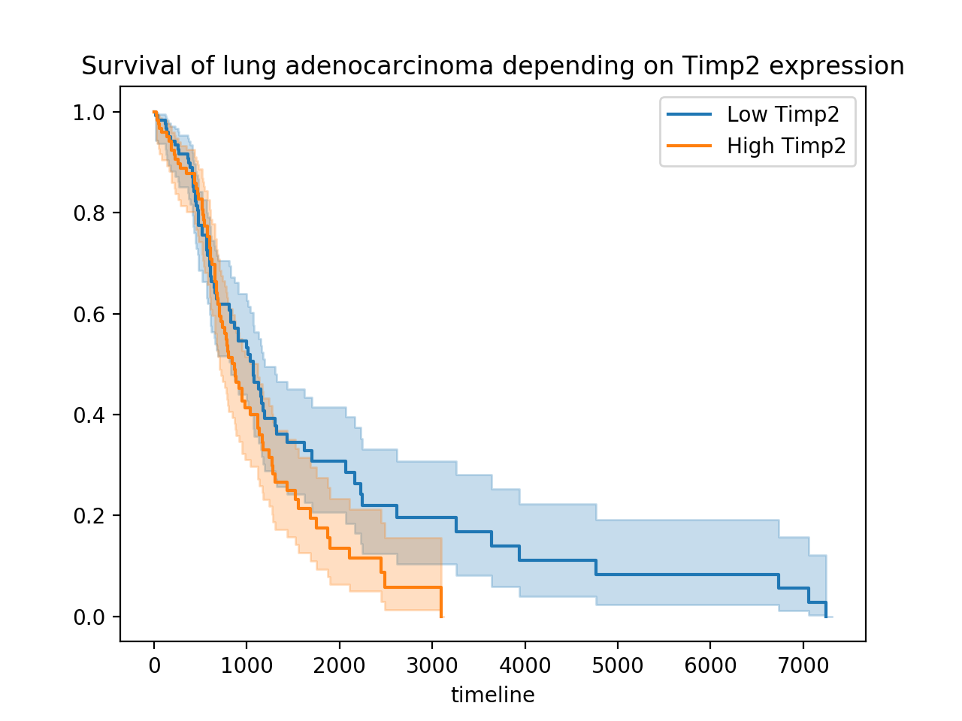
Survival curve of high Timp2 vs Low Timp2 expression

Slide 19
Cox regression
import pandas as pd import os
filename = os.path.abspath(os.path.join('Desktop', 'LUAD_7077_25_25_1.csv')) fin = open(filename) readCSV = pd.read_csv(fin) readCSV.head() # Getting rid of columns readCSV.drop(["Patient"],axis=1,inplace=True) readCSV.head() groups = readCSV['Group'] ix = (groups == 'Low', "High") for r in readCSV['Group'].unique(): ix = readCSV['Group'] == r from lifelines import CoxPHFitter cph = CoxPHFitter() cph.fit(readCSV[['Expression','Days','Status']], duration_col="Days", event_col="Status") cph.print_summary()

Slide 20
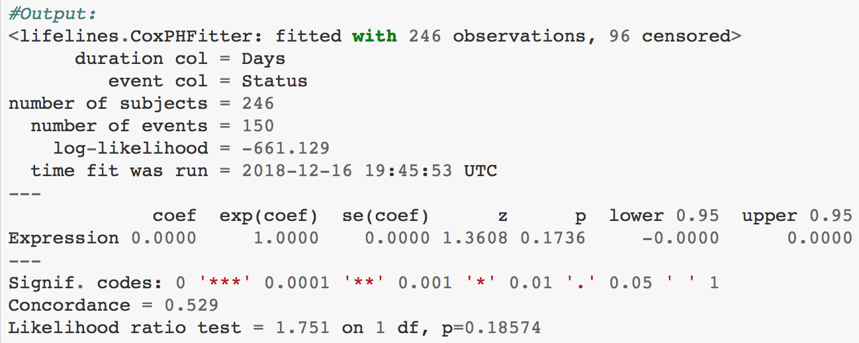
Cox regression output

Slide 21
Summary
Hopefully this project helped you have a better idea of how to design a research question and how to look for evidence that could support your hypothesis.
With these three tasks you are answering:
Task 1: What are you interested in?
Task 2. How is your molecule of interest related to previous studies? or What do previous studies say about your molecule of interest?
Task 3: Why it is important to study that molecule?

