Slide 1
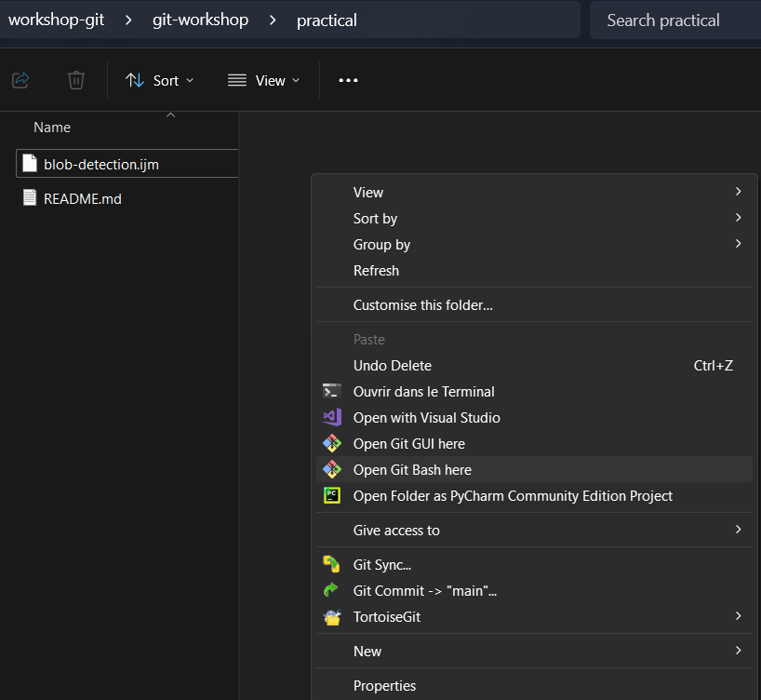
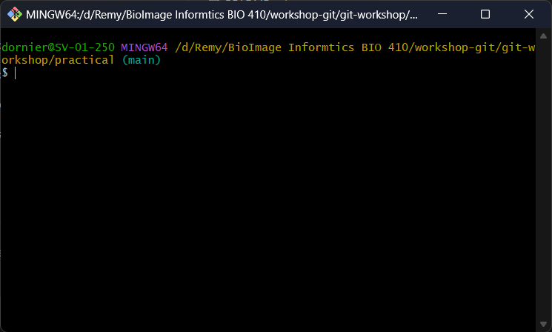
WINDOWS
Right click in the practical folder (+ show more options)
Open the terminal

Slide 2
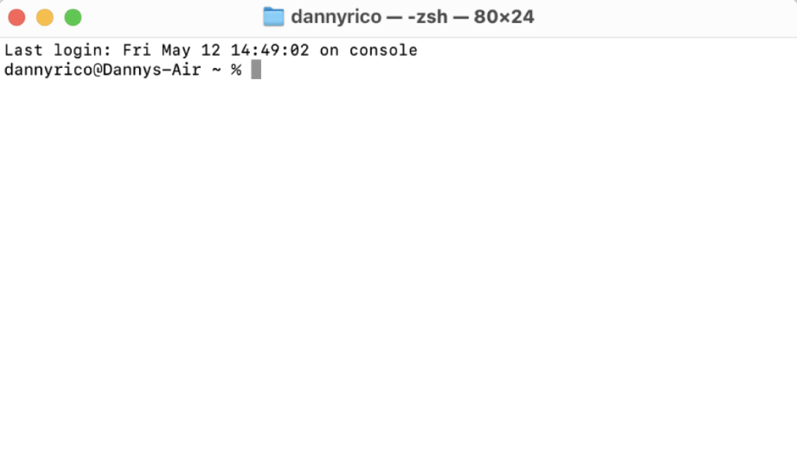
MAC/Linux
Open the terminal
duponton
duponton
duponton@macbook-air
duponton@macbook-air /document/git-workshop/practical %
Change the current directory
cd path/to/practical/folder

Slide 3

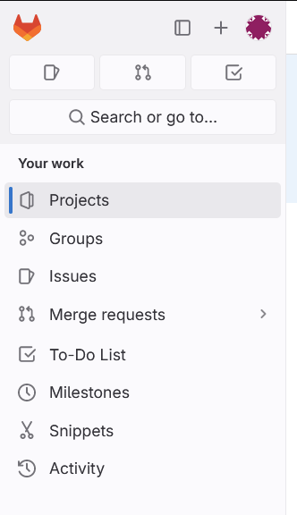
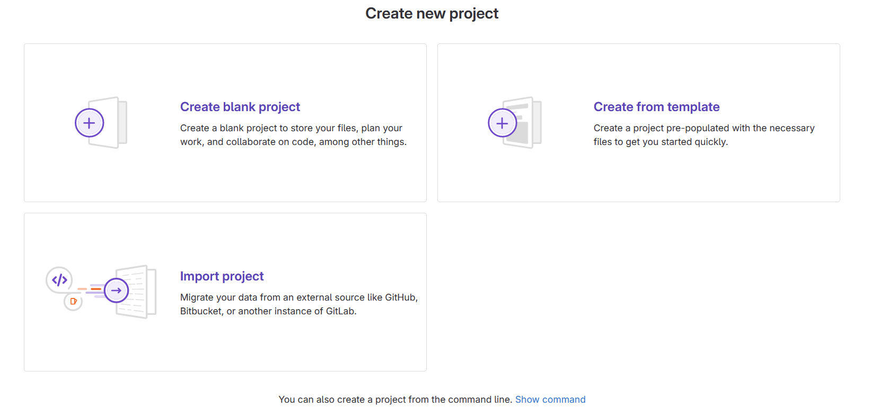

Slide 4
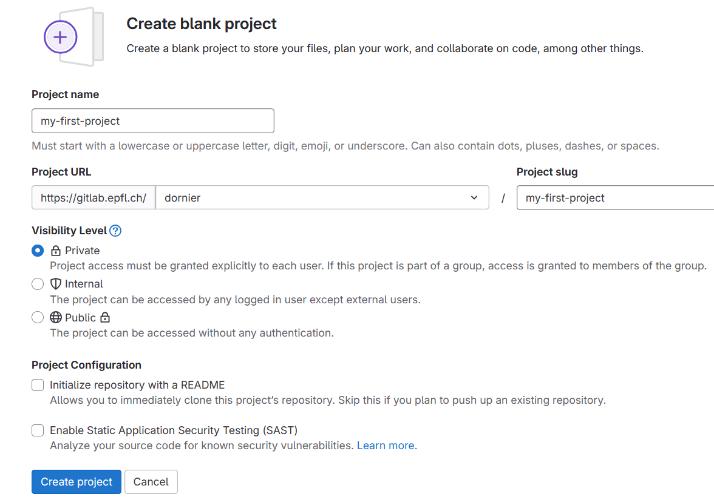
Enter the name of your local projet (same name)
Select your account
Select private
DO NOT check the box

Slide 5
Enter the name of your local projet (same name)
Select your account
Select private
DO NOT check the box

Slide 6
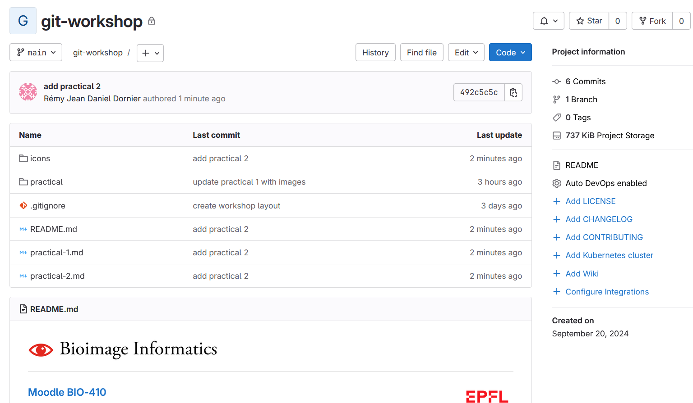
1
2
3
4

Slide 7
2
3
4
1

Slide 8
1
2

Slide 9
1

Slide 10
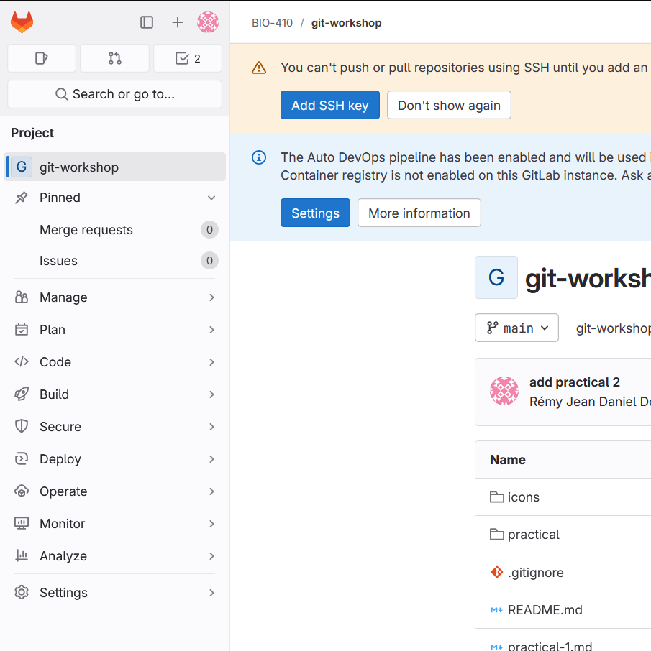
2
1
3
4
5

Slide 11
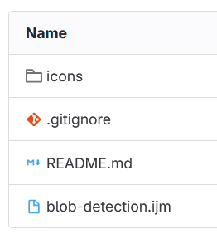
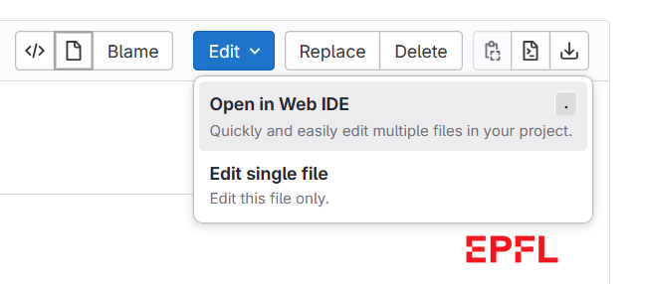


Slide 13



Slide 14
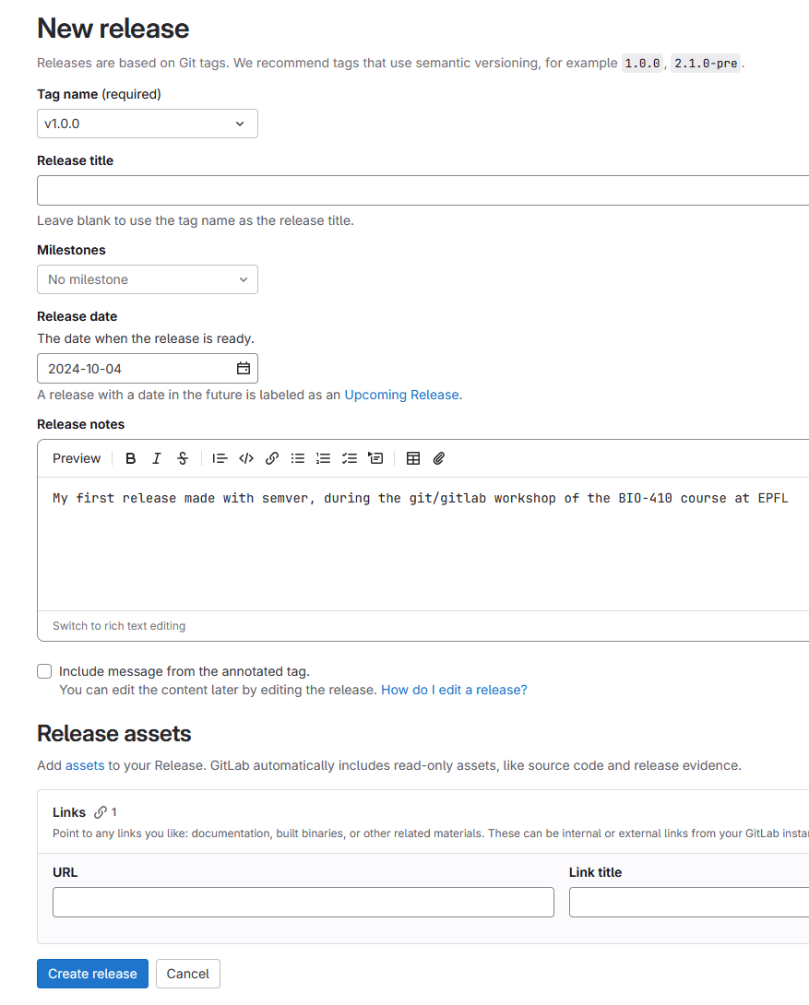
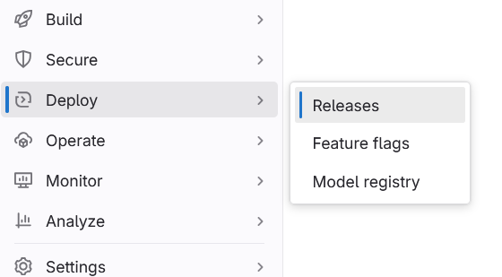

Slide 15
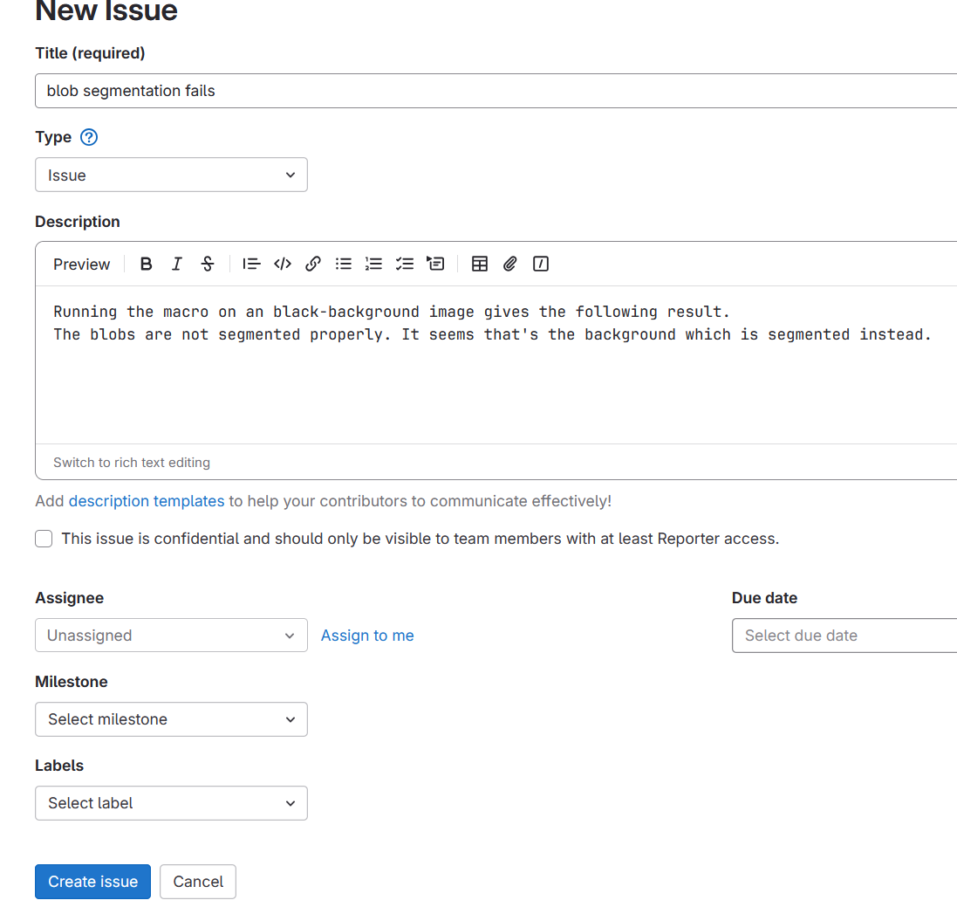

A
B

Slide 16
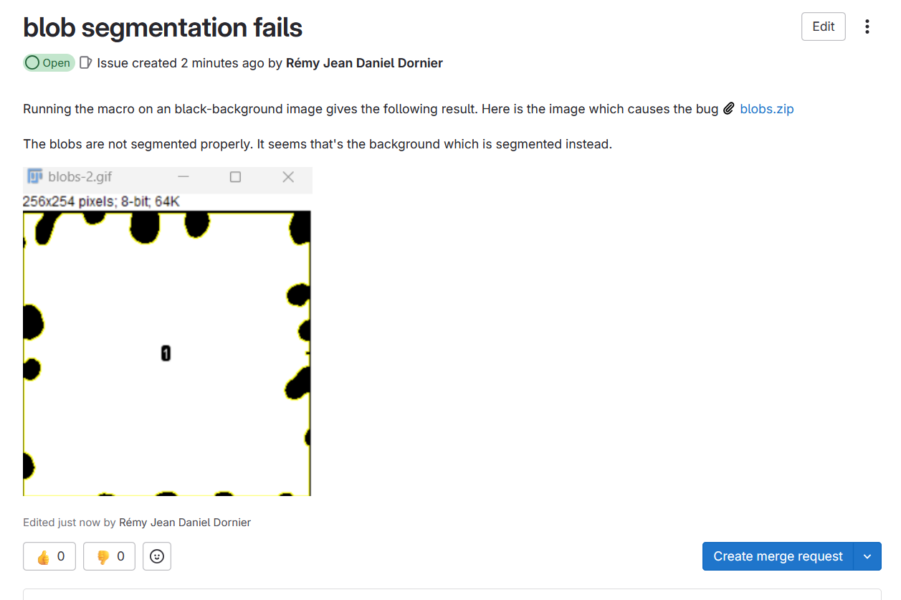


Slide 17

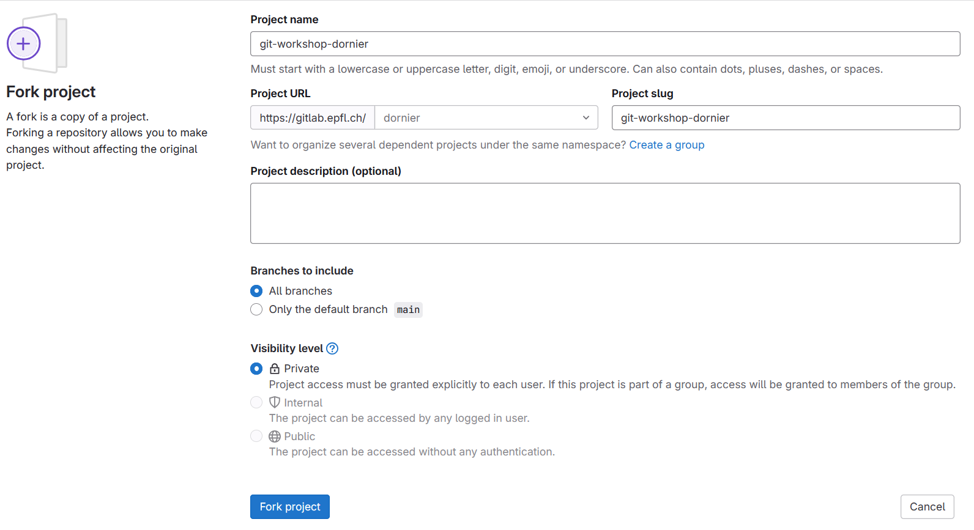

Slide 18
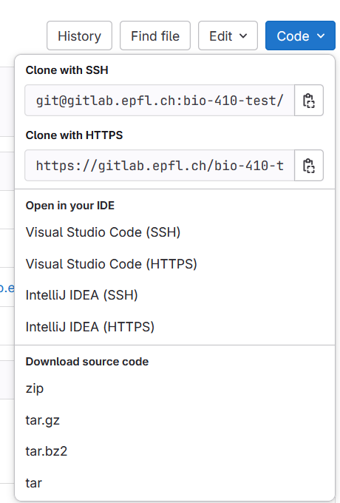

Slide 19
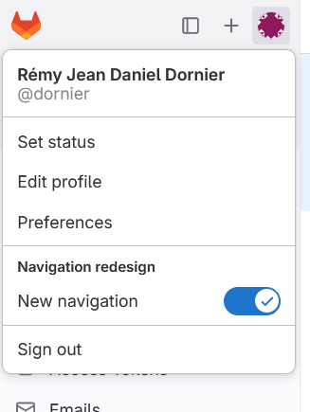
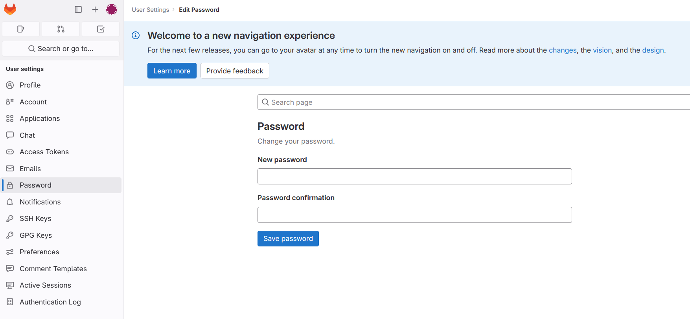

Slide 20
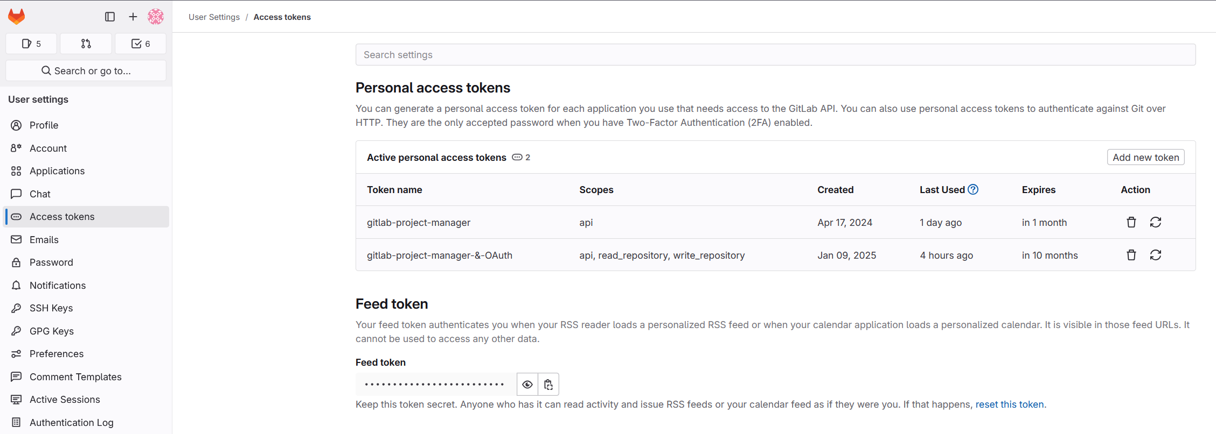

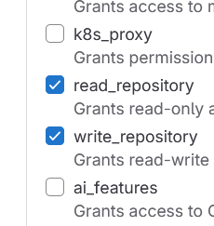

Slide 21
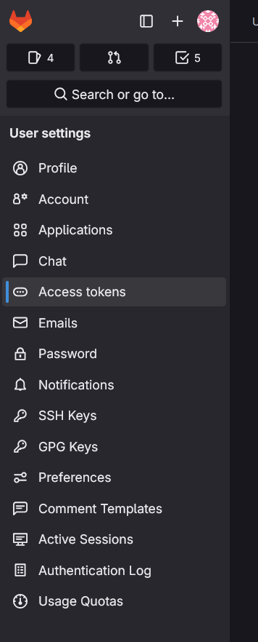
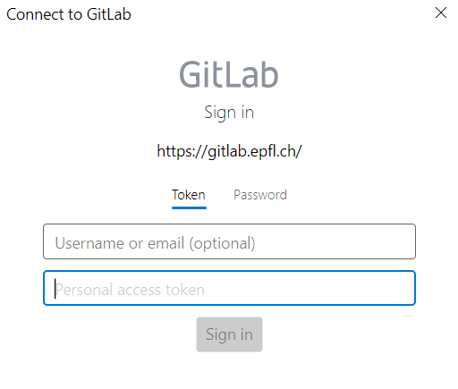

Slide 22


COPY YOUR TOKEN NOW !

Slide 23
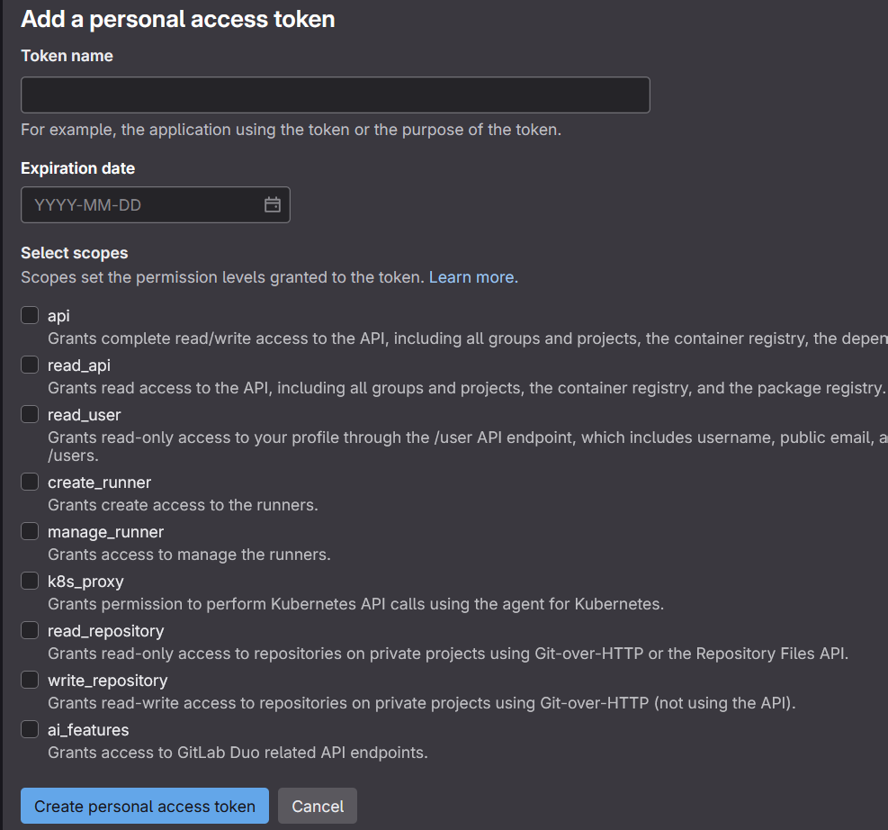
gitlab-bii-workshop

