Slide 1

1/18/23
An introduction to the best package in R

Slide 2
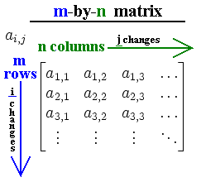
Onto Matrix and Dataframes!
Think of dataframes as sets of vectors combined together!
The columns are the unique vectors wedged together!
For working with data frames you need to know row and column!
To avoid numbers you can use the ‘$’ operator!
This allows use to use column names!

Slide 3
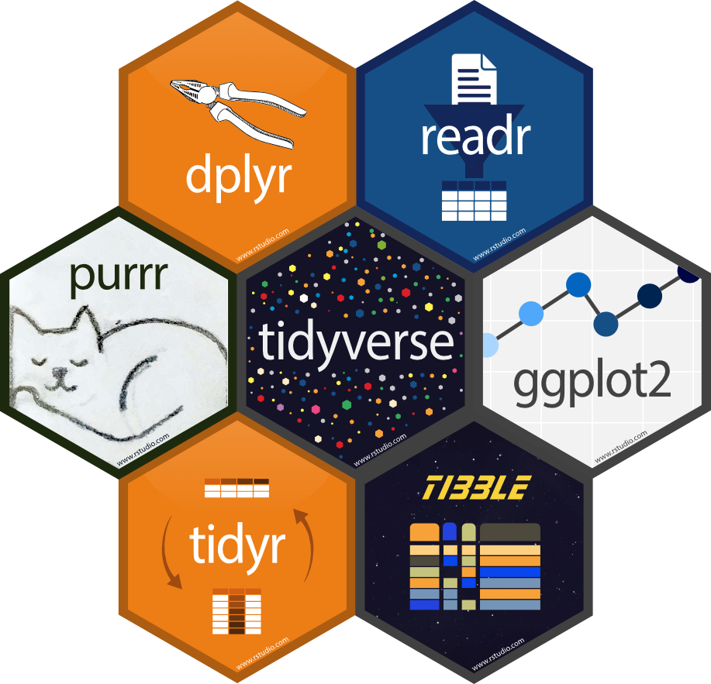
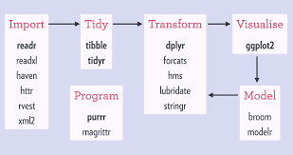
What is the Tidyverse?
A collection of packages that makes it easy to
Import datasets
Wrangle data
Plot data
Quantify models
Apply functions
Tidyverse will improve code readability and quicken the time it takes to get to the modelling or plotting you care about!

Slide 4
Install the Tidyverse with me!
Open R studio
Hover over tools
Click ‘Install Packages’
With CRAN as default, type in ‘tidyverse’
Click Install!
Wait until you get > in the bottom console, then it’s installed!

Slide 5
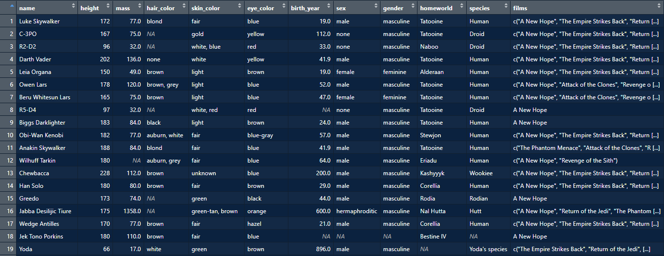
Dataset for Today: Starwars
library(tidyverse)
data("starwars")
view(starwars)
Load the data
View data
Wait until you get > in the bottom console, then it’s installed!

Slide 6

Improved Readability: Filtering
intro to dplyr
Let’s investigate the characters that are older than 50
In Base R: starwars[starwars$birth_year > 50, ]
Translation: in the starwars dataframe in the starwars column birth_year (age) what integers are greater than 50?
In Tidyverse: starwars %>% filter(birth_year > 50)
Translation: within the starwars dataframe whose birth_year (age) is greater than 50?
Remember R is a language we and have to learn how to speak it!

Slide 7

The Pipe Operator – connect operations
MagittR
The Pipe Operator (%>%) tells R: “I am using one specific dataframe, don’t assume any other dataframe!”
try: starwars[birth_year > 75, ]
It will fail because R can’t find a birth_year dataframe!
starwars %>% filter(birth_year > 50)
Here the dataframe only needs to be specified once!
This makes chaining operations together super easy!

Slide 8

New Columns: Mutate
intro to dplyr
This occurs more frequently than you might expected!
1. Convert a column from hours to minutes
2. Change Mass in Lbs to Kg
Let’s filter by age > 50 and then convert their mass to Lbs
Base R
Tidyverse
holder <- starwars[starwars$birth_year > 50,]
holder$weight <- holder$mass*2.2
starwars %>% filter(birth_year > 50) %>% mutate(weight = mass * 2.2)
You can’t conduct two operations in the same line so you must create some separate dataframe ‘holder’, then take the mass column in holder, divide it by 2.2 and apply it to a newly created column in holder called ‘weight
Pipe the data frame to filter function, pipe data to mutate function
This is readable!
This is a nightmare, please don’t suffer like this

Slide 9

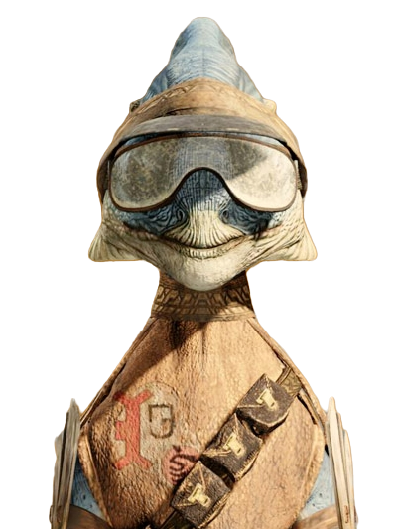
Quick View: Arrange
intro to dplyr
This is a function that can help you quickly view the range of values for a variable of interest
Let’s look for the lightest member in the whole starwars dataset but in terms of weight!
starwars %>% mutate(weight = mass * 2.2) %>% arrange (weight)
It’s critical to always investigate your data before doing any data analysis! Don’t assume your data is all correct!
Congrats you now can conduct data exploration!

Slide 10
Other Functions to be Aware of!
intro to dplyr
Select(): Grabs only columns of interest!
Rename(): Rename Columns!
Relocate(): Allows you to change the column order!
starwars %>% select(name, homeworld, mass, birth_year)
starwars %>% rename(age = birth_year)
Now Go to Canvas and work on the Introduction to the Tidyverse Exercise Stop at Question 7!

Slide 11
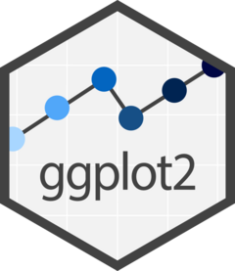
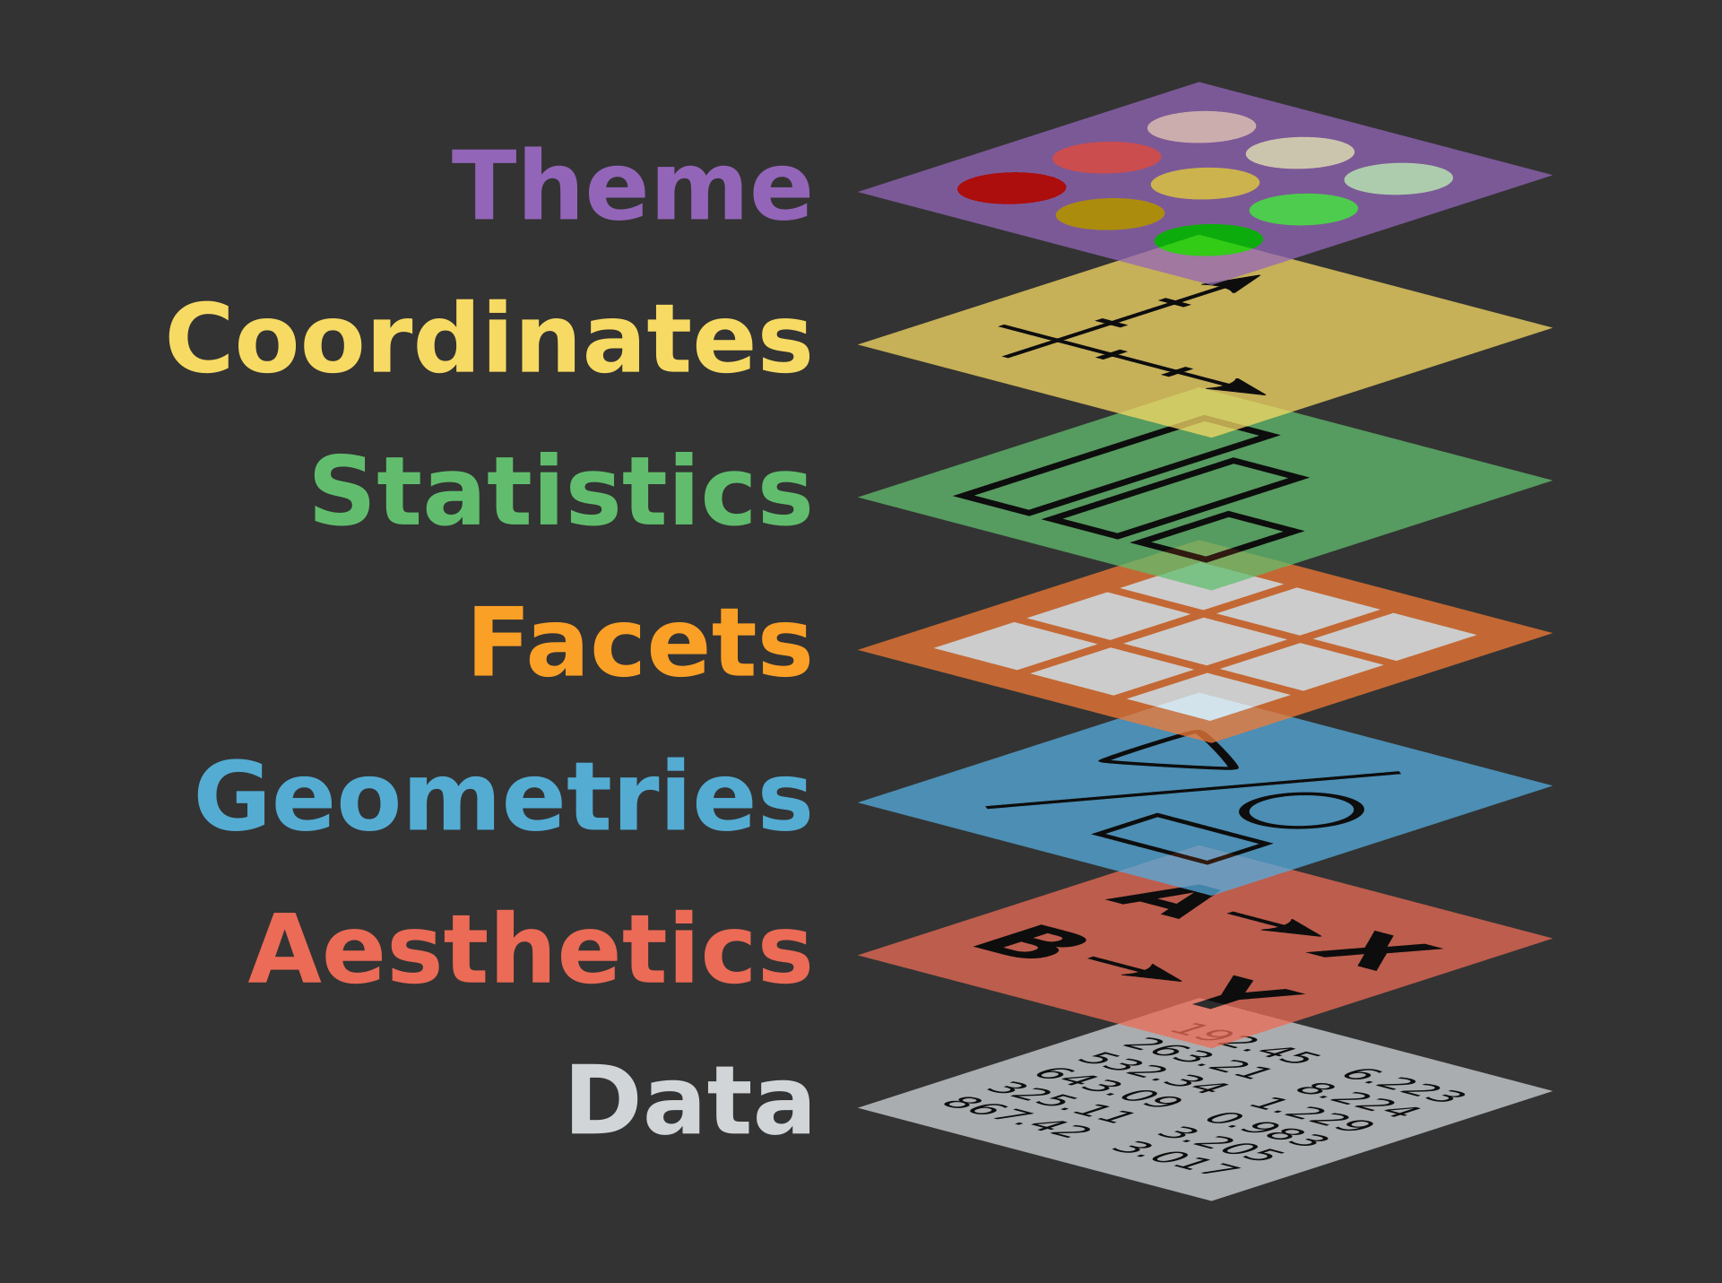
Making your first plot!
The Ggplot2 package is a convenient way to plot data!
First you must imagine that you are stacking layers on top of a blank sheet of paper!
First, you draw the axis, then you decide plot type, then plot data…
The most important thing is called the aesthetics:
In the code this is the aes()
It’s what your X and or Y data will be!
This will make more sense on the next slide!

Slide 12
Making your first plot!
Don’t worry we are only focusing on first 3 layers!
Data frame of interest
Aesthetics (What column do you want on X and Y axis?)
Geometries (Do you want a scatterplot? A bar plot? A histogram?
One critical component of syntax!
Once you pipe to ggplot function all following functions need + between
starwars_weight %>% ggplot(aes(x = height)) + geom_histogram()
Data
aesthetic
Geometry

Slide 13
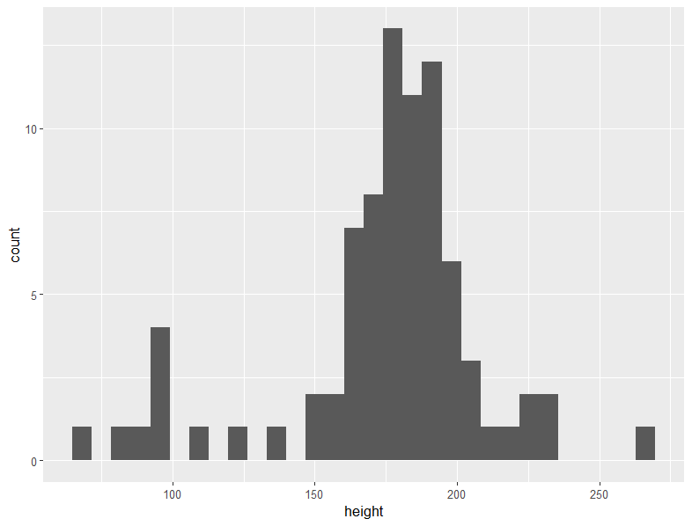
Making your first plot!
Let’s make a histogram of all the heights of Starwars characters!
starwars_weight %>% ggplot(aes(x = height)) + geom_histogram()
Data
aesthetic
Geometry
This is ugly! But don’t worry we will learn more aesthetics to make it prettier!

Slide 14
Word to the wise!
All plot types start with geom_
Geom_boxplot()
Geom_point()
Geom_histogram()
Geom_bar()
Geom_violin()
Please go to canvas and finish the activity for today! Let TAs know if you have any questions!

Slide 15

Read in Excel Files of Interest
This is the most unintuitive part so bear with me!
R doesn’t know where your files are, you must discretely tell it!
This location is referred to as the “directory” also known as the “path”
C:\Users\29sch\OneDrive\Documents\Graduate Classes\Bio 338\x.rmd
File Path File
Must provide R the entire directory
Or you can give it the file path and then call multiple files from there

Slide 16
Read in Excel Files of Interest
Read_xlsx() is main function
Read_xlsx(“C:/Users/29sch/OneDrive/Documents/Graduate Classes/Bio 338/x.rmd”)
Windows: If you copy the file path from library explorer, you will need /
If you have a .csv, same rules apply but function is read.csv()
Setwd() will set the “working directory” to a specific location
Setwd(“C:/Users/29sch/OneDrive/Documents/Graduate Classes/Bio 338/”)
Let’s read in the .xlsx file from Canvas and save it as practice_dataframe!

