Slide 1
Comparison of Observed and Expected Mortality Rates After Heart Surgery
Michaela Palumbo
BIOS 6623
Project 2
November 1, 2017

Slide 2
Study Goals
Study Question: Are the observed 30 day mortality rates after heart surgery higher or lower than expected at 44 different VA hospitals?
Clinical Hypotheses:
No a priori predictions as to which hospitals will do better or worse
Do expect different hospitals to have different mortality rates because they have different patient populations
20% difference between observed and expected is clinically meaningful
Statistical Hypothesis: Is the observed death rate significantly different from the expected death rate at an alpha = 0.05 significance level?

Slide 3
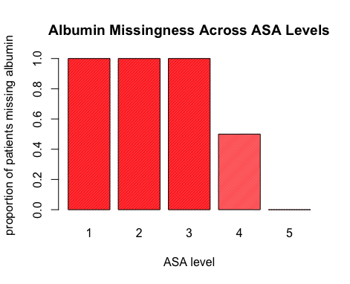
Summary of Analytic Dataset
Sample size for final logsitic model = 21346
Albumin excluded from final model
~60% missing
MAR
No BMI data for hospital 30
Characteristics of period 39 patients:
76.4% CABG surgeries
Average BMI = 28.58
ASA levels:
1: 0.14%
2: 4.29%
3: 18.38%
4: 69.39%
5: 0.2%

Slide 4
Analysis Approach
Calculation of observed death rate:
percentage of patients who died within 30 days of surgery during period 39 within each hospital
Calculation of expected death rate:
Logistic regression model
Outcome = death30
Predictors = procedure type, ASA, BMI
Used predicted values to calculate subject-specific expected death rates for period 39 patients
Averaged subject specific rates within each hospital to get an expected death rate for each hospital
Metrics for assessing significance
Statistical significance: 95% boostrap CI for expected death rate for each hospital
Clinical significance: percent difference greater than or equal to 20%

Slide 5
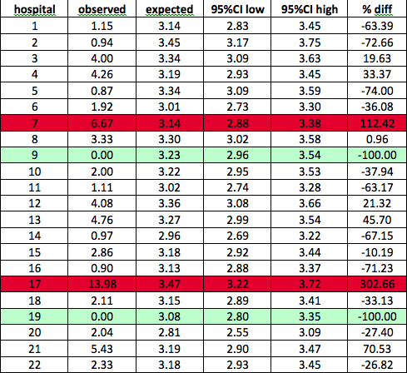
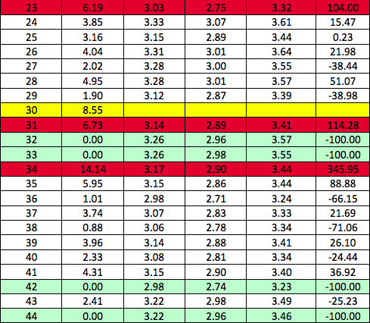
Summary of Statistical Results

Slide 6
Scientific Implications of Results
Recommended hospitals to visit:
Observed death rates better than expected: 9, 19, 32, 33, 42, 44
Observed death rates worse than expected: 7, 17, 23, 31, 34
Followup hospital 30
Potential Limitations:
Bootstrap CIs were very narrow – likely not useful for assessing significance
Missingness of BMI, procedure type, & ASA: not concerning
< 10% missing
Appears MCAR
Albumin excluded
Try to increase reporting if would like to use it in future models

