Slide 1
Exploring the Association of a New Gel Gum Treatment With Change in Pocket Depth and Attachment Loss Over 1 Year
Michaela Palumbo
BIOS 6623
September 13, 2017

Slide 2
Study Goals
Scientific Hypothesis:
Does gel gum treatment result in lower average pocket depth and attachment loss at one year?
Statistical Hypotheses:
Is there a significant difference in the average change in pocket depth over 1 year between any of the treatment groups and controls?
Is there a significant difference in the average attachment loss over 1 year between any of the treatment groups and controls?

Slide 3
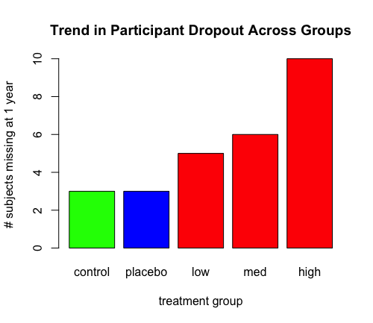
Summary of Data: Descriptive Stats
27 participants lost to follow - up
Not included in the analysis
Increasing trend of dropout with treatment dose
Fairly well-balanced demographics across groups
Higher percentage of females than males across all groups
White is highest percentage race across all groups

Slide 4
Analysis Technique Used
Used change in pocket depth or attachment loss as outcome (1 year measure – baseline measure)
Used controls as reference group
Separate linear univariate models run for each outcome – pocket depth and attachment loss
For each outcome ran:
simple model
crude models
full model
reduced models – single variable removed from full
Using AIC and diagnostic plots chose model that included outcome, treatment group, and baseline as covariate

Slide 5
Summary of Statistical Results
Change in pocket depth over 1 year
No statistically significant results
Change in attachment loss over 1 year
There was a significant difference (p = 0.0232) in average change in attachment loss between the medium dose treatment group and the control group.
The average change in attachment loss over 1 year was 0.176 units (95% CI: 0.025 to 0.327 units) higher for subjects in the medium dose treatment group compared to subjects in the control group.

Slide 6
Scientific Implications of Results
Gel gum treatment does not significantly effect changes in pocket depth over 1 year
Medium dose level treatment had significantly different change in attachment loss over 1 year compared to controls
This result indicates that the medium dose level treatment had a harmful/negative effect on attachment loss
People in this group on average had greater changes in attachment loss over 1 year
Limitations:
How to measure adherence?
Pattern of dropout

