Slide 1
Project 2 Interim Presentation
Michaela Palumbo
October 18, 2017

Slide 2
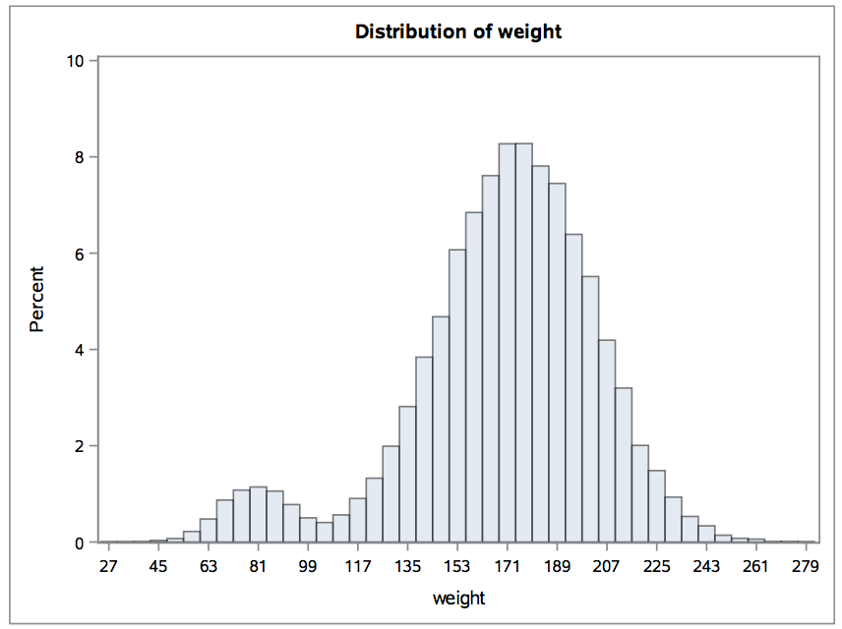
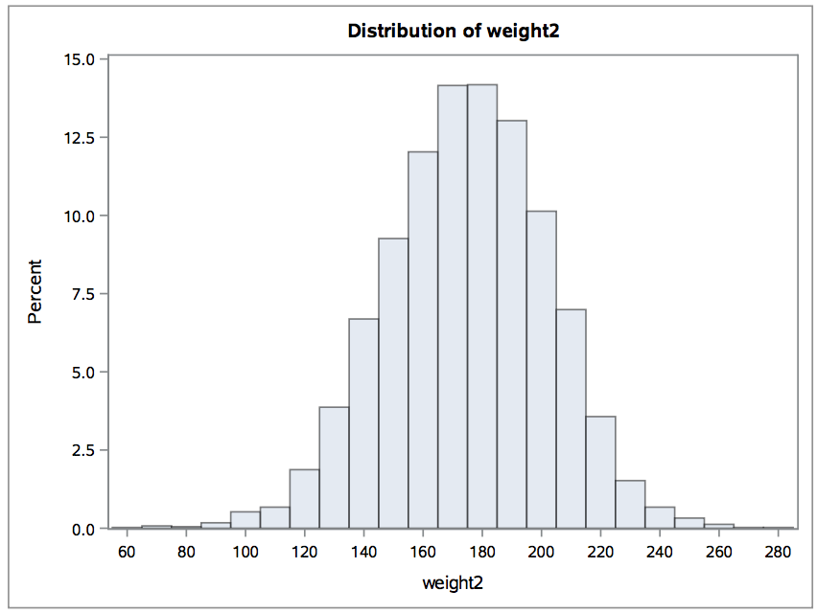
Summary of Data & Data Checking
Primary outcome: 30 day mortality (yes/no)
Covariates:
procedure type (CABG or valve)
BMI
ASA (patient’s condition, scale 1-5)
Albumin (overall health)
Bi-modal weight and potentially impossible BMIs

Slide 3
Investigating Missing Data
No missing outcome data, hospital code or six-month period data
Missing data for the covariates:
Procedure type, BMI, ASA, Albumin
Investigating the pattern of missingness:
Procedure type: ~6% missing, appears MCAR
BMI: ~7% missing, no data for hospital 30 during period 39
ASA: ~8% missing, appears MCAR
Albumin: ~62% missing, appears MAR with relation to ASA
Plan to compare death rates between those with and without missing data
Notes:
ASA 1-3: albumin 100% missing, ASA 4: albumin ~ 50% missing, ASA5: albumin 0% missing

Slide 4
Analysis Plan
Logistic regression using all the data
Calculating predicted value of 30 day mortality rate for each subject
Calculating expected mortality rate by averaging all subjects predicted values for periods 34-38
Calculating observed mortality rate by averaging all subjects predicted values for period 39
Hospital-specific effects: stratify expected and observed mortality rates by calculating separate averages for subjects within the same hospital

