Slide 1
Changes in Treatment Response After 2 Years of HAART Treatment in HIV-1 Positive Men
Michaela Palumbo
BIOS 6623
Project 1
October 9, 2017

Slide 2
Study Goals
Study Question: Does hard drug use effect changes in treatment response at 2 years after beginning HAART treatment in HIV-1 positive bisexual or homosexual men?
Treatment response quantified by 4 metrics:
Quality of life measures:
Mental quality of life score
Physical quality of life score
Biological measures:
Log10 viral load
CD4+ T cell count
Statistical Hypothesis: Is there a significant association between hard drug use and each of the four outcomes of interest?

Slide 3
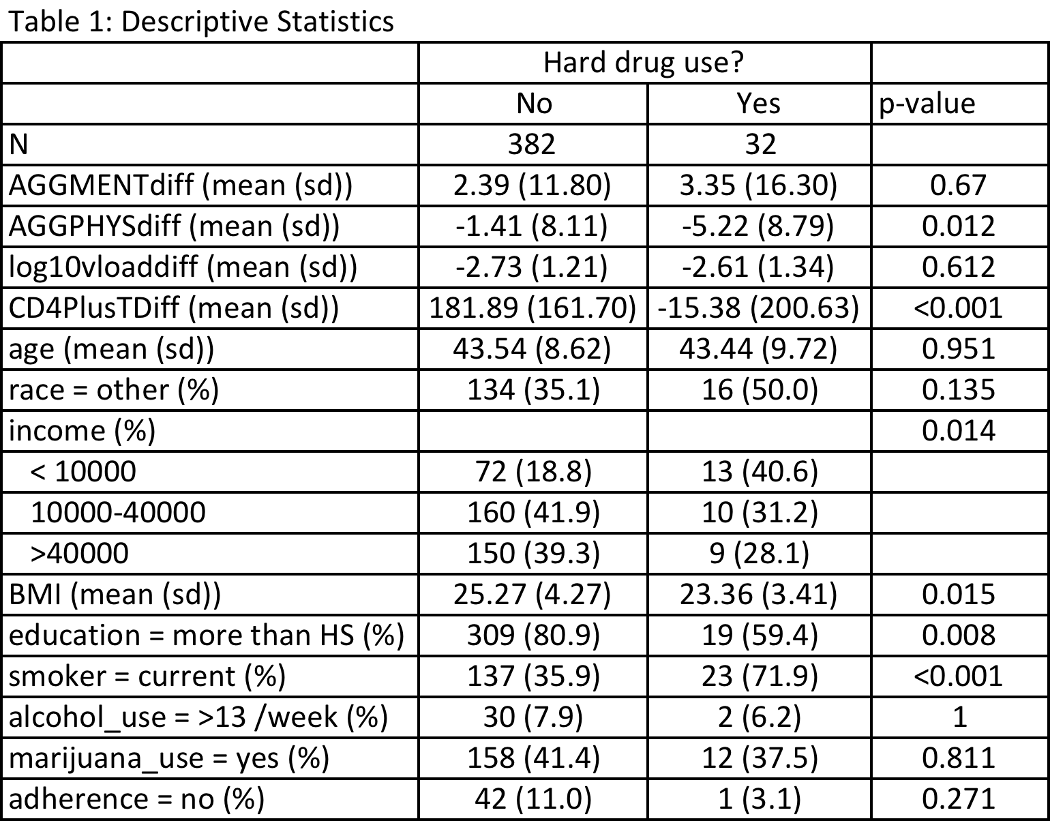
Summary of Data: Descriptive Stats

Slide 4
Analysis Approach
Bayesian approach - PROC MCMC
Crude, Full, and Reduced Models
To get convergence
# burnins = 1000
Thinning = 20
# simulations = 300000 (crude models), 350000 (full and reduced models)
Comparison of DIC by removing hard drug use (reduced model) to determine significance
Priors:
Sigma squared: invGamma(shape = 2.001, scale = 1.001)
Beta coefficients (aggment, aggphys, and log10vload models): Normal(mean=0, var = 1000)
Beta coefficients (CD4+ T cell models): Normal(mean=0, var = 100000)
Starting values:
Sigma squared: 1
Beta coefficients (all models): 0

Slide 5
Summary of Statistical Results
Results match Frequentist results seen in Table1
Significant association between hard drug use and change in physical quality of life score
Significant association between hard drug use and CD4+ T cell count
Table 2: Model Output for Hard Drug Use*
Outcome | Mean | Std. Dev. | 95% HPD Interval | DIC full | DIC reduced* | significant?
AggMentDiff | -1.1225 | 1.9128 | (-4.9229, 2.5846) | 3091.36 | 3089.638 | no
AggPhysDiff | -3.3322 | 1.4651 | (-6.2292, -0.4980) | 2881.642 | 2884.766 | yes
Log10VLoadDiff | 0.0214 | 0.2137 | (-0.4054, 0.4326) | 1284.639 | 1282.741 | no
CD4PlusTDiff | -189.2 | 31.0734 | (-251.4, -128.6) | 5408.589 | 5443.617 | yes
*After adjusting for the following covariates: baseline outcome value, age, bmi, smoking status, alcohol use, marijuana use, income, education level, race, adherence
**Reduced model was equal to the full model with only hard drug use removed

Slide 6
Scientific Implications of Results
Hard drug use may interfere with ability of treatment to restore CD4+ T cell count and immune system functioning
Hard drug use may amplify decline in physical quality of life while receiving HAART
Potential limitations:
Missing data
Self-reported variables
Hard drug use
Adherence

