Slide 1
Project 3 Interim Analysis
Michaela Palumbo
BIOS 6623
November 13, 2017

Slide 2
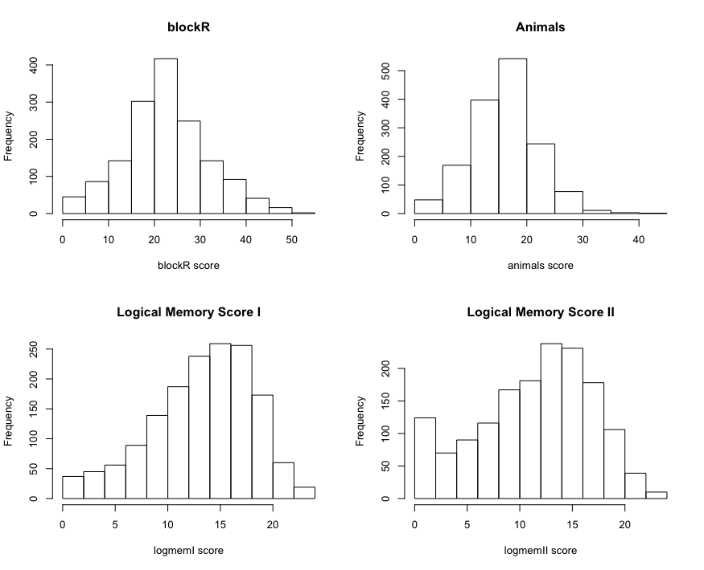
Summary of Study and Data
Outcomes: blockR, animals, logmemI, logmemII
All look fairly normally distributed
Logical memory score II? Normal range?
Covariates: age, gender, SES, demind
Confirm with investigator
Study aims:
Rate of memory decline in healthy individuals
Rate of memory decline in individuals with dementia
Identifying a change point

Slide 3
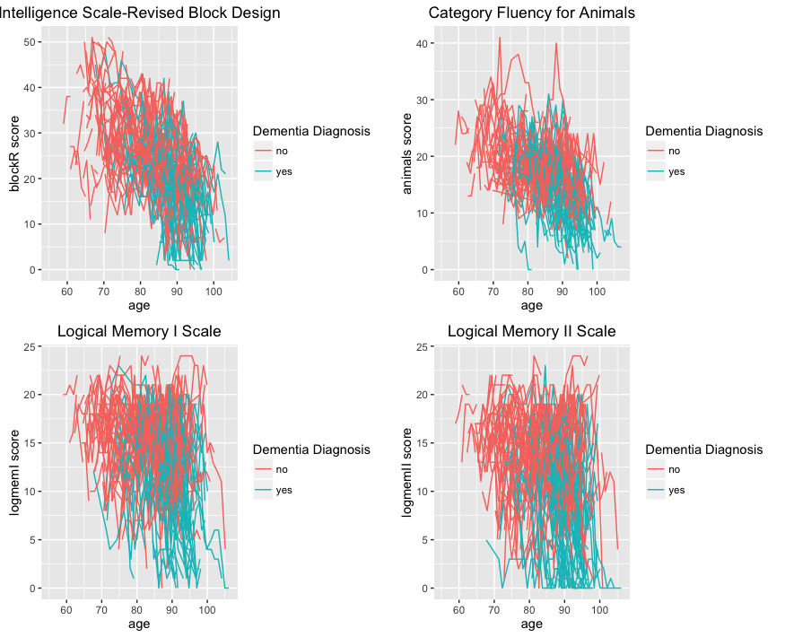

Slide 4
Analysis Plan
Mixed model for each outcome
Pulling criteria by outcome
Subjects with 3 or more repeated measures
Will compare slopes for those with and without dementia diagnosis to estimate the rate of decline for each of these groups
Linear or quadratic terms?
Identifying change point
Methods similar to those in Hall et al. 2000
Need to discuss with investigators/collaborators to fully clarify

