Slide 1
Memory Decline in Community Dwelling Elders
Michaela Palumbo
BIOS 6623
Project 3
November 27, 2017

Slide 2
Study Goals
Study Questions:
What is the rate of memory decline in healthy elderly individuals?
What is the rate of memory decline in individuals diagnosed with MCI during the study?
Is there a time before MCI diagnosis when the rate of memory decline changes?
Clinical Hypotheses:
Expect to see memory decline in all individuals
Expect that 4 years prior to diagnosis is when there will be a change in the rate of memory decline among those who will be diagnosed with MCI
Statistical Hypotheses:
What is the association (slope) between age and memory outcome among healthy individuals?
What is the association (slope) between age and memory outcome among patients with MCI diagnosis?
Among patients with MCI diagnosis, can we estimate a change point at with the association (slope) between age and memory outcome changes

Slide 3
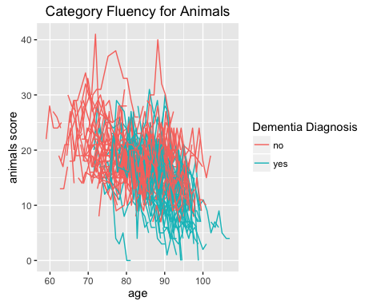
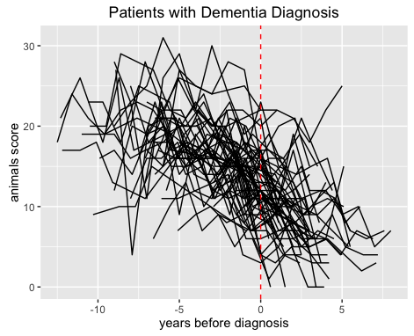
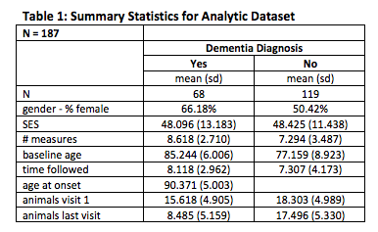
Summary of Analytic Dataset

Slide 4
Analysis Approach
Maximum likelihood estimation to search for change point
Linear mixed model
Outcome = category fluency for animals
Covariates
Age, demind, gender, SES, age by demind interaction
Change point term: max(0, age_{ij} – agedx_{i} + τ)
Random Intercept
Simple R structure
Bootstrap standard errors and 95% CIs
1000 bootstrap samples

Slide 5
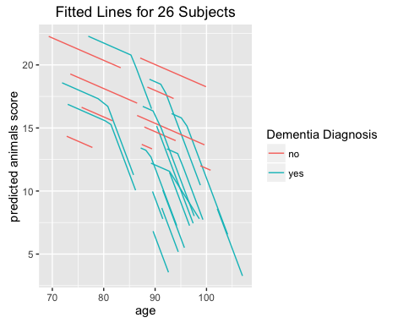
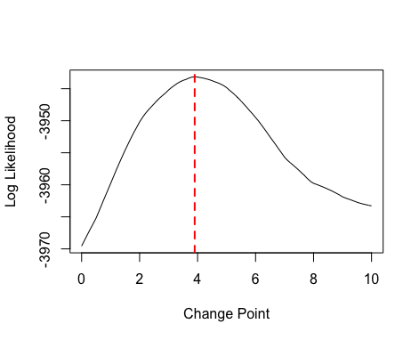
Analysis Approach

Slide 6
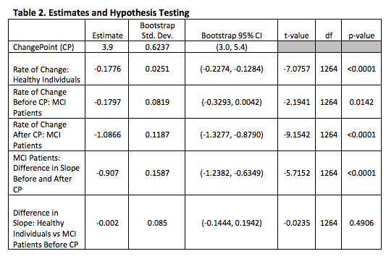
Summary of Statistical Results

Slide 7
Clinical Implications of Results
Healthy Individuals:
Rate of decline = 0.1766 units/year increase in age
Individuals with MCI diagnosis:
Estimated change point: 3.9 years before diagnosis
Rate of decline before cp: 0.1797 units/year increase in age
Similar to healthy individuals
Rate of decline after cp: 1.0866 units/year increase in age
Significant increase in rate of decline compared to before cp
Clinical importance:
Diagnostic decisions for preventative treatments
Identifying patients likely to have MCI
Limitations:
Animals measure assesses memory function in just 1 brain region
Future analyses should assess other memory function outcomes

