Slide 1
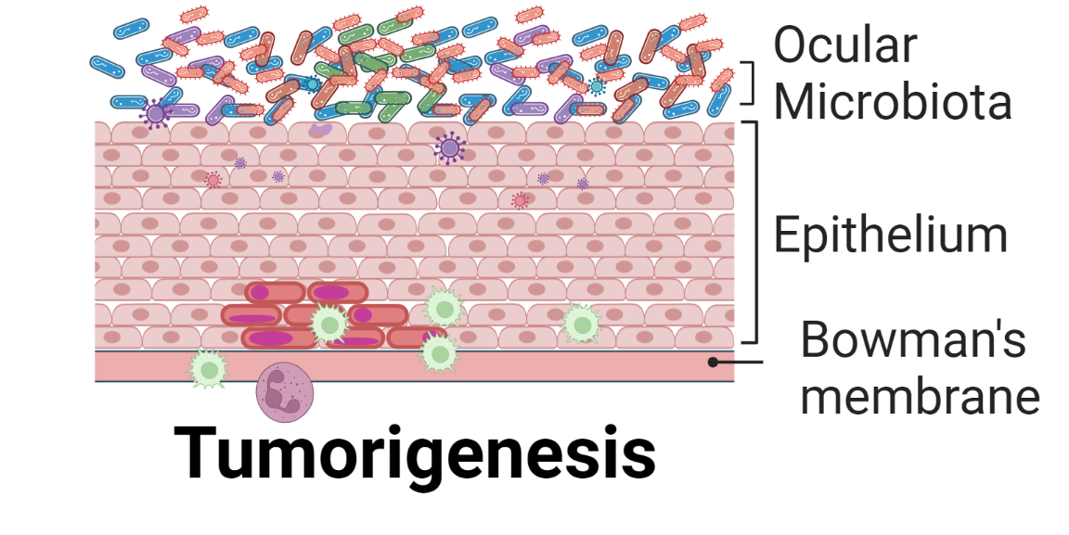
Ocular Cancer
Ken Kugel, SBS (GCMB), Dr. Angeletti’s Lab
Goal of Research: Associations between Ocular Bacterial Taxa and Ocular Cancer (Ocular Surface Squamous Neoplasia)
Potential Bacterial Inflammatory Role
Potential Association with Viral Information
Future Interactome Work
Data Types:
Fastq Files for Sequencing
Metadata (Excel)

Slide 2
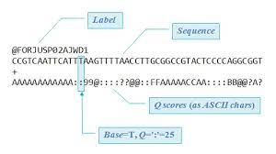
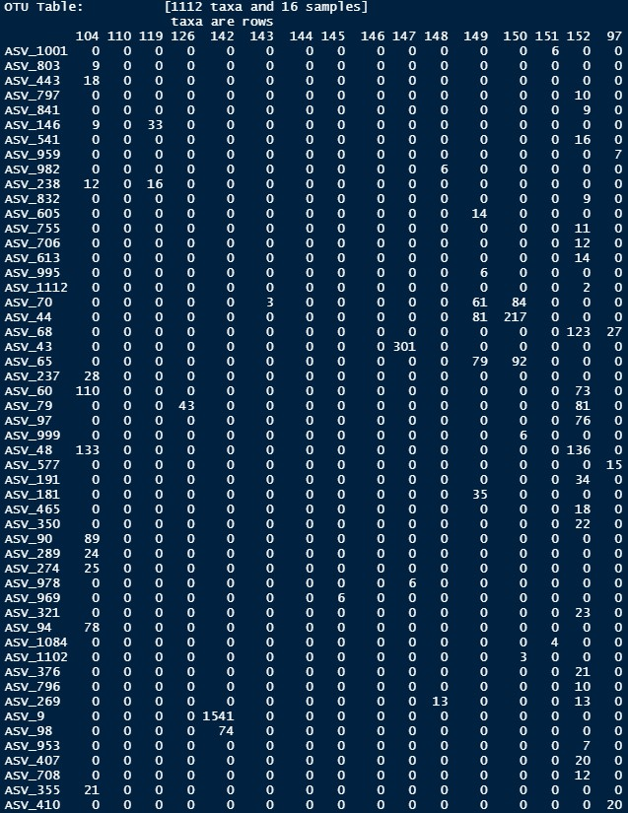
Data Types
Fastq
Essentially complex sequencing files
Metadata (Excel)
Excel file with columns and rows of information (similar to the homework 1)

