Slide 1
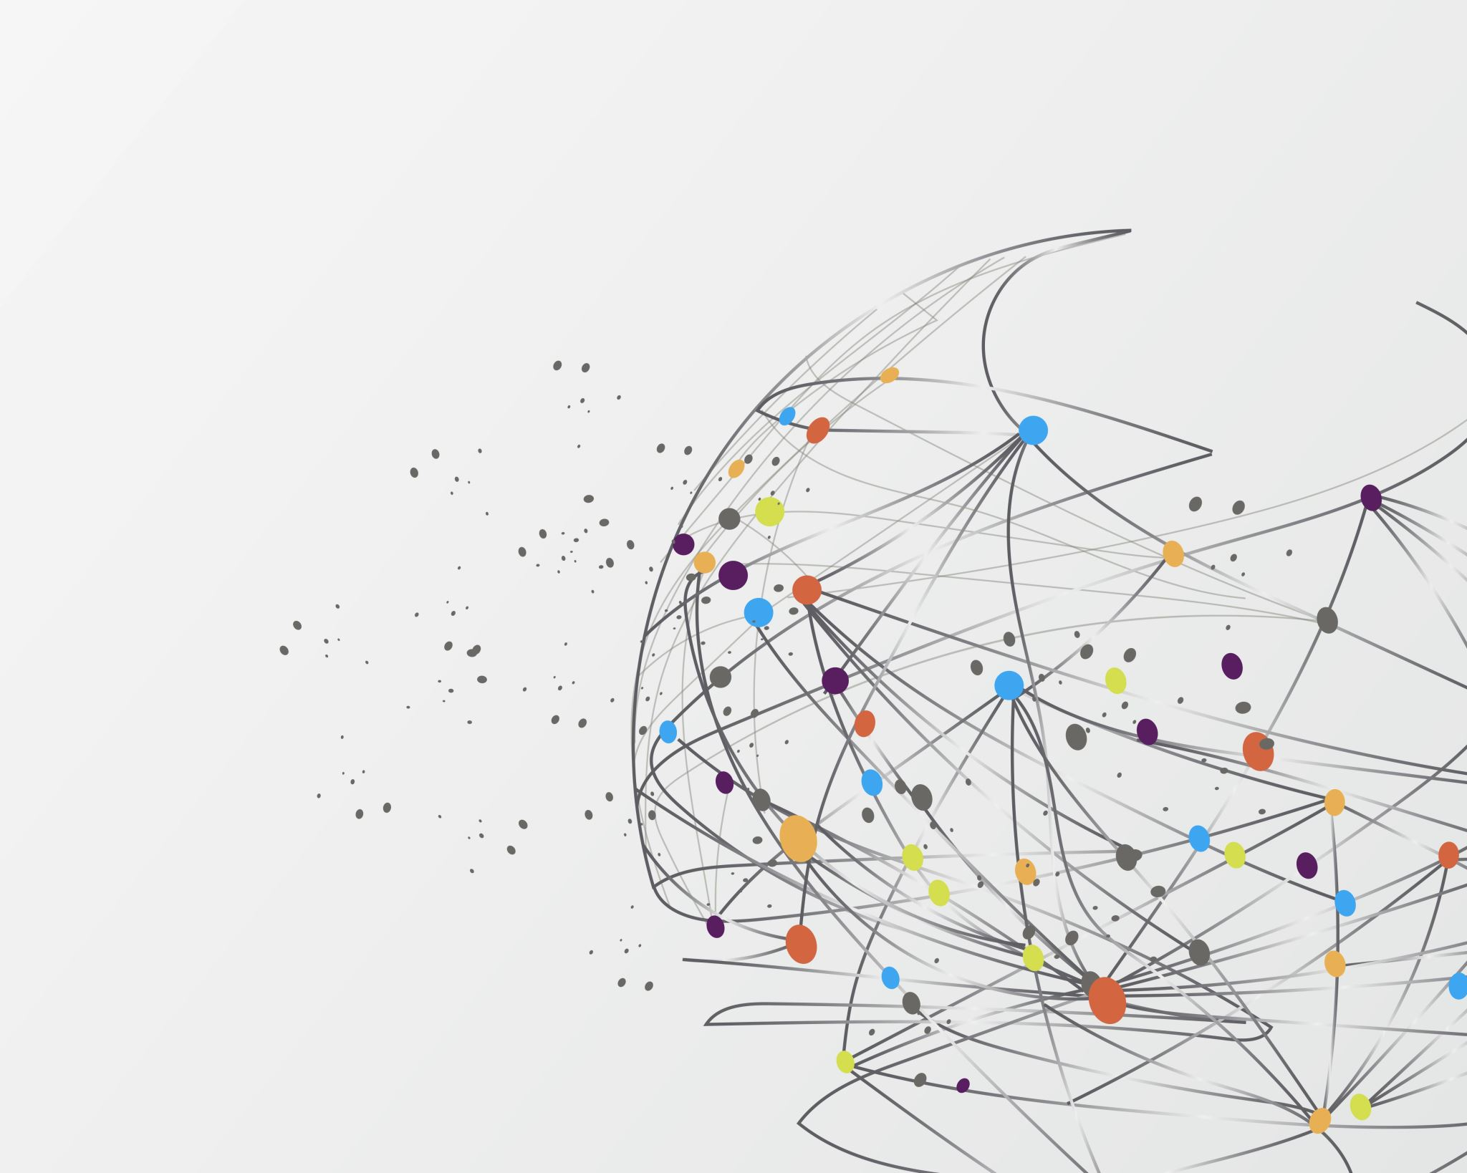
Jack Rodenburg
1st year PhD student in
Dr. Brigitte Tenhumberg’s Lab
Studying Mathematical Ecology with the goal of optimizing biodiversity conservation.

Slide 2
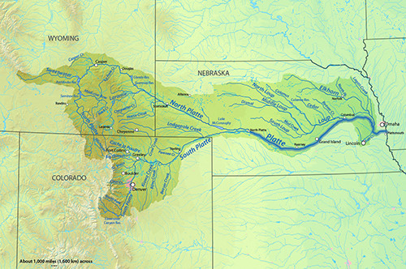
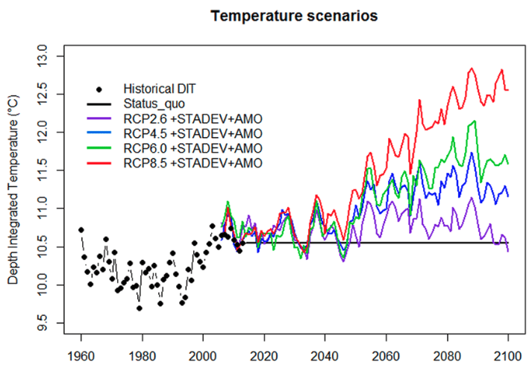
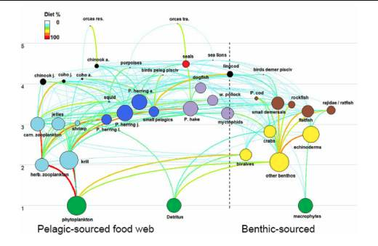
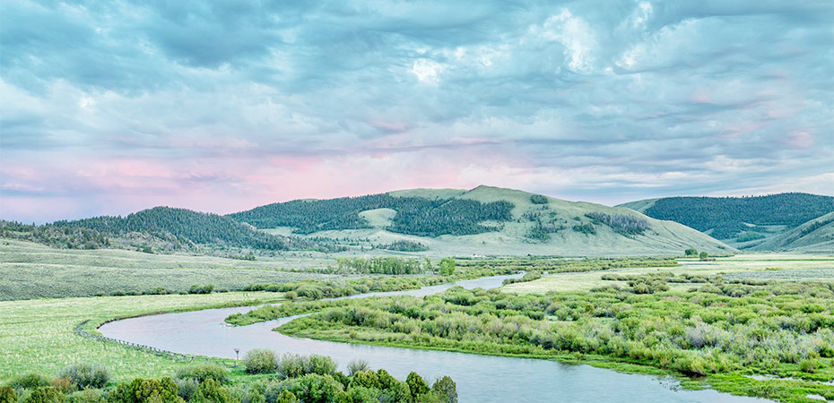
Freshwater Food-webs
How do lotic freshwater food-webs respond to anthropogenic perturbations?
Analyzing 18 years of food web data in the Platte River ecosystem to understand food web structure. (a collaboration with Dr. Mark Pegg in the School of Natural Resources)
Modeling resilience of riverine systems to stressors such as environmental changes, invasive species across trophic groups, and agricultural pollution.

Slide 3
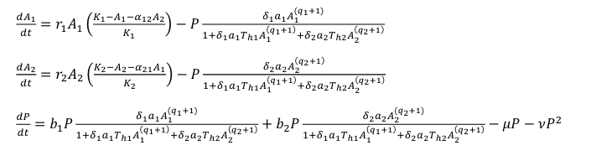
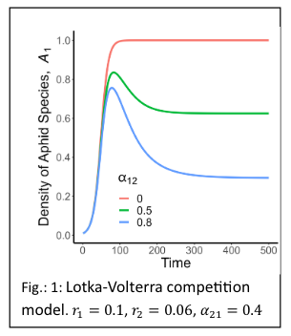
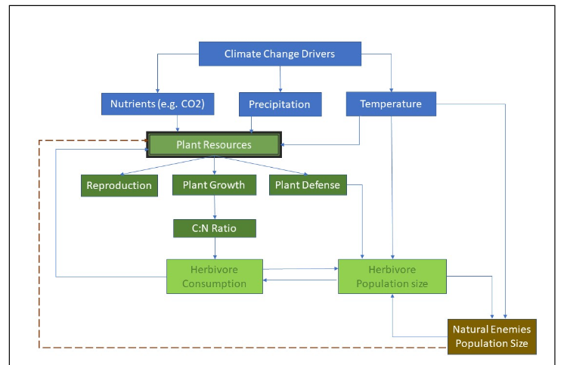
Plant Defense
How does climate change affect plant resource allocation to defensive resources, and how does this affect the associated food-webs?

