Slide 1
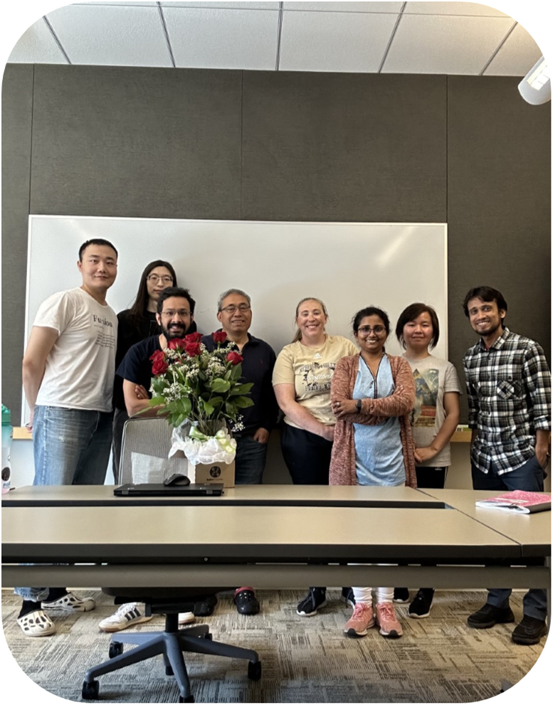
K M Main Uddin
Graduate PhD Student (First Year)
School of Biological Sciences
University of Nebraska-Lincoln
Supervisor: Dr. Qingsheng Li

Slide 2
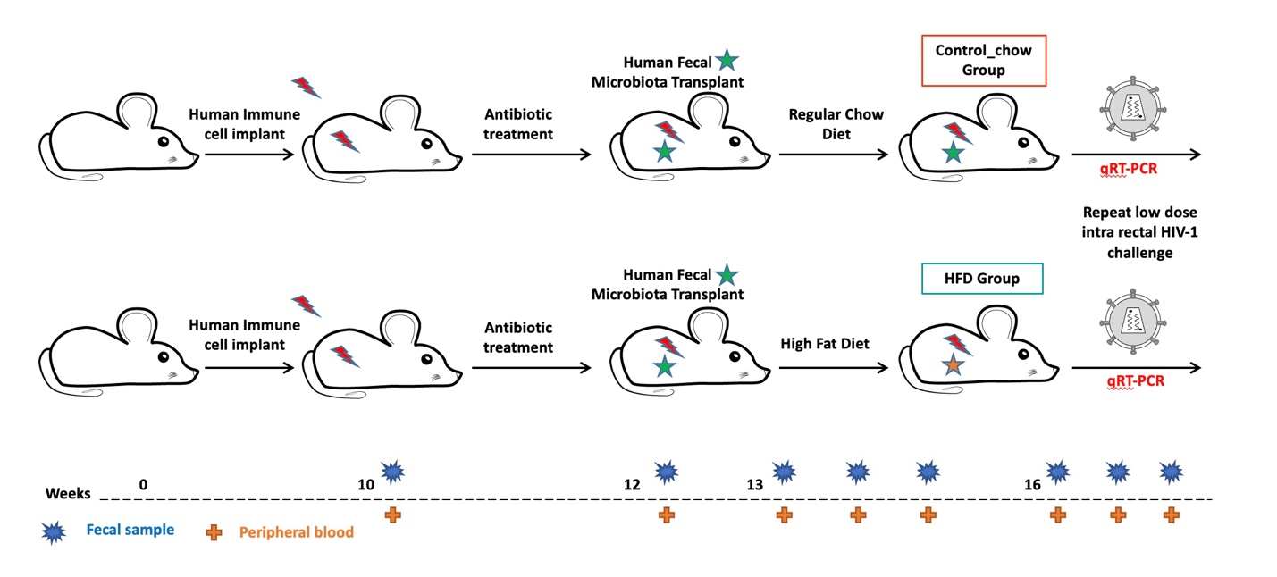
Experimental approach
N=6
N=11
Aim 1: The project aims to enhance our understanding of the association of gut virome and individual's susceptibility to HIV-1 transmission through the rectum.
Aim 2: The project also aims to gain insight into the interplay between the human immune system and human gut virome.
Aim 3: Another aims to enhance our understanding of the correlation between the gut bacteriome and virome.

