Slide 1
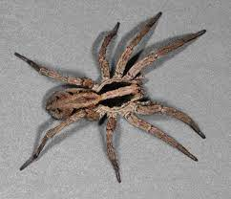
Evolution of multimodal signal of wolf spider Schizocosa mccooki
Q: How Do Signaler/Receiver Diet Condition and Signaling Environment Interact
to Affect Mate Choice?
Multimodal signal: Visual + Vibratory(seismic)
1. Signals contain information related to male condition
:female(receiver) assess the condition of male(signaler)
2. Signaling environment(channel)
:how effectively the signal travels and is received by female
3. Condition-dependent mate choice:
Female choice may vary depending on the condition as well

Slide 2

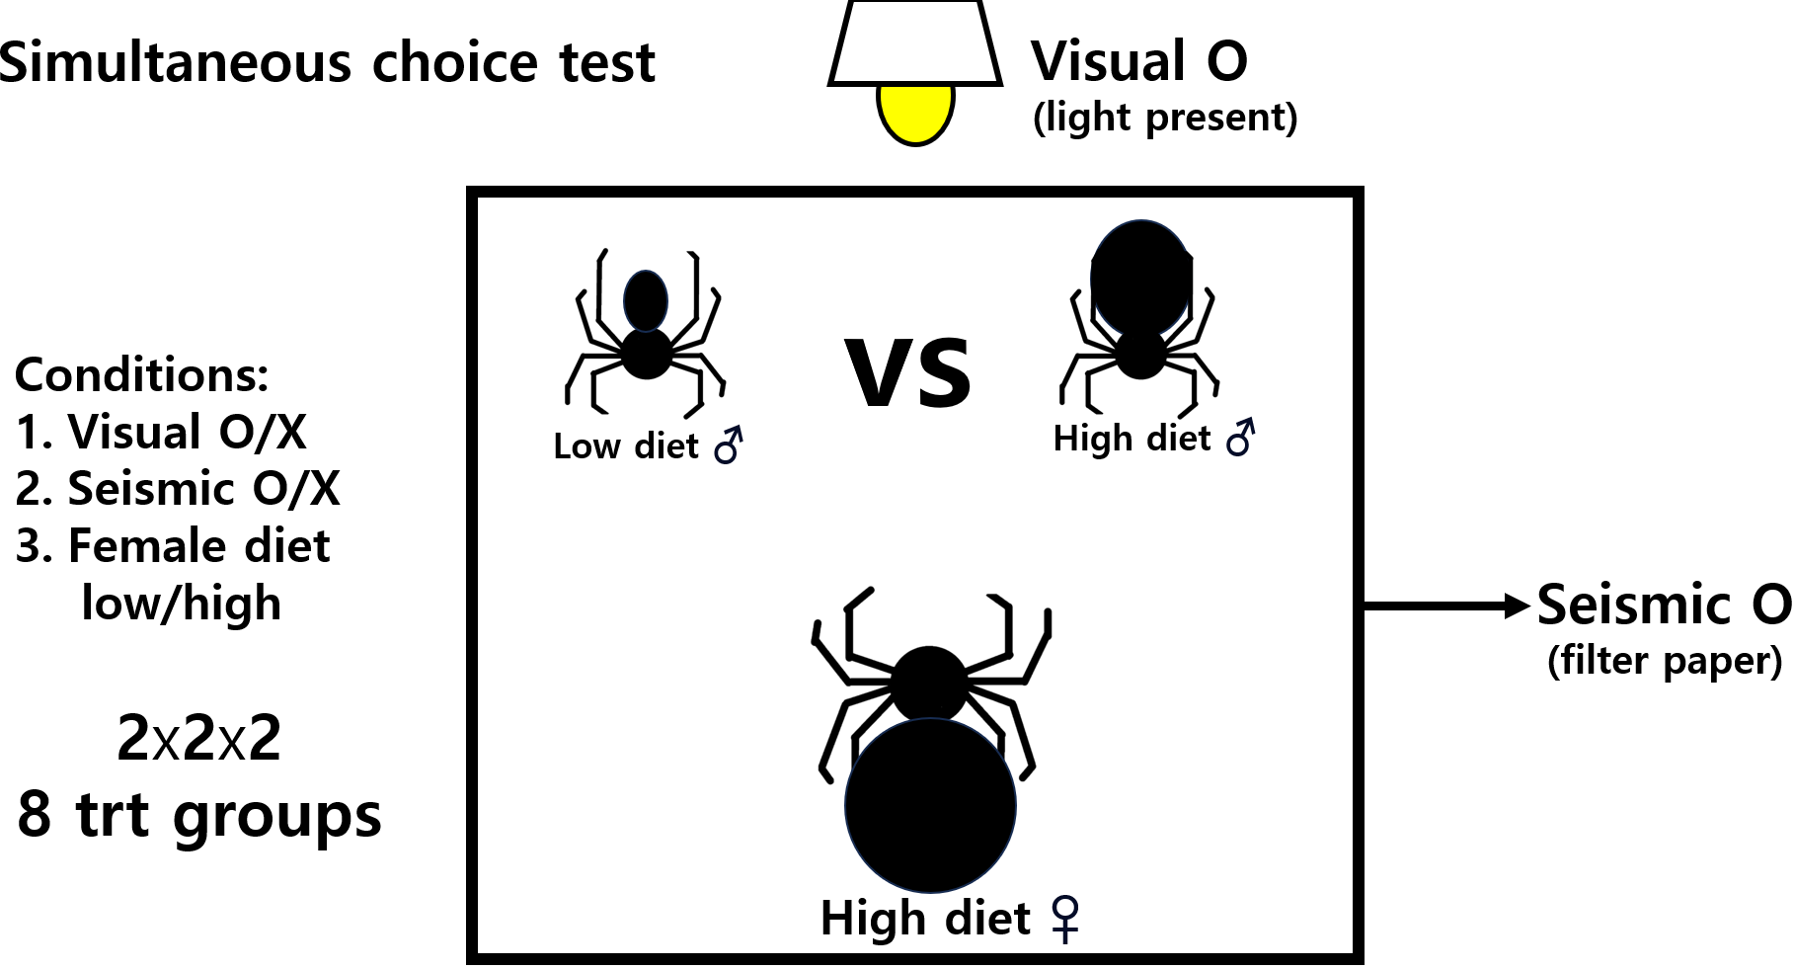
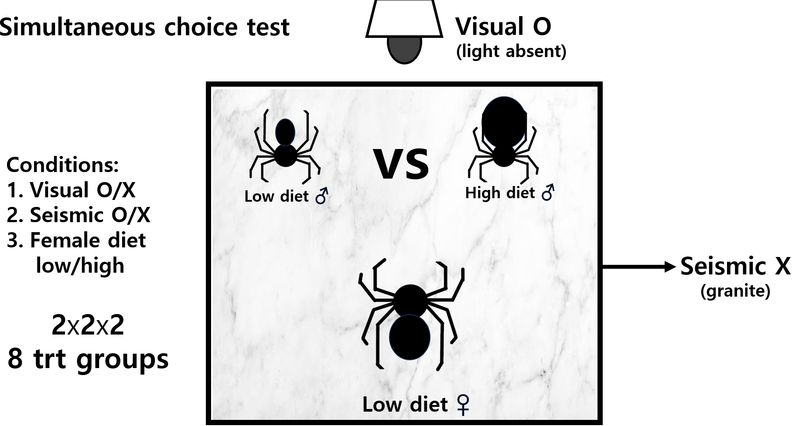
Data from an experiment done in 2007 by Dr. Aaron Rundus

Slide 3
Objectives:
Run proper statistical analyses in R using the provided datasets
2. Create proper/intuitive graphs suitable for publication
using only the R programming language.

Slide 4
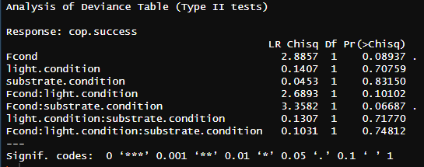
Q1: does the condition of the female and the signaling environment influence
copulation success/female receptivity?
library(nnet)
copsuccess <- multinom(cop.success ~ Fcond * light.condition * substrate.condition ,data=mccooki)
Car::Anova(copsuccess)
None of the predictors were statistically significant
Aaron’s manuscript:
1. HD>LD females (p=0.036)
2. Significant interaction btw female diet and signaling environment(p=0.011)

Slide 5
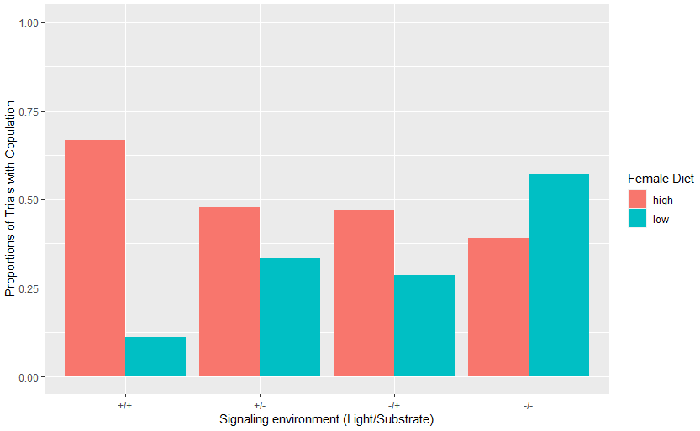
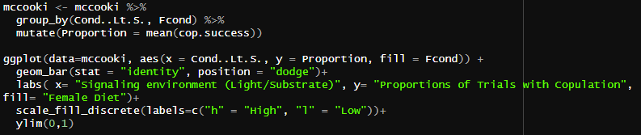
Q1: does the condition of the female and the signaling environment influence
copulation success/female receptivity?
Aaron’s manuscript:
1. HD>LD females (p=0.036)
2. Significant interaction btw female diet and signaling environment(p=0.011)

Slide 6
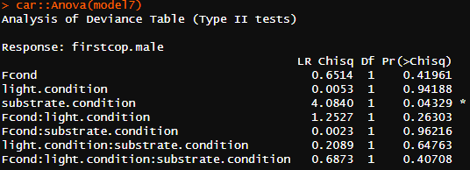
Q2: Does female choice vary based on signaling environments and male quality?
library(nnet)
FemaleChoice <- multinom(firstcop.male~ Fcond * light.condition * substrate.condition ,data=mccooki)
Car::Anova(FemaleChoice)
Significant effects of signaling environment-vibratory signal
Corresponds to Aaron’s results

Slide 7
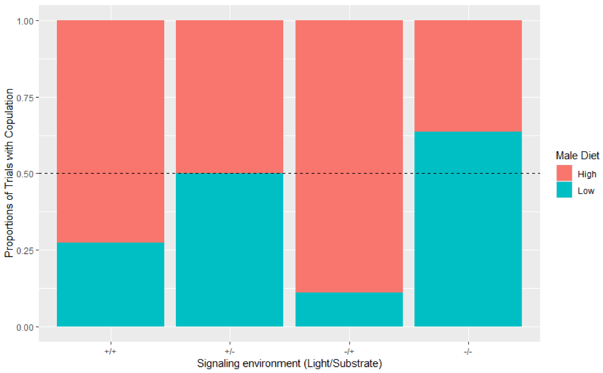
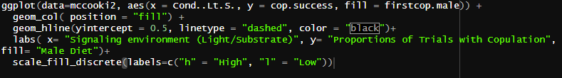
Q2: Does female choice vary based on signaling environments and male quality?
HD males males more likely to copulate than LD males
when the vibratory signal was present

Slide 8
Things to do before final project write-up:
Improve aesthetics of figures
Try other statistical analysis & plotting available on data
-some variables (e.g. latency to copulate) remain unused
Lessons:
1. STOP manipulating raw data in EXCEL!
2. Review this class during winter break and become familiar
with data wrangling and coding
(thank GOD and DAI we have recordings and the website for this course)

