Slide 1
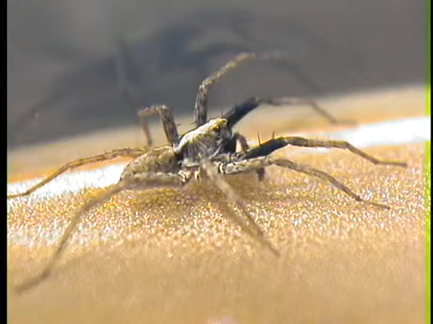
Evolution of complex signal of wolf spider Schizocosa mccooki
Q: How Do Signaler/Receiver Condition (Content-based selection),
and Signaling Environment (Efficacy-based selection) Interact to Affect Mate Choice?
Multimodal signal: Visual + Vibratory(seismic)
1. Signals contain information related to male condition
:female(receiver) assess the condition of male(signaler)
2. Signaling environment(channel)
:how effectively the signal travels and is received by female
3. Condition-dependent mate choice:
Female choice may vary depending on the condition as well
Multimodal courtship display of male wolf spider Schizocosa retrorsa
https://www.youtube.com/watch?v=f3xD3T3BYqw

Slide 2

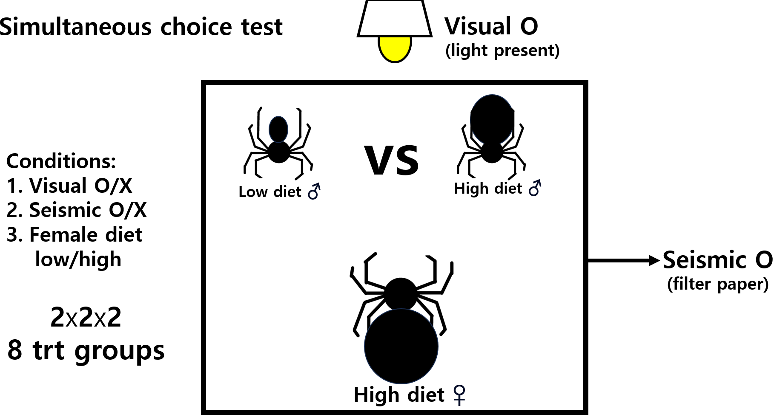
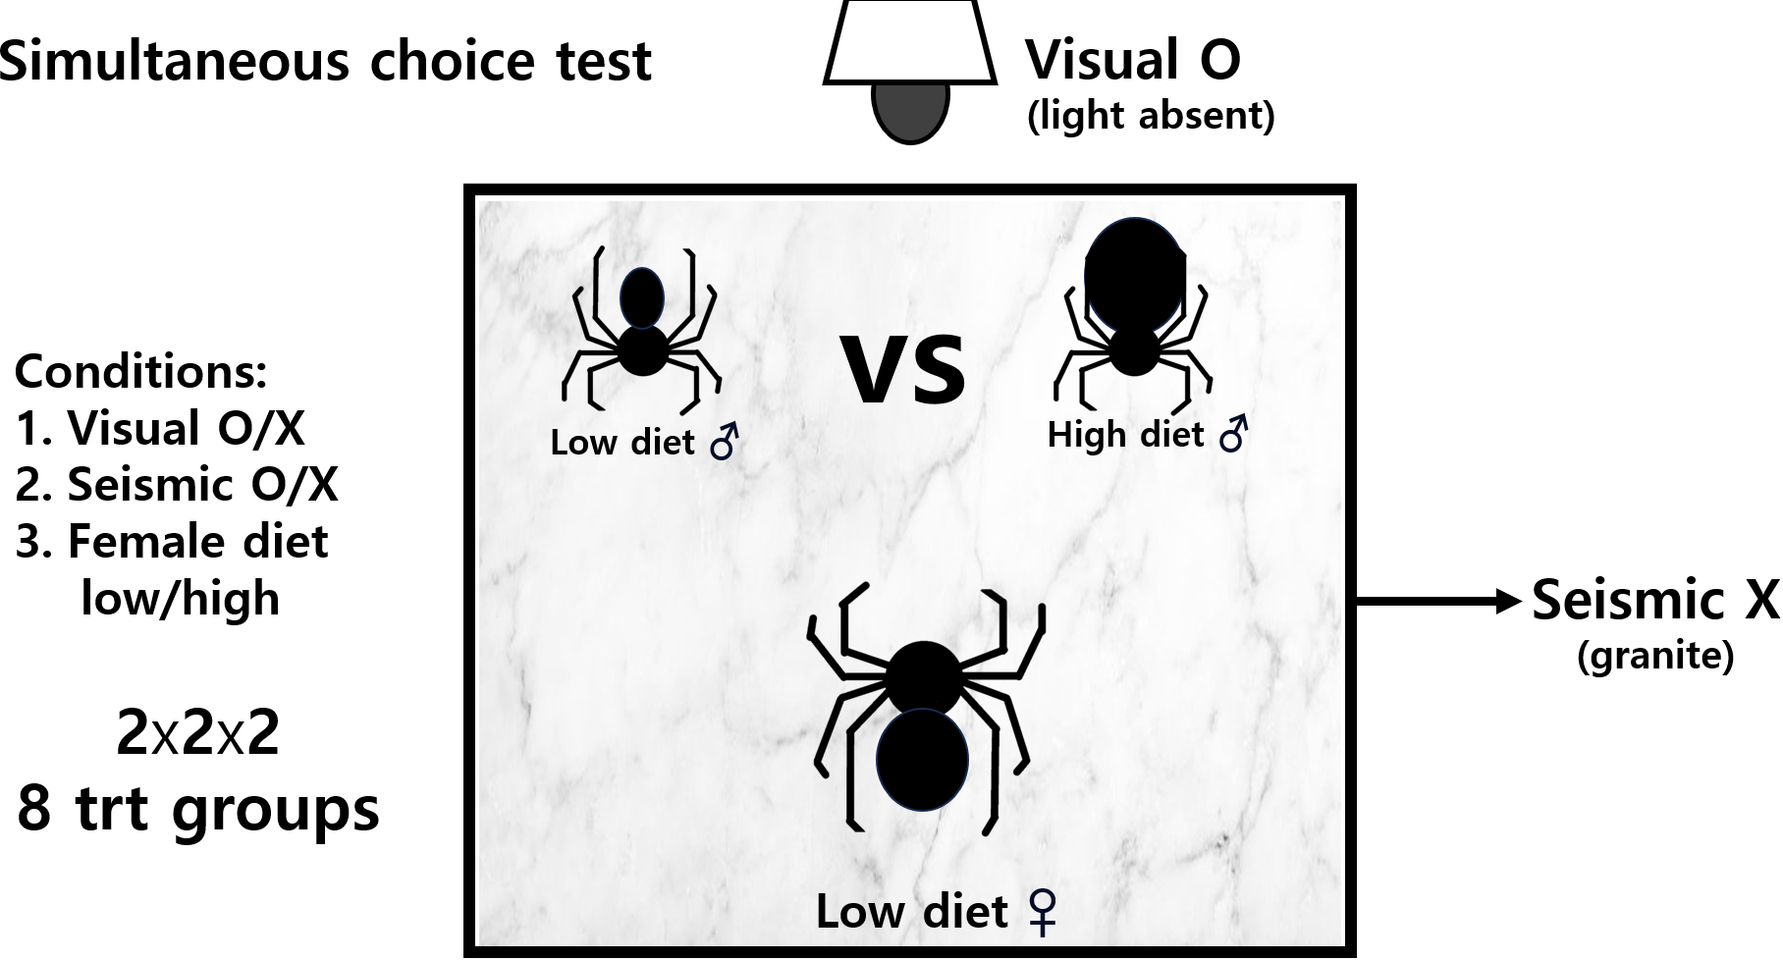
Data from an experiment done in 2007 by Dr. Aaron Rundus

Slide 3
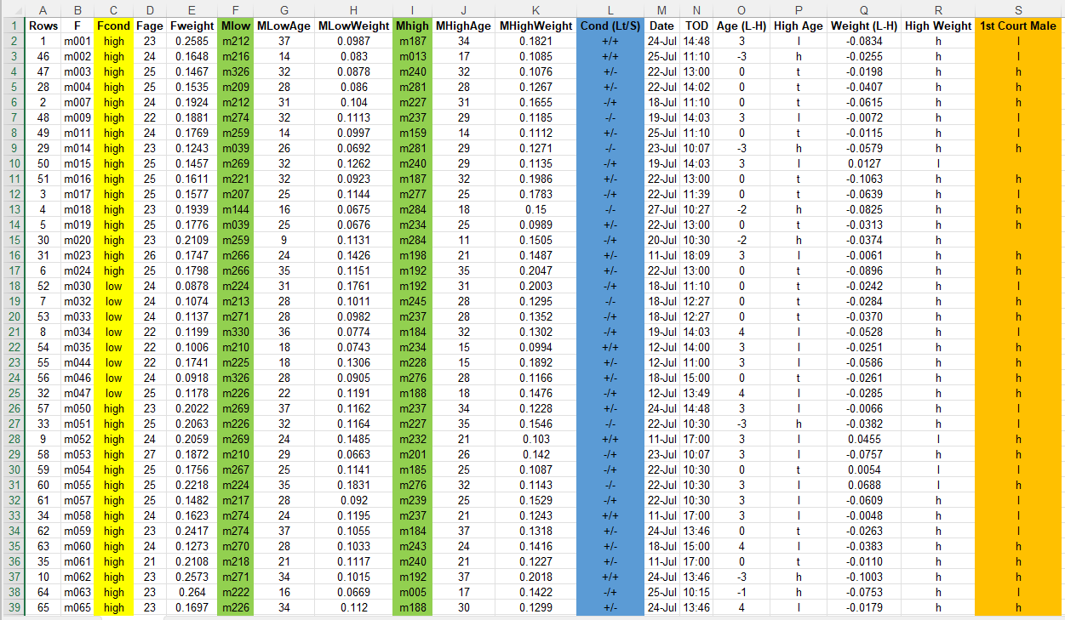
Female ID
&
condition
Male ID
&
condition
Visual/vibratory
Female choice

Slide 4
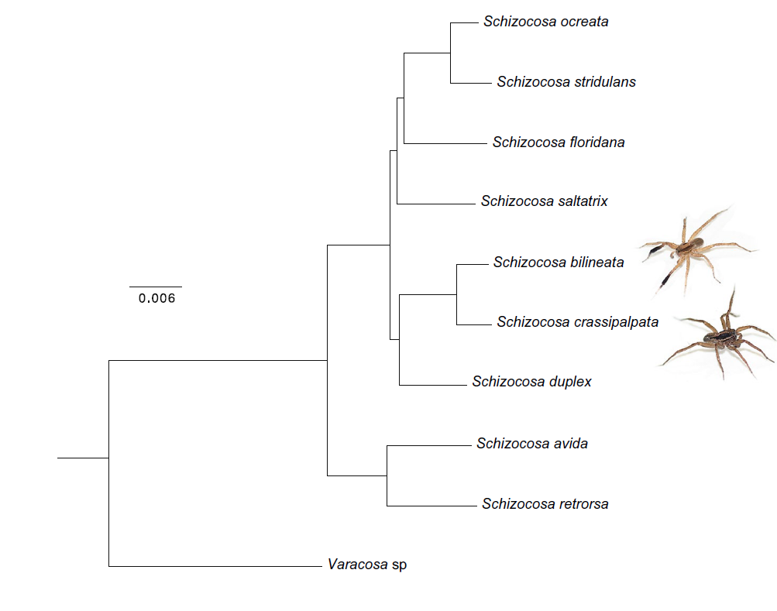
Hebets et al. 2021 Ecology & Evolution

Slide 5
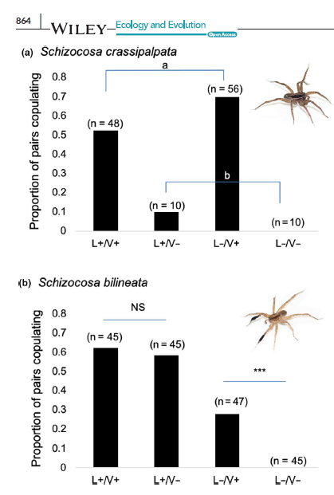
Objectives:
statistical analyses in R using the provided datasets:
paired t-tests, nominal logistic regression, linear mixed-effects model.
2. Create high-quality graphs suitable for publication
using only the R programming language.
Hebets et al. 2021 Ecology & Evolution

