Slide 1

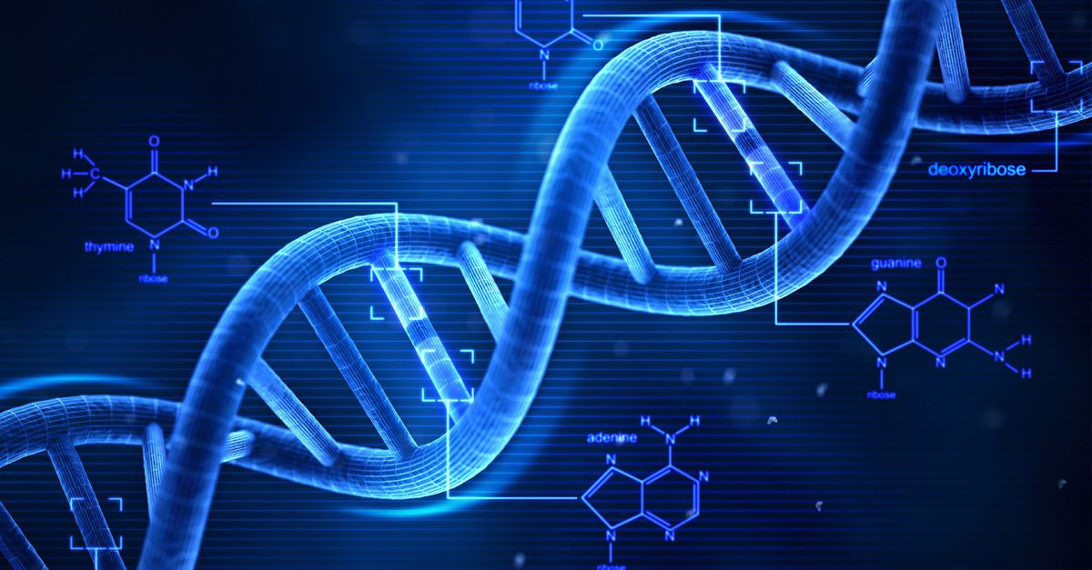
CP468 Artificial Intelligence
Term Project
Simple
Genetic
Algorithm
Group 4

Slide 2
Recap
Natural Selection
Population
Fitness
mimic biological evolution
repeatedly modify
a population over generations
individual with higher fitness has larger probability to be selected
Objective Function
Operators
Goal
maximize or minimize value of OF
reproduction
mutation crossover
reach convergence & find optimum
Notes:
1.GA solving optimization problems based on a natural selection process —
2.GA usually generate the initial population randomly so that it can reach the entire search space —
3.in each generation, the fitness of every individual is evaluated —
4.fitness comes from the value of the objective function —
5.SGA has 3 bio-inspired operators —
6.— we are not assure whether it is a global optima, may converge at local optima

Slide 3

Chromosome
one value:
0 | 1 | 0 | 1 | 1 | 1 | 0 | 0 | 1 | 0
x=740
Himmelblau:
two values:
0 | 1 | 0 | 1 | 1 | 1 | 0 | 0 | 1 | 0 | 0 | 0 | 1 | 0 | 1 | 1 | 0 | 0 | 1 | 1
x=740
y=179
n-D OF: len(binary_string)=10*n
Notes:
1.Python
convenient random function & data visualization tools matplotlib
chromosome (genotype) is a individual solution in the population
represent it as a binary string
10-digit binary string one value 0-1024 740
2. OF input more than one value, for example Himmelblau 2D
DeJong & Rosenbrock n-D

Slide 4
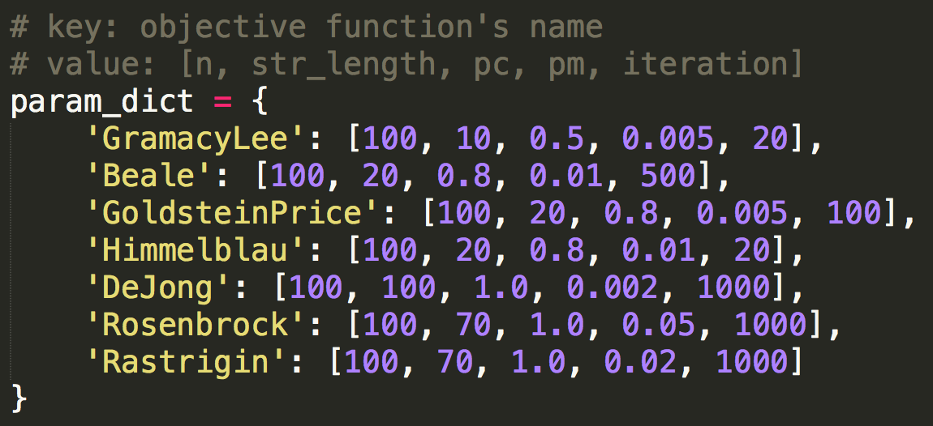
Chromosome
Notes:
7 OFs
put all params into a dict
1st column is size of the population, 100 individuals/chromosomes in one population
2nd column binary string length

Slide 5
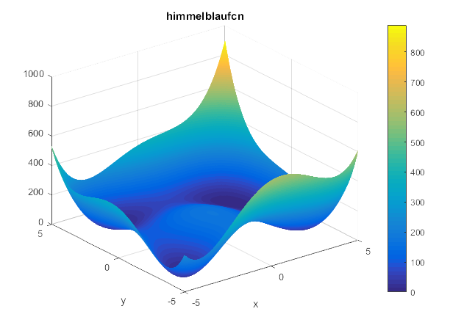
Chromosome
Himmelblau:
domain normally used: [-6,6]
transform [0,1024] to [-6,6]
1. shifting: [0,1024]-512=[-512,512]
2. scaling: [-512,512]/86=[-5.95,5.95]
Notes:
2.the function can be defined on any input domain but it is usually evaluated on [-6,6] for x, y
preprocessing for every OF

Slide 6
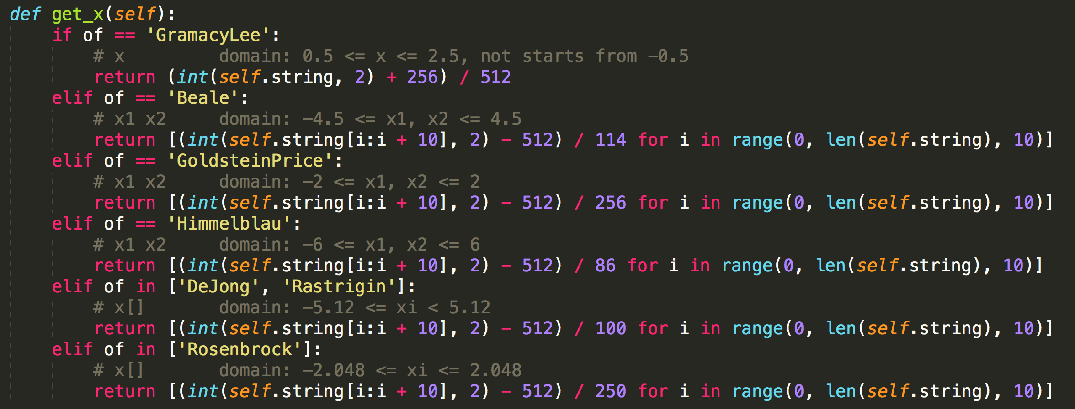
Chromosome

Slide 7
Fitness
maximize/minimize OF
⬇️
maximize fitness
If maximize OF:
fitness = y
Else if minimize OF:
fitness = 1/(1+y)
Notes:
1.each individual chromosome has a fitness value
individual with higher fitness, larger probability to be selected
2.positively correlated larger f larger p
negatively correlated smaller f larger p

Slide 8
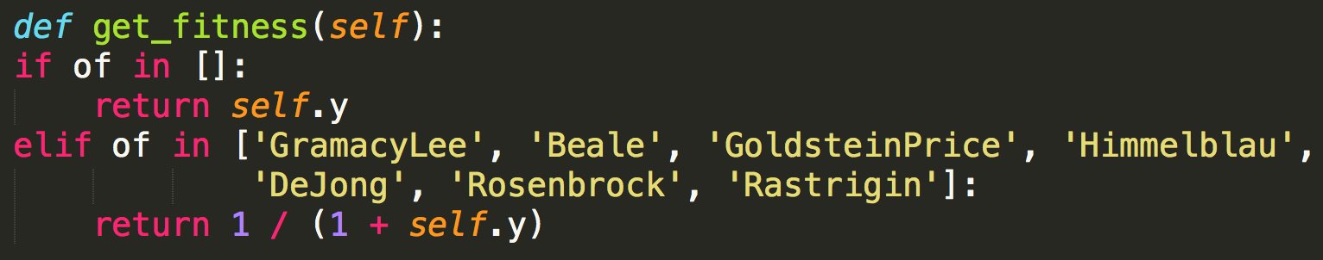
Fitness
Range(y):[0,+∞)
Range(fitness):(0,1]
Notes:
1.fitness functions of all 7 OFs are the same
all are aimed to find the minimum

Slide 9
Fitness
Notes:
1.If we draw a figure of fitness and iteration times we’ll probably get get curve like the red one.
go up and down cause it will generate new individual sort of randomly
2.Can we find a way to get a curve like the green one? Never going down. The answer is yes

Slide 10
Elitist Strategy
natural selection is cruel
let’s make it even more cruel
elites have the privilege
to waive reproduction,
crossover and mutation
Notes:
2.elites are those individuals have the highest fitness
they remained unchanged through generations
so that the maximum fitness of next generation cannot be small than the previous one.

Slide 11
Elitist Strategy
each time before reproduction
put two elites at the front of the population list
No | 0 | 1 | 2 | 3 | 4 | 5 | 6 | 7 | … | 62 | 63 | 64 | 65 | … | 99
F | 0.19 | 0.56 | 0.86 | 0.12 | 0.34 | 0.76 | 0.50 | 0.65 | … | 0.13 | 0.97 | 0.98 | 0.45 | … | 0.36
No | 64 | 63 | 2 | 3 | 4 | 5 | 6 | 7 | … | 62 | 1 | 0 | 65 | … | 99
F | 0.98 | 0.97 | 0.86 | 0.12 | 0.34 | 0.76 | 0.50 | 0.65 | … | 0.13 | 0.56 | 0.19 | 0.45 | … | 0.36
2 first & 98 economy
Notes:
1.in my grogram, one population has 100 chromosomes

Slide 12
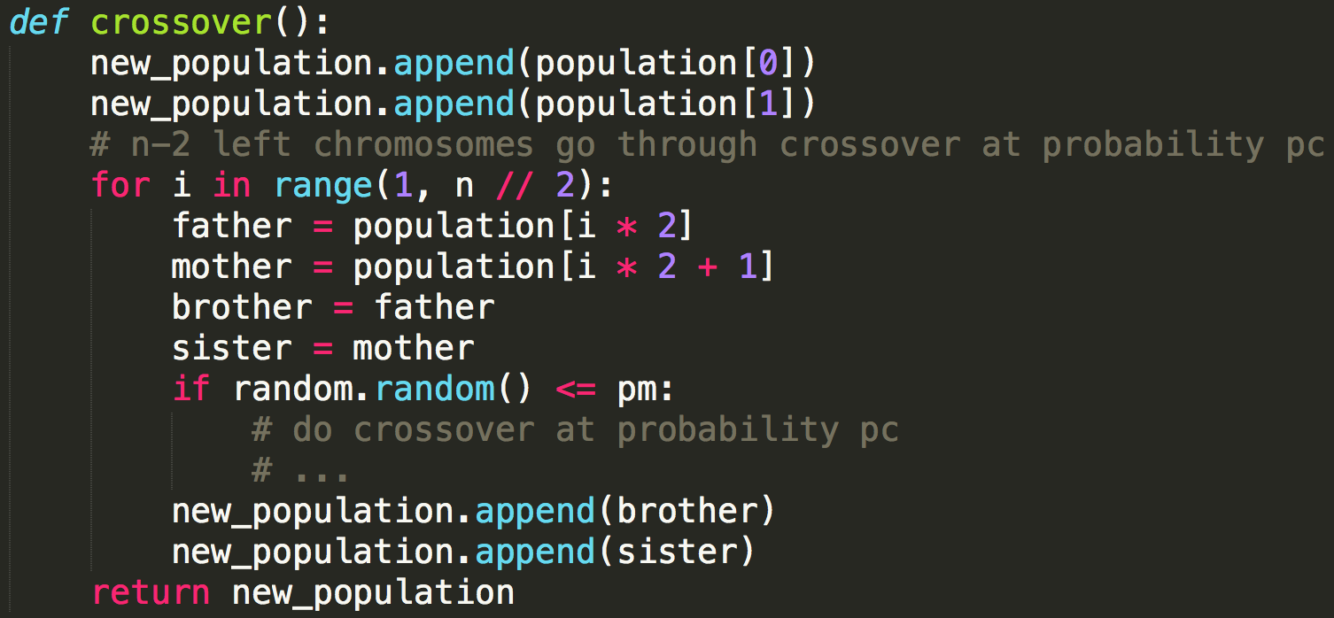
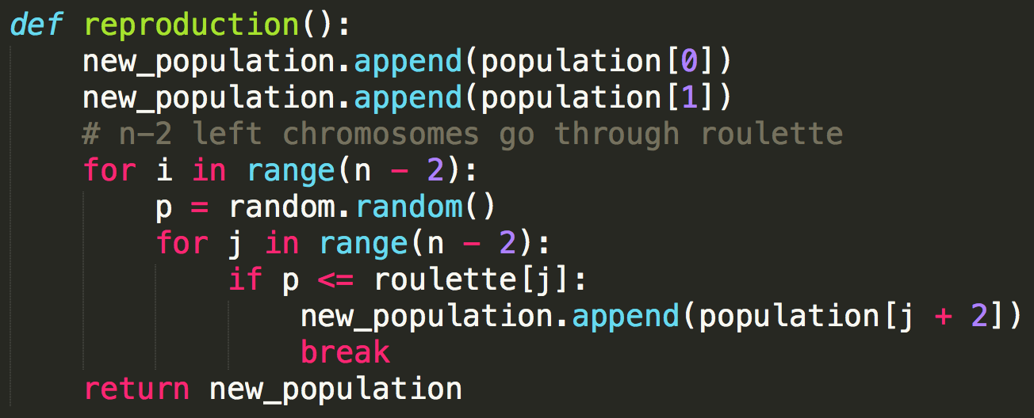
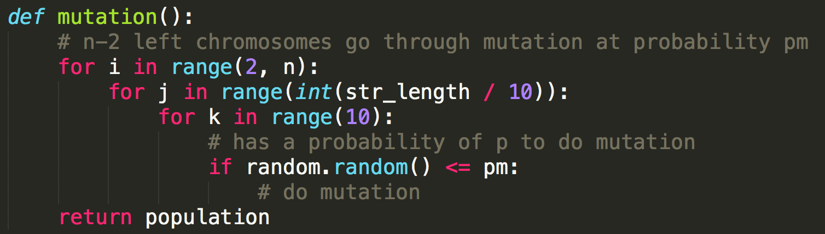
Elitist Strategy
reproduction, crossover & mutation
only works on n-2 civilians

Slide 13
Normal Crossover Step
OF:Himmelblau Function
Chromosome A:
0 | 1 | 0 | 1 | 1 | 1 | 0 | 0 | 1 | 0 | 0 | 0 | 1 | 0 | 1 | 1 | 0 | 0 | 1 | 1
x1=370
x2=179
Chromosome B:
1 | 1 | 0 | 1 | 0 | 0 | 0 | 1 | 0 | 0 | 1 | 0 | 1 | 1 | 1 | 0 | 0 | 1 | 0 | 1
x1=836
x2=741
after crossover at position 5
Chromosome A:
0 | 1 | 0 | 1 | 1 | 0 | 0 | 1 | 0 | 0 | 1 | 0 | 1 | 1 | 1 | 0 | 0 | 1 | 0 | 1
x1=356
x2=741
Chromosome B:
1 | 1 | 0 | 1 | 0 | 1 | 0 | 0 | 1 | 0 | 0 | 0 | 1 | 0 | 1 | 1 | 0 | 0 | 1 | 1
x1=850
x2=179
Notes:
1.if we take one chromosome as a whole in crossover part:
only two x1 actually changed

Slide 14
Conclusion
for n-D OF, only 1/n part of values
may go through crossover
at probability Pc
same thing happens for mutation
First Split Then Operate
Notes:
2.split the whole chromosome into n pieces, and to crossover and mutation separately
3.Next is our tests on several benchmark OFs

Slide 15
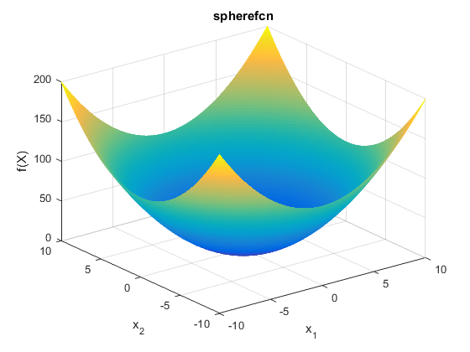
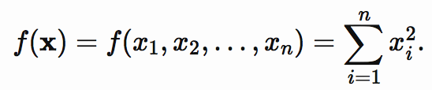
DeJong Sphere Function
definition:
domain: [-5.12,5.12]
global minima: f(x)=0 at x=(0,…,0)
params:
n=100
str_length=100
p_c=1.0
p_m=0.002
iteration=1000
Notes:
all benchmark OFs we choose are aimed to find minimum value, thus the fitness functions are the same
also we set the optima value == 0 so that at that point max_fitness is 1

Slide 16
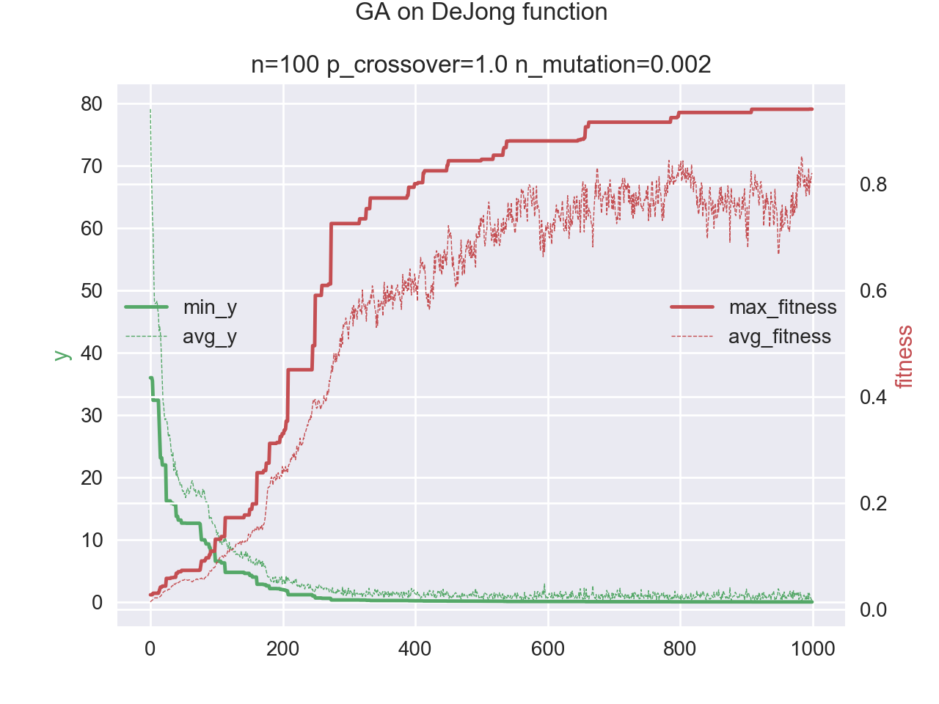
Notes:
Running time: 14s
typo p_mutation, not n_mutation

Slide 17
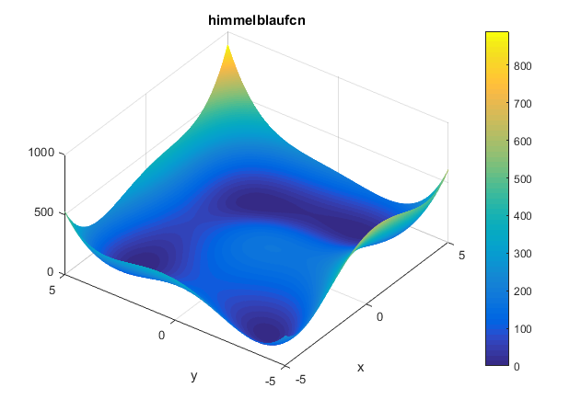
Himmelblau Function
definition:
domain: [-6,6]
local minima: f(x)=0
at x=(3,2),
x=(-2.81,3.28)
x=(-3.78,-3.28)
x=(3.5,-1.8)
params: n=100 str_length=20 p_c=0.8
p_m=0.01 iteration=20

Slide 18
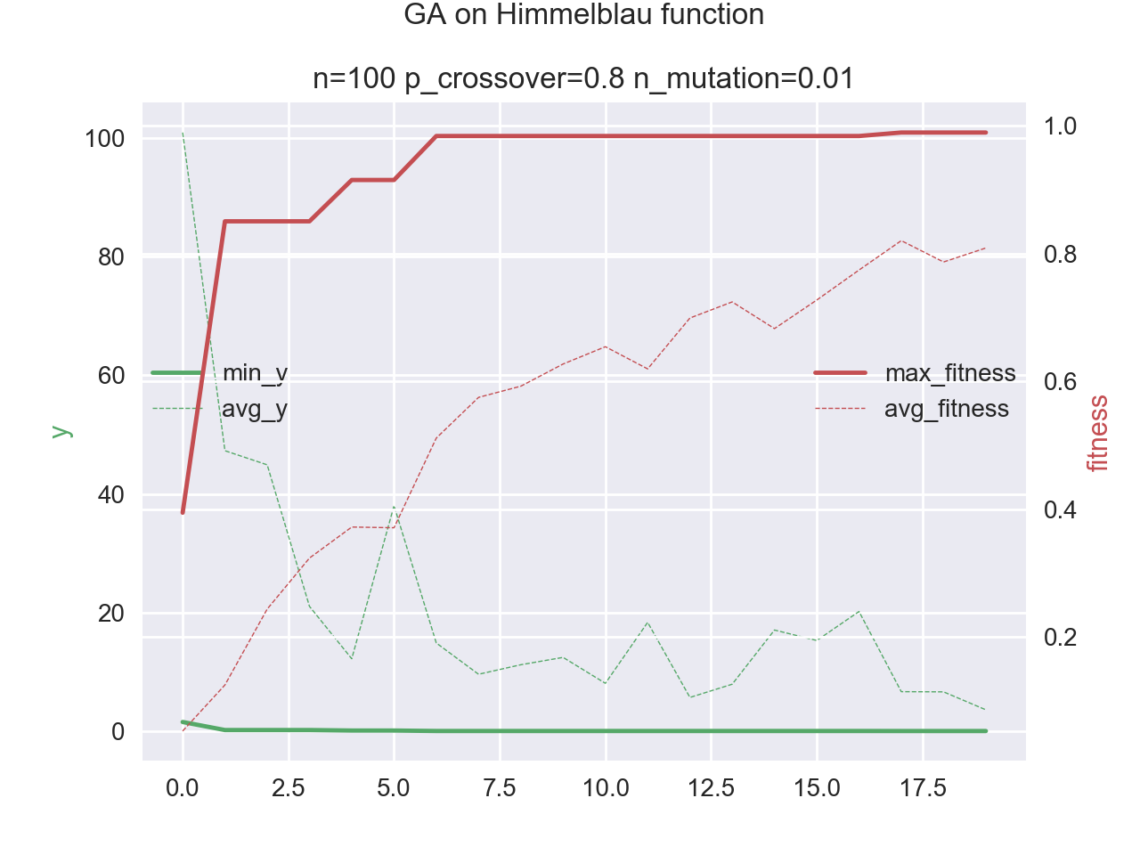
Notes:
Running time: 0.04s

Slide 19
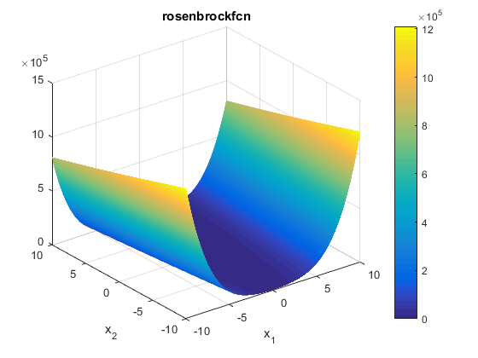
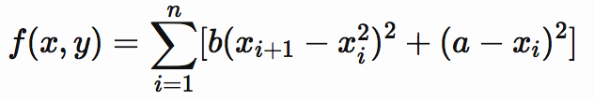
Rosenbrock Function
definition:
domain: [-2.048,2.048]
global minima: f(x)=0
at x=(1,…,1)
params: n=100
str_length=70
p_c=1.0
p_m=0.05
iteration=1000

Slide 20
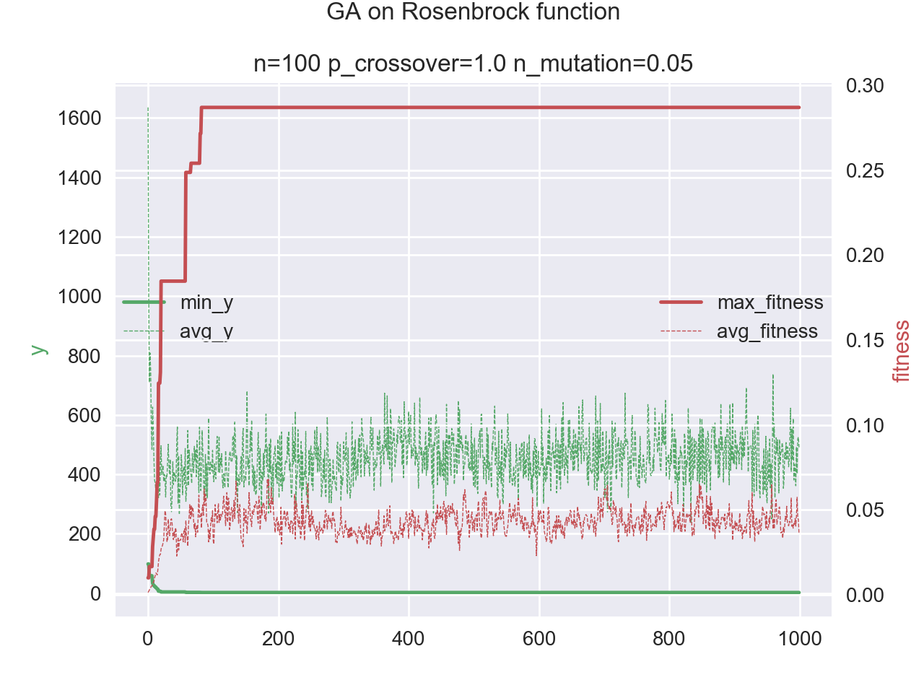
Notes:
Running time: 14s
max_fitness is around 0.28 GA seems failed on this OF
but take a detailed look at y

Slide 21
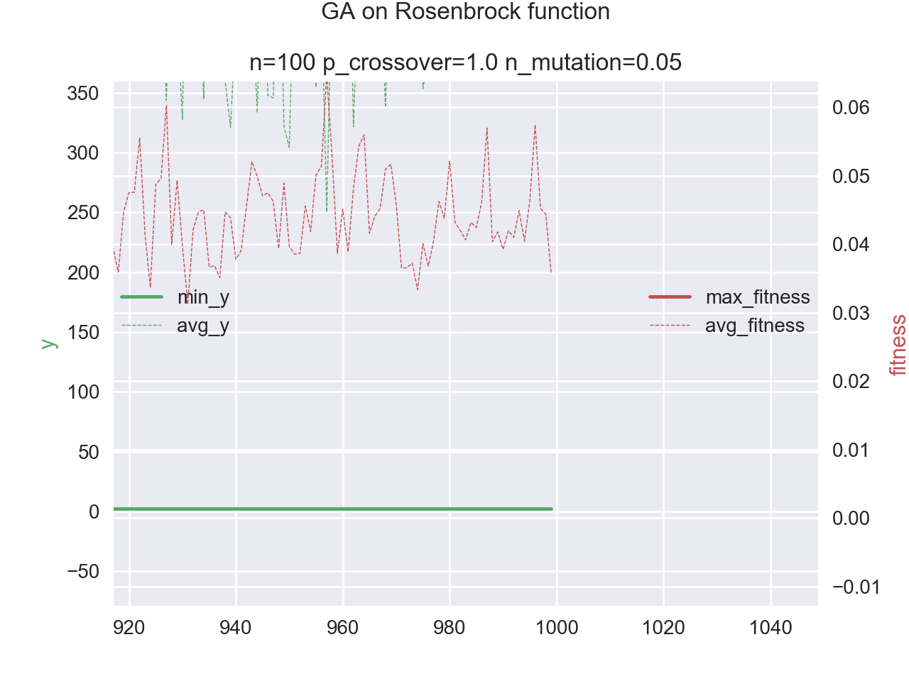
f=1/(1+y)
f=0.28
⬇️
y=1/f-1=2.57
Notes:
at the beginning, avg_y is greater than 1600 and min_y is around 100
after GA, avg_y is around 400 and min_y is 2.57
It is already a nice work I think
max_fitness is small owns to property of fitness function
when y becomes closer to 0, fitness varies a lot
Other OFs:

Slide 22
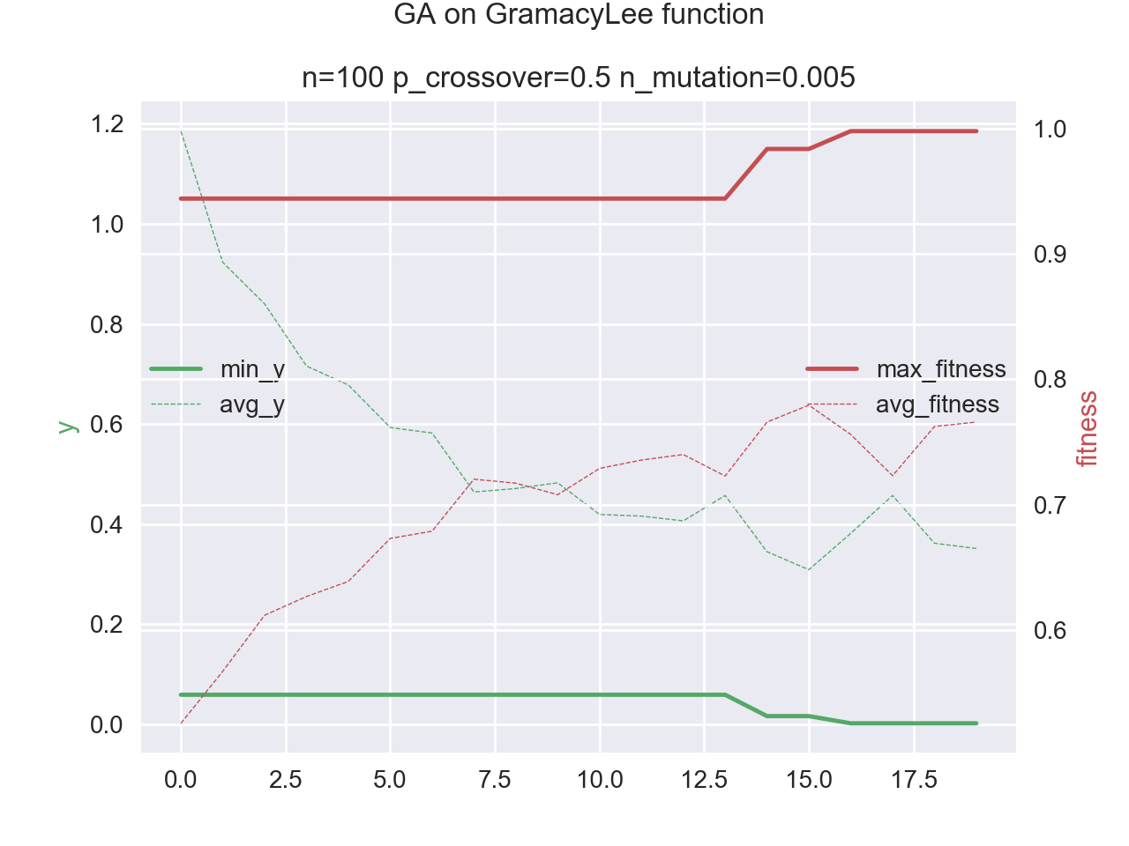
Notes:
GramacyLee 1D
running time: 0.02s

Slide 23
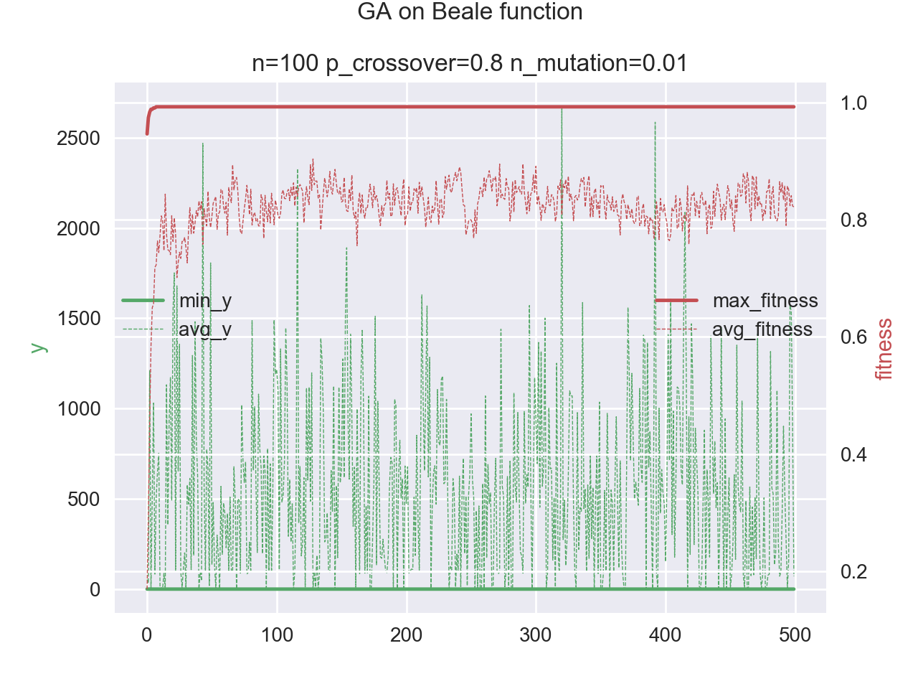
Notes:
Beale 2D
running time: 0.96s
Green dash line oscillate fiercely because p_m may be to large

Slide 24
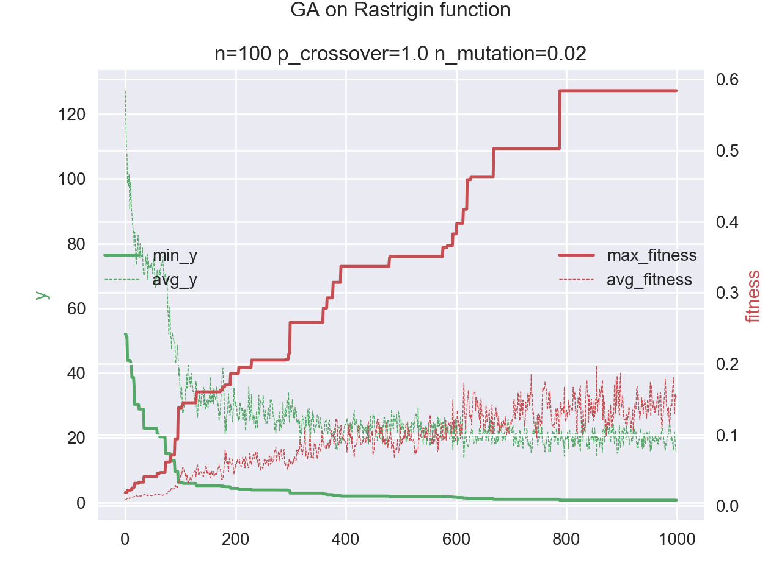
Notes:
Rastrigin n-D. n==7
running time: 12s
when n increases, optimum results goes down inevitably

Slide 25
Questions…

