Slide 1
Review of time series forecasting and related SAS products
Ran Bi, Mike Leonard
7/15/2019

Slide 2
Time series forecasting
Table of contents
1. Overview of Time Series Forecasting Methods
2. Connections to SAS products
3. Conclusion

Slide 3



Overview of Time Series Forecasting
What is time series forecasting?
Time series analysis comprises methods for analyzing time series data in order to extract meaningful statistics and other characteristics of the data.
Time series forecasting is the use of a model to predict future values based on previously observed values.
store sales forecasting
financial forecasting
web traffic forecasting

Slide 4
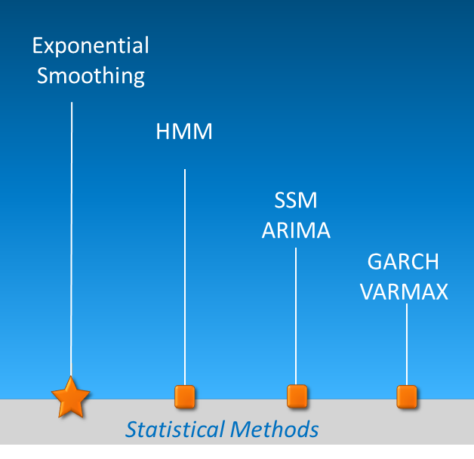
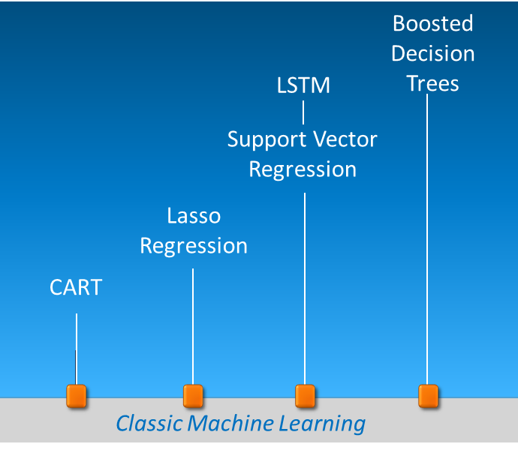
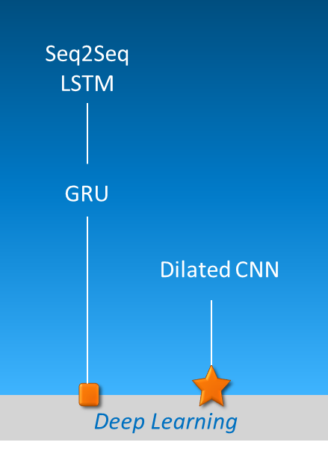
Overview of Time Series Forecasting
Representative Methods

Slide 5
Traditional models with SAS products
Hidden Markov Models
(PROC HMM)
ARCH/ GARCH
(PROC AUTOREG/ PROC MODEL)
1950s
1970s
1980s
1960s
1980s
Exponential Smoothing
(PROC ESM)
State Space Models (PROC SSM)
ARIMA (PROC ARIMA)
Vector Autoregression
(PROC VARMAX)

Slide 6
ML models with SAS products
Lasso Regression
(PROC GLMSELECT)
Support Vector Regression
(PROC HPSVM)
1984
1997
1999
1996
1998
Classification And Regression Tree
(PROC HPSPLIT)
Long Short-Term Memory
(PROC HPNEURAL)
Boosted Decision Trees
(PROC HPSLIT)

Slide 7
Deep Learning with SAS products
Gated Recurrent Unit
(SAS DLPY)
Dilated CNN
(Ongoing…)
2014
Future
2016
The flourish of Deep Learning
Seq2Seq LSTM
(PROC TSMODEL; Object TNF)
Let’s find out…

Slide 8
SAS Procedures of Time Series Forecasting
Representative Methods
Proc ESM
Exponential
Smoothing
HMM
Proc HMM
SSM
ARIMA
Proc SSM
Proc ARIMA
GARCH
VARMAX
Proc MODEL
Proc VARMAX
Statistical Methods

Slide 9
SAS Procedures of Time Series Forecasting
Representative Methods
Proc GRADBOOST
Boosted Decision Trees
Proc HPNEURAL
LSTM
Proc HPSVM
Support Vector Regression
Proc GLMSELECT
Lasso
Regression
Proc HPSLIT
CART
Classic Machine Learning

Slide 10
SAS Procedures of Time Series Forecasting
Representative Methods
Proc TSMODEL; Object TNF
Seq2Seq LSTM
SAS DLPY
GRU
Something new!
Dilated CNN
Deep Learning

Slide 11
Comparisons of algorithms
Methods
Machine learning algorithms | Several of them restricted to a domain that is defined by training data Most machine learning models cannot derive confidence intervals, because they are not all based on statistical distributions Need a lot of training data Loss of interpretability
Time series algorithms | The ability to extrapolate patterns outside of the domain of training data (project into the future) The ability to derive confidence intervals The ability to work on small dataset Interpretability

Slide 12
Comparisons
Methods
Traditional methods (ARIMA, ES, GARCH, etc.) | Nice and simple for small datasets interpretable
RNN (LSTM, GRU, etc.) (Benchmark of Seq2Seq model) | Outperformed other models when dealing with large datasets Effectively learn long-range dependencies Need a lot of training data Loss of interpretability
Dilated CNN | Lower level of complexity than RNN Easier to train than RNN Better performance than RNN

Slide 13
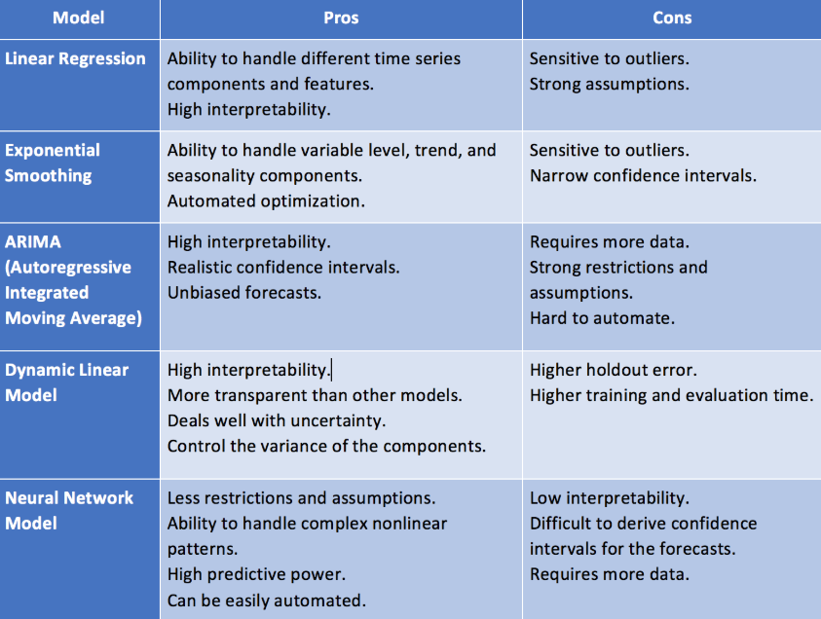
Common algorithms

Slide 14
Reference
Van Den Oord, A., Dieleman, S., Zen, H., Simonyan, K., Vinyals, O., Graves, A., Kalchbrenner, N., Senior, A.W. and Kavukcuoglu, K., 2016. WaveNet: A generative model for raw audio. SSW, 125.
Bai, S., Kolter, J.Z. and Koltun, V., 2018. An empirical evaluation of generic convolutional and recurrent networks for sequence modeling. arXiv preprint arXiv:1803.01271.
De Gooijer, J.G. and Hyndman, R.J., 2006. 25 years of time series forecasting. International journal of forecasting, 22(3), pp.443-473.
Eddy, J., 2019. TimeSeries_Seq2Seq, URL: https://github.com/JEddy92/TimeSeries_Seq2Seq

Slide 15

Q & A

